Slide 1
Data Handling and Model Evaluation
Prof Nirmalie Wiratunga
Ref: Python Machine Learning by Sebastian Raschka

Slide 2
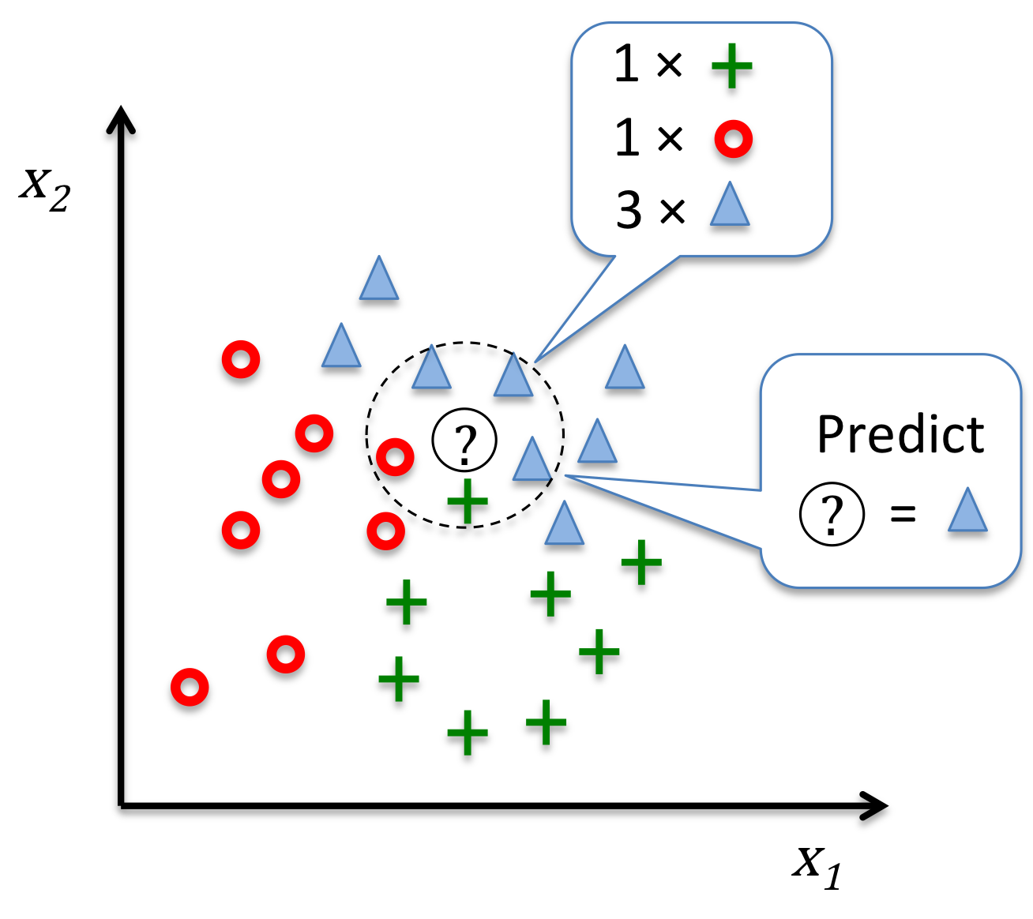
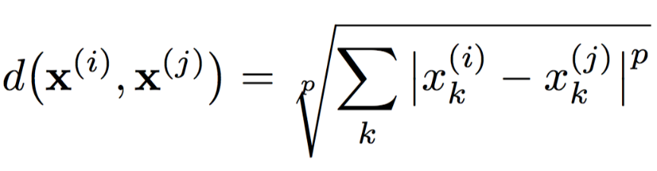
Last Week - K-Nearest Neighbors
k=5
Image source: https://github.com/rasbt/python-machine-learning-book/blob/master/code/ch03/images/03_20.png

Slide 3

Python Libraries: matplotlib
python 2D plotting library which produces publication quality figures in a variety of hardcopy formats
a set of functionalities similar to those of MATLAB
line plots, scatter plots, barcharts, histograms, pie charts etc.
relatively low-level; some effort needed to create advanced visualization
Link: https://matplotlib.org/

Slide 4
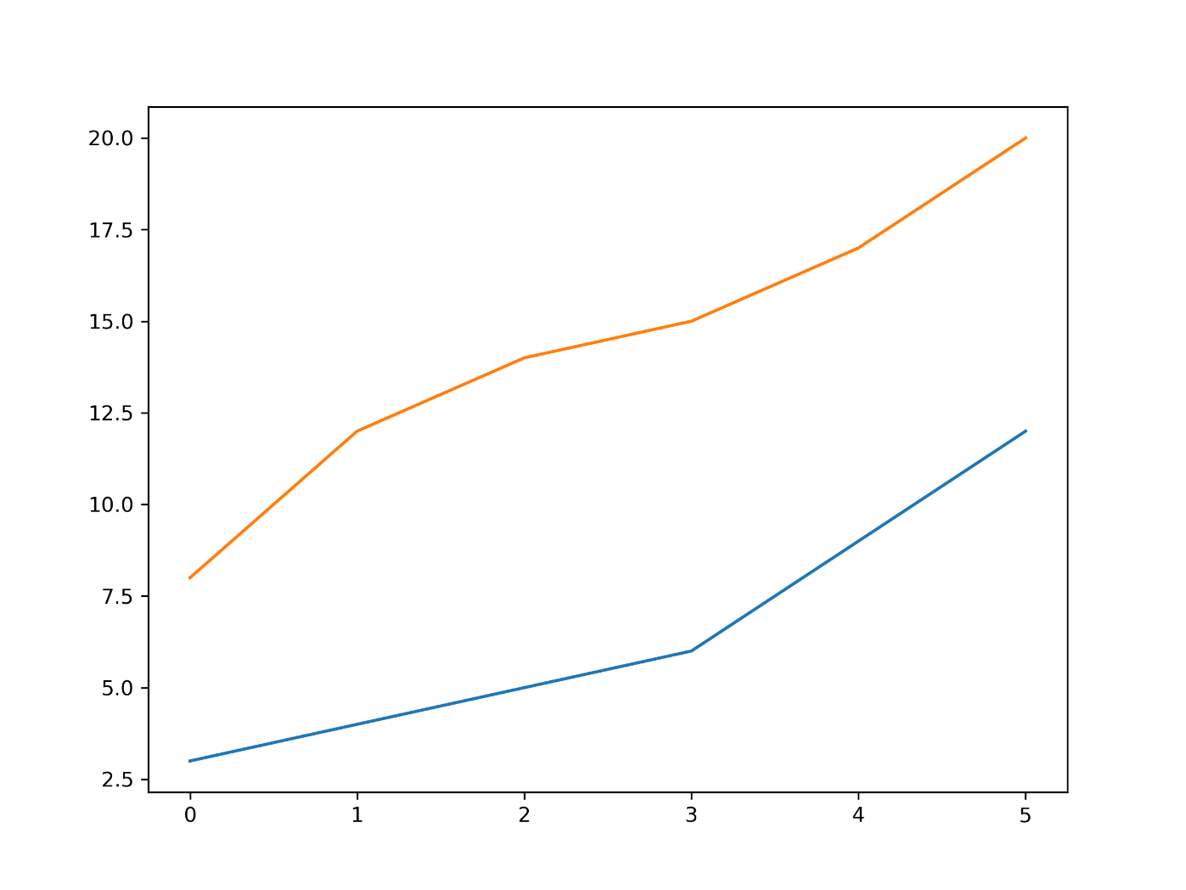
Matplotlib - Saving a figure for Word
value_height = 6
value_width = 8
import matplotlib.pyplot as plt
list1 = [3,4,5,6,9,12] # dummmy data
list2 = [8,12,14,15,17,20] # dummmy data
fig = plt.figure()
fig.set_figheight(value_height)
fig.set_figwidth(value_width)
ax = fig.add_subplot(111)
ax.plot(list1)
ax.plot(list2)
fig.savefig('fig1.png', dpi = 300)

Slide 5
Graphics
 | description
distplot | histogram
barplot | A barplot (or barchart) is one of the most common type of graphic
violinplot | similar to boxplot, also shows the probability density of the data
jointplot | Scatterplot
regplot | Regression plot
pairplot | Pairplot
boxplot | estimate of central tendency for a numeric variable
swarmplot | categorical scatterplot
factorplot | General categorical plot

Slide 6
Outline
Loading Data
Working with different datasets
Analysing Values
Preparing data for training and testing
Train-test-splits
Cross Validation
Importance of Stratification
Comparison Strategies
Performance Metrics
Grid Search
ROC curves

Slide 7
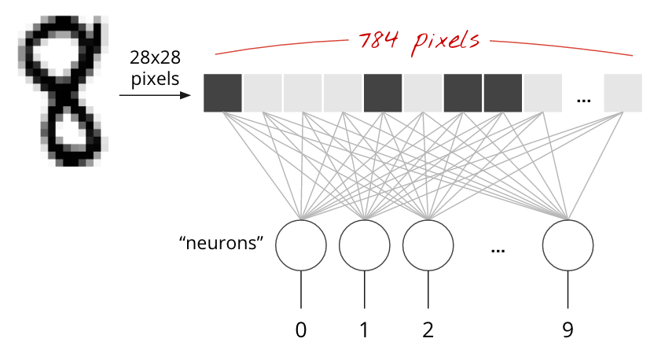
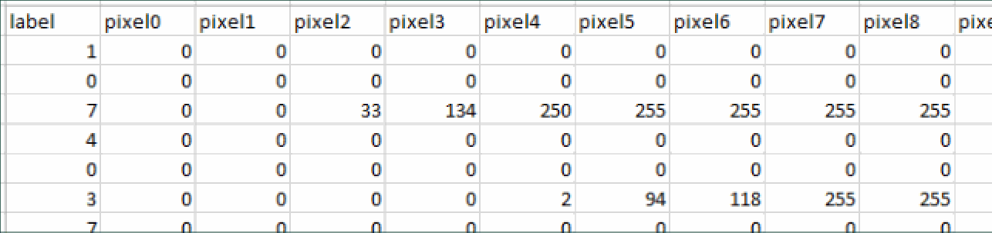
MNIST
All input attributes are integers in the range 0..255
first column is the class code
Class labels from 0..9

Slide 8

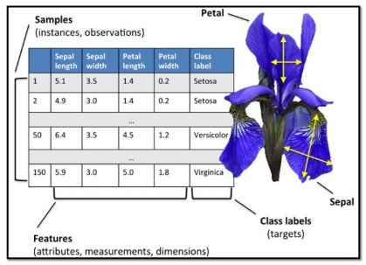


Iris Dataset
Iris-Versicolor
Iris-Setosa
All input attributes are real and the range depends on the column
last attribute is the class code
Class labels from {Versicolor, Setosa and Virginica}
Iris-Virginica

Slide 9
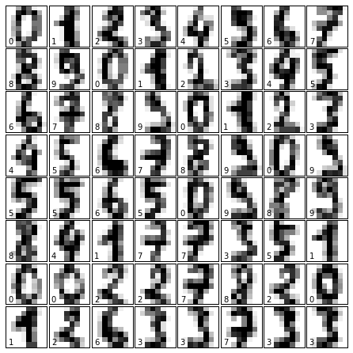
Digits Dataset
All input attributes are integers in the range 0..100
last attribute is the class code
Class labels are numeric in the range 0..9

Slide 10
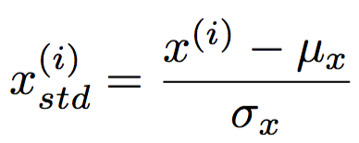
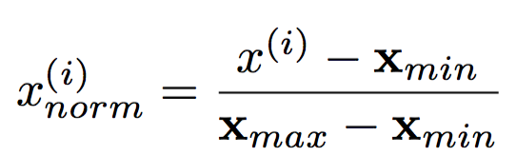
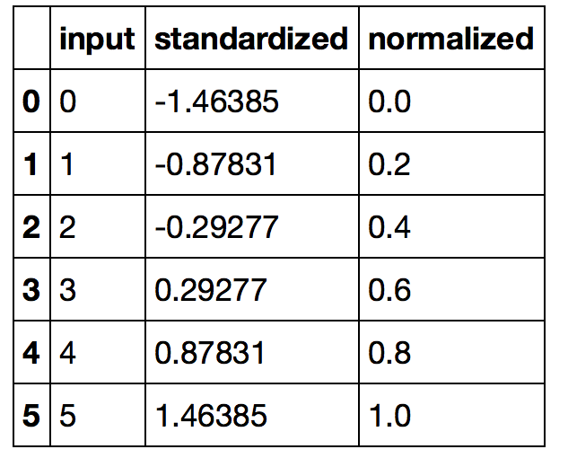
Feature Scaling
min-max scaling
(“normalization”)
standardization
from sklearn import preprocessing
Notes:
Details here
http://scikit-learn.org/stable/auto_examples/preprocessing/plot_all_scaling.html#sphx-glr-auto-examples-preprocessing-plot-all-scaling-py

Slide 11
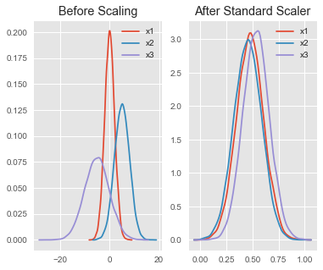
Standard Scalar
df = pd.DataFrame({
'x1': np.random.normal(0, 2, 10000),
'x2': np.random.normal(5, 3, 10000),
'x3': np.random.normal(-5, 5, 10000)
})
# Use StandardScaler
scaler = preprocessing.StandardScaler()
scaled_df = scaler.fit_transform(df)
scaled_df = pd.DataFrame(scaled_df, columns=['x1', 'x2', 'x3'])
-0.5 -0.2 O 2.5 5
Notes:
The idea behind Standard Scaler is that it will transform your data, such that the distribution will have a mean value of 0 and a standard deviation of 1. np.random.seed(1)
Generate random data to try above code
# Create data samples x1, x2, x3 np.random.seed(1) df = pd.DataFrame({ 'x1': np.random.normal(0, 2, 10000), 'x2': np.random.normal(5, 3, 10000), 'x3': np.random.normal(-5, 5, 10000) }) # Use StandardScaler scaler = preprocessing.StandardScaler() scaled_df = scaler.fit_transform(df) scaled_df = pd.DataFrame(scaled_df, columns=['x1', 'x2', 'x3']) # Plot and visualize fig, (ax1, ax2) = plt.subplots(ncols=2, figsize=(6, 5)) ax1.set_title('Before Scaling') sns.kdeplot(df['x1'], ax=ax1) sns.kdeplot(df['x2'], ax=ax1) sns.kdeplot(df['x3'], ax=ax1) ax2.set_title('After Standard Scaler') sns.kdeplot(scaled_df['x1'], ax=ax2) sns.kdeplot(scaled_df['x2'], ax=ax2) sns.kdeplot(scaled_df['x3'], ax=ax2) plt.show()

Slide 12
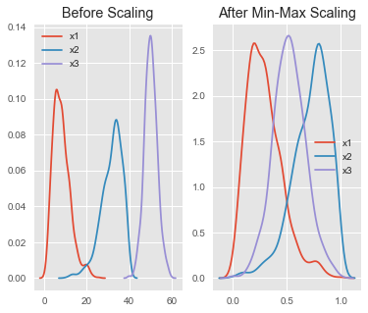
Min-max Scalar
# Use MinMaxScaler
scaler = preprocessing.MinMaxScaler()
scaled_df = scaler.fit_transform(df)
scaled_df = pd.DataFrame(scaled_df, columns=['x1', 'x2', 'x3'])
Notes:
Not robust to outliers
# Create data samples x1, x2, x3
df = pd.DataFrame({
# positive skew 'x1': np.random.chisquare(8, 1000),
# negative skew 'x2': np.random.beta(8, 2, 1000) * 40,
# no skew 'x3': np.random.normal(50, 3, 1000)
})

Slide 13

Python Libraries: Pandas
adds data structures and tools designed to work with table-like data (similar to Series and Data Frames in R)
provides tools for data manipulation: reshaping, merging, sorting, slicing, aggregation etc.
allows handling missing data
Link: http://pandas.pydata.org/

Slide 14
Data Frames methods
Unlike attributes, python methods have parenthesis.
All attributes and methods can be listed with a dir() function: dir(df)
df.method() | description
head( [n] ), tail( [n] ) | first/last n rows
describe() | generate descriptive statistics (for numeric columns only)
max(), min() | return max/min values for all numeric columns
mean(), median() | return mean/median values for all numeric columns
std() | standard deviation
sample([n]) | returns a random sample of the data frame
dropna() | drop all the records with missing values

Slide 15
Reading data using pandas
In [ ]:
#Read csv file
df = pd.read_csv("Salaries.csv")
Note: The above command has many optional arguments to fine-tune the data import process.
There is a number of pandas commands to read other data formats:
pd.read_excel('myfile.xlsx',sheet_name='Sheet1', index_col=None, na_values=['NA'])
pd.read_stata('myfile.dta')
pd.read_sas('myfile.sas7bdat')
pd.read_hdf('myfile.h5','df')

Slide 16
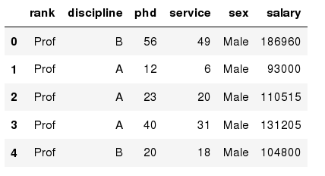
Exploring data frames
In [3]:
#List first 5 records
df.head()
Out[3]:

Slide 17
Data Frame data types
Pandas Type | Native Python Type | Description
object | string | The most general dtype. Will be assigned to your column if column has mixed types (numbers and strings).
int64 | int | Numeric characters. 64 refers to the memory allocated to hold this character.
float64 | float | Numeric characters with decimals. If a column contains numbers and NaNs(see below), pandas will default to float64, in case your missing value has a decimal.
datetime64, timedelta[ns] | N/A (but see the datetime module in Python’s standard library) | Values meant to hold time data. Look into these for time series experiments.

Slide 18
Data Frame data types
In [4]:
#Check a particular column type
df['salary'].dtype
Out[4]: dtype('int64')
In [5]:
#Check types for all the columns
df.dtypes
Out[4]:
object
object
int64
int64
object
int64
rank
discipline
phd
service
sex
salary
dtype: object

Slide 19
Data Frames attributes
Python objects have attributes and methods.
df.attribute | description
dtypes | list the types of the columns
columns | list the column names
axes | list the row labels and column names
ndim | number of dimensions
size | number of elements
shape | return a tuple representing the dimensionality
values | numpy representation of the data

Slide 20
Selecting a column in a Data Frame
Method 1: Subset the data frame using column name:
df['sex']
Method 2: Use the column name as an attribute:
df.sex
Note: there is an attribute rank for pandas data frames, so to select a column with a name "rank" we should use method 1.

Slide 21
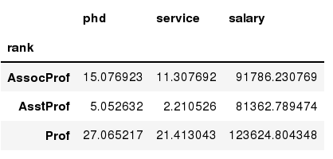
Data Frames groupby method
Using "group by" method we can:
Split the data into groups based on some criteria
Calculate statistics (or apply a function) to each group
Similar to dplyr() function in R
In [ ]:
#Group data using rank
df_rank = df.groupby(['rank'])
In [ ]:
#Calculate mean value for each numeric column per each group
df_rank.mean()

Slide 22
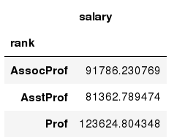
Data Frames groupby method
Once groupby object is create we can calculate various statistics for each group:
In [ ]:
#Calculate mean salary for each professor rank:
df.groupby('rank')[['salary']].mean()
Note: If single brackets are used to specify the column (e.g. salary), then the output is Pandas Series object. When double brackets are used the output is a Data Frame

Slide 23
Data Frames groupby method
groupby performance notes:
- no grouping/splitting occurs until it's needed. Creating the groupby object only verifies that you have passed a valid mapping
- by default the group keys are sorted during the groupby operation. You may want to pass sort=False for potential speedup:
In [ ]:
#Calculate mean salary for each professor rank:
df.groupby(['rank'], sort=False)[['salary']].mean()

Slide 24
Data Frame: filtering
To subset the data we can apply Boolean indexing. This indexing is commonly known as a filter. For example if we want to subset the rows in which the salary value is greater than $120K:
In [ ]:
#Calculate mean salary for each professor rank:
df_sub = df[ df['salary'] > 120000 ]
Any Boolean operator can be used to subset the data:
> greater; >= greater or equal;
< less; <= less or equal;
== equal; != not equal;
In [ ]:
#Select only those rows that contain female professors:
df_f = df[ df['sex'] == 'Female' ]

Slide 25
Data Frames: Slicing
There are a number of ways to subset the Data Frame:
one or more columns
one or more rows
a subset of rows and columns
Rows and columns can be selected by their position or label

Slide 26
Data Frames: Slicing
When selecting one column, it is possible to use single set of brackets, but the resulting object will be a Series (not a DataFrame):
In [ ]:
#Select column salary:
df['salary']
When we need to select more than one column and/or make the output to be a DataFrame, we should use double brackets:
In [ ]:
#Select column salary:
df[['rank','salary']]

Slide 27
Data Frames: Selecting rows
If we need to select a range of rows, we can specify the range using ":"
In [ ]:
#Select rows by their position:
df[10:20]
Notice that the first row has a position 0, and the last value in the range is omitted:
So for 0:10 range the first 10 rows are returned with the positions starting with 0 and ending with 9

Slide 28
Data Frames: Selecting rows
If we need to select a range of rows, we can specify the range using ":"
In [ ]:
#Select all rows and columns in a range by their position:
df[:,0:20]
In [ ]:
#Select all rows and first column:
df[:,0]
In [ ]:
#Select all rows and all columns starting from column index 1:
df[:,1:]

Slide 29
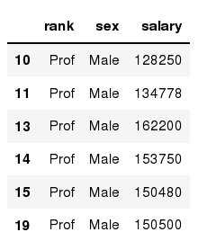
Data Frames: method loc
If we need to select a range of rows, using their labels we can use method loc:
In [ ]:
#Select rows by their labels:
df_sub.loc[10:20,['rank','sex','salary']]
Out[ ]:

Slide 30
Data Frames: method iloc (summary)
df.iloc[:, 0] # First column
df.iloc[:, -1] # Last column
df.iloc[i] #(i+1)th row
df.iloc[0:7] #First 7 rows
df.iloc[:, 0:2] #First 2 columns
df.iloc[1:3, 0:2] #Second through third rows and first 2 columns
df.iloc[[0,5], [1,3]] #1st and 6th rows and 2nd and 4th columns

Slide 31
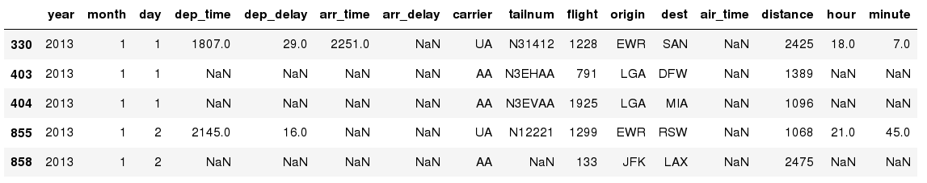
Missing Values
in which axis=0 along the rows (namely, index in pandas), and axis=1 along the columns
Missing values are marked as NaN
In [ ]:
# Read a dataset with missing values
flights = pd.read_csv("flights.csv")
In [ ]:
# Select the rows that have at least one missing value
flights[flights.isnull().any(axis=1)].head()
Out[ ]:
Notes:
in which axis=0 along the rows (namely, index in pandas), and axis=1 along the columns

Slide 32
Missing Values
There are a number of methods to deal with missing values in the data frame:
df.method() | description
dropna() | Drop missing observations
dropna(how='all') | Drop observations where all cells is NA
dropna(axis=‘columns’, how='all') | Drop columns if all the values are missing
dropna(thresh = 5) | Drop rows that contain less than 5 non-missing values
fillna(0) | Replace missing values with zeros
isnull() | returns True if the value is missing
notnull() | Returns True for non-missing values

Slide 33
Missing Values
When summing the data, missing values will be treated as zero
If all values are missing, the sum will be equal to NaN
cumsum() and cumprod() methods ignore missing values but preserve them in the resulting arrays
Missing values in GroupBy method are excluded (just like in R)
Many descriptive statistics methods have skipna option to control if missing data should be excluded . This value is set to True by default (unlike R)

Slide 34
Outline
Loading Data
Working with different datasets
Analysing Values
Preparing data for training and testing
Train-test-splits
Cross Validation
Importance of Stratification
Comparison Strategies
Performance Metrics
Grid Search
ROC curves

Slide 35
Training & Test Data
All Data
Training Data
Test Data
Typically:
75% : 25%
2/3 : 1/3

Slide 36
Supervised Workflow
TRAINING
GENERALIZATION
Fit model on all data after evaluation

Slide 37
Supervised Workflow
estimator.fit(X_train, y_train)
TRAINING
estimator.predict(X_test)
GENERALIZATION
estimator.score(X_test, y_test)

Slide 38
Cleaning class labels
If these are categorical then map them to integers
class_mapping = {label:idx for idx,label in
enumerate(np.unique(df['classLabels']))}
#use the mapping dictionary to transform the class labels into integers
df['classLabels'] = df['classLabels'].map(class_mapping)
df

Slide 39
Holdout Evaluation I

Slide 40
Holdout Evaluation II

Slide 41
Holdout Validation I

Slide 42
Holdout Validation II

Slide 43
Holdout Validation III

Slide 44
K-fold Cross-Validation

Slide 45
K-fold Cross-Validation Pipeline I

Slide 46
K-fold Cross-Validation Pipeline II

Slide 47
Nested CV

Slide 48
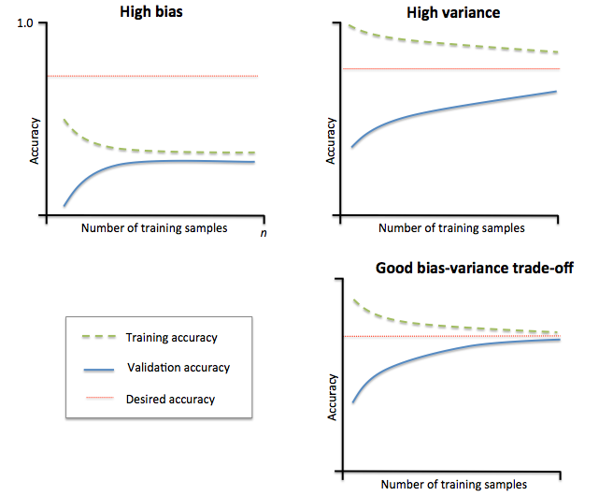
Learning Curves
overfitting
underfitting
Image source: https://github.com/rasbt/python-machine-learning-book/blob/master/code/ch06/images/06_04.png

Slide 49
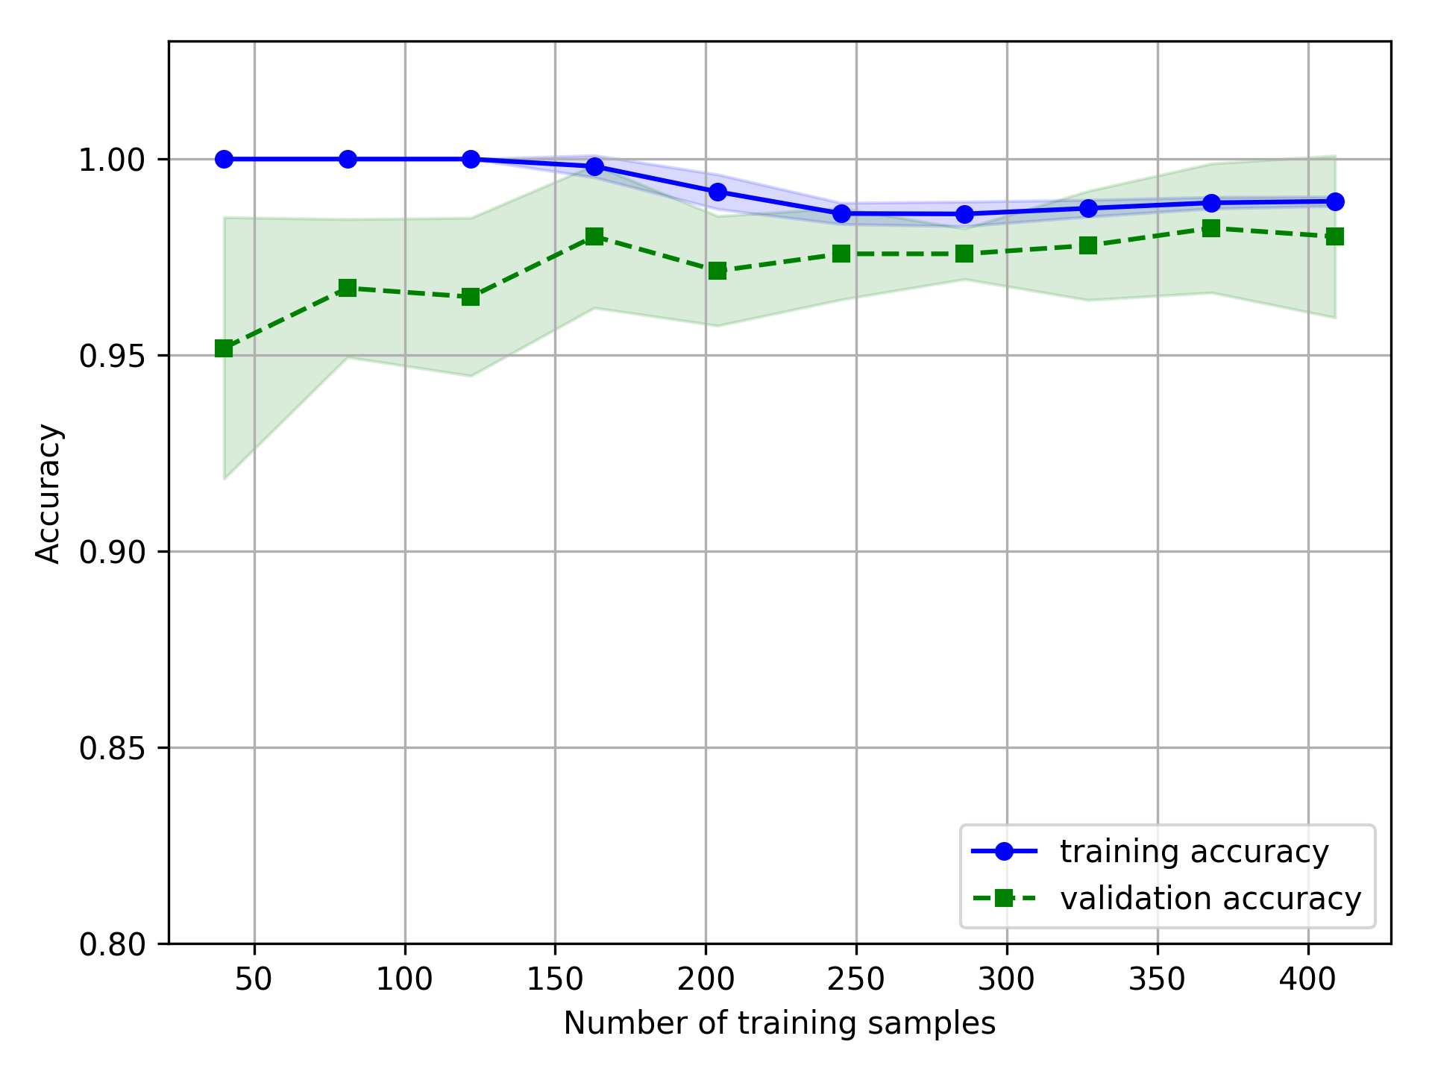
Model Complexity

Slide 50
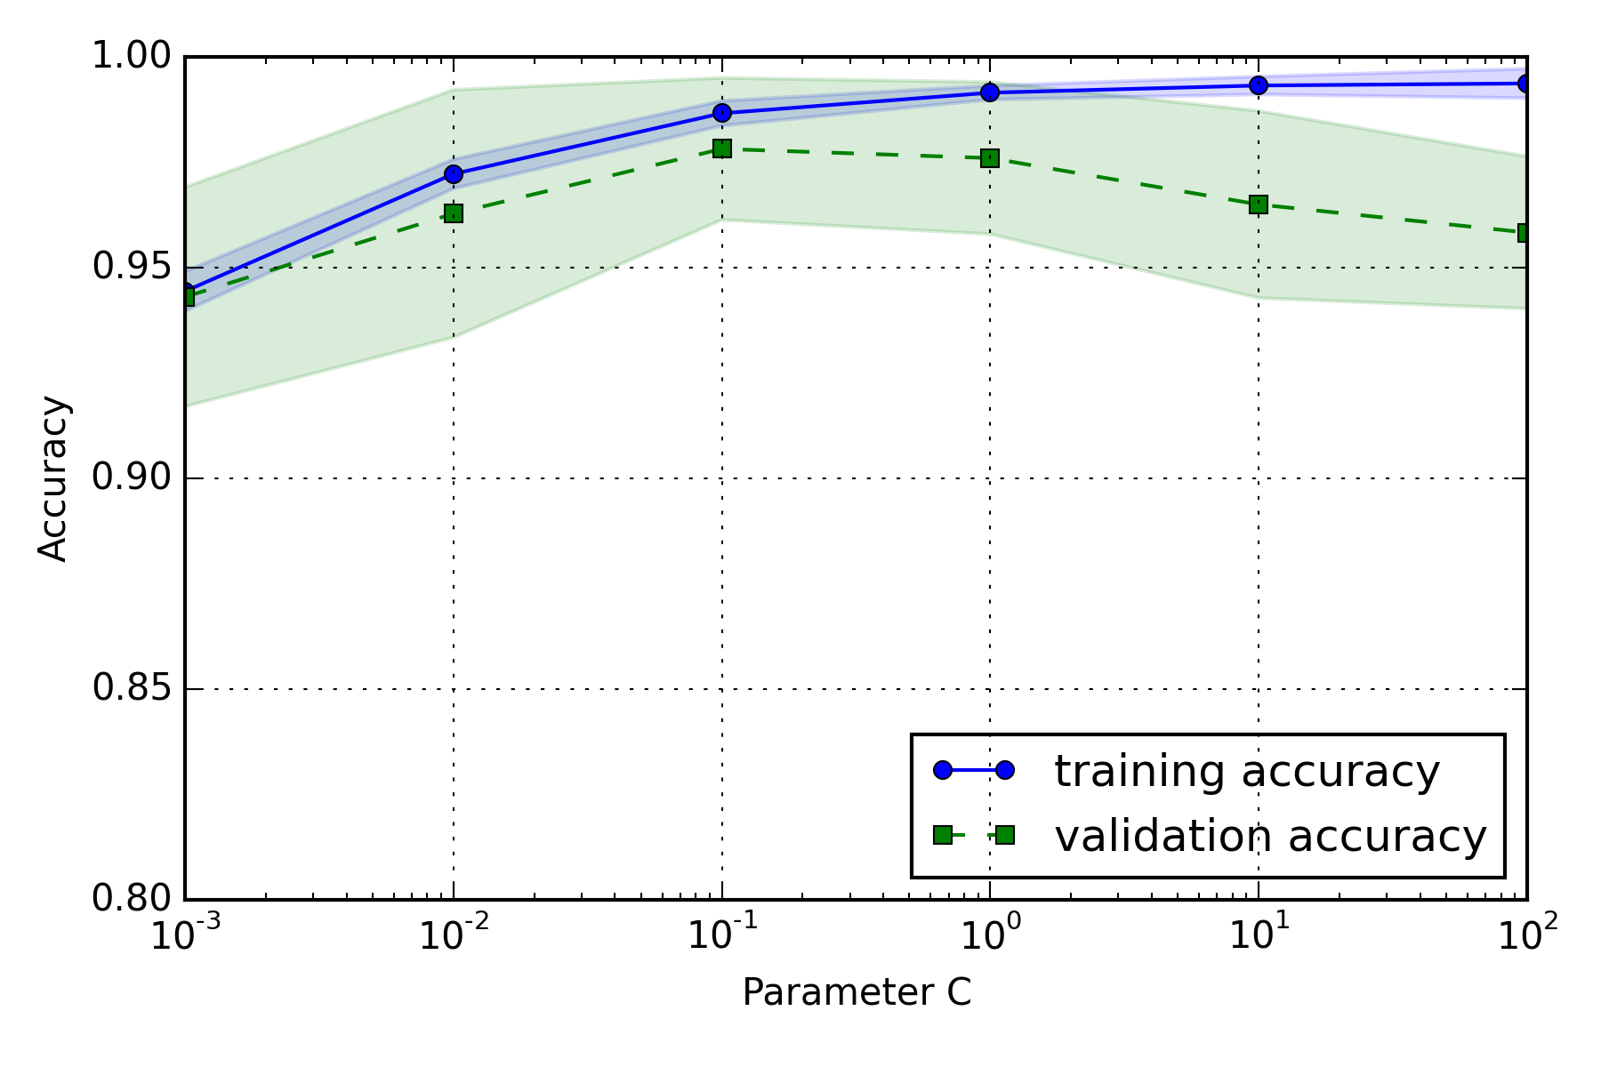
Model Complexity

Slide 51

Python Libraries for Data Science
SciKit-Learn:
provides machine learning algorithms: classification, regression, clustering, model validation etc.
built on NumPy, SciPy and matplotlib
Link: http://scikit-learn.org/

Slide 52
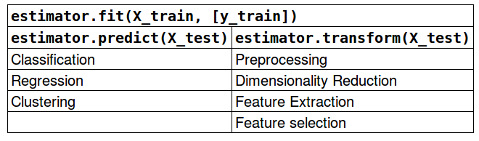
Scikit-learn API
model_selection
train_test_split, KFold, StratifiedKFold, StratifiedShuffleSplit, ShuffleSplit, cross_val_score, GridSearchCV
train_X, test_X, train_y, test_y = train_test_split(X, y)

Slide 53
scikit-learn estimator api
est.fit(X_train)
Training Data
Test Data
est.transform(X_train)
Model
est.transform(X_test)
Transformed
Training Data
Transformed
Test Data

Slide 54
Missing Values with sklearn’s Imputer
Can use
‘most_frequent’ for categorical values
from sklearn.preprocessing import Imputer
df = pandas.read_csv(StringIO(csv_data))
#check that it has stored the NaN missing values
df.isnull().sum()
imr = Imputer(missing_values=np.nan, strategy = 'mean', axis = 0)
imr = imr.fit(df)
imputed_data = imr.transform(df.values)
imputed_data

Slide 55
scikit-learn estimator api for classifiers
Training Data
Training Labels
est.fit(X_train, y_train)
Model
Test Data
est.predict(X_test)
Predicted labels

Slide 56
Classifier models
classifier1 = KNeighborsClassifier())
classifier1.fit(train_X, train_y)
pred_y = classifier1.predict(test_X)
classifier2.score(test_X, test_y)
classifier2 = LogisticRegression()
classifier2.fit(train_X, train_y)
pred_y = classifier2.predict(test_X)
classifier1.score(test_X, test_y)

Slide 57
Kfold and cross_val_score
for name, model in models:
kfold = KFold(n_splits=10, random_state=seed)
cv_results = model_selection.cross_val_score(model, X, y, cv=kfold, scoring=scoring)
results.append(cv_results)
names.append(name)

Slide 58
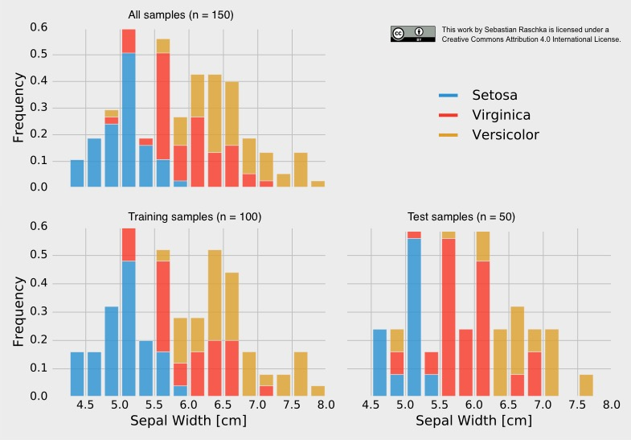
Stratification
Non-stratified split:
training set → 38 x Setosa, 28 x Versicolor, 34 x Virginica
test set → 12 x Setosa, 22 x Versicolor, 16 x Virginica

Slide 59
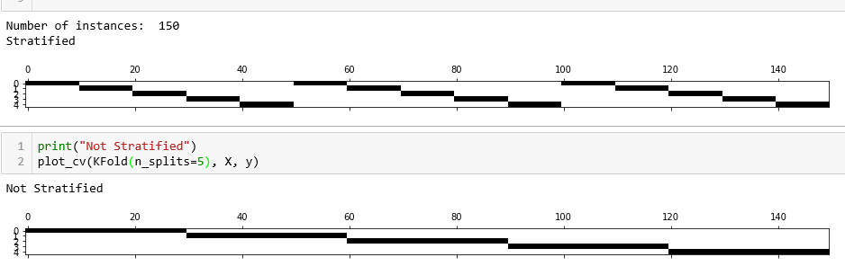
Plotting fold creation with & without stratification
StratifiedKFold(n_splits=5)
KFold(n_splits=5)

Slide 60
train_test_split
from sklearn.model_selection import train_test_split
train_X, test_X, train_y, test_y =
train_test_split(X, y, train_size=0.5, test_size=0.5,random_state=seed,stratify=y)
To generate several splits and the average over the results is better than to use a single split. In the lab you will do this with
StratifiedShuffleSplit(n_splits=10, test_size=.03, random_state=seed), iris.data, iris.target
Notes:
X = 2d-array of data with each row consisting of an instance’s feature values
Y = 1d-array consisting of corresponding class labels

Slide 61
Outline
Loading Data
Working with different datasets
Analysing Values
Preparing data for training and testing
Train-test-splits
Cross Validation
Importance of Stratification
Comparison Strategies
Performance Metrics
Grid Search
ROC curves

Slide 62
Grid Search
search for best hyper-parameters
setup a parameter grid
param_grid = [
{
'activation' : ['identity', 'logistic'],
'solver' : ['lbfgs', 'adam'],
‘max_iter’ : [50, 200, 300],
'hidden_layer_sizes': [(10,),(30,)] }
]
model = GridSearchCV(MLPClassifier(), param_grid, cv=5, scoring='accuracy')
Model.fit(X_train, y_train)

Slide 63
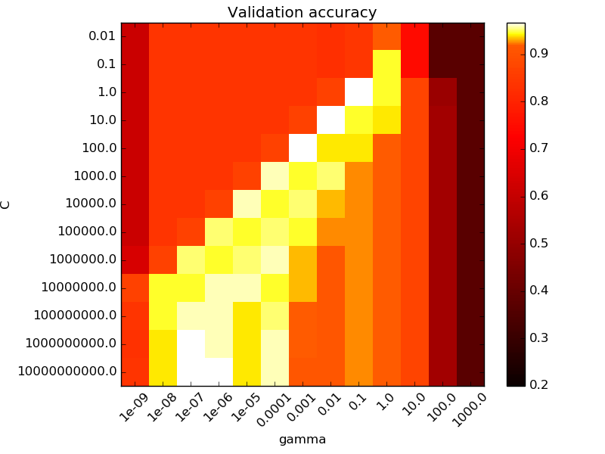
Grid Search
C parameter
gamma parameter
Source: http://scikit-learn.org/stable/auto_examples/svm/plot_rbf_parameters.html

Slide 64
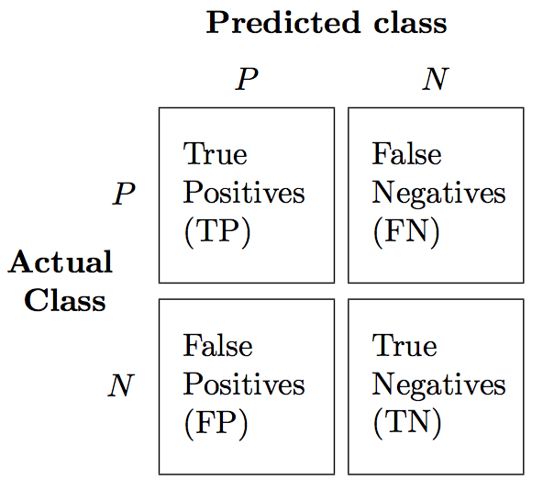
Model Testing / Evaluation
How effective is the model at classifying unseen data?
The test data is used as ‘unseen data’

Slide 65
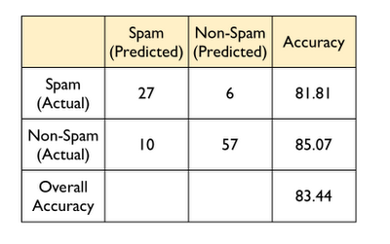


Confusion Matrix
Confusion
matrix
= 27/(27 + 6)
= 57/(57 + 10)
84
= (27 + 57) / (27 + 6 + 57 + 10)

Slide 66
Confusion Matrix
TP: True Positives
FN: False Negatives
Confusion
matrix
TN: True Negatives
84
= (27 + 57) / (27 + 6 + 57 + 10)
FP: False Positives

Slide 67
Confusion Matrix
Accuracy on each class
Confusion
matrix
= 27/(27 + 6)
= 57/(57 + 10)
(81.81 + 85.07)/2 = 83.44

Slide 68
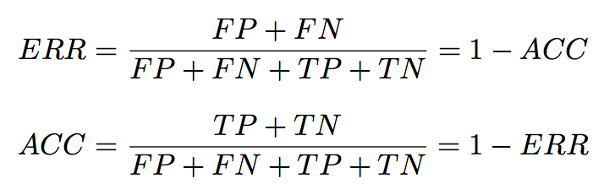
Classification Metrics I

Slide 69
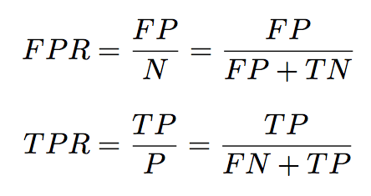
Classification Metrics II
Notes:
FPR = false positive rate
TPR = true positive rate

Slide 70
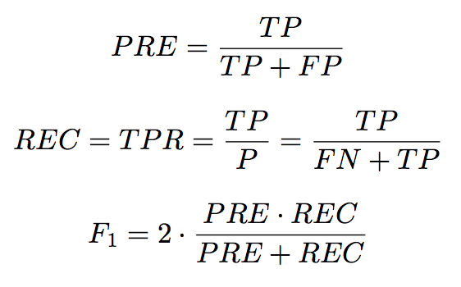
Classification Metrics III (Precision & Recall)
Notes:
Commonly used in text classification

Slide 71
Scikit-Learn Performance metrics for classification
provide a string as the scoring parameter
cross_validation.cross_val_score(model, X, y, scoring=‘accuracy')
['accuracy', 'adjusted_rand_score', 'average_precision', 'f1', 'log_loss', 'mean_absolute_error', 'mean_squared_error', 'precision', 'r2', 'recall', 'roc_auc']

Slide 72
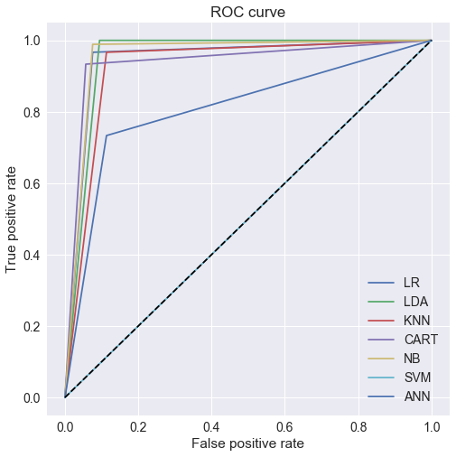
Receiver Operator Characteristic
Diagonal has AUC=0.5
As good as random guessing
Suited to binary classification
Useful to evaluate classifiers that generate confidence in predictions
Neural nets
Naïve Bayes
Notes:
AUC = area under the curve
For a perfect classifier the ROC curve will go straight up the Y axis and then along the X axis. A classifier with no power will sit on the diagonal, whilst most classifiers fall somewhere I
Threshold Selection
It is immediately apparent that a ROC curve can be used to select a threshold for a classifier which maximises the true positives, while minimising the false positives.
However, different types of problems have different optimal classifier thresholds. For a cancer screening test, for example, we may be prepared to put up with a relatively high false positive rate in order to get a high true positive, it is most important to identify possible cancer sufferers.
For a follow-up test after treatment, however, a different threshold might be more desirable, since we want to minimise false negatives, we don’t want to tell a patient they’re clear if this is not actually the case.
n between.

Slide 73
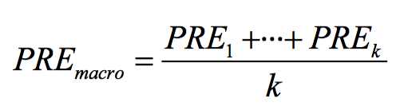
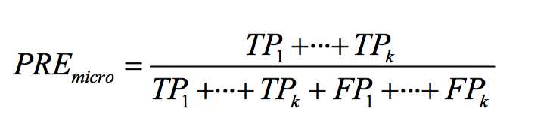
Multi-Class
The macro average calculates the individual TP, TN, FP, and FN of the system to compute say precision.
In a k-class system we would then aggregate the precisions.
So all classes have equal weight
The micro average calculates this as the average scores of the different systems.
Since classes don’t have equal weight this is suited to unbalanced class situations
Notes:
'f1_macro', 'f1_micro', 'f1_weighted', 'precision_macro', 'precision_micro', 'precision_weighted', 'recall_macro', 'recall_micro', 'recall_weighted‘
Micro- and macro-averages (for whatever metric) will compute slightly different things, and thus their interpretation differs.
A macro-average will compute the metric independently for each class and then take the average (hence treating all classes equally),
whereas a micro-average will aggregate the contributions of all classes to compute the average metric.
In a multi-class classification setup, micro-average is preferable if you suspect there might be class imbalance
(i.e you may have many more examples of one class than of other classes).
To illustrate why, take for example precision
Let's imagine you have a One-vs-All (there is only one correct class output per example) multi-class classification system with four classes and the following numbers when tested:
Class A: 1 TP and 1 FP
Class B: 10 TP and 90 FP
Class C: 1 TP and 1 FP
Class D: 1 TP and 1 FP
You can see easily that
PrA=PrC=PrD=0.5PrA=PrC=PrD=0.5, whereas PrB=0.1PrB=0.1.
A macro-average will then compute: Pr=0.5+0.1+0.5+0.54=0.4Pr=0.5+0.1+0.5+0.54=0.4
A micro-average will compute: Pr=1+10+1+12+100+2+2=0.123Pr=1+10+1+12+100+2+2=0.123
These are quite different values for precision.
Intuitively, in the macro-average the "good" precision (0.5) of classes A, C and D is contributing to maintain a "decent" overall precision (0.4).
While this is technically true (across classes, the average precision is 0.4), it is a bit misleading, since a large number of examples are not properly classified.
These examples predominantly correspond to class B, so they only contribute 1/4 towards the average in spite of constituting 94.3% of your test data.
The micro-average will adequately capture this class imbalance, and bring the overall precision average down to 0.123 (more in line with the precision of the dominating class B (0.1)).

Slide 74
Conclusion
Python has a substantial number of libraries for data scientists
Data analysis and preprocessing is always the first step in the ML pipeline
Training Machine Learning classifiers requires organization of datasets into train and test
There are many strategies for organising train and test data to ensure that results are a good approximation of what can be expected at deployment.
Notes:
Numpy : advanced mathematical and statistical operations
SciPy: algorithms for linear algebra, differential equations, numerical integration, optimization, statistics and more
Pandas: Data structures and manipulation
SciKit-Learn: ML library
matplotLib: python 2D plotting library , augmented by seaborn

