Slide 1
Deep Learning with Keras
Prof N Wiratunga
Ref:
Hands-on ML with scikit-learn and tensor flow; Aurelien Geron
Slides adopted from DL/ML tutorial Hung-yi Lee@NTU

Slide 2
Outline
Intro to Keras (ANN)
Intro to Recurrent Neural Network (RNN)
Intro to Convolutional Neural Network (CNN)

Slide 3
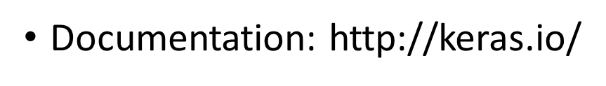
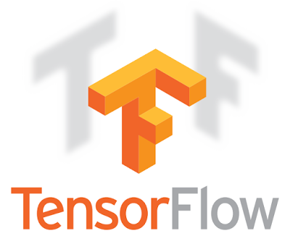


Keras
Very flexible
or
Need some effort to learn
Easy to learn and use
Interface of TensorFlow or Theano
(still have some flexibility)
You can modify it if you can write TensorFlow or Theano
keras
Notes:
Documentation: http://keras.io/
Example: https://github.com/fchollet/keras/tree/master/examples

Slide 4
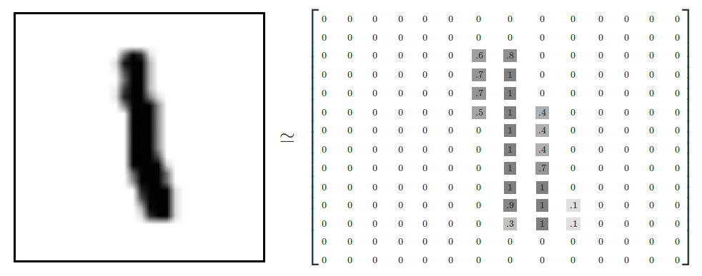
Example Application
Handwriting Digit Recognition
Machine
“1”
28 x 28
MNIST Data: http://yann.lecun.com/exdb/mnist/
“Hello world” for deep learning
Keras provides data sets loading function: http://keras.io/datasets/
Notes:
from keras.datasets import imdb
(x_train, y_train), (x_test, y_test) = imdb.load_data(path="imdb.npz",
num_words=None,
skip_top=0,
maxlen=None,
seed=113,
start_char=1,
oov_char=2,
index_from=3)

Slide 5
Keras
Step 1: design the model
Step 3: refine the model
Step 2: goodness of model
28x28
Model=Sequential()
……
model.add(Dense (input_dim=28*28,units= 512))
model.add(Activation('sigmoid'))
512
……
model.add (Dense ( units = 128))
model.add ( Activation('sigmoid'))
128
……
Softmax
model.add (Dense ( units = 10))
model.add ( Activation('softmax'))
y₁
y₂
y₁₀
……

Slide 6
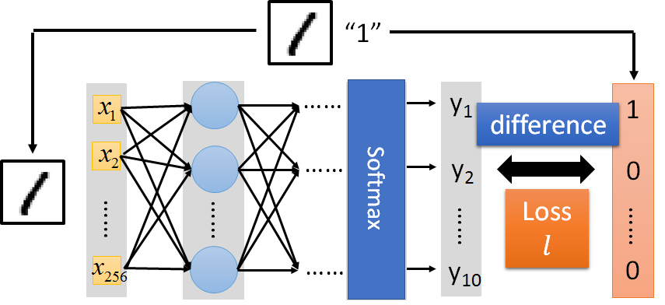

Keras
Step 1: design the model
Step 3: refine the model
Step 2: goodness of model

Slide 7
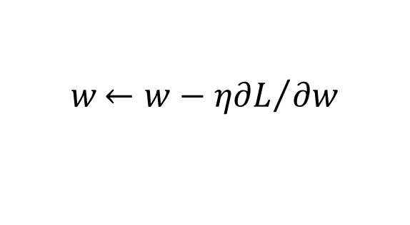
Keras
Step 1: design the model
Step 3: refine the model
Step 2: goodness of model
Step 3.1: Configuration
$$w{←w−η∂L}/{∂w}$$
0.1
Step 3.2: Find the optimal network parameters
Training data
(Images)
Labels
(digits)

Slide 8
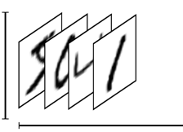
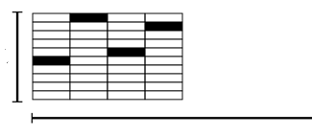
Keras
Step 1: design the model
Step 3: refine the model
Step 2: goodness of model
Step 3.2: Find the optimal network parameters
model.fit(X_train, y_train_ohe, batch_size=128, nb_epoch=5)
numpy array
(one-hot-encoding)
numpy array
28 x 28
=784
……
10
……
Number of training examples
Number of training examples
https://www.tensorflow.org/versions/r0.8/tutorials/mnist/beginners/index.html

Slide 9
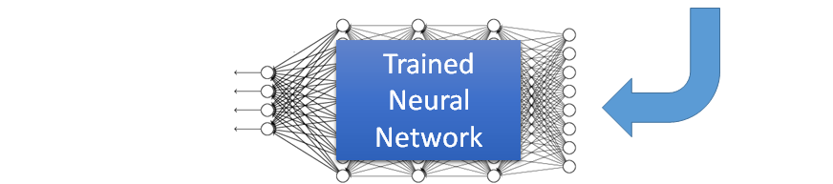

Keras
Step 1: design the model
Step 3: refine the model
Step 2: goodness of model
Save and load models
http://keras.io/getting-started/faq/#how-can-i-save-a-keras-model
How to use the neural network (testing):
score = model.evaluate(X_test, y_test_ohe)
print('Total loss on training', score[0])
print('Total accuracy on training', score[1])
case 1:
case 2:

Slide 10


In the Lab
Mean Squared Error
Cross Entropy
Several alternatives: https://keras.io/objectives/

Slide 11
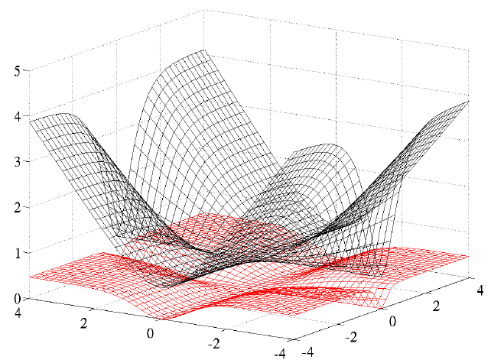
Choosing Proper Loss
When using softmax output layer, choose cross entropy
Cross Entropy
Total
Loss
Square
Error
http://jmlr.org/proceedings/papers/v9/glorot10a/glorot10a.pdf
w₁
w₂

Slide 12
Vanishing Gradient Problem
……
y₁
……
y₂
……
……
……
……
……
……
y_{M}
Smaller gradients
Larger gradients
Learn very slow
Learn very fast
Almost random
Already converge
based on random initialisation!?

Slide 13





ReLU
Rectified Linear Unit (ReLU)
Properties:
$$a$$
$$σ\left(z\right)$$
1. Fast to compute
$$a=z$$
2. No saturation at
higher values
$$a=0$$
$$z$$
3. Vanishing gradient problem
[Xavier Glorot, AISTATS’11]
4. Neurons can die!
[Andrew L. Maas, ICML’13]
[Kaiming He, arXiv’15]
Notes:
Parametric ReLU, -> PReLU
Ref: Glorot, Xavier, Antoine Bordes, and Yoshua Bengio. "Deep sparse rectifier neural networks." International Conference on Artificial Intelligence and Statistics. 2011.

Slide 14
ReLU
$$a$$
$$a=z$$
$$a=0$$
$$z$$
0
0
0
0

Slide 15
ReLU
$$a$$
$$a=z$$
A Thinner linear network
$$a=0$$
$$z$$
Do not have smaller gradients

Slide 16
Outline
Intro to Keras (ANN)
Intro to Recurrent Neural Network (RNN)
Intro to Convolutional Neural Network (CNN)
Widely used in image processing

Slide 17
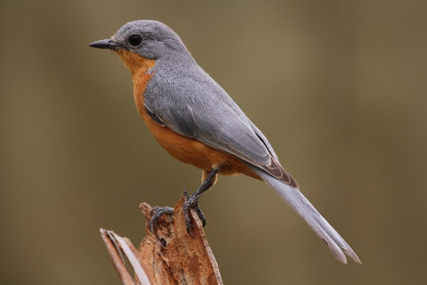
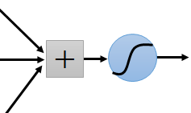
What is the idea behind CNNs?
Some patterns are much smaller than the whole image
A neuron does not have to see the whole image to discover the pattern.
Connecting to small region with less parameters
“beak” detector

Slide 18
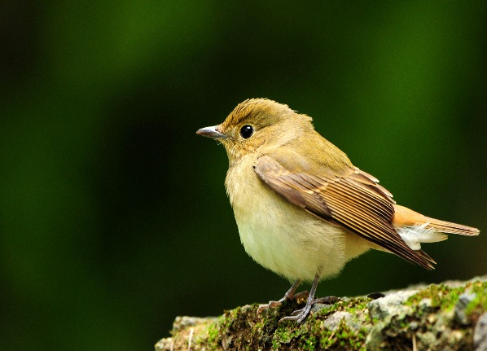
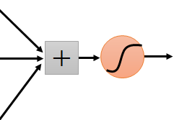
What is the idea behind CNNs?
The same patterns appear in different regions.
“upper-left beak” detector
Do almost the same thing
They can use the same set of parameters.
“middle beak” detector

Slide 19
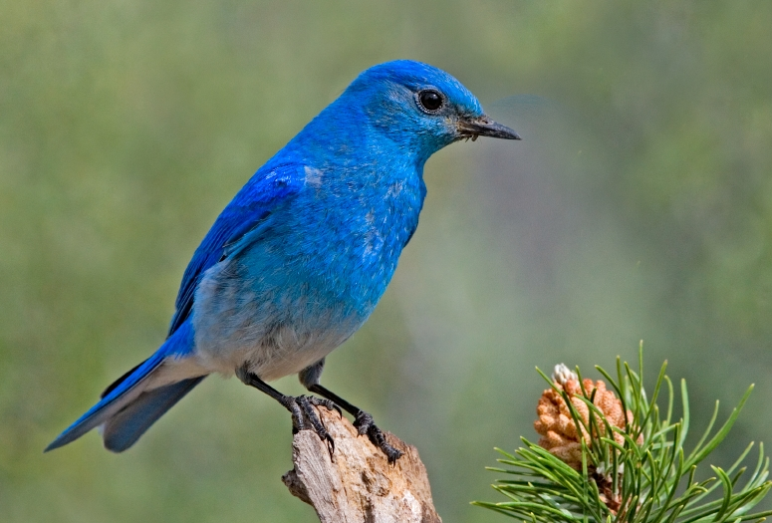

What is the idea behind CNNs?
Subsampling the pixels will not change the object
bird
bird
Subsampling
or pooling
We can subsample the pixels to make image smaller
Less parameters for the network to process the image

Slide 20
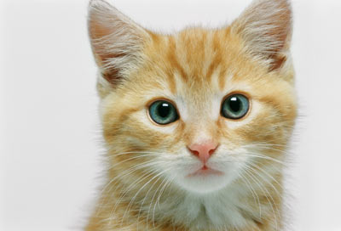
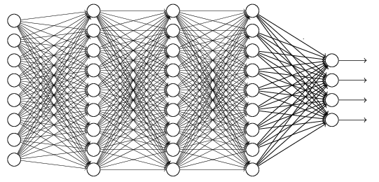
The whole CNN
cat dog ……
Convolution
Max Pooling
Can repeat many times
Fully Connected Feedforward network
Convolution
Max Pooling
Flatten

Slide 21
The whole CNN
Property 1
Some patterns are much smaller than the whole image
Convolution
Property 2
Max Pooling
The same patterns appear in different regions.
Can repeat many times
Property 3
Convolution
Subsampling the pixels will not change the object
Max Pooling
Flatten

Slide 22
The whole CNN
cat dog ……
Convolution
Max Pooling
Can repeat many times
Fully Connected Feedforward network
Convolution
Max Pooling
Flatten

Slide 23
CNN – Convolution
Those are the network parameters to be learned.
1 | -1 | -1
-1 | 1 | -1
-1 | -1 | 1
1 | 0 | 0 | 0 | 0 | 1
0 | 1 | 0 | 0 | 1 | 0
0 | 0 | 1 | 1 | 0 | 0
1 | 0 | 0 | 0 | 1 | 0
0 | 1 | 0 | 0 | 1 | 0
0 | 0 | 1 | 0 | 1 | 0
Filter 1
Matrix
-1 | 1 | -1
-1 | 1 | -1
-1 | 1 | -1
Filter 2
Matrix
……
6 x 6 image
Each filter detects a small pattern (3 x 3).
Property 1

Slide 24
CNN – Convolution
1 | -1 | -1
-1 | 1 | -1
-1 | -1 | 1
Filter 1
stride=1
1 | 0 | 0 | 0 | 0 | 1
0 | 1 | 0 | 0 | 1 | 0
0 | 0 | 1 | 1 | 0 | 0
1 | 0 | 0 | 0 | 1 | 0
0 | 1 | 0 | 0 | 1 | 0
0 | 0 | 1 | 0 | 1 | 0
3
-1
6 x 6 image

Slide 25
CNN – Convolution
1 | -1 | -1
-1 | 1 | -1
-1 | -1 | 1
Filter 1
If stride=2
1 | 0 | 0 | 0 | 0 | 1
0 | 1 | 0 | 0 | 1 | 0
0 | 0 | 1 | 1 | 0 | 0
1 | 0 | 0 | 0 | 1 | 0
0 | 1 | 0 | 0 | 1 | 0
0 | 0 | 1 | 0 | 1 | 0
3
-3
Lets work with stride=1
6 x 6 image

Slide 26
CNN – Convolution
1 | -1 | -1
-1 | 1 | -1
-1 | -1 | 1
Filter 1
stride=1
1 | 0 | 0 | 0 | 0 | 1
0 | 1 | 0 | 0 | 1 | 0
0 | 0 | 1 | 1 | 0 | 0
1 | 0 | 0 | 0 | 1 | 0
0 | 1 | 0 | 0 | 1 | 0
0 | 0 | 1 | 0 | 1 | 0
3
-1
-3
-1
-3
1
0
-3
-3
-3
0
1
3
-2
-2
-1
6 x 6 image
Property 2

Slide 27
CNN – Convolution
-1 | 1 | -1
-1 | 1 | -1
-1 | 1 | -1
Filter 2
stride=1
Do the same process for every filter
1 | 0 | 0 | 0 | 0 | 1
0 | 1 | 0 | 0 | 1 | 0
0 | 0 | 1 | 1 | 0 | 0
1 | 0 | 0 | 0 | 1 | 0
0 | 1 | 0 | 0 | 1 | 0
0 | 0 | 1 | 0 | 1 | 0
3
-1
-3
-1
-1
-1
-1
-1
-3
1
0
-3
-1
-1
-2
1
Feature
Map
-3
-3
0
1
-1
-1
-2
1
3
-2
-2
-1
6 x 6 image
-1
0
-4
3
4 x 4 image

Slide 28
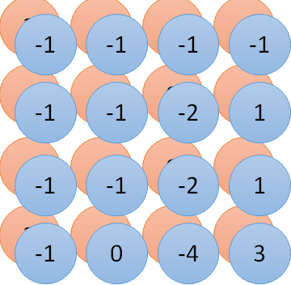
Convolution v.s. Fully Connected
1 | 0 | 0 | 0 | 0 | 1
0 | 1 | 0 | 0 | 1 | 0
0 | 0 | 1 | 1 | 0 | 0
1 | 0 | 0 | 0 | 1 | 0
0 | 1 | 0 | 0 | 1 | 0
0 | 0 | 1 | 0 | 1 | 0
1 | -1 | -1
-1 | 1 | -1
-1 | -1 | 1
-1 | 1 | -1
-1 | 1 | -1
-1 | 1 | -1
convolution
image
1 | 0 | 0 | 0 | 0 | 1
0 | 1 | 0 | 0 | 1 | 0
0 | 0 | 1 | 1 | 0 | 0
1 | 0 | 0 | 0 | 1 | 0
0 | 1 | 0 | 0 | 1 | 0
0 | 0 | 1 | 0 | 1 | 0
Fully-connected
……
……

Slide 29
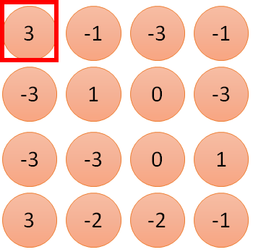
1 | -1 | -1
-1 | 1 | -1
-1 | -1 | 1
1:
1
Filter 1
2:
0
3:
0
3
4:
0
1 | 0 | 0 | 0 | 0 | 1
0 | 1 | 0 | 0 | 1 | 0
0 | 0 | 1 | 1 | 0 | 0
1 | 0 | 0 | 0 | 1 | 0
0 | 1 | 0 | 0 | 1 | 0
0 | 0 | 1 | 0 | 1 | 0
…
7:
0
8:
1
9:
0
10:
0
…
13:
0
6 x 6 image
14:
0
Less parameters!
15:
Only connect to 9 input, not fully connected
1
16:
1
…

Slide 30
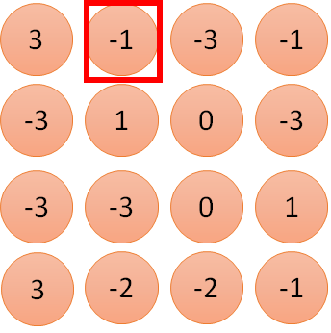
1 | -1 | -1
-1 | 1 | -1
-1 | -1 | 1
1:
1
Filter 1
2:
0
3:
0
3
4:
0
1 | 0 | 0 | 0 | 0 | 1
0 | 1 | 0 | 0 | 1 | 0
0 | 0 | 1 | 1 | 0 | 0
1 | 0 | 0 | 0 | 1 | 0
0 | 1 | 0 | 0 | 1 | 0
0 | 0 | 1 | 0 | 1 | 0
…
7:
0
8:
1
-1
9:
0
10:
0
…
13:
0
6 x 6 image
14:
0
Less parameters!
15:
1
16:
1
Shared weights
Even less parameters!
…

Slide 31
The whole CNN
cat dog ……
Convolution
Max Pooling
Can repeat many times
Fully Connected Feedforward network
Convolution
Max Pooling
Flatten

Slide 32
CNN – Max Pooling
1 | -1 | -1
-1 | 1 | -1
-1 | -1 | 1
-1 | 1 | -1
-1 | 1 | -1
-1 | 1 | -1
Filter 1
Filter 2
3
-1
-3
-1
-1
-1
-1
-1
-3
1
0
-3
-1
-1
-2
1
-3
-3
0
1
-1
-1
-2
1
3
-2
-2
-1
-1
0
-4
3

Slide 33
CNN – Max Pooling
New image
but smaller
1 | 0 | 0 | 0 | 0 | 1
0 | 1 | 0 | 0 | 1 | 0
0 | 0 | 1 | 1 | 0 | 0
1 | 0 | 0 | 0 | 1 | 0
0 | 1 | 0 | 0 | 1 | 0
0 | 0 | 1 | 0 | 1 | 0
Conv
3
0
-1
1
Max
Pooling
3
1
0
3
2 x 2 image
6 x 6 image
Each filter
is a channel

Slide 34
The whole CNN
3
0
-1
1
Convolution
3
1
0
3
Max Pooling
Can repeat many times
A new image
Convolution
Smaller than the original image
The number of the channel is the number of filters
Max Pooling

Slide 35
The whole CNN
cat dog ……
Convolution
Max Pooling
A new image
Fully Connected Feedforward network
Convolution
Max Pooling
A new image
Flatten

Slide 36
Flatten
3
0
1
3
0
-1
1
3
3
1
-1
0
3
Flatten
1
Fully Connected Feedforward network
0
3

Slide 37


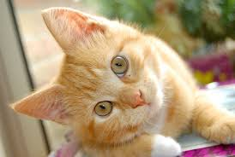
Convolutional Neural Network
Step 1: define a set of function
Step 2: goodness of function
Step 3: pick the best function
Convolutional
Neural Network
“monkey”
0
CNN
“cat”
1
……
“dog”
0
Convolution, Max Pooling, fully connected
target
Learning: Nothing special, just gradient descent ……

Slide 38
CNN in Keras
Only modified the network structure and input format (vector -> 3-D tensor)
input
model_cnn.add(Conv2D(25, (3, 3), input_shape=(28,28,1)))
Convolution
1 | -1 | -1
-1 | 1 | -1
-1 | -1 | 1
-1 | 1 | -1
-1 | 1 | -1
-1 | 1 | -1
There are 25 3x3 filters.
……
Max Pooling
Input_shape = (28 , 28, 1 )
1: black/weight, 3: RGB
28 x 28 pixels
Convolution
model_cnn.add(MaxPooling2D(pool_size=(2,2)))
3
-1
3
Max Pooling
-3
1

Slide 39

CNN in Keras
Only modified the network structure and input format (vector -> 3-D tensor)
input
1 x 28 x 28
Convolution
How many parameters for each filter?
9
25 x 26 x 26
Max Pooling
25 x 13 x 13
Convolution
How many parameters for each filter?
225
50 x 11 x 11
Max Pooling
50 x 5 x 5

Slide 40
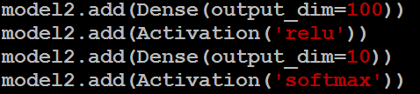
CNN in Keras
Only modified the network structure and input format (vector -> 3-D tensor)
input
1 x 28 x 28
output
Convolution
25 x 26 x 26
Fully Connected Feedforward network
Max Pooling
25 x 13 x 13
Convolution
50 x 11 x 11
Max Pooling
1250
50 x 5 x 5
Flatten

Slide 41
Outline
Intro to Keras (ANN)
Intro to Recurrent Neural Network (RNN)
Intro to Convolutional Neural Network (CNN)
Neural Network with Memory

Slide 42
Variants of Neural Networks
Convolutional Neural Network (CNN)
Recurrent Neural Network (RNN)
Neural Network with Memory

Slide 43

Example Application
Slot Filling
I would like to arrive Aberdeen on November 2nd
ticket booking system
Destination:
Aberdeen
Slot
time of arrival:
November 2nd
Notes:
https://catalog.ldc.upenn.edu/docs/LDC93S4B/corpus.html

Slide 44
Example Application
Solving slot filling by Feedforward network?
Input: a word
Each word is represented as a vector e.g. binary, TF or TFIDF
Aberdeen

Slide 45
1-of-N encoding
How to represent each word as a vector?
1-of-N Encoding
lexicon = {apple, bag, cat, dog, elephant}
The vector is lexicon size.
apple = [ 1 0 0 0 0]
bag = [ 0 1 0 0 0]
Each dimension corresponds to a word in the lexicon
cat = [ 0 0 1 0 0]
The dimension for the word is 1, and others are 0
dog = [ 0 0 0 1 0]
elephant = [ 0 0 0 0 1]
Notes:
Can be very large

Slide 46
Example Application
time of departure
dest
Solving slot filling by Feedforward network?
Input: a word
(Each word is represented as a vector)
Output:
Probability distribution that the input word belongs to the slots
Aberdeen

Slide 47
Example Application
time of departure
dest
arrive Aberdeen on November 2nd
other
dest
other
time
time
Problem?
leave Aberdeen on November 2nd
place of departure not dest
Neural network needs memory!
Aberdeen

Slide 48
Recurrent Neural Network (RNN)
The output of hidden layer are stored in the memory.
store
Memory can be considered as another input.

Slide 49
RNN
The same network is used again and again.
Probability of “arrive” in each slot
Probability of “Aberdeen” in each slot
Probability of “on” in each slot
y¹
y²
y³
store
store
a¹
a²
a³
a¹
a²
x¹
x²
x³
Arrive Aberdeen on November 2nd
Notes:
General idea

Slide 50
RNN
Different
Prob of “leave” in each slot
“Aberdeen” in each slot
Prob of “arrive” in each slot
“Aberdeen” in each slot
y²
……
y²
……
y¹
y¹
store
store
a¹
a²
a¹
a²
a¹
……
a¹
……
x¹
x²
……
x¹
x²
……
leave
Aberdeen
arrive
Aberdeen
The values stored in the memory is different.
Notes:
Output y^{i} depends on x¹, x², …… x^{i}
The same input can have totoally different output.

Slide 51
Of course it can be deep …
y^{t}
y^{t+1}
y^{t+2}
……
……
……
……
……
……
……
……
……
x^{t}
x^{t+1}
x^{t+2}

Slide 52
Learning Target
other
dest
other
0
…
1
…
0
…
…
…
…
0
1
0
0
1
0
y¹
y²
y³
copy
copy
a¹
a²
a³
a¹
a²
W^{i}
x¹
x²
x³
Training
Sentences:
arrive Aberdeen on November 2nd
other
dest
other
time
time
Notes:
General idea

Slide 53


Learning
Backpropagation through time (BPTT)
copy
$$w$$
$$w←w−η∂L∕∂w$$
RNN Learning is very difficult in practice.

Slide 54
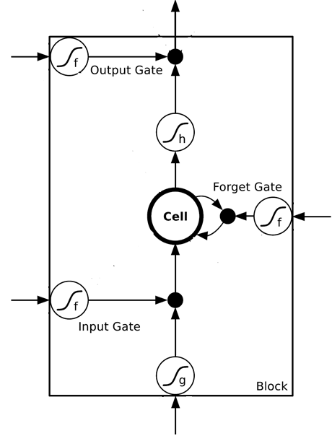
Helpful Techniques
Long Short-term Memory (LSTM)
Can deal with gradient vanishing (not gradient explode)
Don’t worry if you cannot understand this. Keras can handle it.
Memory and input are added
Keras supports
“LSTM”, “GRU”, “SimpleRNN” layers
The influence never disappears unless forget gate is closed
No Gradient vanishing
add
(If forget gate is opened.)
Gated Recurrent Unit (GRU):
simpler than LSTM
[Cho, EMNLP’14]

Slide 55
Many to one
Input is a vector sequence, but output is only one vector
Sentiment Analysis
4
3
Excellent plot, enjoyed it …….
Acting was poor & storyline confusing ...
Definitely recommend this ….
2
1
Positive
Negative
Positive
0
……
Excellent
plot
enjoyed
……
great
movie
☺

Slide 56
Many to Many (No Limitation)
Both input and output are both sequences with different lengths. → Sequence to sequence learning
E.g. Machine Translation (the cat … → le chat …)
Containing all information about input sequence
the
cat
is
black
<EOS>
Notes:
中翻英 英翻中 沒有哪一個一定比較長或比較短

Slide 57
Many to Many (No Limitation)
le
chat
est
noir
…
EOS
……
……
black
<EOS>
Include <SOS> and <EOS>
Notes:
EOS end of sentence
SOS start of sentence

Slide 58
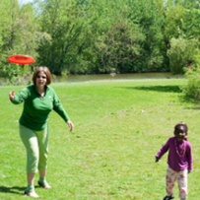
Image Caption Generation
Input an image, but output a sequence of words
[Kelvin Xu, arXiv’15][Li Yao, ICCV’15]
A vector for whole image
a
woman
is
<EOS>
CNN
……
Input image
Caption Generation
Notes:
A woman is throwing a Frisbee in a part.

Slide 59

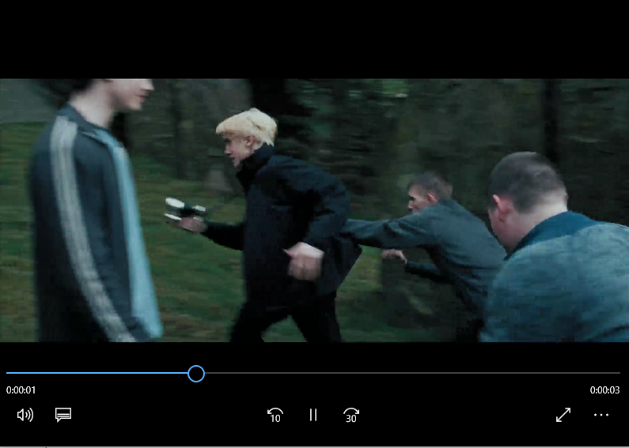
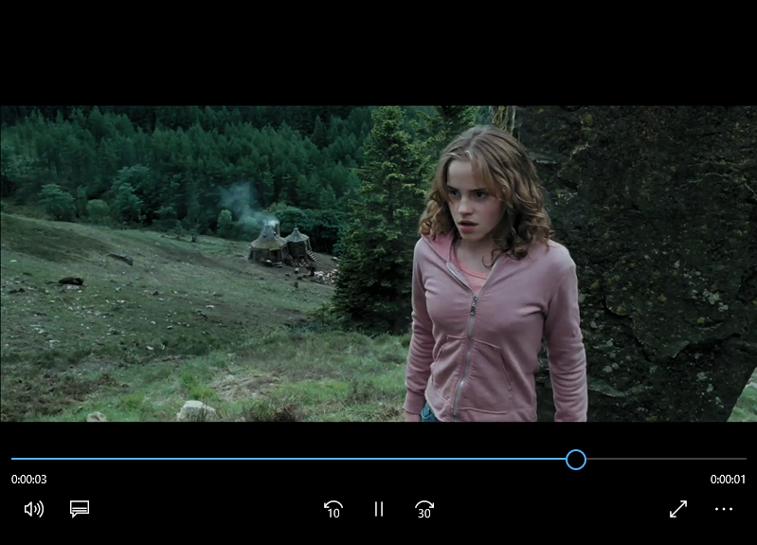

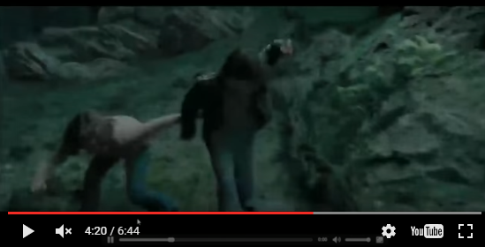
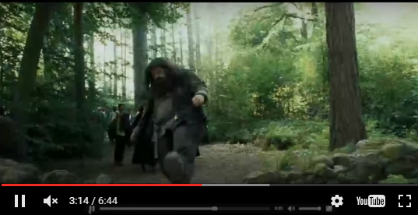
Video Caption Generation
A girl is running.
Video
A group of people knocked by a tree.
A group of people walking in the forest.

Slide 60
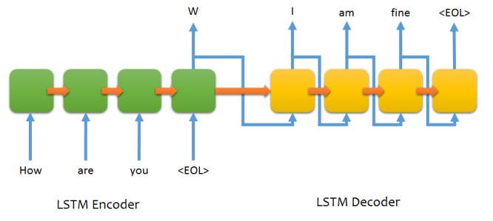
Chat-bot
Requires large collections for training ; results not promising yet
Notes:
Will you build a wall?

Slide 61
Conclusions
Keras provides an easy to use interface with Tensorflow as the back-end
CNN discovers repetitive patterns (conv filters) and exploits sub-sampling to progressively create higher conceptual features
But the deeper the longer the training …
RNNs are neural nets with memory and have transformed the field of NLP
An exciting field to work in…

