Slide 1
k Nearest Neighbour
Advanced Artificial Intelligence CM4107
Week 4
Dr Sadiq Sani

Slide 2
Introduction
All algorithms you have seen so far in this course are parametric
Learn a hypothesis (model) at training time
Hypothesis is defined by a fixed number of parameter values (e.g. weights in ANN)
Number of parameters is independent of number of training instances
Instance based models
Work by comparing new (query) instance with training instances stored in memory
Hypothesis complexity can grow with size of training data

Slide 3
k-Nearest Neighbour (kNN)
Makes prediction based on k closest training instances
Establishes a new local approximation for every new instance
Does not learn a model, simply keep a memory of all training instances
Lazy learner, all work done at test time
Able to easily incorporate new training instances at test time

Slide 4

kNN
All instances correspond to points in m-dimensional space $R^{d}$
$x^{i}=(x_{1},x_{2},x_{3},…,x_{d})$
$x^{i}$: instance, example
$x_{j}$: feature, attribute, descriptor

Slide 5
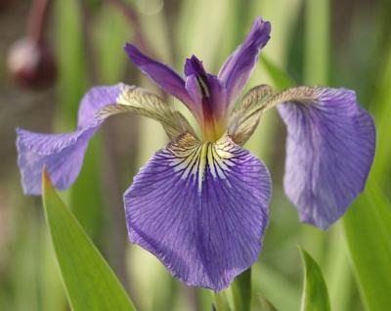
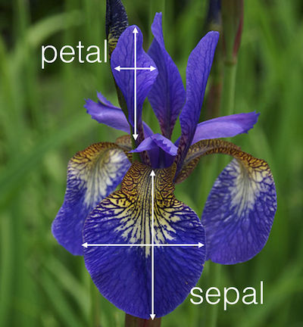
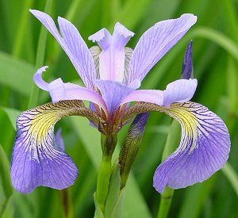
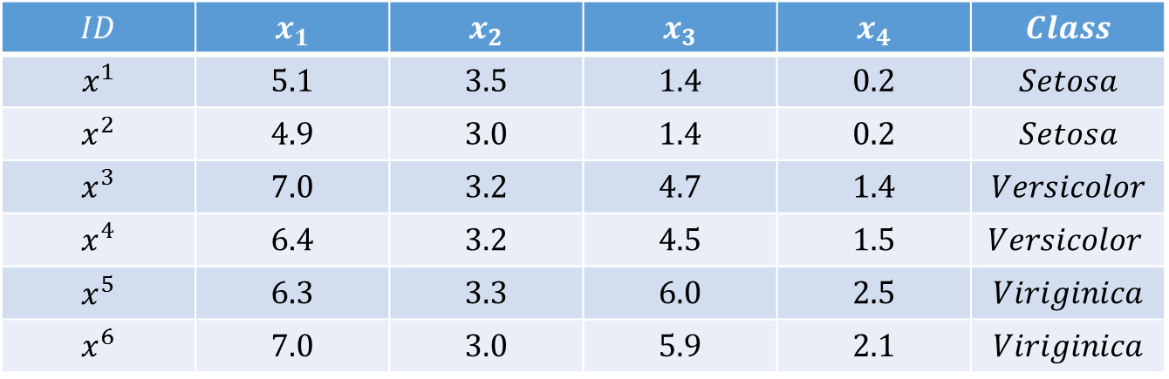
Iris Dataset
Setosa
Versicolor
Virginica
$$ID$$ | $$x_{1}$$ | $$x_{2}$$ | $$x_{3}$$ | $$x_{4}$$ | $$Class$$
$$x^{1}$$ | $$5.1$$ | $$3.5$$ | $$1.4$$ | $$0.2$$ | $$Setosa$$
$$x^{2}$$ | $$4.9$$ | $$3.0$$ | $$1.4$$ | $$0.2$$ | $$Setosa$$
$$x^{3}$$ | $$7.0$$ | $$3.2$$ | $$4.7$$ | $$1.4$$ | $$Versicolor$$
$$x^{4}$$ | $$6.4$$ | $$3.2$$ | $$4.5$$ | $$1.5$$ | $$Versicolor$$
$$x^{5}$$ | $$6.3$$ | $$3.3$$ | $$6.0$$ | $$2.5$$ | $$Viriginica$$
$$x^{6}$$ | $$7.0$$ | $$3.0$$ | $$5.9$$ | $$2.1$$ | $$Viriginica$$

Slide 6
kNN
$$ID$$ | $$x_{1}$$ | $$x_{2}$$ | $$x_{3}$$ | $$x_{4}$$ | $$class$$
$$x^{q}$$ | $$5.7$$ | $$4.4$$ | $$1.5$$ | $$0.4$$ | $$?$$
Setosa
Versicolor
Virginica

Slide 7
kNN Parameters
k: Size of neighbourhood
Similarity/distance metric
Prediction function

Slide 8
k – Size of neighbourhood

Slide 9
k – Size of neighbourhood

Slide 10
k – Size of neighbourhood
1<= k <= N (N=entire training set size)
Optimal value
Accuracy
Accuracy
0
Size of k
N
0
Size of k
N
Accuracy
Accuracy
0
Size of k
N
0
Size of k
N

Slide 11
Optimal choice of k
Highly data dependent
Larger k suppresses noise but makes classification boundaries less distinct
Accuracy
Accuracy
0
Size of k
N
0
Size of k
N
Accuracy
Accuracy
0
Size of k
N
0
Size of k
N

Slide 12
kNN Parameters
k: Size of neighbourhood
Similarity/distance metric
Prediction function

Slide 13
Distance Metrics
Manhattan
Euclidean
Nearest Neighbours

Slide 14

Distance metrics
Manhattan
$$dist\left(x^{q},x^{i} \right)=\sum_{j=1}^{d}{\left|x_{j}^{q}−x_{j}^{i}\right|}$$
Euclidean
$$dist\left(x^{q},x^{i}\right)= \sqrt{\sum_{j=1}^{d}{{\left(x_{j}^{q}−x_{j}^{i}\right)}^{2}}}$$
Minkowski
$${dist\left(x^{q},x^{i}\right)=\left(\sum_{j=1}^{d}{{\left(\left|x_{j}^{q}−x_{j}^{i}\right|\right)}^{p}}\right)}^{1/p}$$

Slide 15

Converting Distance to similairty metric
$$sim\left(x^{q},x^{i}\right)= \frac{1}{dist\left(x^{q},x^{i}\right)+1}$$
$$sim\left(x^{q},x^{i}\right)=\frac{1}{e^{dist(x^{q},x^{i})}}$$

Slide 16
Similarity Metrics
Dot Product/Cosine
Nearest Neighbours

Slide 17

Similarity metrics
Dot product
$$sim\left(a,b\right)= \sum_{i=1}^{m}{a_{i}b_{i}}$$
Cosine
$$sim\left(a,b\right)= \frac{\sum_{i=1}^{m}{a_{i}b_{i}}}{\sqrt{\sum_{i=1}^{m}{a_{i}^{2}}}\sqrt{\sum_{i=1}^{m}{b_{i}^{2}}}}$$

Slide 18
Other Similarity/Distance metrics
Hamming distance: Number of positions at which two strings are different
Applications: Spell check, Genomics
Jaccard: Overlap between sets
Good for categorical features
Employment status, marital status, etc
“slat”
“salt”
Notes:
Examples

Slide 19
kNN Parameters
k: Size of neighbourhood
Similarity/distance metric
Prediction function

Slide 20
Prediction function
Setosa
Versicolor
Virginica

Slide 21
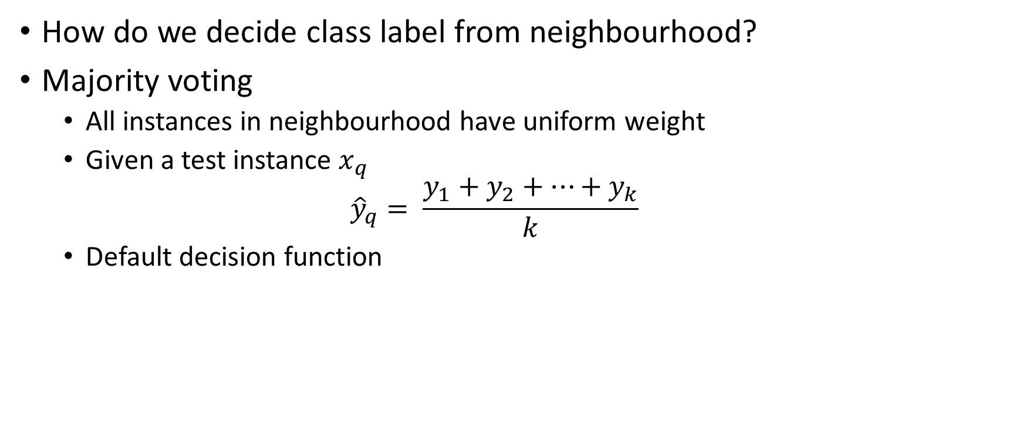
Prediction function
How do we decide class label from neighbourhood?
Majority voting
All instances in neighbourhood have uniform weight
Given a test instance $x_{q}$
$${\hat{y}}_{q}= \frac{y_{1}+y_{2}+…+y_{k}}{k}$$
Default decision function

Slide 22
Prediction function
Is majority vote always right?

Slide 23
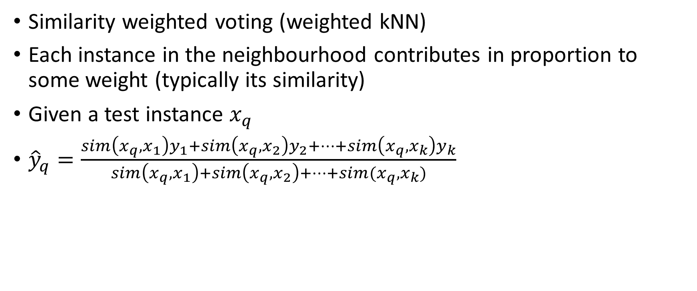
Prediction function
Similarity weighted voting (weighted kNN)
Each instance in the neighbourhood contributes in proportion to some weight (typically its similarity)
Given a test instance $x_{q}$
${\hat{y}}_{q}=\frac{sim\left(x_{q},x_{1}\right)y_{1}+sim\left(x_{q},x_{2}\right)y_{2}+…+sim\left(x_{q},x_{k}\right)y_{k}}{sim\left(x_{q},x_{1}\right)+sim\left(x_{q},x_{2}\right)+…+sim(x_{q},x_{k})}$

Slide 24
Today’s lab: kNN class in Python
class kNN:
def __init__(self, X_train, Y_train, k=3, sim=manhattan, weighted=False):
def get_neighbours(self, test_instance):
def predict(self, neighbours):
def test(self, X_test, Y_test):
- External methods to define similarity metrics
e.g. Manhattan, Euclidean, etc.

Slide 25

Some problems with kNN
Very slow when making prediction
Similarity needs to computed with each instance in training set
Search time complexity $O(nd)$
Easily fooled by irrelevant features

Slide 26

Making kNN efficient
Efficient indexing
k-d (k-dimensional) trees
Binary tree for organising points in k-dimensional space
Invented by Jon Louise Betley in 1975
Reduces search time complexity to $O(\log{n}d)$

Slide 27




























K-d Trees
$$x=\left(x_{1},x_{2}\right)$$
$$\left(1,9\right), \left(2,3\right), \left(4,2\right), \left(3,8\right), \left(5,4\right), \left(9,6\right),\left(6,7\right),\left(7,2\right),\left(7,9\right),(8,8)$$
$$x_{1}≥6$$
$$\left(1,9\right), \left(2,3\right), \left(4,2\right), \left(3,8\right), \left(5,4\right)$$
$$\left(9,6\right),\left(6,7\right),\left(7,2\right),\left(7,9\right),(8,8)$$
$$x_{2}≥4$$
$$x_{2}≥7$$
$$\left(1,9\right), \left(2,3\right), \left(4,2\right)$$
$$\left(3,8\right), \left(5,4\right)$$
$$\left(9,6\right),\left(6,7\right),\left(7,2\right)$$
$$\left(7,9\right),(8,8)$$
$$x_{1}≥2$$
$$x_{1}≥3$$
$$x_{1}≥6$$
$$x_{1}≥7$$
$$\left(1,9\right), \left(2,3\right)$$
$$\left(9,6\right),\left(6,7\right)$$
$x_{2}≥$ 3
$$\left(4,2\right)$$
$$\left(3,8\right)$$
$$\left(5,4\right)$$
$$\left(7,2\right)$$
$$\left(7,9\right)$$
$$(8,8)$$
$$x_{2}≥6$$
$$\left(2,3\right)$$
$$\left(1,9\right)$$
$$\left(9,6\right)$$
$$\left(6,7\right)$$

Slide 28
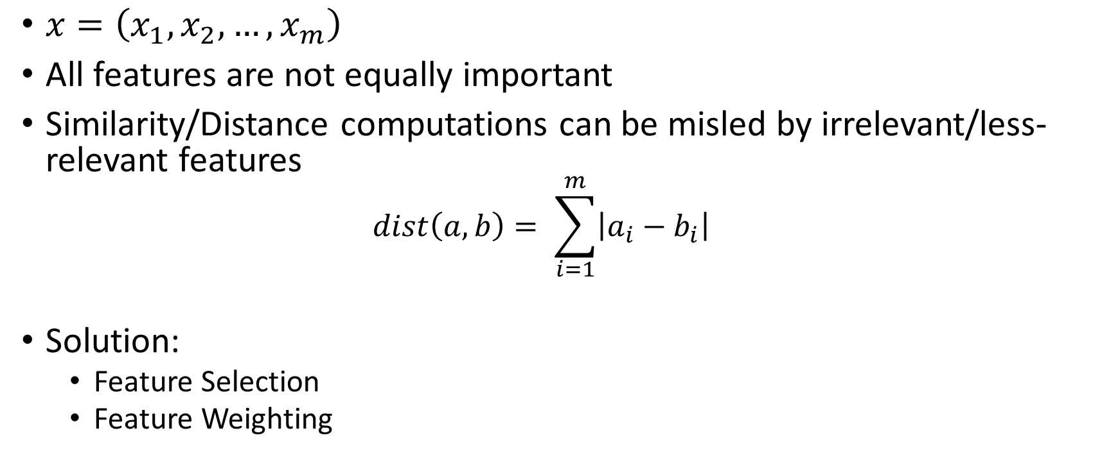
Feature selection/weighting
$x=\left(x_{1},x_{2},…, x_{m}\right)$
All features are not equally important
Similarity/Distance computations can be misled by irrelevant/less-relevant features
$$dist\left(a,b\right)= \sum_{i=1}^{m}{\left|a_{i}−b_{i}\right|}$$
Solution:
Feature Selection
Feature Weighting

Slide 29
Feature Selection
Remove all but top m features
Very effective for high dimensional representations
Can lead to efficiency gains in computation
Wrapper
Discard features based on algorithm performance
Good for removing redundant features
Filter
Discard features that low correlation with class
Less expensive to compute compared with wrapper

Slide 30
Wrapper feature Selection
Forward Addition
Greedy approach
Start with the best feature, continue to add features best out of remaining features so long as performance continues to improve above threshold
Backward elimination
Start with all features, continue to eliminate features so long as performance does not drop below threshold

Slide 31
Filter feature selection
x₃
Good Feature
x₇
x₁₄
x₅
x₂
Bad Feature
x₁₀
x₁
x₄
x₆
…

Slide 32
Filter feature selection
Chi squared
Mutual Information
Information Gain

Slide 33
Feature Selection
Good for high dimensional data
Text classification
Eliminates redundant features
Efficiency gains
Removing features needs to allowed!!!

Slide 34
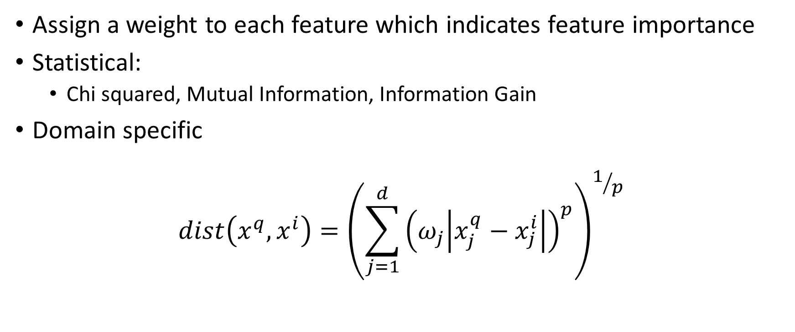
Feature Weighting
Assign a weight to each feature which indicates feature importance
Statistical:
Chi squared, Mutual Information, Information Gain
Domain specific
$${dist\left(x^{q},x^{i}\right)=\left(\sum_{j=1}^{d}{{\left(ω_{j}\left|x_{j}^{q}−x_{j}^{i}\right|\right)}^{p}}\right)}^{1/p}$$

Slide 35
Feature selection/weighting
A lot of manual work to define good features for kNN
Would be automate this process
Metric Learning
Learn good set of data directly from data
Better fit to the dataset
Deep Metric Learning
Neural networks for learning features
Siamese networks
Matching networks

Slide 36
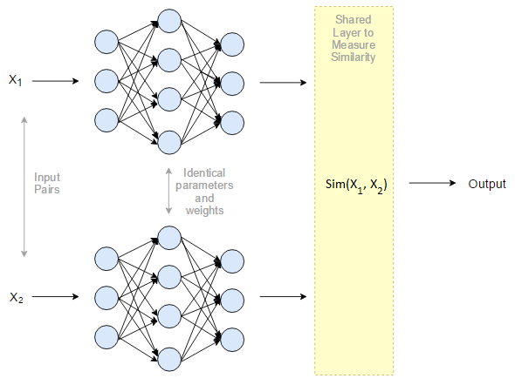
Siamese networks
An architecture made up of two neural networks which share identical weights and parameters.
Input is fed in in pairs of examples.
The individual neural networks develop a feature vector for a member of a pair.
These vectors are then compared to see whether they are ‘impostor’ or ‘genuine’ based upon a threshold.
Backpropagation

Slide 37
Siamese networks

Slide 38
Siamese Networks
Work on pairs of examples at a time
Many problems are multi-class
More convenient to have multi-class solution

Slide 39
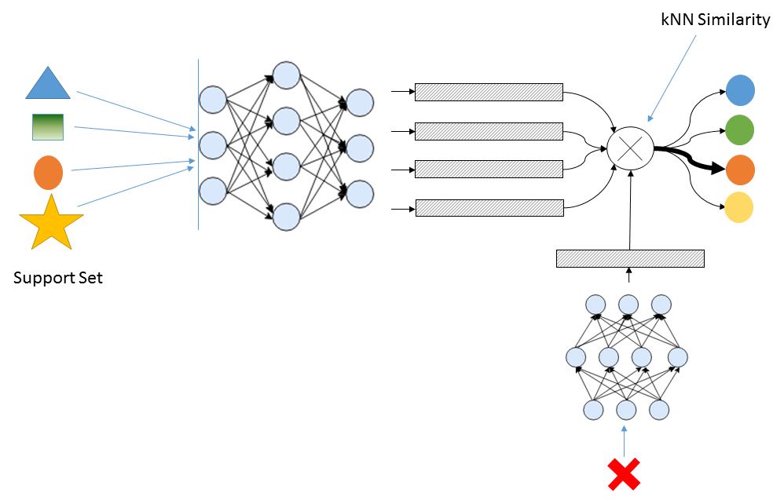
Matching Networks

