Slide 1
Common data for a shared reality - Information extraction from data with statistically enhanced LLMs
Antoine Soetewey & Cédric Heuchenne
Beamm.Conf26, June 30 2026
Notes:
Opening (about 30 seconds). Welcome everyone and thank CAPE and the organisers. Frame the talk around one idea: turning rich but hard-to-use socio-economic data into something that is at once accessible to non-specialists and statistically trustworthy. Be honest from the start that this is work in progress, and that two of the three parts were built by colleagues, a Master's student (Carnot Dongmo Mbane) and a PhD student (Thaddee D'haegeleer); I present on their behalf and credit them as we go. The whole project is supervised by Prof. Cedric Heuchenne. Read the title out loud once.

Slide 2
Rich data, but hard to use…
Belgium and Europe collect large-scale administrative and survey data on key dimensions of socio-economic life:
Income and taxation (IPCAL, EU-SILC)
Labour market and employment (LFS, CBSS)
Housing (EU-SILC, Housing data)
Consumption (HBS)
Mobility (OVG, Beldam, Monitor)
Household finances (HFCS)
Time use (HETUS)
etc.
Data is not public for obvious confidentiality reasons, but Beamm researchers have access under strict confidentiality and data-protection rules
Even with access, it is hard to use:
Variables hide behind opaque names (e.g., HY040G, PL031) and descriptions are in codebooks of 200 to 600 pages
Even with a perfect description for each variable, it would be hard to navigate across all of them, and even more complicated to see associations between them
→ Unlocking this data's full potential requires new tools
Notes:
Motivation (about 1 minute). The aim is to make the audience feel two barriers, not one.
First barrier, ACCESS. These are not open datasets you download. They are confidential research microdata that universities obtain under data-protection agreements (Eurostat and the national statistical institutes for the European surveys, the tax administration for IPCAL). So even a well-posed question has no easy entry point, and the people who could use the data often cannot reach it. I will come back to how a synthetic copy can widen that access.
Second barrier, RELIABILITY. Even once you are inside, naive exploration is risky: with thousands of variables you will always find strong-looking correlations. Some are trivially true (age and being retired), some are spurious (driven by a third variable). So just letting people query the data is not enough; that is the trap the whole project tries to avoid.
This is a public-finance and policy-evaluation audience, so tie it back to them: a shared, reliable factual base supports better-informed debate. Keep the tone modest. Say we are trying to lower these two barriers, not that we have removed them.

Slide 3
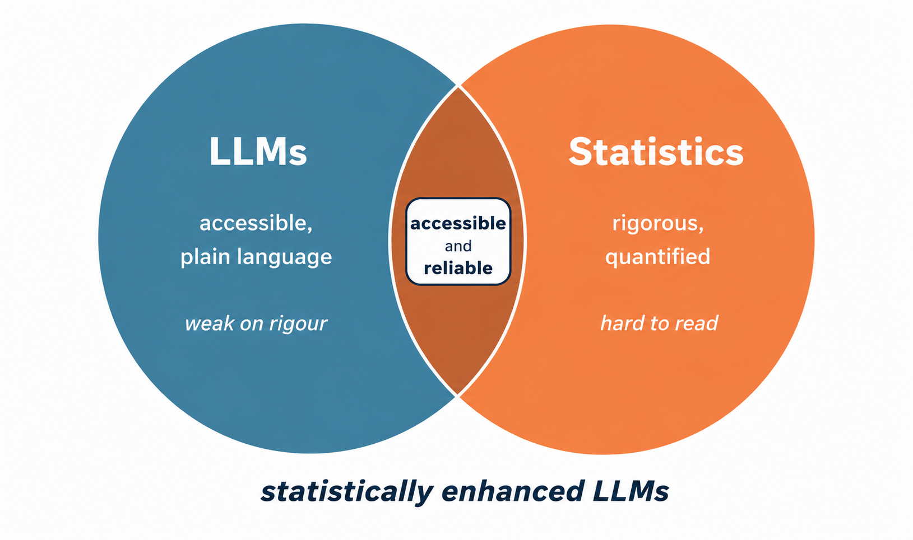
Two halves of a solution
LLMs make data accessible through plain language, but on their own they are unreliable: they can hallucinate, cannot quantify, and may call a trivial association interesting
Statistics are rigorous and quantified, but opaque to a non-technical audience
The project combines the two: statistically enhanced LLMs, for common data and a shared reality
Notes:
The thesis (about 1.5 minutes with the next slide). This is the spine of the talk, so say it slowly.
Make the symmetry explicit. LLMs are excellent at the human-facing side: you ask in plain words and get an answer. But on their own they are unreliable for data work: they invent things, they cannot compute a p-value, and they have no sense of whether an association is statistically real, so they can present something trivial or fake as a great find.
Statistics are the opposite: rigorous and quantified, but to most people a correlation matrix or a multinomial model is a wall.
The claim is not that either side is bad, but that each covers the other's weakness. Put an LLM in front for access and for judging novelty, and put rigorous statistics underneath for reliability. That overlap, accessible and reliable, is what I mean by statistically enhanced LLMs, and it is what gives a shared, trustworthy factual base.
Likely question: is this just an LLM wrapper? Answer: the LLM is only one half; the other half is the statistics layer that decides what is real and what is merely surprising. Keep the tone modest: we think combining them helps.

Slide 4
A three-tool workflow
Notes:
Roadmap (about 1 minute). This single picture is the structure of the whole talk, and I return to it at the end.
Walk left to right. We start with more than 7,000 opaque variables. Tool 1, semantic search, finds the few that are relevant. Tool 2, AssociationExplorer, surfaces, among those, the associations that are statistically strong and also non-obvious. Tool 3, Partial Association Explorer, checks which of those survive once we adjust for confounders. The output is a reliable, shareable data story. Each tool is a separate tool, but they chain into one funnel.
Do the credits clearly here so I do not interrupt later. Tool 1 is the Master's work of Carnot Dongmo Mbane; Tool 2 I develop myself; Tool 3 is the PhD work of Thaddee D'haegeleer; Cedric Heuchenne supervises all three, and Hugues Annoye co-supervises Tool 1. So for Tools 1 and 3 I am presenting colleagues' work.

Slide 5
Tool 1: Semantic search Or how to navigate among variables?
Collaboration with Carnot Dongmo Mbane and Hugues Annoye
7,010
variables across 6 datasets
6 Belgian datasets: EU-SILC (income and living conditions), EU-LFS (labor), HBS (household consumption), HFCS (household finances), IPCAL (tax records), DEMOBEL (demographics)
7,010 variables in total. Codes like HY040G, PL031, A0270 mean nothing without the manual
Documentation is spread across codebooks of 200 to 600 pages, in French, Dutch and English (and with a lot of technical details)
A researcher studying a specific topic has no obvious entry point
200 to 600
pages of codebook each
Notes:
Part 1, the data problem (about 1.5 minutes). This is the foundation slide; it introduces the raw material for the whole talk, so take time and be concrete.
The 6 sources, briefly: EU-SILC (income and living conditions), EU-LFS (labour force), HBS (household budgets), HFCS (household finance and consumption), IPCAL (the Belgian tax-return variables), and DEMOBEL (a socio-fiscal microsimulation model). Together: 7,010 variables. You do not need to memorise the acronyms; the point is the scale and the heterogeneity.
Stress the access point, because I corrected it in this version: these are confidential research microdata, available to universities under data-protection rules, not open data. That is exactly why a synthetic, anonymised copy matters later.
Why it is hard: opaque codes (HY040G is gross rental income, PL031 an activity-status code) whose meaning lives in huge codebooks, in three languages. The corpus is also imbalanced: IPCAL alone is about 76% of all variables, which matters for Tool 1's design (size bias) and is in the appendix.
Anticipated question, are these joinable at the individual level? Honest answer: Tool 1 is about the metadata, finding and describing variables, not yet about merging microdata, which is a separate problem. We unified the variable dictionary, 7,010 entries, into one searchable form.

Slide 6
The solution: Simply ask in plain language
Query the corpus in natural language, instead of memorising codes
Two directions:
Find variables: from a question/topic to the relevant variables (« help you discover »)
Describe variables: from a code to a readable description (« help you understand »)
Screenshot placeholder Gradio interface (insert your capture here)
Screenshot placeholder Gradio interface (insert your capture here)
Notes:
Part 1, the goal and who it serves (about 1 minute). Two ideas: the natural-language interface, and who actually uses it.
The interface is two-way. From a question to variables: I type difficulty paying bills and it returns the matching codes, ranked. From a code to a description: I paste HY040G and get a plain-language explanation. The first helps you discover, the second helps you understand.
On the audience, this is the point I revised. Because the data is confidential, the direct users are researchers (senior and early-career), public administration, policymakers and advisors, and NGOs and engaged citizens, working on the restricted microdata. Journalists and the wider public come in through a different door: a synthetic copy of the data, generated with Wasserstein GANs by Hugues Annoye and Cedric Heuchenne, that reproduces the statistical structure of the population while protecting privacy. That synthetic layer is exactly how you give a shared factual base to people who cannot touch the real records, which is the deeper meaning of common data for a shared reality. There is an appendix slide with the references if anyone asks.

Slide 7
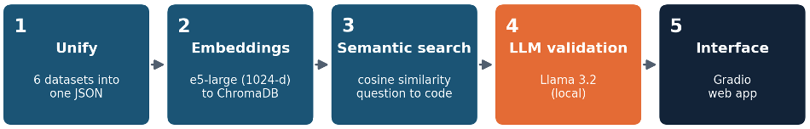
The process: A five-step pipeline
Unify: each dataset has its own format; a per-dataset function maps it into one common JSON dictionary, one record per variable (with code, source, short and long description, category, etc.)
Embeddings: every description becomes a 1024-dimensional vector with multilingual-e5-large (XLM-RoBERTa encoder, ~560M parameters), stored in ChromaDB; similar meanings sit close together, even across languages
Semantic search: the user's question is embedded too, and variables are ranked by cosine similarity (i.e., cosine of the angle between vectors)
LLM validation: a local model (Llama 3.2 via Ollama) reads the top candidates and classifies each as truly relevant, partially relevant, or off-topic, with a short justification
Interface: a Gradio web app ties it together
Notes:
Part 1, the pipeline (about 1.5 minutes). Walk through the five boxes; this is the engine of Tool 1.
1, Unify: each dataset has its own format; a per-dataset function maps it into one common JSON dictionary, one record per variable (code, source, short and long description, category).
2, Embeddings: every description becomes a vector with the multilingual-e5-large model (1024 numbers), stored in a vector database, ChromaDB. I define embedding on the next slide; for now, text becomes a point in space.
3, Semantic search: the user's question is embedded too, and we rank variables by cosine similarity, the cosine of the angle between vectors. This is why it works across languages and across wording.
4, LLM validation: a local model, Llama 3.2, reads the top candidates and says, for each, whether it truly answers the question, is partially relevant, or off-topic, with a short justification.
5, Interface: a Gradio web app ties it together.
The line at the bottom is the engineering point: the five steps are modular, so adding IPCAL and DEMOBEL needed no rewrite, just new sections. That modularity is itself a contribution. If asked why not just use a hosted chatbot, the answer is steps 2 to 4 and the fact that it runs locally, which is the next slide.

Slide 8
Two design choices: RAG, and running locally
Embedding: a piece of text mapped to a vector, so similar meanings sit close together, even across languages
Model: multilingual-e5-large (XLM-RoBERTa encoder, 24 layers, about 560M parameters), 1024-dimensional vectors in a ChromaDB store, ranked by cosine similarity
RAG (Retrieval-Augmented Generation): we do not retrain the model; we retrieve the relevant variables and pass them as context at query time
Why RAG over fine-tuning: a new dataset needs no retraining, the retrieved variables stay visible, and the model invents fewer non-existent codes
Local execution: Llama 3.2 through Ollama; the data never leaves the machine, which matters for confidential records
Notes:
Part 1, the two design choices (about 2 minutes). The most technical slide of Tool 1; give the intuition so a non-specialist follows, and keep the depth ready for specialists.
Embedding: reinforce the one-line definition with a picture. Imagine every variable description placed as a dot in a large space, arranged so that rent income and revenus locatifs and huurinkomen land near each other even with no shared words. The question becomes a dot too, and we return its nearest neighbours. Cosine similarity is how small the angle is; about 0.9 is very close. The model is multilingual-e5-large, an XLM-RoBERTa encoder, which is why French, Dutch and English align.
RAG versus fine-tuning, the distinction examiners like. Fine-tuning retrains the model's weights on our corpus, so it memorises it. RAG leaves the model untouched and feeds it the relevant context at question time. We chose RAG because adding a survey is instant (embed and index, no retraining), it is transparent (you see which variables were retrieved and fed in), and it hallucinates less (the model only talks about variables actually retrieved). Fine-tuning, LoRA on Llama-3-8B, was the earlier plan and is kept as a documented alternative; be clear it was not implemented. The appendix has the comparison table.
Local execution: both the embedder and Llama 3.2 run on the user's machine through Ollama. For confidential income and tax data, not sending anything to an external service is a real advantage. The trade-off, if pushed: a small local model is weaker than a frontier hosted model, and we accept that for privacy. Do not claim no hallucination; say reduced, because retrieval constrains but does not eliminate it.

Slide 9
Two design choices: RAG, and running locally
Fine-tuning means retraining the model on our 7,000 variables so it “memorises” them
RAG (Retrieval-Augmented Generation) works differently: the model never sees our variables during training; instead, when a question arrives, we first search for the most relevant variables (step 3, the retrieval part), then hand them to the model as a note to read before answering (step 4, the augmented generation part)
We started with the fine-tuning approach (LoRA on Llama-3-8B) but moved to RAG because:
adding a new dataset requires no retraining; just embedding and indexing the new variables (faster)
we always know exactly which variables were given to the model (more transparent)
it can only refer to variables we actually gave, not invent codes from an imperfect memory (fewer hallucinations)
Local execution: both the embedder and Llama 3.2 run locally through Ollama; might be weaker than a hosted model, but we accept it in return for:
Price (free)
Privacy (no change in the architecture if confidential metadata is added later)
Notes:
Two design choices (about 2 minutes). The most technical slide of Tool 1; give the intuition so a non-specialist follows.
Start by explaining the difference between fine-tuning and RAG with the exam analogy: fine-tuning is like a student who studies the textbook before the exam and answers from memory; RAG is like an open-book exam, the model has not studied our variables but gets a cheat sheet at the moment of answering.
We started with fine-tuning, specifically LoRA on Llama-3-8B, which partially retrains the model's weights on our corpus. We moved to RAG because it has three concrete advantages: faster to update (just index the new variables), more transparent (you see exactly what was handed to the model), and fewer hallucinations (the model can only refer to what it was given, not invent codes from memory).
For local execution: the current metadata is not itself confidential, so the main reason is that Ollama is free. But running locally also means that if we later add more sensitive metadata, nothing will change in the architecture. The trade-off is that a small local model is weaker than GPT-4; we accept that.
If asked why not just use ChatGPT: cost, privacy, and the fact that RAG with a local model already works well for this task.

Slide 10
Making variables more readable
Codebook labels are often too short and/or technical to give good search results
A second loop generates a long, plain-language description for each variable
Two generators: a rule-based one (instant, always available) and an LLM one (richer, with a worked example)
These enriched descriptions are used as inputs for step 2, making the semantic search much more effective
Notes:
Part 1, descriptions, in progress (about 1 minute). Flagged as work in progress on purpose; present it as unfinished.
The problem: even after you find a variable, its official description is written for survey specialists (HY040G: income from rental of a property or land, gross). So a second loop rewrites each variable as a long, friendly paragraph: what it measures, a concrete example, how to use it, what to watch for.
Two generators on purpose. The rule-based one detects language, guesses the variable type and unit, and assembles a structured paragraph; it needs no model, so it is instant and always works, the safety net. The LLM one (Llama 3.2) is richer, adding a realistic example and caveats, but is slower and can occasionally fail, in which case we fall back to the rule-based text. So every variable always has a usable description.
Be candid about status: the loop is still running over all 7,010 variables; the most advanced is EU-LFS (about 105 of 155 done at the time of the progress note). Early length and quality indicators look good, but there is no formal user validation yet. If asked how good they are, say promising, not yet evaluated.
The grey box is where I drop a live screenshot of the Gradio app before the talk. A short live demo is possible if the laptop is set up, otherwise the screenshot is safer.

Slide 11
Tool 2: AssociationExplorer From variables to associations
We now have a shortlist of relevant variables
Which of them are actually related, and which links deserve a closer look?
AssociationExplorer fills this gap:
Computes associations of every pair among the selected variables
But also: every pair between the selected variables and the rest of the data to highlight unexpected associations
First, how do we actually compute associations?
Notes:
Transition into Part 2 (about 1 minute). From here on I am on home ground, since I built this part, so I can be more relaxed and take questions live.
The logic: Tool 1 narrowed 7,000 variables to a relevant handful, but relevant is not the same as related. AssociationExplorer takes that shortlist and computes the association of every pair, and also against the rest of the data, so a strong link to an unselected variable can still appear.
It builds on our published Shiny app, but this newer version adds the surprise judge I will show in a few slides. Next slide: how we measure association when a variable can be a number or a category.

Slide 12
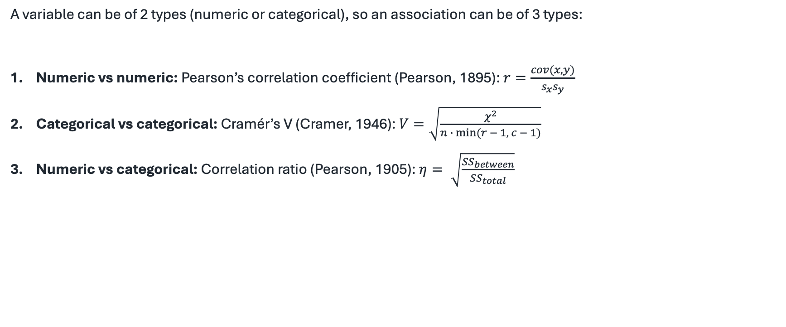
Three measures depending on variable type
A variable can be of 2 types (numeric or categorical), so an association can be of 3 types:
Numeric vs numeric: Pearson’s correlation coefficient (Pearson, 1895): $r=\frac{cov(x, y)}{s_{x}s_{y}}$
Categorical vs categorical: Cramér’s V (Cramer, 1946): $V=\sqrt{\frac{χ^{2}}{n ∙ min⁡(r − 1, c − 1)}}$
Numeric vs categorical: Correlation ratio (Pearson, 1905): $η= \sqrt{\frac{{SS}_{between}}{{SS}_{total}}}$
Notes:
Part 2, the three measures (about 2 minutes). Audience is mixed, so lead with the problem, then give the precise measures and their tests for the specialists.
Problem: a dataset mixes numbers (income, hours) and categories (region, education). No single classic correlation works for every pair, so we pick the right tool per pair type and the matching significance test. Two numbers: Pearson r, tested with the usual t-statistic. Two categories: Cramer's V, derived from the chi-square test of independence. A number against a category: the correlation ratio eta-squared, reported as an ANOVA adjusted R-squared and tested with the F-statistic.
The trick that makes them comparable: express each as proportion of variance explained, r-squared, V-squared, adjusted R-squared. A 0.20 of one type then means the same as a 0.20 of another, so we can rank one mixed list and draw a single network over mixed variable types.
Two details worth saying: we still show the raw r with its sign, because direction matters, even though we rank on r-squared; and adjusted R-squared is deliberately conservative, penalising categories with many levels so they do not look strong by accident. Define Cramer's V out loud, the grey line, since many will not know it.

Slide 13
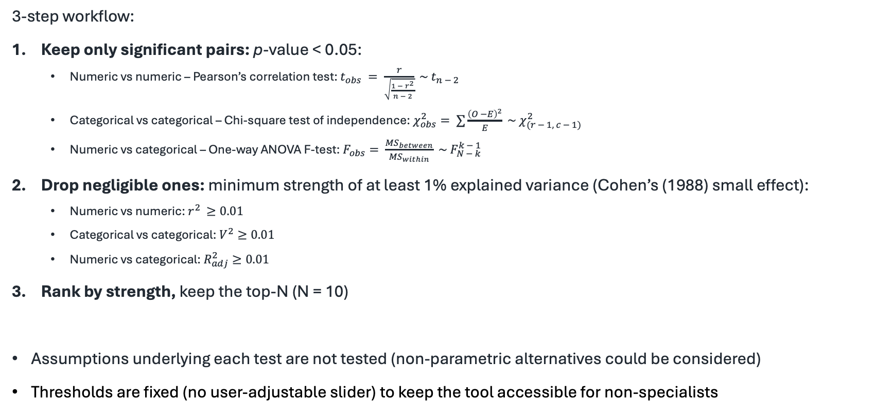
From all pairs to the interesting few
3-step workflow:
Keep only significant pairs: p-value < 0.05:
Numeric vs numeric – Pearson’s correlation test: $t_{obs} = \frac{r}{\sqrt{\frac{1 − r^{2}}{n − 2}}} \sim t_{n − 2}$
Categorical vs categorical – Chi-square test of independence: $χ_{obs}^{2}= ∑\frac{{\left(O −E\right)}^{2}}{E} \sim χ_{(r − 1, c − 1)}^{2}$
Numeric vs categorical – One-way ANOVA F-test: $F_{obs}= \frac{{MS}_{between}}{{MS}_{within}} \sim F_{N − k}^{k − 1}$
Drop negligible ones: minimum strength of at least 1% explained variance (Cohen’s (1988) small effect):
Numeric vs numeric: $r^{2 }≥0.01$
Categorical vs categorical: $V^{2}≥0.01$
Numeric vs categorical: $R_{adj}^{2}≥0.01$
Rank by strength, keep the top-N (N = 10)
Assumptions underlying each test are not tested (non-parametric alternatives could be considered)
Thresholds are fixed (no user-adjustable slider) to keep the tool accessible for non-specialists
Notes:
Part 2, selection (about 1.5 minutes). Short and mechanical; the interesting idea is the next slide.
Two filters then a cap. Significance: discard anything with p at or above 0.05, which could be noise. Strength floor: even a real association can be too weak to matter, so we drop everything below about 1% explained variance, Cohen's small-effect convention, applied consistently across the three metrics (absolute r at least 0.10, V at least 0.10, adjusted R-squared at least 0.01). Then we rank what remains by strength and keep the top ten.
On the design choice: this version selects automatically, with no sliders. I frame that as a feature, not a limitation: it keeps the tool simple for non-specialists and makes the output reproducible, the same data gives the same shortlist, rather than depending on where someone drags a slider. Segue: but strength alone is the wrong ranking for finding a story, which is the next slide.

Slide 14
An LLM as a judge
A statistically significant (via the p-value) and strong (via the strength) association is not always an interesting association, if it is expected (e.g., age and retirement, education and salary)
So we add another perspective: surprise
An LLM (mistral-medium-latest, via Mistral API) receives the two variable descriptions and association type (but not the statistical strength nor the data to avoid being biased); it reasons before scoring (better performance), then assigns two sub-scores:
How documented is this association in the scientific literature? (0 = well established, 1 = rarely studied)
How theoretically plausible is it? (0 = fully expected, 1 = surprising)
The semantic surprise score is the average of the two
Finally, journalistic interest = (semantic) surprise × (statistical) reliability, with reliability = −log₁₀(p) / (−log₁₀(p) + 3) (grows without saturating, so it still separates very small p-values)
The product is high only when an association is both surprising and statistically solid; the ideal candidate for a story
The LLM judges novelty, the statistics judge reliability
As a bonus: for each pair, an automatic reflection lead proposes hypotheses to explore as « food for thoughts »:
With the observed data (correlation, mean by group, association strength, etc.)
But without concluding or claiming causality
Notes:
Part 2, the surprise judge (about 2.5 minutes). The new contribution of Tool 2, so give it room.
The insight: statistical strength and being interesting are different. Age and retirement are almost perfectly associated, but no editor wants that story. Ranking by strength alone surfaces the obvious, so we add a second axis, surprise.
How: an LLM, Mistral, reads only the two variables' descriptions and scores semantic surprise from 0 to 1, the average of two sub-scores, how well documented the link already is in the literature, and how theoretically plausible or expected it is. The model is told to ignore the statistical strength and the data when scoring surprise, so a strong number does not bias it.
Then we combine the two worlds: journalistic interest equals semantic surprise, from the LLM, times statistical reliability, from the p-value (the formula on the slide grows without saturating, so it still separates very small p-values). The product is high only when an association is both surprising and statistically solid, the ideal candidate for a story. That product is statistically enhanced LLMs in miniature: the LLM judges novelty, the statistics judge reliability.
Finally, for each pair the system writes a short reflection lead: it states the strength, leans on the surprise sub-scores, and proposes hypotheses, explicitly without concluding or asserting causation.
Anticipated push-back: is an LLM judging surprise subjective or hallucination-prone? Be honest: it is a heuristic judgement, we constrain it (two defined sub-scores, calibration examples, it shows its reasoning), and reliability is anchored in a real p-value. It guides attention; it does not certify truth. This is also where journalist interviews shaped the design.

Slide 15
Seeing the structure
An association network: nodes are variables, edges are associations; closer nodes mean stronger links
Click an edge for a bivariate view: scatterplot with an OLS line (num vs num), mean plots (num vs cat), coloured contingency tables (cat vs cat)
Edge opacity proportional to journalistic interest
Screenshot placeholder Association network (insert your capture here)
Notes:
Part 2, visualisation (about 1.5 minutes). Mostly show and tell; the grey box is where I drop a real screenshot of the network before the talk.
The network is the overview: each dot is a variable, each line an association; stronger associations pull dots closer, so clusters stand out. It is for spotting structure, not precise reading.
Click a line to drill into a pair, and the app picks the right plot from the variable types: a scatter with a fitted OLS line for two numbers, a mean plot for a number across categories, a colour-coded contingency table for two categories (blue where a combination occurs more than expected under independence).
Plant the hook for the next slide: some lines are darker than others. Opacity is not strength, it is journalistic interest, the genuinely new idea I am about to explain. If I demo live, click one obvious pair and one surprising pair to contrast.

Slide 16
Tool 3: Partial Association Explorer Strong and surprising, but is it real?
Collaboration with Thaddée D’haegeleer
A strong, significant association can still be an artefact.
Confounder: a third variable that influences both, for example age, education or region.
Example: a link between two income variables may simply reflect education or age.
A marginal association says nothing causal, so we add a more careful screening step.
Notes:
Transition into Part 3 and the confounding problem (about 1.5 minutes). Back to presenting a colleague's work, Thaddee's PhD, so I lean on these notes. Take it slowly; confounding is the concept of Part 3.
Story so far: we have associations that are strong and surprising. The uncomfortable question: are they real, or an illusion? The classic trap is the confounder, a third variable that drives both sides, creating an association between two things that are not directly linked. The textbook image is ice-cream sales and drownings, both driven by summer heat.
Define confounder plainly, as on the slide: a background variable influencing both sides. Here the usual suspects are age, education, region, household type. For the running example, two income variables may look strongly associated, but both are downstream of education; adjust for education and the link may shrink or vanish.
Land the key sentence: a marginal, unadjusted association tells you nothing about causation and can be an artefact. So before anyone writes that X drives inequality, we want a screening step that asks whether it survives adjustment. That is Tool 3. Manage expectations now and repeat at the end: this is still not causal inference, just a more careful layer of exploration.

Slide 17
The idea: adjust for chosen controls
Pick control variables Z, then recompute each association between X and Y after adjusting for Z.
Partial association: the link that remains once the effect of the controls is removed, by residualising on Z.
This separates links that hold up from those that were really driven by a confounder.
Same workflow, with and without controls, so the two can be compared directly.
Notes:
Part 3, the solution, intuition (about 1.5 minutes). Still Thaddee's work; keep it conceptual but precise.
The move is simple to state: the user chooses background variables to hold constant, the controls Z (age, education, region), and the tool recomputes each association after removing the influence of Z. What remains is the partial association, the part of the relationship not explained by the controls.
Intuition for adjusting: within groups that are similar on Z, do X and Y still move together? If yes, the link holds up; if it collapses, it was largely the confounder. Technically this is done by residualising, regressing on Z and keeping the leftovers, which the next slide makes precise for each variable type.
Key interface point: it is the same workflow and the same pair plots with and without controls, you just switch the controls on, which makes the before and after comparison direct. If asked how Z is chosen: by the user, from subject knowledge, which is also the limitation, results depend on which controls you pick. Be upfront about that.

Slide 18
One idea, three data types
Numeric vs numeric: partial correlation r(XY·Z), the correlation of residuals from X on Z and Y on Z; t-test on n−q−2 degrees of freedom; strength = r².
Numeric vs categorical: partial η² by ANCOVA, comparing the reduced model Y on Z with the full model Y on X plus Z (extra sum of squares); global F-test.
Categorical vs categorical: a likelihood-ratio measure V_L = √(1 − exp(−G²/n)) with G² = 2(ℓ₁ − ℓ₀); conditional V_L|Z fits a structured multinomial-logit model, so controls may be continuous or categorical.
Filtering: on effect size and on the p-value, in both the marginal and the conditional case.
Marginal measures become conditional ones by adjusting for Z. Full formulas in the appendix.
Notes:
Part 3, the three conditional measures (about 1.5 minutes). The heaviest machinery in the talk. Give the intuition out loud and let the slide and appendix carry the formal detail; do not read equations aloud.
One idea, adjust for Z, realised three ways because the variable types differ, mirroring Part 2.
Two numbers: marginal is Pearson r, conditional is partial correlation. Regress X on Z and Y on Z, take the residuals, what Z could not explain, and correlate those; the t-test loses q extra degrees of freedom for the q controls.
Number versus category: marginal is eta-squared, conditional is partial eta-squared by ANCOVA. Compare a reduced model with the controls only against a full model with controls plus the grouping, and measure the extra variance the grouping explains, the extra sum of squares; an F-test gives the p-value.
Two categories: Thaddee's most novel piece. Marginal is V_L, a 0 to 1 measure built from a likelihood-ratio statistic, a Linfoot or Cox and Snell type transformation, an information-based cousin of Cramer's V; conditional is V_L given Z, the same construction after fitting a multinomial-logit model that includes the controls. The advantage over old log-linear methods: controls can be continuous or categorical without chopping them into bins.
Ready for specialists: why not Poisson log-linear? Because continuous controls would force arbitrary discretisation and sparse tables; the multinomial-likelihood approach uses controls as regressors instead. Every measure is filtered on both effect size and p-value. If the room is non-technical, compress to: partial correlation, partial eta-squared, and a likelihood-ratio measure, each in a with-controls version.

Slide 19
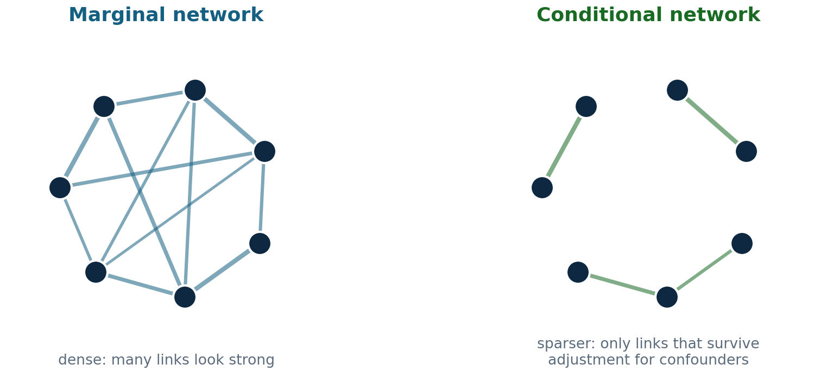
Networks before and after adjustment
Screenshot placeholder App: marginal vs conditional (insert your capture here)
Not causal inference: a more cautious, transparent screening layer that shows where deeper modelling is worth it.
The visual question: which edges persist, which fade?
Notes:
Part 3, the payoff visual (about 1.5 minutes). The image people remember from Tool 3, so sell the contrast.
Left: the marginal network, dense, many strong-looking links. Right: the conditional network after adjusting for the chosen confounders, much sparser. The story is the difference: links that survive adjustment are the ones worth pursuing; links that fade were largely the confounder. So instead of asking only whether X and Y are associated, the user asks whether they are still associated once we account for age, education and region, a more responsible question for working with public data.
The grey box is where I drop a real before and after screenshot from Thaddee's app; the schematic on the left conveys the idea until then.
Say the limitation out loud, twice if needed: this is not causal proof. Conditional associations depend on which controls you chose and on the models being reasonable; sparse categorical tables and rare categories can make estimates fragile. The honest framing: a transparent screening layer that shows where more formal modelling is warranted. With this audience, that candour is a strength.

Slide 20
The full funnel, end to end
Tool 1: a plain-language question returns the relevant income and inequality variables
Tool 2: strong and non-obvious associations are highlighted and ranked by interest
Tool 3: only the associations that survive adjustment for age, education and region are kept
Common data for a shared reality: a factual base that is at once accessible to non-experts and statistically defensible.
Notes:
Synthesis (about 1.5 minutes). Bring the three Tools together and restate the thesis.
Re-run the example as one sentence per tool: our researcher asked about income inequality (Tool 1 found the variables), saw which associations were strong and non-obvious (Tool 2 ranked them by interest), and kept only those that held up after adjusting for age, education and region (Tool 3 screened out the confounded ones). What comes out the narrow end is a short list of relationships that are accessible to explain and statistically defensible.
Read the blue bar as the closing thesis: accessible because of the LLM front end, defensible because of the statistics underneath, that is common data for a shared reality. The three tools are separate today but designed to chain into one pipeline. Keep it humble: a promising direction, not a finished system.

Slide 21
What works, what is still open
Working today: the search pipeline over 7,010 variables; AssociationExplorer with the surprise judge; Partial Association Explorer with conditional measures.
Early user feedback: interviews with journalists informed the design of AssociationExplorer (Part 2), which we adapted accordingly.
Preliminary or in progress: the description loop is still running; Tool 1's evaluation metrics need recomputing; the Part 2 and Part 3 manuscripts are drafts.
Not yet, stated plainly: no broad user study yet, and none of this is causal inference.
Next: recompute Tool 1's metrics, integrate the three tools into one flow, and widen access through the synthetic-data layer.
Notes:
Limits and perspectives (about 1.5 minutes). Tone matters as much as content: modest and candid. This audience trusts honesty.
Working: the end-to-end search over 7,010 variables, the association explorer with the surprise judge, and the conditional association tool all run.
User feedback, the point I corrected: we did interview journalists and used their feedback to adapt AssociationExplorer, so user input has already shaped Part 2. I just do not yet have a broad, structured study.
Preliminary: the description loop is still processing; the Tool 1 numbers (similarity about 0.74, MRR about 0.42, recall at 10 about 0.53, in the appendix) predate two changes and must be recomputed, so I present them as outdated, not as results; and the Part 2 and Part 3 papers are drafts. Not yet: no broad user study, and, say it plainly, no causal inference at any step. Next: recompute Tool 1's metrics, stitch the three tools into one flow, and open access through the synthetic data. End on openness to feedback; this is the right room for it.

Slide 22
Thank you!
Questions?
Notes:
Close (about 15 seconds, then questions). Thank the audience and the organisers and invite questions. If a technical question comes up I have back-up slides: RAG versus fine-tuning, embeddings and ChromaDB, the Part 2 formulas, the Part 3 formulas, the synthetic-data references, and the note on evaluation metrics. Contact: antoine.soetewey@uliege.be. The question window is about ten minutes (the 11:30 to 12:10 slot).

Slide 23
Appendix: RAG vs fine-tuning
Criterion | RAG (used) | Fine-tuning (not implemented)
Principle | Model unchanged, dynamic retrieval | Partially retrain the model weights
Set-up cost | Low, no training | High: GPU, training time, expertise
Add a dataset | Immediate: embed and index | Costly: a new training cycle
Transparency | High: retrieved variables are visible | Low: knowledge diffused in weights
Hallucination | Reduced: answers from real variables | Possible: may invent plausible but fake codes
Status here | Operational on 6 datasets (7,010 vars) | Documented alternative (LoRA, Llama-3-8B)
Notes:
Back-up. The comparison from the progress note. RAG was chosen for transparency and for adding datasets without retraining; fine-tuning (LoRA on Llama-3-8B) stays a documented, not implemented, alternative, and the rich descriptions from Tool 1 could later serve as its training corpus.

Slide 24
Appendix: embeddings and retrieval
multilingual-e5-large: XLM-RoBERTa encoder, 24 layers, about 560M parameters; the [CLS] vector summarises each text; contrastive training on about 1 billion multilingual pairs.
Prefixes: indexed texts use passage:, user questions use query:, which aligns short questions with longer descriptions.
Store: ChromaDB with cosine similarity; relevant matches usually score 0.85 to 0.93.
Collections: seven, one per dataset plus a unified one over all 7,010 variables.
Size bias: IPCAL is about 76% of the corpus; an early hybrid weighting was removed in favour of plain cosine.
Notes:
Back-up. Detail on the retrieval layer for a specialist: how the semantic search works, why it is multilingual, and how the IPCAL size imbalance was handled (hybrid weighting tried, then dropped for plain cosine).

Slide 25
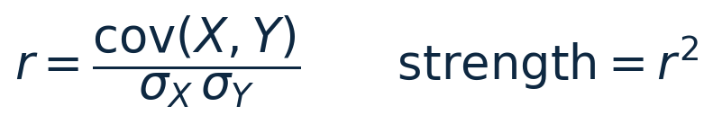
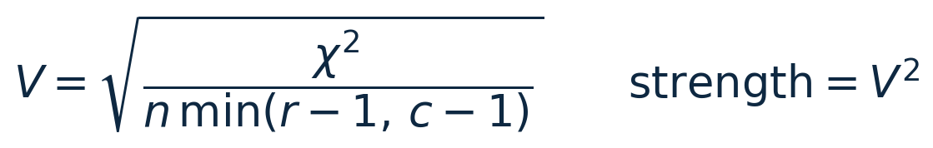
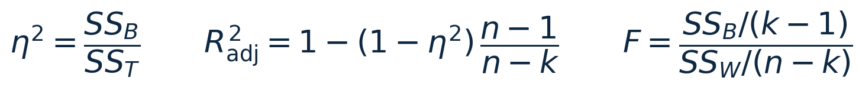
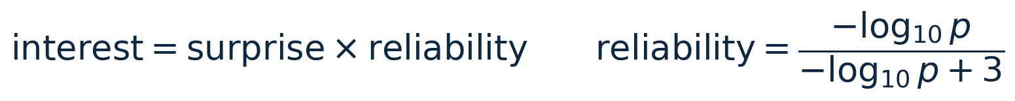
Appendix: Part 2 measures
Numeric vs numeric (Pearson)
Categorical vs categorical (Cramer's V)
Numeric vs categorical (ANOVA)
Journalistic interest
Notes:
Back-up. Exact Part 2 formulas. n is the number of observations, k the number of categories, r and c the rows and columns of the contingency table. The reliability curve grows without saturating, so it still separates very small p-values.

Slide 26
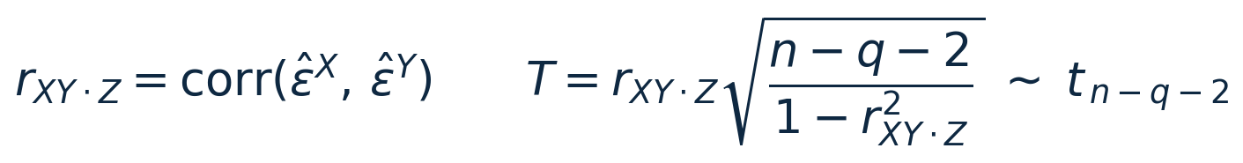
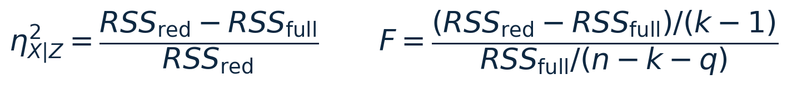
Appendix: Part 3 conditional measures
Numeric vs numeric: partial correlation
Numeric vs categorical: partial eta-squared (ANCOVA)
Categorical vs categorical: likelihood-ratio measure
Notes:
Back-up. Exact Part 3 formulas. q is the number of controls, RSS the residual sum of squares, and the script-l terms are maximised log-likelihoods. V_L is a Linfoot or Cox and Snell type transformation of the likelihood-ratio statistic, an information-based cousin of Cramer's V; the conditional V_L given Z reuses the same construction after adjusting for Z.

Slide 27
Appendix: a note on evaluation metrics
An early evaluation (20 annotated questions) gave mean similarity about 0.742, MRR about 0.417, recall at 10 about 0.533.
These predate two changes: removing the hybrid weighting, and extending from 4 to 6 datasets.
They must be recomputed on the current system, so treat them as preliminary, not final.
Notes:
Back-up and honesty slide. If asked for hard numbers on Tool 1, show this and stress that the figures are outdated, measured before the weighting was removed and before IPCAL and DEMOBEL were added. Recomputing them is a priority, not a finished result.

Slide 28
Appendix: widening access with synthetic data
The six datasets are confidential research microdata, not open to the public.
Wasserstein GANs generate a synthetic copy that reproduces the statistical structure of the population while protecting privacy (tested on the Belgian Labour Force Survey).
This synthetic layer can widen access to journalists, students and citizens without exposing real records.
References: Annoye, Heuchenne and co-authors, Applied Intelligence (2025), Knowledge-Based Systems, and Expert Systems with Applications.
Notes:
Back-up. This is the confidentiality answer and the link to the wider public. The GAN work is by Hugues Annoye and Cedric Heuchenne and co-authors: Wasserstein GANs that learn to generate synthetic socio-economic survey data preserving the population structure while protecting individual privacy. It is what makes common data for a shared reality realistic for users who cannot access the confidential microdata.

