Slide 1
WEB SCRAPING
AND
DATA ANALYTICS
TO FIND
KEY INSIGHTS

Slide 2
WEB SCRAPING
Data collection via the Skytrax website.
Compiling over a thousand rows of different company customer reviews.
Focused on different customer targets, their reviews and whether or not they recommend the service they received.

Slide 3
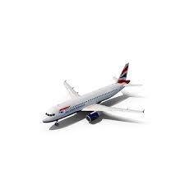
KEY INSIGHTS
Who recommends us according to the target
2. Which target rate us better.

Slide 4
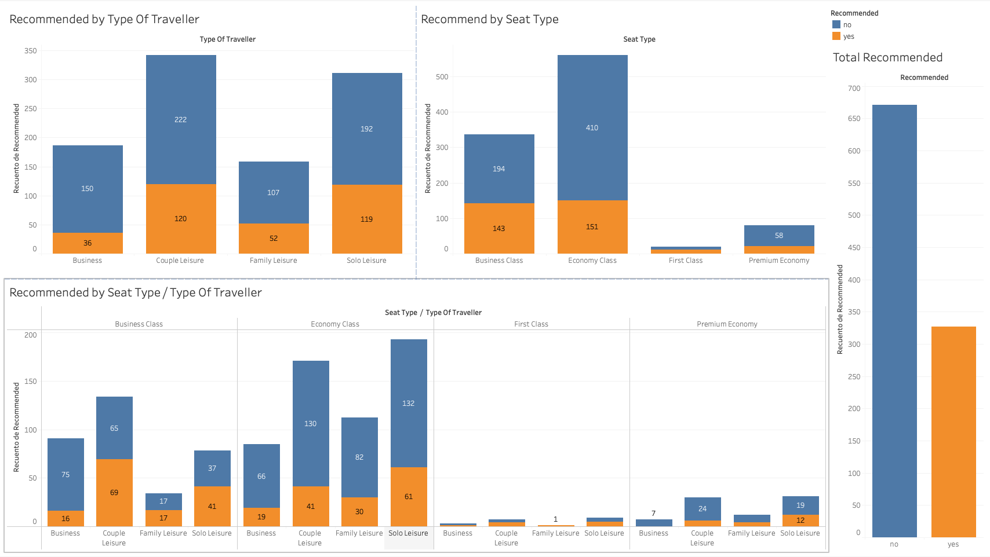

Slide 5
INSIGHTS 1 (Summary)
There is a clear majority that would not recommend our services, which is worrying for the company.
Business class has the highest recommendation ratio, while economy class has the lowest (closely followed by premium economy class).
Clearly, referral rates are more optimal for leisure travel than for business travel. (perhaps the mood of the customer makes the difference)

Slide 6
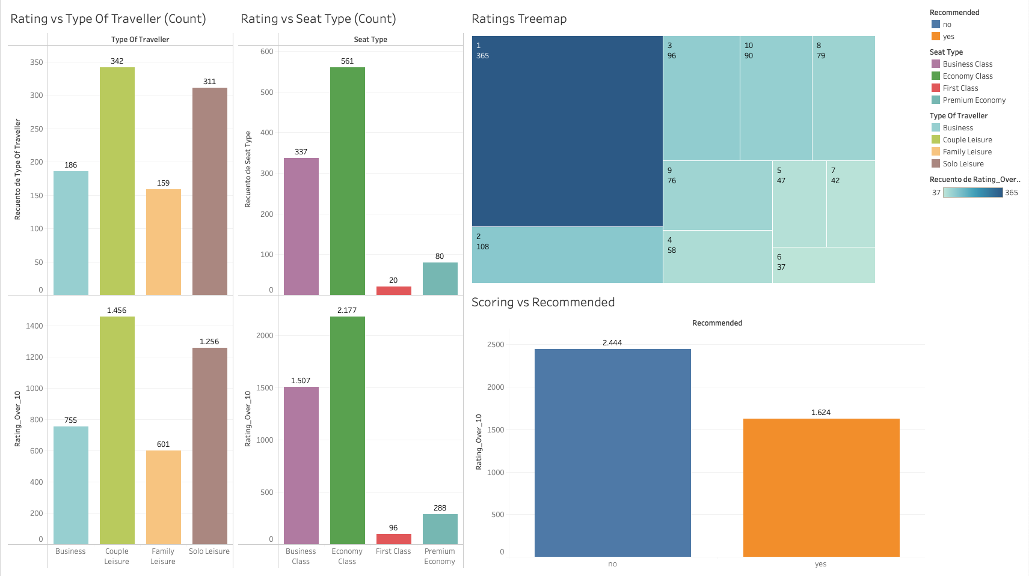

Slide 7
INSIGHTS 2 (Summary)
The most commonly used rating is 1, followed by low extremes and then high extremes, indicating that the people who rate are not usually neutral.
We can see a proportional increase in business class ratings while we see the opposite effect in the economy class.
As the majority of our clients do not recommend our services, it is from this sector that we receive the highest number of ratings (we can understand that people send more reviews when they are dissatisfied).

Slide 8
Thanks Everyone.
to view the graphs in higher quality:
https://public.tableau.com/app/profile/antonio.terr.n.carrasco/viz/BritishAirwaysJobSimulation/Historia1?publish=yes

