Slide 1



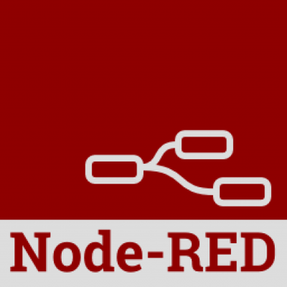

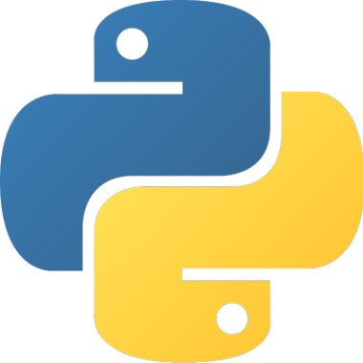

USER
CLOUD
EXTERNAL
IBM CLOUD
WATSON VISUAL RECOGNITION
USER
MESSENGER
NODE-RED
API
PYTHON
WATSON ASSISTANT

Slide 2


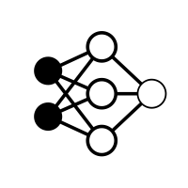
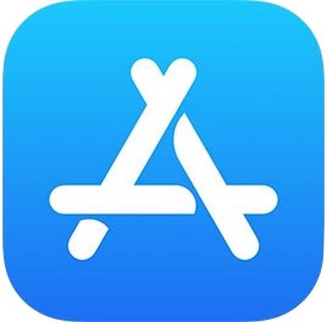
USER
CLOUD
EXTERNAL
DATABASE
MARKETPLACE
ESTIMATION NEURAL NETWORK
EXTERNAL DATABASE
USER
APP
SERVER
WATSON VISUAL RECOGNITION
WATSON ASSISTANT
API
PYTHON

