Slide 1
Software Engineering Aspects
Ian Welch
Ian.welch@ecs.vuw.ac.nz
2015 Wellington SDN Workshop

Slide 2
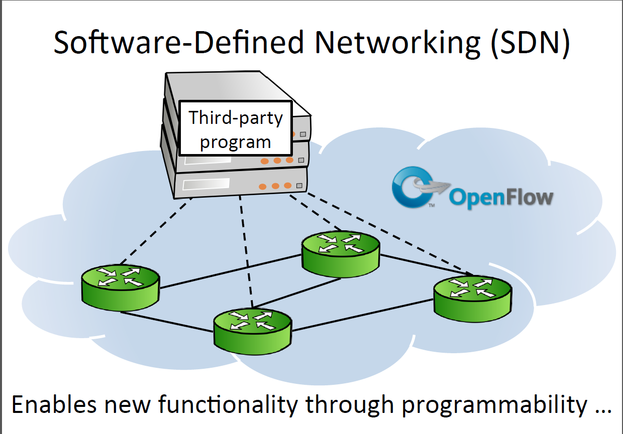
Slide from [1]
Notes:
We have been hearing today about how software defined networking will change our life.

Slide 3
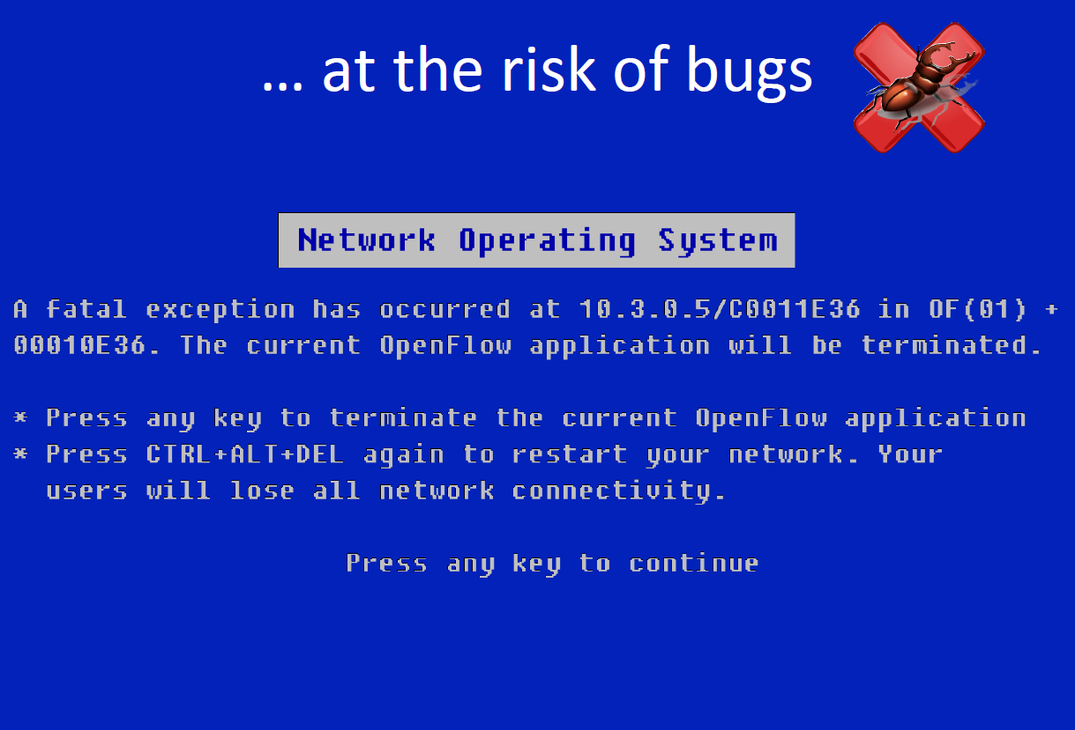
Slide from [1]
Notes:
Unfortunately it is inevitable that all code will have bugs, this is actually the case already when people make misconfiguration errors but things could be much much worse.

Slide 4
Example: pyswitch
Consider pyswitch (NOX distribution)
Only 98 lines of code, what could go wrong?
NICE automated bug finder found three software flaws missed despite testing by the developers.
Notes:
Our first application is the pyswitch software included in the NOX distribution (98 LoC). The application implements MAC learning, coupled with flooding to unknown destinations, common in Ethernet switches. Realizing this functionality seems straightforward (e.g., the pseudo-code in Figure 3), yet NICE automatically detects three violations of correctness properties.
Host unreachable after move --- under some subtle circumstances where a host moves from location to another, the controller is not informed and there is no rule change
Delayed direct path – in another case, where a rule installed for communicating A->B there is no rule for B->A is installed until B returns a packet to A, this is okay but suboptimal given that TCP connections from A->B imply B will want to talk back to A
Excess flooding – where we have a cycle in the network we get

Slide 5
Why so hard?
Human factors, to err is human.
Program does not execute in isolation.
Data-plane driven i.e. packet content can change controller behaviour (think QoS applications)
Complex network behaviour i.e. event ordering (packet arrivals, topology changes) affect program behaviour.
Race conditions can arise (inconsistencies between controller’s view and actual switch state).
LOTS AND LOTS OF STATE THAT AFFECT PROGRAM EXECUTION!
Notes:
Key issues: large space of switch state, large input space (applications are dataplane driven, the packet contents drive controller behaviour, large space of event ordering (packet arrivals, topology changes can occur at any time, rules can be installed at any time).
Race condition can arise where controller tells the switch to install a rule but this is delayed or doesn’t take place before a packet that should be matched arrives at the controller.

Slide 6
Software Engineering
Programmable networks may be buggy.
But so are conventional ones.
Programmability means that you can use software engineering techniques to build more reliable networks than previously.
Network engineers need to be aware of these approaches.

Slide 7
Non-exhaustive list of approaches
Write tests for the SDN applications:
Hand-crafted tests (unit tests)
Automated test generation (black-box specification-based, white-box source code based, example-based fuzzing)
Interactive debuggers (gdb but for networks)
Domain-specific languages (first-class abstractions, declarative, use of compilers).

Slide 8
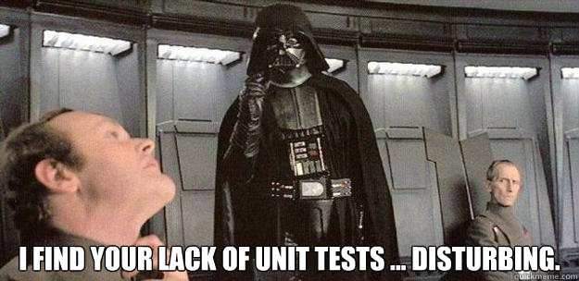
Unit tests
Focus in the smallest testable parts of the application.
Ideally write the tests (expected behaviour) as you go along.
Run the test as part of the compilation process.
Frameworks exist for python, has been applied to controllers (Ryu).
Writing unit tests should be basic good practice.
Notes:
Unit testing is a software development process in which the smallest testable parts of an application, called units, are individually and independently scrutinized for proper operation. Unit testing is often automated but it can also be done manually.
Researchers have still discovered bugs in code where unit testing is used.
Not suprising given the data-drive nature and complex environment, a programmer cannot craft unit tests that have complete coverage of conditions that might lead to the discovery of a bug.

Slide 9
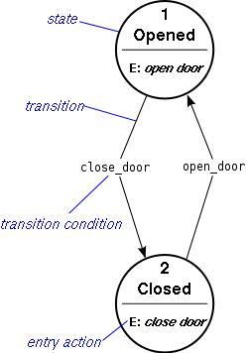
Automated test generation
1. Specify the expected behaviour (finite state machine) (see [2])
Tests = executable paths
Generate unit tests that exercise these paths
Problem: building the specification in the first place
2. Extract a specification from code (see [1]):
Problem: very detailed models can lead to too many tests
Notes:
Idea here is to analyse

Slide 10
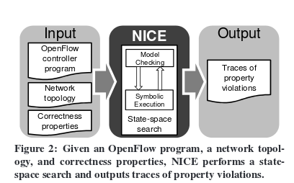
NICE tool (2012)
Correctness conditions -- safety (something bad never happens) and liveness (eventually something good happens).
Trace allows you to identify what led to correctness being violated
Found 11 mostly design bugs in 3 real applications.
Download and use it! http://code.google.com/p/nice-of/
Practical approach, showed can work with real programs (98LOC, 378LOC and 1209LOC).
All about automation so can use compute resources to run many different scenarios.
Notes:
Made practical through application of symbolic execution, set of heuristics and simplified models of hosts and switches.
Used to analyse pyswitch (98 LOC), web balancer (1209 LOC), energy efficient network manager (378 LOC).
NICE [7] took 30 hours to model check a network with two switches, two hosts, the NOX MAC-learning control program (98 LoC), and five concurrent messages between the hosts.

Slide 11
Automated test generation
3. Fuzz testing (see [3]):
Generate invalid input (from specifications or based upon examples of real inputs).
Can be used in a black-box manner.
Specify invariants (“loss of connectivity”, “access control violations”).
Violation of an invariant indicates a bug, output is a trace of the inputs leading to failure .
Used by commercial developers of production controllers.
Problem: Tedious process to analyse the trace because includes irrelevant inputs.
Notes:
Idea here is to analyse

Slide 12
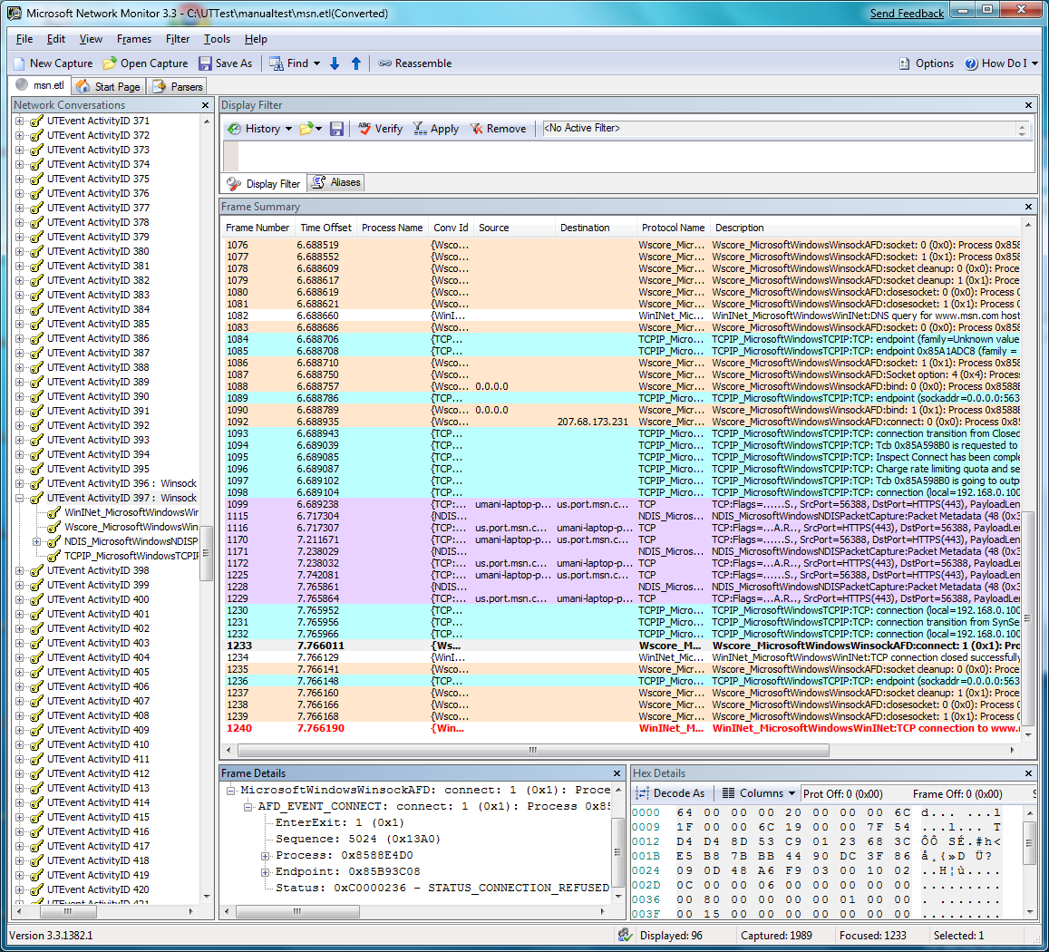
SDN Troubleshooting System (2014)
Finding the root cause requires ignoring irrelevant events.
SDN Troubleshooting System (STS) [3]automates finding a minimum set of events.
Applied to five production controllers (code agnostic).
Significant reduction in size of traces
1500 events to 2 events.
Note focus isn’t bug finding (fuzzing does that), more diagnosis.
Notes:
Isolate minimal trace of inputs that causes a given failure i.e. only include those inputs that cause the bug and remove irrelevant ones.
Reduces the work done by analysts, establishes minimal set of tests (makes re-testing more scalable).
Scott et. al. (2014) developed such as system and applied to five production controllers.
Showed significant reduction in size of traces (for example, 1500 events to 2 events).
Coverage depends upon quality of the original fuzz testing (unlike whitebox approach of model-based testing) but much more scalable than model checking approach (i.e. minutes to model a network with 2000 switches)

Slide 13
Interactive Debugger (2012)
Most IDEs support interactive debugging.
ndb – debugger for SDN applications [4]
Breakpoint:
Filter (header, switch)
Backtrace:
Path of flow taken by packet
State of flowtable at each switch
Implementation doesn’t require changes to switches but does introduce extra traffic.
Limited to OpenFlow 1.0.
Notes:
Can be used debug reachability problems (A cannot talk to B, set a breakpoint A->B to look all traffic sent to B and how it arrives there, in test case was able to identify corruption), isolation problems (A shouldn’t be able to talk to B, breakpoint on receiving a packet from A and inspect how it go there).
Also race conditions.

Slide 14
Domain Specific Languages
Language for expressing solutions to problems in a specific domain.
Example: make, lex, bison, yacc, regexp …
Choose abstractions that are more expressive than base language.
Embed in existing language (Pyretic – extends python, composition of modules together, enhanced reuse of code that has already been tested) [6]
Create a new language (Fat tire 2013 – regexp) [5]
Declarative DSLs compile down into implementations (less error prone).
Example SQL-like language used by Frenetic project, programmer concentrates on what rather than how [6].
Compiler technology used here to achieve the how.
Advantages: reuse, automation, portability.
Notes:
What is the problem?
Why is it hard to write software defined network applications that are reliable?

Slide 15
Summary
Programmable networks vulnerable to bugs due to programming or design errors that can bring down your network.
But because programmable we can apply software engineering techniques to avoid, find or prevent these bugs from leading to failure.
Possibly this might even lead to more reliable networks than non-SDN ones because lack of tools for existing systems to catch configuration errors
Notes:
What is the problem?
Why is it hard to write software defined network applications that are reliable?

Slide 16
Sources
[1] M. Canini, D. Venzano, P. Pereˇs ́ıni, D. Kostic, and J. Rexford. A nice way to test openflow applications. In Presented as part of the 9th USENIX Symposium on Networked Systems Design and Implementation (NSDI 12), pages 127–140, San Jose, CA, 2012. USENIX. Slides: https://www.usenix.org/conference/nsdi12/technical-sessions/presentation/canini
[2] Model Based Black-Box Testing of SDN Applications J Yao, Z Wang, X Yin, X Shi, J Wu, Y Li CoNEXT, 2014 - dl.acm.org
[3] C. Scott, A. Wundsam, B. Raghavan, A. Panda, A. Or, J. Lai, E. Huang, Z. Liu, A. El-Hassany, S. Whitlock, H. Acharya, K. Zarifis, and S. Shenker. Troubleshooting blackbox sdn control software with minimal causal sequences. In Proceedings of the 2014 ACM Conference on SIGCOMM, pages 395–406. ACM, 2014. http://ucb-sts.github.com/experiments
[4] Nikhil Handigol, Brandon Heller, Vimalkumar Jeyakumar, David Maziéres, and Nick McKeown. 2012. Where is the debugger for my software-defined network?. In Proceedings of the first workshop on Hot topics in software defined networks (HotSDN '12). ACM, New York, NY, USA, 55-60.
[5] Mark Reitblatt, Marco Canini, Arjun Guha, and Nate Foster. 2013. FatTire: declarative fault tolerance for software-defined networks. In Proceedings of the second ACM SIGCOMM workshop on Hot topics in software defined networking (HotSDN '13).
[6] Nate Foster, Michael J. Freedman, Arjun Guha, Rob Harrison, Naga Praveen Katta, Christopher Monsanto, Joshua Reich, Mark Reitblatt, Jennifer Rexford, Cole Schlesinger, Alec Story, and David Walker. Languages for software-defined networks. IEEE Communications Magazine, 51(2):128-134, 2013
Notes:
Our first application is the pyswitch software included in the NOX distribution (98 LoC). The application implements MAC learning, coupled with flooding to unknown destinations, common in Ethernet switches. Realizing this functionality seems straightforward (e.g., the pseudo-code in Figure 3), yet NICE automatically detects three violations of correctness properties.
Host unreachable after move --- under some subtle circumstances where a host moves from location to another, the controller is not informed and there is no rule change
Delayed direct path – in another case, where a rule installed for communicating A->B there is no rule for B->A is installed until B returns a packet to A, this is okay but suboptimal given that TCP connections from A->B imply B will want to talk back to A
Excess flooding – where we have a cycle in the network we get

