Slide 1
Software Defined Networks 101
Bryan Ng and Ian Welch,
Victoria University of Wellington
10 February 2016

Slide 2
Talk
Problems with traditional networks
What is SDN and how it helps
Openflow SDN
Example: Firewalls
Switches and Controllers
Hands on Session

Slide 3
Traditional network architecture
Heriarchial tiers of ethernet switches connect hosts to form local area networks (layer 2)
Local area networks connected by routers (layer 3)
Organisations use gateways (layer 3) to connect to their Internet providers.
Assumes static network perimeters, limited client and server mobility.

Slide 4
Traditional network node: Router
Changing protocols is hard, monolithic implementation, vendor specific protocols
Adjacent Router
Router
Adjacent Router
Management/Policy plane
Configuration / CLI / GUI
Routing
Control plane
Control plane
Static routes
s
OSPF
OSPF
OSPF
Neighbor table
Link state database
IP routing table
Switching
Data plane
Data plane
Data plane
Forwarding table
Shamelessly copied from ONF© , J Rexford and Chao HC with permissions.

Slide 5
Changing assumptions
Data centre:
servers appear and disappear (essentially are mobile)
Bring your own devices:
traditional network control is coarse grained, need fine-grained control
cannot rely on fixed perimeters of control
Cloud computing and big data:
we can scale compute, want to be able to scale bandwidth as well

Slide 6
Subsequent problems
Static nature of networks make it difficult to adapt to changing mobility.
Diversity of network devices and ways to configure them make it hard to enforce system wide policies.
Can no longer rely on overprovision to cope with increased dynamic bandwidth requirements.
Monolithic architectures cannot innovate faster than the three year standard product cycle.
Notes:
Static nature of network prevents adaption to changing traffic, application and user demands.
Device-specific configuration mechanisms make enforcing system wide policies leading security breaches, non-compliance with regulations etc.
Scaling is difficult because cannot assume oversubscription and static traffic patterns.
Network operators want to make changes faster than the three year standard product cycle.

Slide 7
Talk
Problems with traditional networks
What is SDN and how it helps
Openflow SDN
Example: Firewalls
Switches and Controllers
Hands on Session

Slide 8
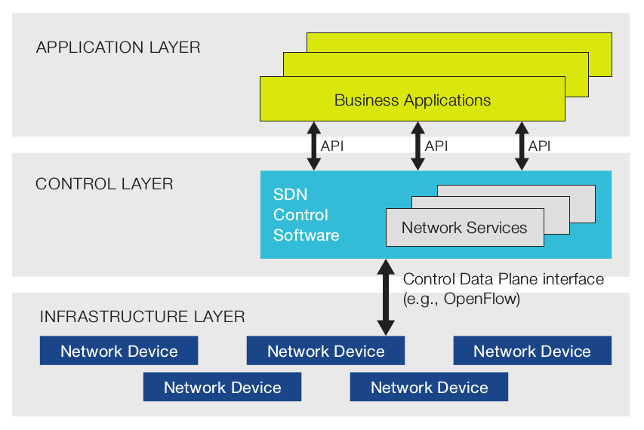
Software Defined Networking
Figure from ONF White Paper: Software Defined Networking – The New Norm for Networks (2011)
Notes:
Static nature of network prevents adaption to changing traffic, application and user demands.
Device-specific configuration mechanisms make enforcing system wide policies leading security breaches, non-compliance with regulations etc.
Scaling is difficult because cannot assume oversubscription and static traffic patterns.
Network operators want to make changes faster than the three year standard product cycle.

Slide 9
Software Defined Networking
Separate the different concerns in a network
Figure from ONF White Paper: Software Defined Networking – The New Norm for Networks (2011)
Notes:
Static nature of network prevents adaption to changing traffic, application and user demands.
Device-specific configuration mechanisms make enforcing system wide policies leading security breaches, non-compliance with regulations etc.
Scaling is difficult because cannot assume oversubscription and static traffic patterns.
Network operators want to make changes faster than the three year standard product cycle.

Slide 10
Software Defined Networking
Applications deal with abstract logically centralised network view
Decides where packets should be forwarded (proactively or reactively)
Data plane does processing and forwarding (per packet)
Figure from ONF White Paper: Software Defined Networking – The New Norm for Networks (2011)
Notes:
Static nature of network prevents adaption to changing traffic, application and user demands.
Device-specific configuration mechanisms make enforcing system wide policies leading security breaches, non-compliance with regulations etc.
Scaling is difficult because cannot assume oversubscription and static traffic patterns.
Network operators want to make changes faster than the three year standard product cycle.

Slide 11
Potential benefits
Directly programmable network (decoupling allows control logic to be changed independently of forwarding hardware).
Agile network (can reprogramme network flow to meet needs).
Centrally managed (allowing optimal choices).
Programmatically configured (allow system-wide enforcement of policies).
Open standards-based and vendor-neutral (avoiding vendor tie-in)
Notes:
Directly programmable: Network control is directly programmable because it is decoupled from forwarding functions.
Agile: Abstracting control from forwarding lets administrators dynamically adjust network-wide traffic flow to meet changing needs.
Centrally managed: Network intelligence is (logically) centralized in software-based SDN controllers that maintain a global view of the network, which appears to applications and policy engines as a single, logical switch.
Programmatically configured: SDN lets network managers configure, manage, secure, and optimize network resources very quickly via dynamic, automated SDN programs, which they can write themselves because the programs do not depend on proprietary software.
Open standards-based and vendor-neutral: Whenimplemented through open standards, SDN simplifies network design and operation because instructions are provided by SDN controllers instead of multiple, vendor-specific devices and protocols.

Slide 12
SDN varieties
Openflow SDN
Vendor X SDN
Network functions virtualisation
NetFPGA-based SDN
Hybrid SDN solutions

Slide 13
Talk
Problems with traditional networks
What is SDN and how it helps
Openflow SDN
Example: Firewalls
Switches and Controllers
Hands on Session

Slide 14
Origins of OpenFlow
Desire for clean slate experimentation.
Manufacturers opening up forwarding behaviours.
Broader number of manufacturers wanting to innovate.
Openflow standardised API (Open Networking Foundation) for controlling forwarding behaviour of switches.
Unifies a broad range of network devices (routers, learning switches, NATs …).
Notes:
Led to agreement amongst openflow

Slide 15
OpenFlow Versions
Openflow 1.0 allowed initial experimentation.
Subsequent versions (1.1, 1.2, 1.3, 1.4 and 1.5) have added extra capabilities:
IPv6
Multiple tables (goto)
Managing full tables
Following examples are version 1.0
Notes:
Led to agreement amongst openflow

Slide 16
OpenFlow Switch
Performs packet lookup and forwarding
Flow 1.
Rule
(exact & wildcard)
Action
Statistics
Flow 2.
Rule
(exact & wildcard)
Action
Statistics
Flow 3.
Rule
(exact & wildcard)
Action
Statistics
Flow N.
Rule
(exact & wildcard)
Default Action
Statistics
Figures from Chao HC & Y. Liang with permissions.
Notes:
<number>
<number>

Slide 17
Flow Entry (OF 1.x)
A flow entry consists of
Match fields
Match against packets
Action
Modify the action set or pipeline
processing
Stats
Update the matching packets
1. Packet
2. Byte counters
Match Fields
Action
Stats
In Port
Src MAC
Dst MAC
Eth Type
Vlan Id
IP Tos
IP Proto
IP Src
IP Dst
TCP Src Port
TCP Dst Port
Layer 2
Layer 3
Layer 4
Forward packet to port(s)
Encapsulate and forward to controller
Drop packet
Send to normal processing pipeline
Modify MAC and IP addresses
Figures from Chao HC & Y. Liang with permissions.

Slide 18
Example Table
Switch
Port
MAC
src
MAC
dst
Eth
type
VLAN
ID
IP
Src
IP
Dst
IP
Prot
TCP
sport
TCP
dport
Action
*
*
00:1f:..
*
*
*
*
*
*
*
port6
port3
00:20..
00:1f..
0800
vlan1
1.2.3.4
5.6.7.8
4
17264
80
port6
*
*
*
*
*
*
*
*
*
22
drop
More exact matches have priority.
Table miss sends packet to controller over secure TLS connection.
Table entries have idle and hard timeouts.
O-65,535 seconds (0 = no timeouts).

Slide 19
Switch → Controller
PACKET_IN:
Rule not found in table.
Encapsulated packet (metadata).
FLOW_REMOVED:
Due to timeout or controller driven removal.
PORT_STATUS:
Port events.
<number>

Slide 20
Controller → Switch
Modify switch state:
Add, remove and modify entries.
Read statistics:
Flow tables, ports and individual flow entries.
Barriers:
Synchronisation primitives.
<number>

Slide 21
Controller → Switch
Modify switch state:
Add, remove and modify entries.
Read statistics:
Flow tables, ports and individual flow entries.
Barriers:
Synchronisation primitives.
<number>

Slide 22
Talk
Problems with traditional networks
What is SDN and how it helps
Openflow SDN
Example: Firewalls
Switches and Controllers
Hands on Session

Slide 23
Example: Firewalls
Context here is a campus or small enterprise network.
Examples in SDN session about traffic shaping.
Here focus on implementing a firewall (why? honours project completed last year, illustrates some tradeoffs and was a learning exercise for us).
<number>

Slide 24
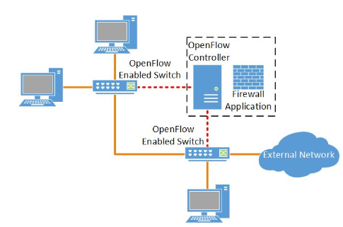
Example: Access Control
Implement time-based access ACLs within a network.
Firewall application.
Administrator uses simple policy language to specify rules.
Enforced globally across organisation.
<number>

Slide 25
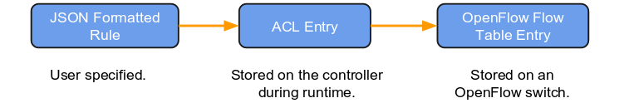
Example: Access Control
Policy translation to flow table entry.
only allow specific source and destination endpoints
drop all other flows
Proactive distribution of rules (avoid the slow path).
Housekeeping when new switches appear and disappear.
<number>

Slide 26
Example: Access Control
Add in time into the equation (consider schools).
Timeout range not sufficient to express desired constraints.
Controller proactively removes flow table entries.
Question: what would effect of propagation delay be in a larger organisation? Inconsistency across switches?
<number>

Slide 27
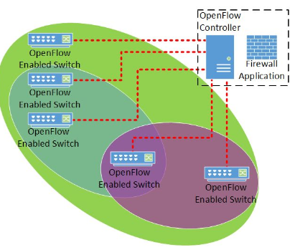
Example: Access Control
We decided to enforce rules in the core.
Does that make sense? Why waste table space?
Defined a policy language to group switches in shared policy domains.
<number>

Slide 28
Example: Access Control
Implemented in software and tested using mininet.
Mininet is a network emulator allowing topologies to be created made up of openflow switches, controllers and hosts.
Didn't test using a real switch (other students have done that) and this would be part of any extension.
<number>

Slide 29
Example: Access Control
Use SDN to manipulate flow rules according to policy definitions.
Pseudocode ~
User connect and attempt to send pkts
No policy ... .... Send to controller
Controller looksup policy DB ... he’s our CTO ... super user
Install flow rules for CTO ...
May want to log his info?
<number>

Slide 30
Talk
Problems with traditional networks
What is SDN and how it helps
Openflow SDN
Example: Firewalls
Switches and Controllers
Hands on Session

Slide 31
OpenFlow Switches
Openflow switches are widely deployed in big organisations and are reliable (Google, Microsoft, ESnet etc.)
We use mininet/ovs for classes (no need for hardware) but that is different from experience of real equipment.
We use cheaper or borrowed equipment and there is a lot evolution is going on.
Can mean that things don't work as expect or there are limits of performance.
More generally, some parts of specifications are optional so you need to be aware of this!
<number>

Slide 32
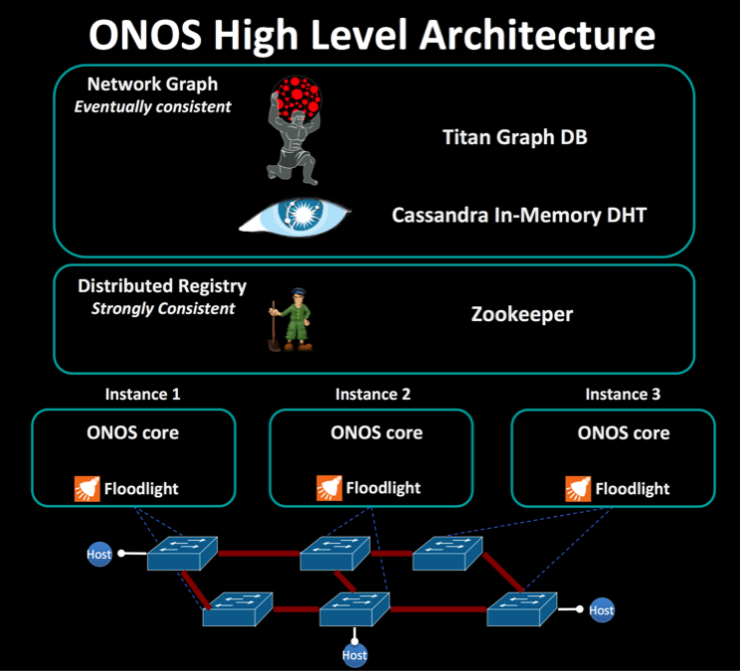
Software Controllers
Differ in terms of language, version of open flow supported and features.
Examples:
Ryu (Ree-yooh) is component based SDN programming framework written in python.
Floodlight is SDN controller written in Java.
ONOS aims to provide a reliable carrier-grade controller that implements a network operating system.

Slide 33
Talk
Problems with traditional networks
What is SDN and how it helps
Openflow SDN
Example: Firewalls
Switches and Controllers
Hands on Session

Slide 34
Hands on Session
We've adapted some existing tutorials covering:
Using mininet and ovs tools
Running a ryu sdn application
Using the faucet switch
Using two sdn applications together
Self-paced, we will get you up and running and circulate.

