Slide 1
ECC3479 · DATA AND EVIDENCE IN ECONOMICS · FINAL PRESENTATION
Rental Market Turnover and Rent Growth
in Melbourne Suburbs, 2018 – 2025
Anton Kozlovsky
Monash University · May 2026
github.com/Anton1321/ECC3479-project-Anton
Notes:
Good morning. My project investigates the relationship between rental market activity and subsequent rent growth at the suburb level in Melbourne from 2018 to 2025. A few words on what I was originally trying to do, what I could and could not get, and what I ended up being able to say.

Slide 2
Research question
Does within-suburb variation in lagged rental market turnover predict subsequent rent growth in Melbourne, controlling for common time shocks and the lagged rent level?
Why it matters
Declared ambition
Melbourne rents fell during COVID lockdowns, then surged from 2022 as borders reopened and supply stayed tight.
Standard housing story: tighter markets → faster rent growth (the rental analogue of the Beveridge curve).
Descriptive, not causal. The estimates identify a conditional within-suburb correlation, not a causal effect of turnover on rents.
Research question
2 / 10
Notes:
The question I set out to answer is essentially: at the suburb level, does rental market slack predict slower rent growth in the next quarter? The textbook housing-economics story says yes — tighter markets, more landlord bargaining power, faster rent growth. The rental-market analogue of the Beveridge curve from labour economics. Importantly — and I will come back to this — I am declaring the ambition descriptive, not causal. What I am identifying is a conditional within-suburb correlation. I want to be upfront about that now and explain why throughout the talk.

Slide 3
We wanted vacancy. We got turnover.
What we needed
What was available
Suburb-level rental vacancy rates, quarterly, Melbourne 2018 – 2025.
The standard explanatory variable in housing economics — the
stock of empty rentals.
✗ SQM Research — ~$5,000 AUD commercial quote ✗ Monash Library — no CoreLogic / RP Data / Cotality ✗ RoZetta academic access — no response in time
The workaround
Moving annual bond lodgements per suburb — from the same DFFH spreadsheet that supplies the rent data. A new bond marks a new tenancy, so the count measures the flow of new rental activity. Vacancy is a stock; turnover is a flow. The two can diverge. This is the structural reason the work is descriptive, not causal.
Data dilemma
3 / 10
Notes:
This slide is probably the most important one in the talk. Everything that follows pivots on it. I wanted suburb-level vacancy rates from a source like SQM Research. They quoted me about five thousand AUD for a commercial licence. Monash Library does not subscribe to CoreLogic, RP Data, or Cotality. I also pursued academic access through RoZetta Institute, which did not return data in time for this submission. So I went back to the Victorian Government rental report — the same spreadsheet I was getting rent data from — and pulled a second column that I had been ignoring: moving annual bond lodgements per suburb. Every new tenancy in Victoria triggers a bond lodgement. So that count measures, by suburb, the flow of new rentals being signed. But — and this is the cost of the swap — vacancy is a stock, turnover is a flow. The two are related but not equivalent. A market can have low vacancy and low turnover, or high vacancy and high turnover. That is why I am declaring the work descriptive, not causal.

Slide 4
Data
Source: Victorian Department of Families, Fairness and Housing — Rental Report (Quarterly), via data.vic.gov.au (CC-BY 4.0).
SAMPLE
DEPENDENT VARIABLE — RENT GROWTH
3,300
Mean: 1.16% / quarter SD: 2.33 percentage points Range: −11.11 to +14.58 pp
suburb-quarter observations
110 Melbourne suburbs × 30 quarters (2018Q1 – 2025Q3)
Key variables
Role | Variable | Description
Outcome | rent_growth | Quarter-on-quarter % change in median rent
Regressor | lag_log_bond_count | Log of previous quarter's moving annual bond count
Control | log_lag_median_rent | Log of previous quarter's median rent (captures mean reversion)
Cleaning: code/01_clean_data.py — wide-to-long reshape, Melbourne sub-regions only, drop first quarter per suburb (no lag).
Data
4 / 10
Notes:
The data comes from the Victorian Government rental report, published quarterly on the open data portal. Every formal residential tenancy in Victoria appears in this data — it is a population-level administrative source, not a sample. My analysis sample is a balanced panel of 110 Melbourne suburbs across 30 quarters, giving 3,300 suburb-quarter observations. The dependent variable is quarter-on-quarter rent growth, which has a mean of 1.16% per quarter and a standard deviation of 2.33 percentage points. I take logs of both bond count and median rent — bond counts span two orders of magnitude across suburbs (38 at the low end to over 17,000 at the high end), so logging normalises the distribution and gives the coefficient a semi-elasticity reading.

Slide 5
Empirical strategy
rent_growthᵢₜ = β · lag_log_bond_countᵢₜ + δ · log(lag_median_rent)ᵢₜ + αᵢ + γₜ + εᵢₜ
β
δ
αᵢ
γₜ
turnover coefficient
rent-level control
suburb fixed effects
quarter fixed effects
The within-suburb semi-elasticity of rent growth to lagged turnover.
Captures mean reversion — high-rent suburbs grow more slowly.
Absorb every time-invariant suburb trait (region, CBD distance, stock).
Absorb every Melbourne-wide shock (COVID, RBA, border reopening).
IDENTIFYING ASSUMPTION
After absorbing all time-invariant suburb traits, all Melbourne-wide shocks, and the lagged rent level, the remaining within-suburb variation in turnover is uncorrelated with residual determinants of rent growth.
Empirical strategy
5 / 10
Notes:
The preferred specification is a two-way fixed-effects panel regression with one control. The suburb fixed effects absorb everything that does not change about a suburb over time — region, distance to the CBD, dwelling-type composition, school zoning. So I am no longer comparing Toorak to Footscray; I am comparing each suburb to its own average. The quarter fixed effects absorb every Melbourne-wide shock — COVID lockdowns, RBA cash rate movements, border reopening, HomeBuilder. So I am comparing each suburb-quarter against the Melbourne-wide average that quarter. Combined, the identifying variation is: when a particular suburb has unusually high turnover relative to both its own average AND the Melbourne-wide average that quarter, does its rent grow unusually slowly? The rent-level control captures mean reversion — high-rent suburbs grow more slowly. As we will see, this control matters a lot.

Slide 6
Why these specification choices
LOG TRANSFORMATION
ONE-QUARTER LAG
Bond counts span 38 to 17,354 across suburbs — two orders of magnitude. Logging normalises the distribution and gives β a semi-elasticity reading.
Mitigates simultaneity — this quarter's rent growth cannot have caused last quarter's turnover. Rents also adjust with a lag.
TWO-WAY FIXED EFFECTS
CLUSTER SE AT SUBURB
Suburb FE alone leaves common time variation (COVID, rates, borders) in the residual. Adding quarter FE absorbs it.
Within-suburb errors are serially correlated. 110 clusters — well above the Angrist–Pischke threshold of ~42.
Why these choices
6 / 10
Notes:
Before showing results, I want to address the design choices upfront, because the rubric rewards defending them and they each carry real consequences. I take logs because bond counts span two orders of magnitude and logging normalises the distribution. It also lets me interpret the coefficient as a semi-elasticity — a 1% change in bond count maps to β percentage points of rent growth. I lag the regressor by one quarter for two reasons. First, simultaneity — this quarter's rent growth cannot have caused last quarter's turnover. Second, economic timing — markets adjust with a lag. I use both suburb and quarter fixed effects, not just suburb FE alone. Why? Because if I only absorb suburb-level variation, the COVID lockdowns and the RBA cash rate end up in the residual — and those are correlated with both turnover and rent growth across all suburbs. Quarter FE cleans that out. I cluster standard errors at the suburb level. Errors within a suburb are serially correlated — a suburb that overshoots one quarter likely overshoots the next. With 110 clusters I am well above the Angrist-Pischke rule of thumb of about 42.

Slide 7
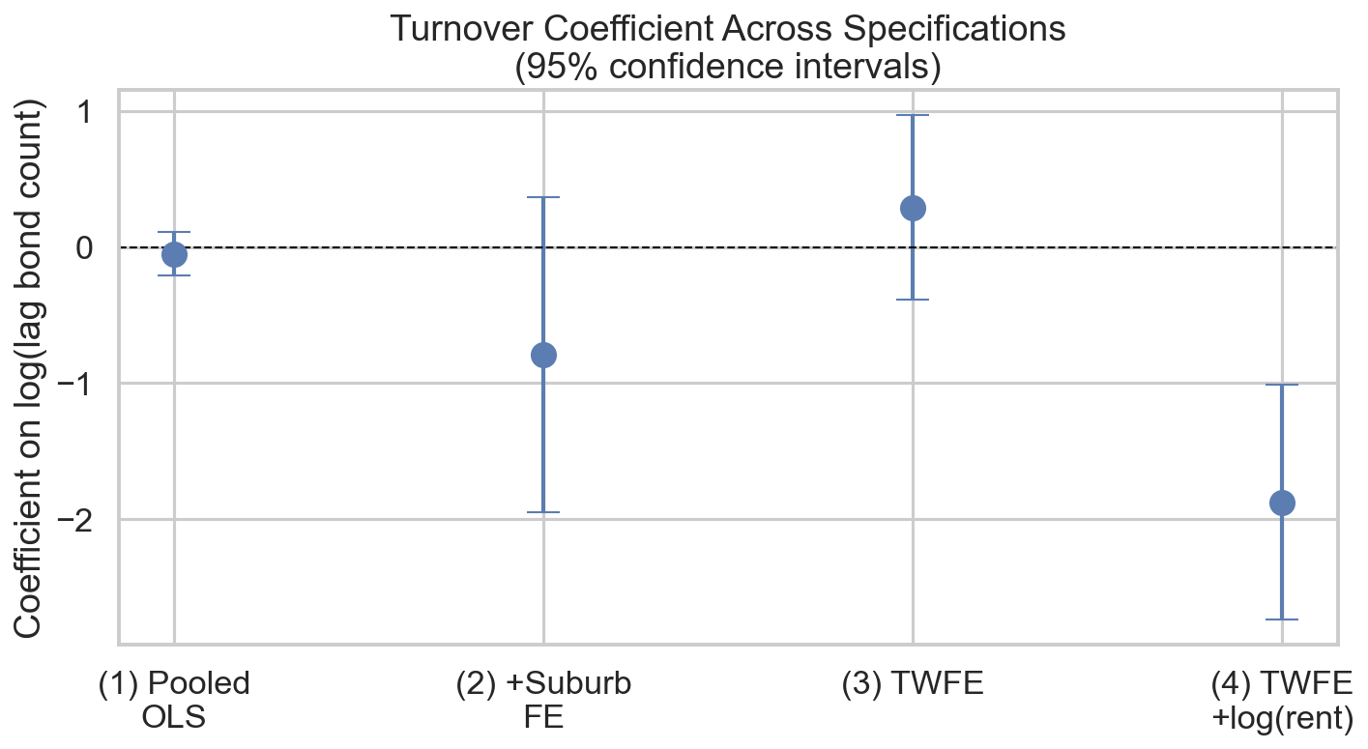
Main results
THE HEADLINE
β = −1.875***
Cluster-robust SE 0.439 · t = −4.27
DIRECTION
Negative — higher turnover precedes slower growth
MAGNITUDE
1% higher bond count → 0.019 pp slower growth
AT SCALE
Doubling turnover → ~1.3 pp slower growth
Figure 1. Turnover coefficient across the four nested specifications. Pooled OLS → +Suburb FE → +Quarter FE (TWFE) → +log(lag rent).
CALIBRATED
≈ 2/3 of one SD of the dependent variable
Reading: the coefficient drifts toward zero with quarter FE alone (col 3), then becomes precisely negative when the rent-level control is added (col 4). Next slide explains why.
Main results
7 / 10
Notes:
The headline coefficient is minus 1.875, significant at 1%, t-statistic of negative 4.27, in the preferred two-way fixed effects specification with the lagged rent control. In plain English: a 1% higher lagged bond count in a Melbourne suburb is associated with about 0.019 percentage points lower next-quarter rent growth, holding constant every time-invariant suburb feature, every Melbourne-wide shock, and the lagged rent level. That sounds tiny, so I recalibrate it. A doubling of turnover corresponds to about 1.3 percentage points lower rent growth. Given the standard deviation of the dependent variable is 2.33 percentage points, that's roughly two-thirds of one SD. Economically meaningful, not trivial. Reading the figure: the coefficient is essentially zero in pooled OLS, drifts negative once I add suburb fixed effects, returns to near zero with quarter FE, and only becomes precisely negative when I add the lagged rent control. The next slide explains why that last step is doing so much of the work.

Slide 8
Why adding the rent control flips the sign
Column 3 → Column 4 is one extra control — but β swings from +0.291 to −1.875. Over two percentage points. This is what omitted variable bias looks like, made visible on our own data.
1
2
3
Turnover ↔ rent levels
Rent levels → growth
Product: positive bias
Positive correlation within suburbs. Denser, activity-heavy areas have both more turnover and higher rents.
Strong negative. Mean reversion — high-rent suburbs grow more slowly (δ = −12.0 in col 4).
About +2 pp of bias in col 3, masking the true within-suburb negative relationship.
Takeaway: I do not hide the col 3 result. I report it explicitly because the comparison is the strongest econometric evidence in the project — a textbook OVB pattern, demonstrated cleanly on our own data.
The OVB story
8 / 10
Notes:
I want to spend a moment on the jump from column 3 to column 4, because it is the strongest piece of econometric evidence in the whole project. Column 3 and column 4 use the same regression. The only difference is column 4 adds one control variable — the lagged log median rent. But the turnover coefficient swings from positive 0.29 to negative 1.88. Over two percentage points. This is exactly what omitted variable bias looks like, made visible. The mechanism has three pieces. First, turnover and rent levels are positively correlated within suburbs — denser, more activity-heavy areas have both more turnover and higher rents. Second, rent levels strongly negatively predict rent growth — that's mean reversion, and the coefficient on the rent control is minus 12. Third, multiply those two together and you get a positive bias of about 2 percentage points in column 3, masking the true negative relationship. I report column 3 explicitly rather than hiding it, because the comparison itself is the strongest evidence: the regression machinery cleanly demonstrates a textbook econometric concept on my own data.

Slide 9
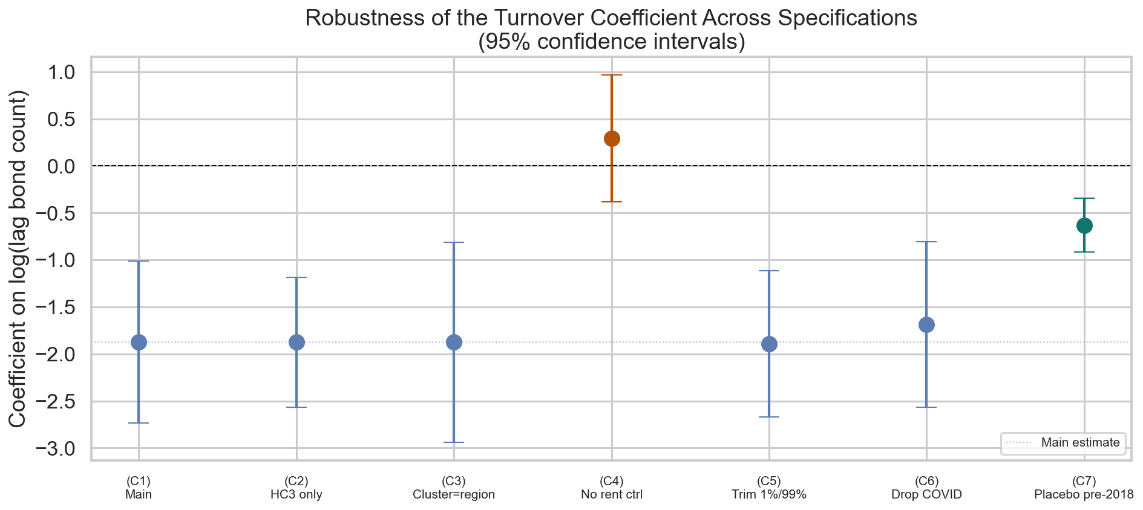
Robustness — 6 of 7 checks support the headline
WHAT EACH CHECK PROBED
Inference: HC3 SE and region-cluster SE leave β unchanged. Controls: Dropping log(rent) flips sign — the OVB pattern from slide 7. Outliers: Trimming 1%/99% of growth barely moves β. Era: Dropping COVID era only shrinks β by ~10%. Placebo: 2000–2017 returns same sign at 1/3 magnitude — stable across 25 years.
Figure 2. Turnover coefficient across seven robustness specifications. Main (C1) in blue, OVB-revealing failure (C4) in orange, pre-2018 placebo (C7) in green.
MOST IMPORTANT REMAINING THREAT
Turnover ≠ vacancy. A high-turnover quarter could mean slack being absorbed (rent softens — our sign) OR strong demand churning through stock (rent should not soften). The FE design cannot decompose which.
Robustness
9 / 10
Notes:
I stress-tested the headline through seven specifications probing different assumptions. On inference: changing the standard error estimator from cluster-by-suburb to HC3, or to cluster-by-region with only 9 clusters, leaves the point estimate unchanged. The t-statistic stays above three across all three. On controls: dropping the lagged rent control flips the sign — that's the orange point above zero. This is the OVB pattern I just walked through. I report it as a structural failure rather than hide it. On sample: trimming the top and bottom one percent of rent growth removes 66 observations and barely moves β. Dropping the COVID era removes 770 observations and shrinks β by only ten percent. So the result is not outlier-driven and not COVID-driven. On era: I ran the same specification on the pre-2018 era of the same panel — 7,802 observations spanning 2000 to 2017. Same sign, one-percent significant, one-third the magnitude. The relationship is stable across 25 years; its current-era intensity may be partly era-specific. Six of seven defensible variations support the headline. The one that breaks is structural and explainable. But — and this is the most important remaining threat — bond turnover is not the same thing as vacancy. A high-turnover quarter could mean slack being absorbed, consistent with my negative sign, OR strong demand churning through existing stock, which is not consistent with my sign. The fixed-effects design cannot decompose which story is operating. That is the structural reason I am declaring the work descriptive, not causal.

Slide 10
Conclusion and next steps
WHAT I CAN CONCLUDE
WHAT I CANNOT CONCLUDE
A stable, statistically reliable, economically meaningful within-suburb conditional correlation between lagged bond turnover and subsequent rent growth in Melbourne — negative, and robust across SE estimators, sample restrictions, and a 25-year placebo era.
· This is the vacancy–rents relationship — turnover is a flow, not a stock · This is causal — reverse causality (rents → moves → bonds) remains · This generalises beyond Melbourne — one city, one set of institutions · Suburbs can be ranked — FE strip all between-suburb variation
NEXT STEPS — TO RESOLVE THE REMAINING THREAT
1. Obtain suburb-level vacancy data (SQM Research, Cotality, or PropTrack) via Monash Library or RoZetta Institute academic-access. Re-estimate the same panel; demote turnover to a robustness check. 2. For a causal estimate, instrument for vacancy with a supply or accessibility shifter independent of contemporaneous rents — rezoning timing, new transit infrastructure. Beyond an undergraduate submission, but where the field goes next.
Conclusion
10 / 10
Notes:
To summarise. What I can conclude. Within Melbourne, there is a stable, statistically reliable, economically meaningful within-suburb conditional correlation between lagged bond turnover and subsequent rent growth. The relationship is negative, and it survives essentially every defensible analytical variation except the OVB-revealing one I explained earlier. What I cannot conclude. First, this is not the vacancy-rents relationship — I have turnover, a flow, not vacancy, a stock. Second, this is not causal — reverse causality from rents to turnover remains, and the lag is only a partial fix. Third, this does not generalise beyond Melbourne. Fourth, the fixed effects strip all between-suburb variation, so I cannot rank suburbs by tightness. To resolve the most important remaining threat — the turnover-versus-vacancy gap — the next step is to obtain actual vacancy data from SQM, Cotality, or PropTrack, ideally through Monash Library or the RoZetta Institute academic-access partnership. With that data, the same panel design re-estimates cleanly, and turnover gets demoted to a robustness check. For a fully causal estimate, you would need an instrument for vacancy — something that shifts supply or accessibility independent of contemporaneous rents. Rezoning timing, new train stations. That is beyond this submission, but it is where the field goes next. Thank you. Happy to take questions.

