Slide 1
Webpack
Module bundler

Slide 2
Usual problems
Large number of technologies:
Angular/react/jQuery;
Variety of versions;
File optimization;
Variety of file types and standarts:
SASS/SCSS/LESS/Stylus/JSON/PJSON/ES5/ES6/CoffeScript/TypeScript;
Notes:
1) Technologies example
2) Angular 1, Angular 2 etc
3) Minimization, compilation, code splitting, etc
4) CSS preprocessors and support of standarts that didn't realize in current browsers, transpilers

Slide 3




Toolkits
grunt
gulp
browserify
webpack
Task runners
Bundlers
Notes:
1) Differences between task runners and bundlers
2) Difference between browserify adn webpack
3) Extra: difference between task runnser from the slide

Slide 4

Webpack
Notes:
1) Start of the main part, little pre description about presentation

Slide 5
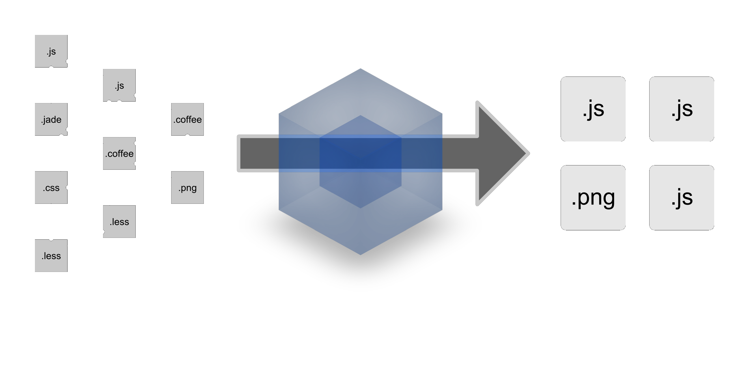
What does it do?
Notes:
1) Work desription

Slide 6
What is it?
Webpack takes modules with dependencies and generates static assets representing those modules
How is webpack different:
Code Splitting
Loaders
Clever parsing
Plugin system
Notes:
1) What webpack is
2) creaters position about webpack(Predestination)
3) Differences: splitting 2 types, loaders, parsing, Plugin system

Slide 7
Goals
Split the dependency tree into chunks loaded on demand
Keep initial loading time low
Every static asset should be able to be a module
Ability to integrate 3rd-party libraries as modules
Ability to customize nearly every part of the module bundler
Suited for big projects
Notes:
1) Goals of project x6

Slide 8
Why?
Compatibility
Dynamic loading
Different modules types
Preprocessors
Live reload
Notes:
1)Сompatibility : Java, python, gulp, grunt, etc
2) Dynamic loading
3) Modules types: AMD,UMD
4) Preprocessors

Slide 9
Examples
Preparation
Notes:
1) introduce that will be shown some started steps to use webpack

Slide 10
First step – initializing working dir
Notes:
1) Ask about Package.json and describe what is it if someone will need to knbout it

Slide 11
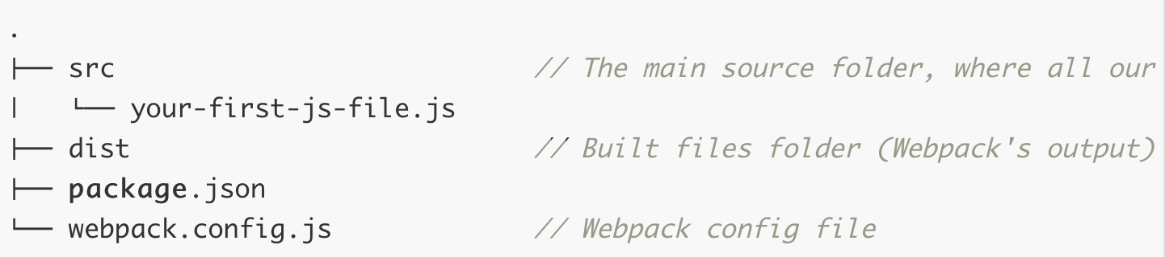
Second step – dir structure
Notes:
1) Describe that this can be missed
2) File structure of project

Slide 12
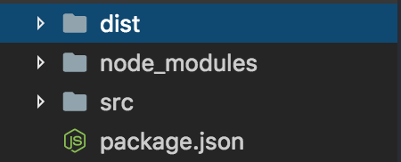
Third step – initializing webpack
Notes:
1) Say about initializing webpack
2) Node_modules folder creation

Slide 13
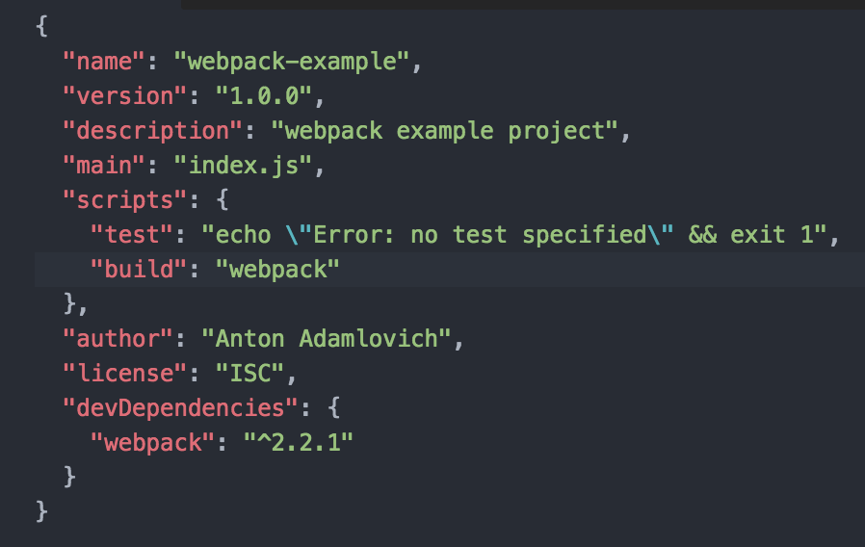
Fourth step – npm configuration
Notes:
1) add comands in package.json to call compilation

Slide 14
Examples
Work begining

Slide 15
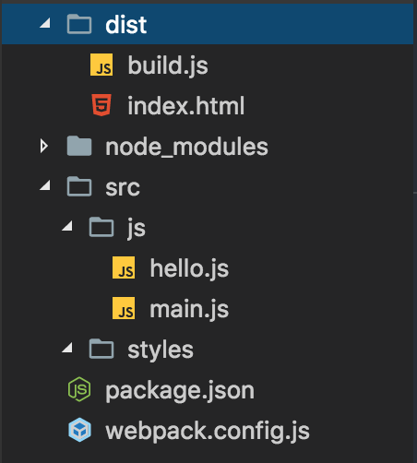
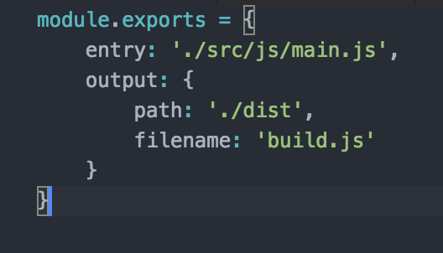
First step – start webpack
Notes:
1) First start of build function
2) Folders structure
3) Js files description
4) Base config file

Slide 16
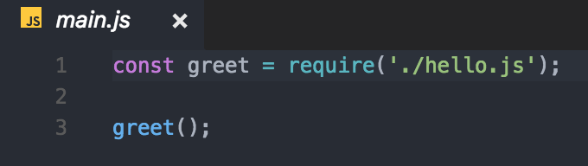
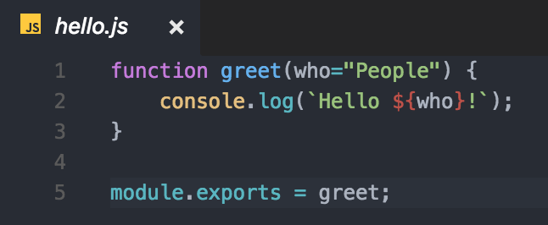
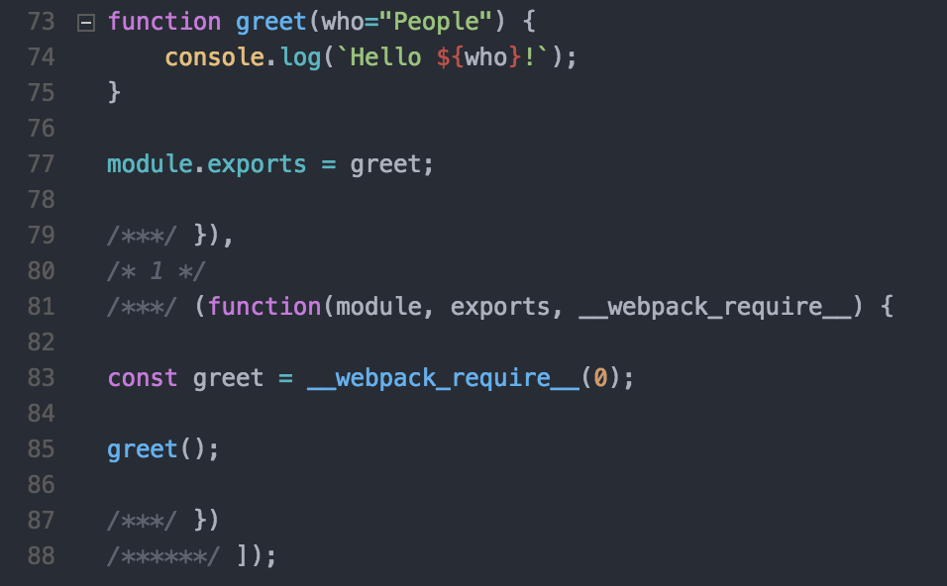
Files structure
Notes:
1) describe files structure of previous slide

Slide 17
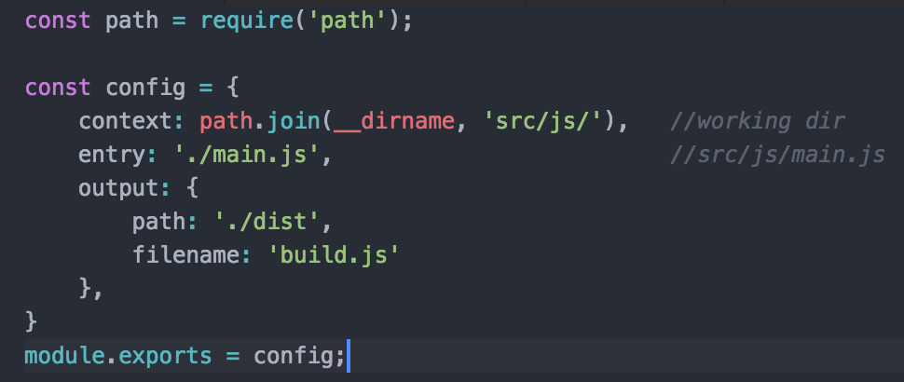
Second step - relative pathes
Notes:
1) Module path
2) Variable __dirname
3) Pathes

Slide 18
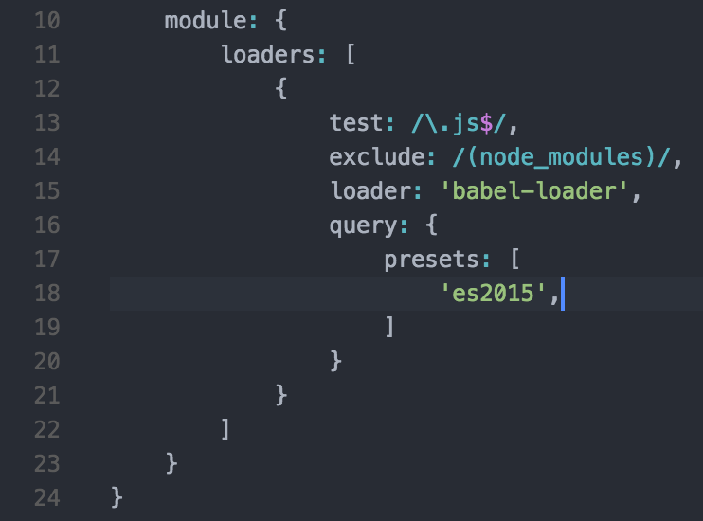
Third step – loaders (babel)
Notes:
1) what is preset
2) description: babel-core, babel-loader

Slide 19
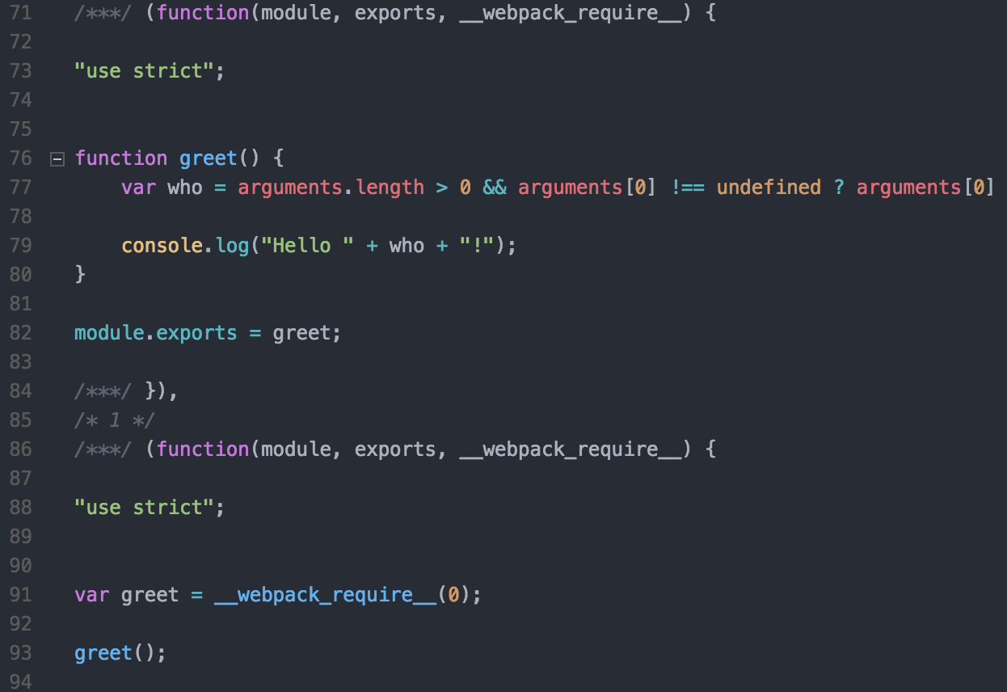
Compilation result
Notes:
Image description, where is babael result

Slide 20
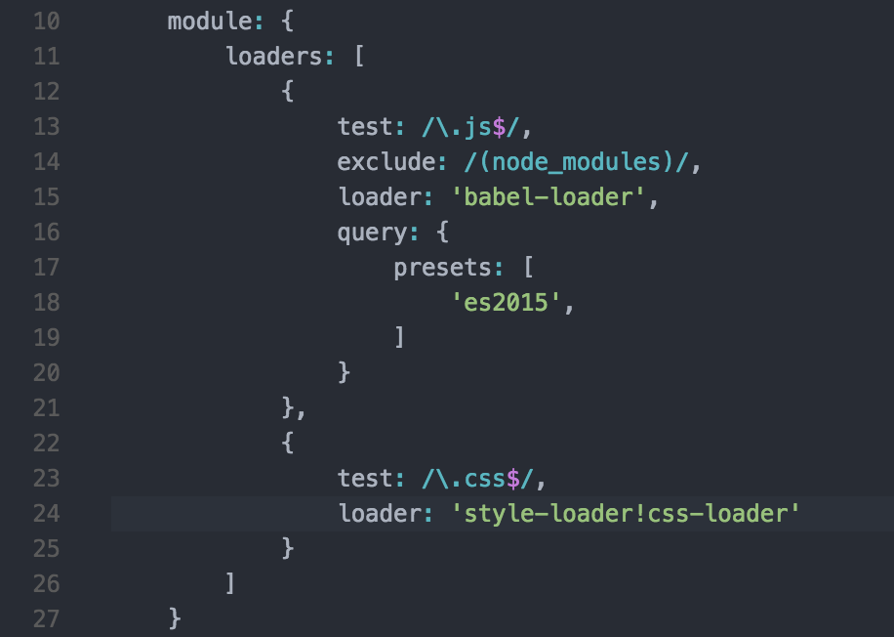
CSS loaders

Slide 21
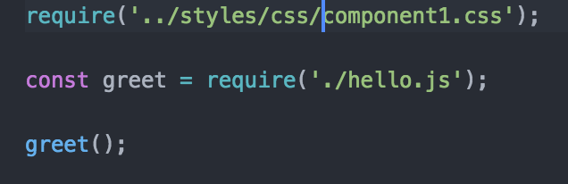
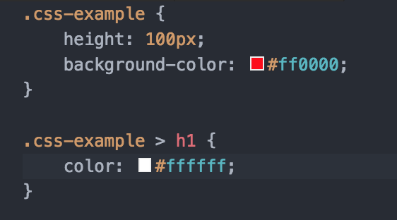
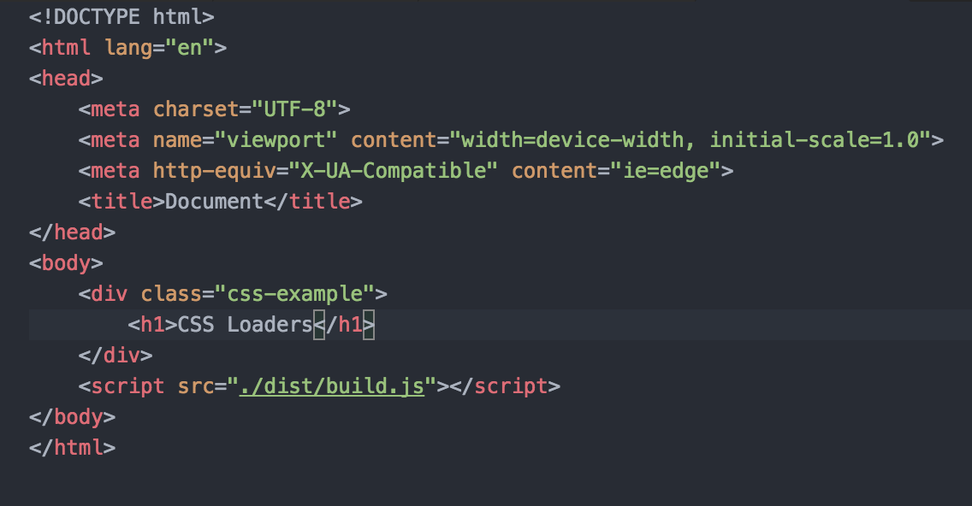

Slide 22

CSS loader result

Slide 23
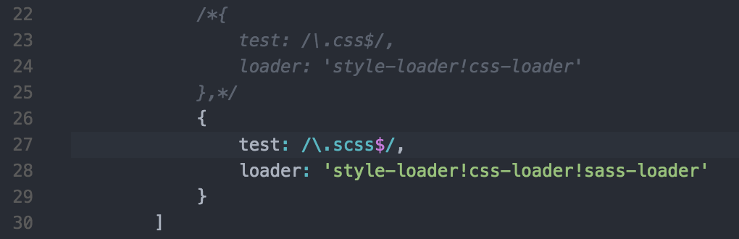
SASS loaders

Slide 24
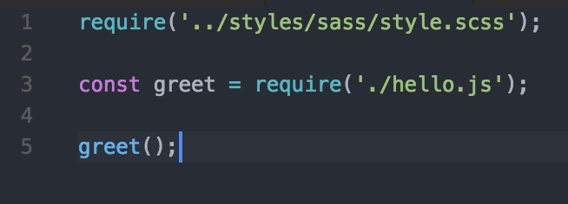
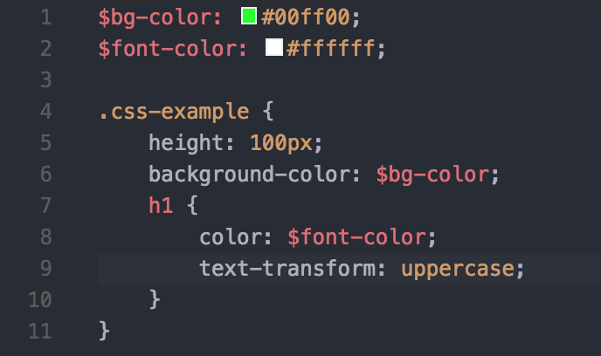

Notes:
1) Differences between css loaders

Slide 25
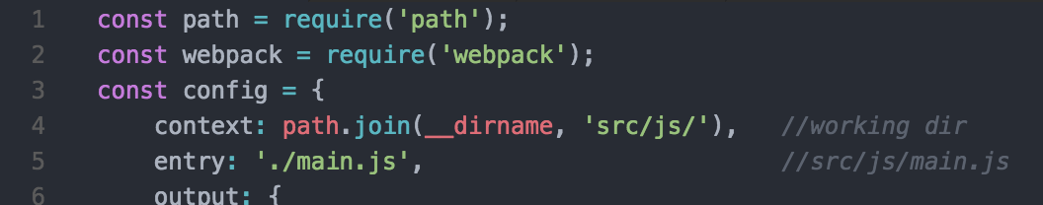
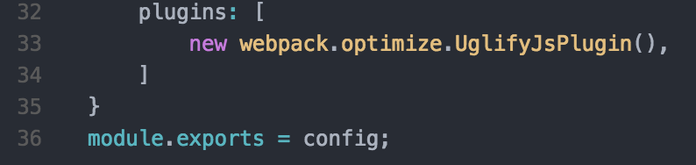
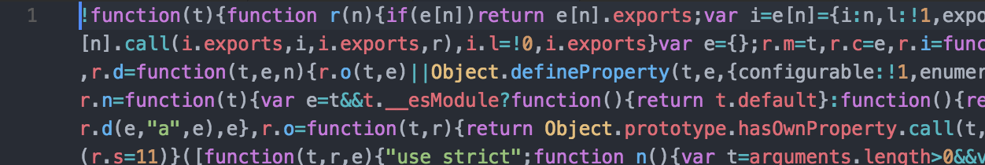
Built in modules (minimization)
Notes:
1) built in modules
2) second minimization type (modules options minimize=true )
3) uglifyJs fon work with ES6

Slide 26
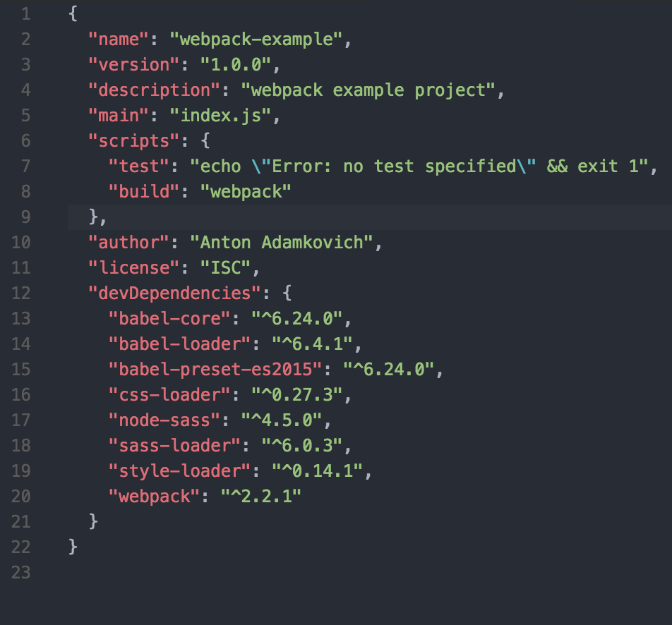
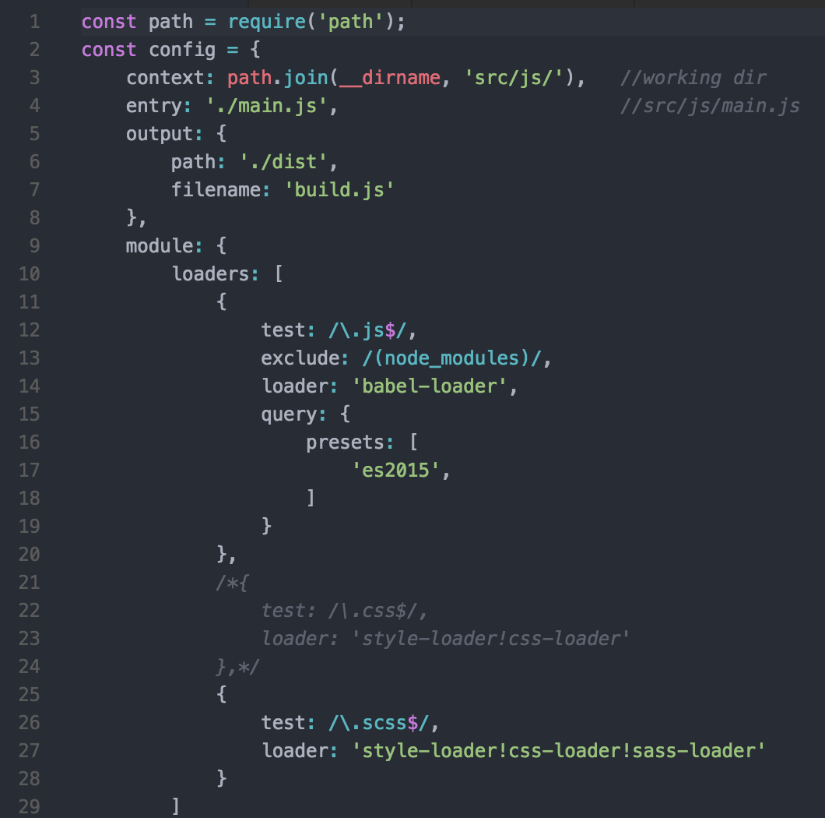
Notes:
1)end configuration

Slide 27
Links
http://webpack.github.io/
webpack.js.org Webpack 2.x official web site
Youtube: The net ninja "Webpack Tutorials for Beginners"

