Slide 1
Webpack
Module bundler

Slide 2
Usual problems
Large number of technologies:
Angular/react/jQuery;
Variety of versions;
File optimization;
Variety of file types and standarts:
SASS/SCSS/LESS/Stylus/JSON/PJSON/ES5/ES6/CoffeScript/TypeScript;
Notes:
1) Technologies example
2) Angular 1, Angular 2 etc
3) Minimization, compilation, code splitting, etc
4) CSS preprocessors and support of standarts that didn't realize in current browsers, transpilers

Slide 3




Toolkits
grunt
gulp
browserify
webpack
Task runners
Bundlers
Notes:
1) Differences between task runners and bundlers
2) Difference between browserify adn webpack
3) Extra: difference between task runnser from the slide

Slide 4

Webpack
Notes:
1) Start of the main part, little pre description about presentation

Slide 5
What is it?
Webpack takes modules with dependencies and generates static assets representing those modules
How is webpack different:
Code Splitting
Loaders
Clever parsing
Plugin system
Notes:
1) What webpack is
2) creaters position about webpack(Predestination)
3) Differences: splitting 2 types, loaders, parsing, Plugin system

Slide 6
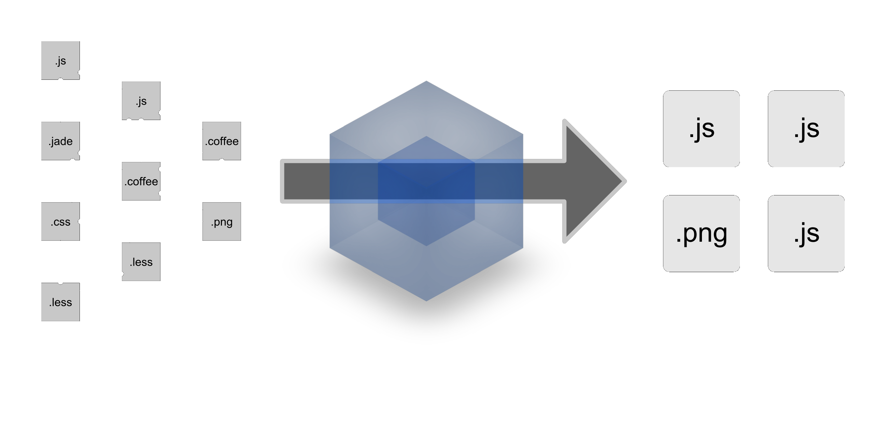
What does it do?
Notes:
1) Work desription

Slide 7
Goals
Split the dependency tree into chunks loaded on demand
Keep initial loading time low
Every static asset should be able to be a module
Ability to integrate 3rd-party libraries as modules
Ability to customize nearly every part of the module bundler
Suited for big projects
Notes:
1) Goals of project x6

Slide 8
Why?
Compatibility
Dynamic loading
Different modules types
Preprocessors
Live reload
Notes:
1)Сompatibility : Java, python, gulp, grunt, etc
2) Dynamic loading
3) Modules types: AMD,UMD
4) Preprocessors

Slide 9
Examples
Preparation
Notes:
1) introduce that will be shown some started steps to use webpack

Slide 10
First step – initializing working dir
Notes:
1) Ask about Package.json and describe what is it if someone will need to knbout it

Slide 11
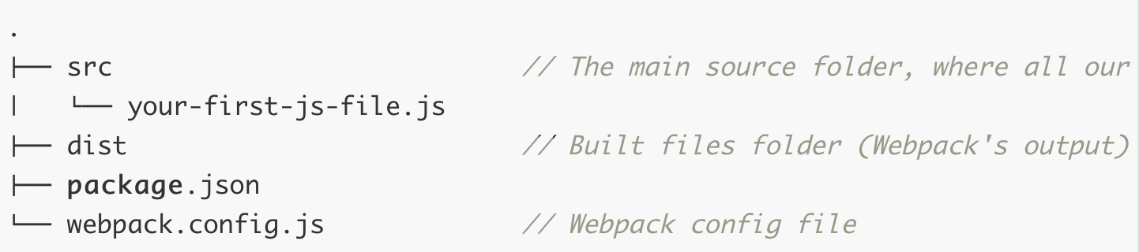
Second step – dir structure
Notes:
1) Describe that this can be missed
2) File structure of project

Slide 12
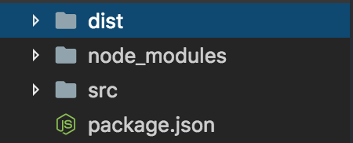
Third step – initializing webpack
Notes:
1) Say about initializing webpack
2) Node_modules folder creation

Slide 13
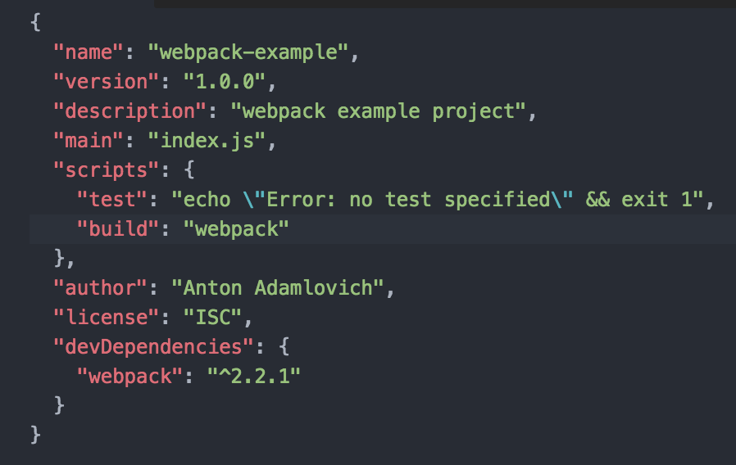
Fourth step – npm configuration
Notes:
1) add comands in package.json to call compilation

Slide 14
Examples
Work begining

Slide 15
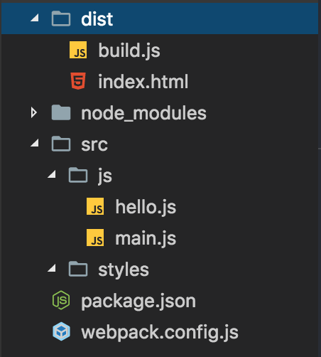
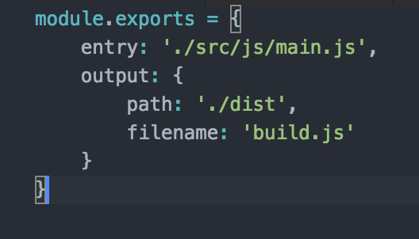
First step – start webpack
Notes:
1) First start of build function
2) Folders structure
3) Js files description
4) Base config file

Slide 16
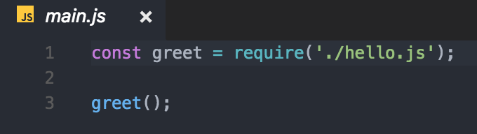
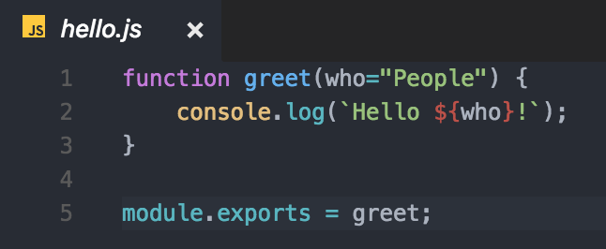
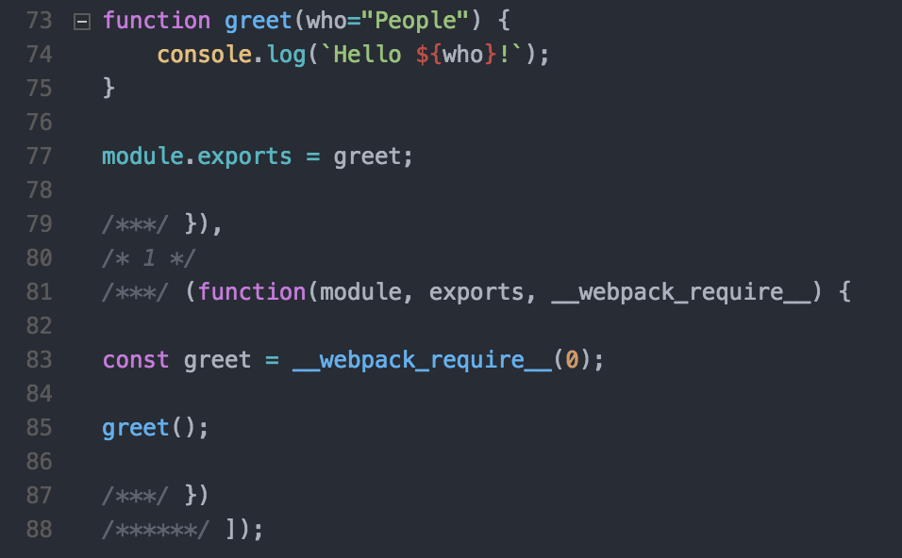
Files structure
Notes:
1) describe files structure of previous slide

Slide 17
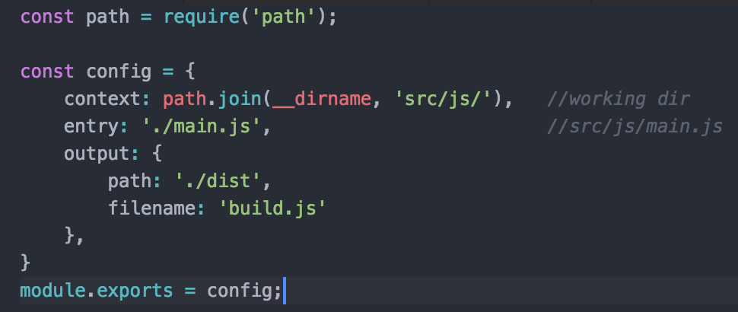
Second step - relative pathes
Notes:
1) Module path
2) Variable __dirname
3) Pathes

Slide 18
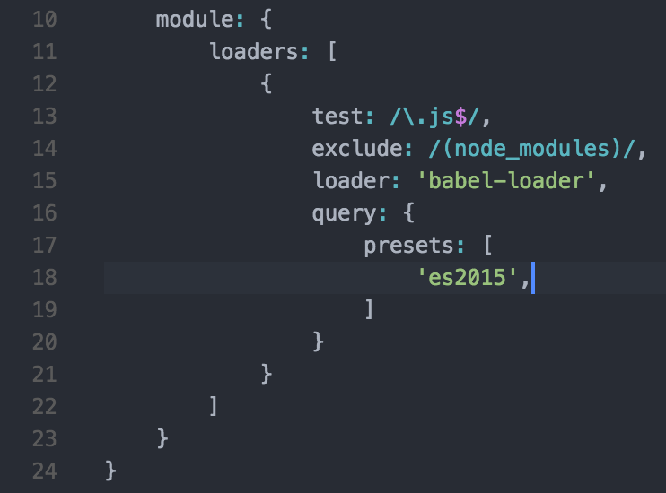
Third step – loaders (babel)
Notes:
1) what is preset
2) description: babel-core, babel-loader

Slide 19
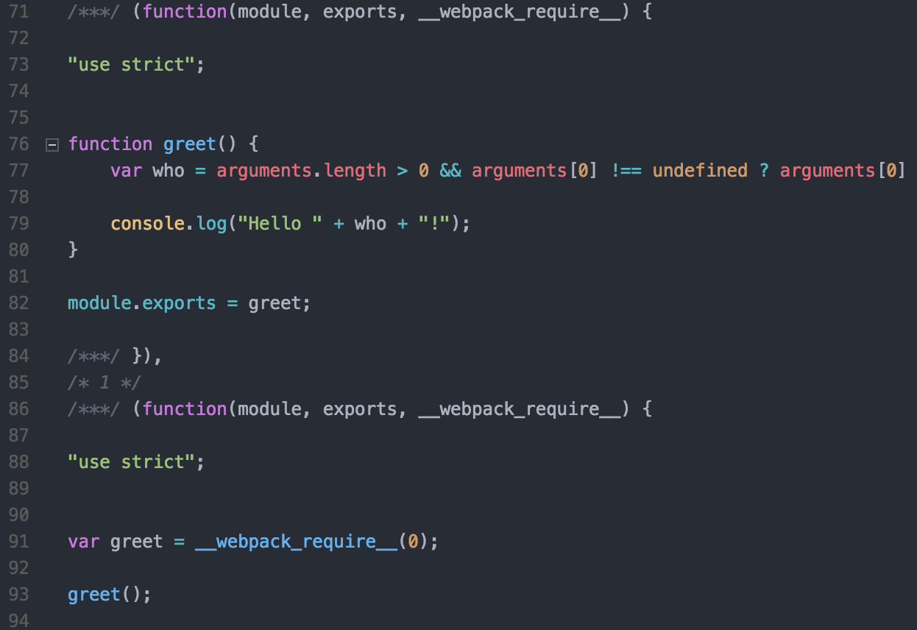
Compilation result
Notes:
Image description, where is babael result

Slide 20
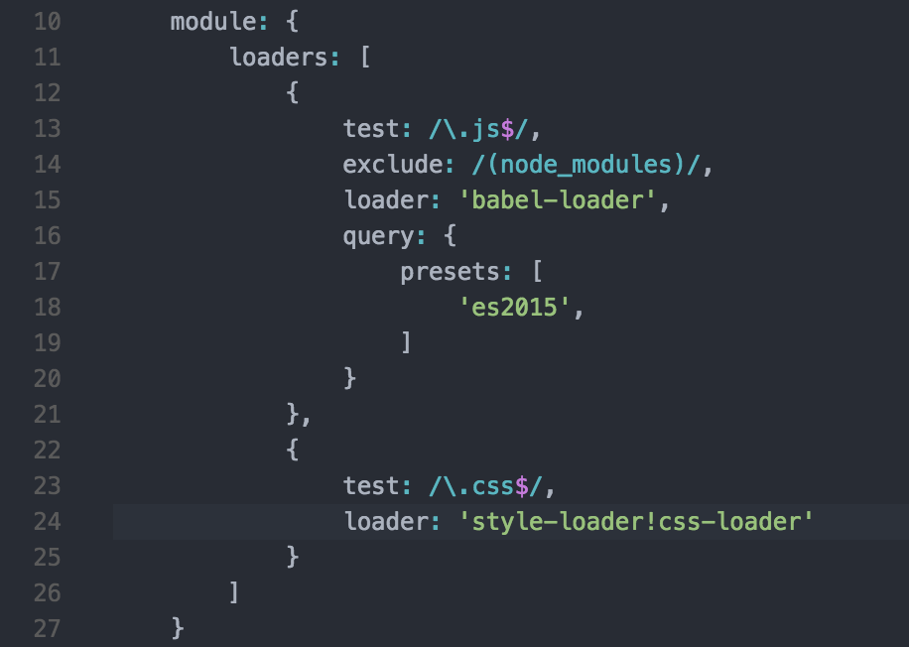
CSS loaders

Slide 21
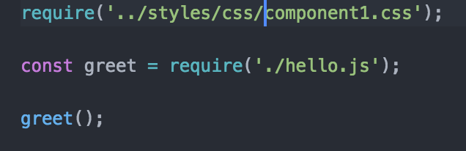
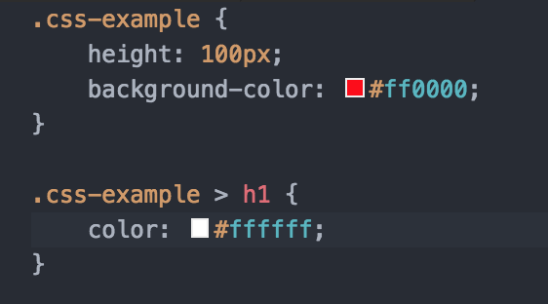
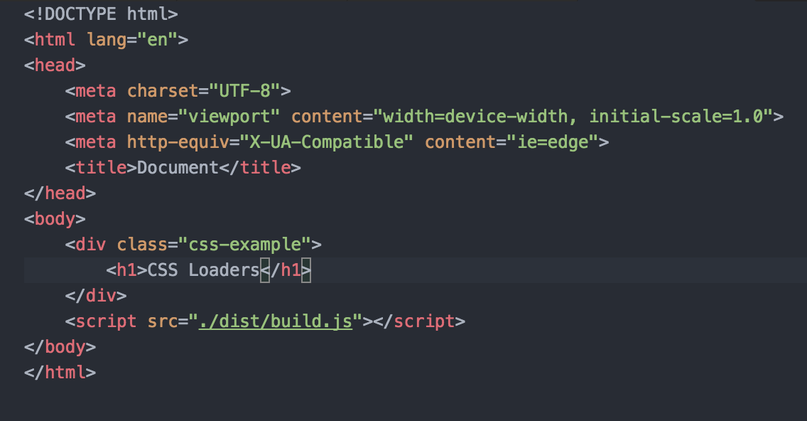

Slide 22

CSS loader result

Slide 23
CSS to single file with minification

Slide 24
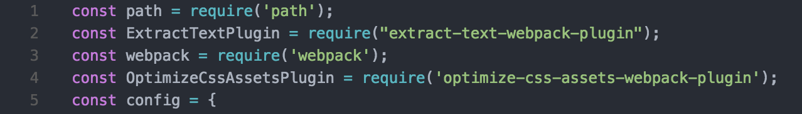
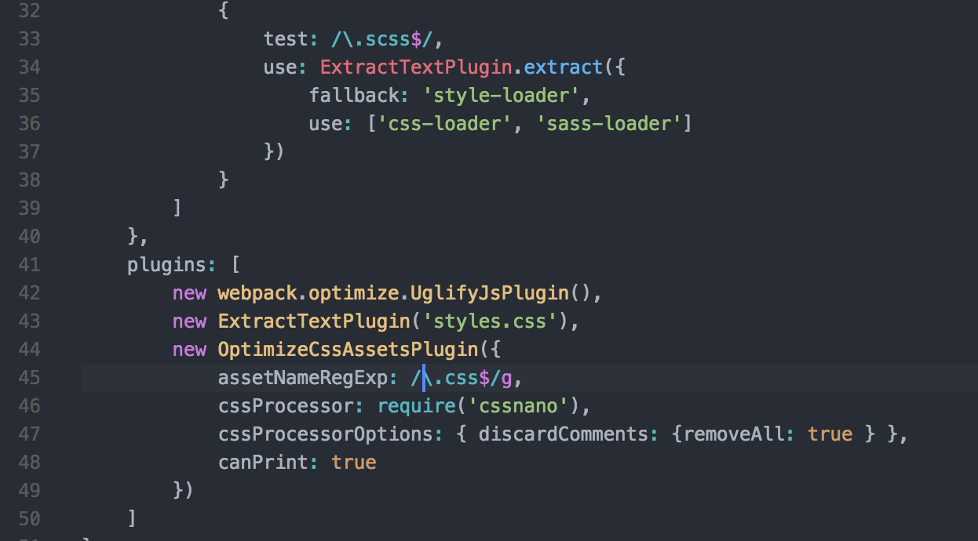
Webpack config

Slide 25
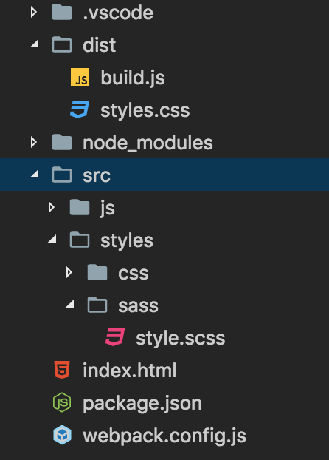
Result

Slide 26
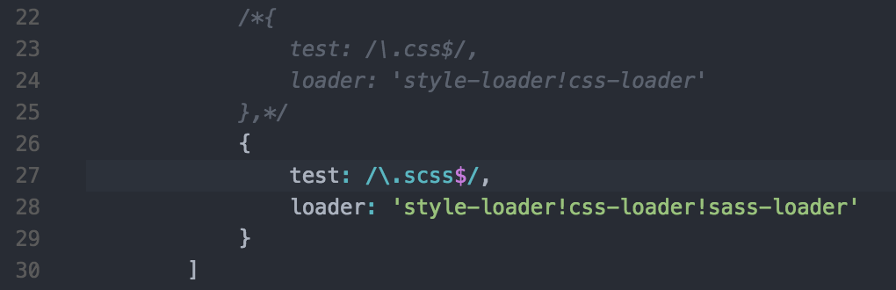
SASS loaders

Slide 27
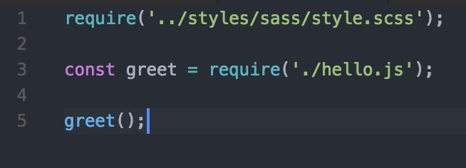
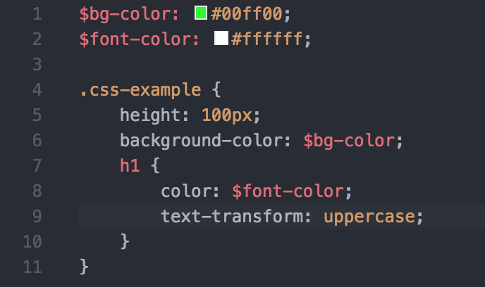

Notes:
1) Differences between css loaders

Slide 28
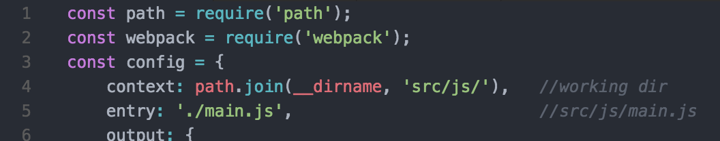
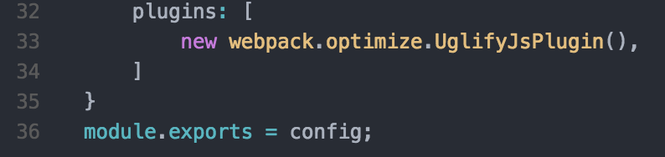
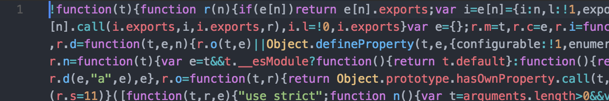
Built in modules (minimization)
Notes:
1) built in modules
2) second minimization type (modules options minimize=true )
3) uglifyJs fon work with ES6

Slide 29
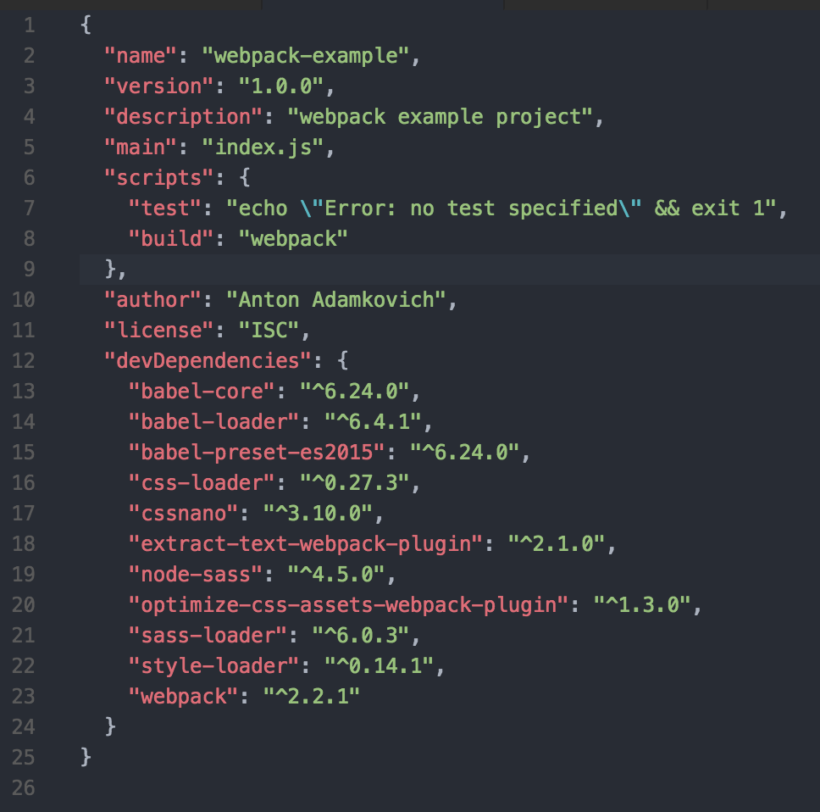
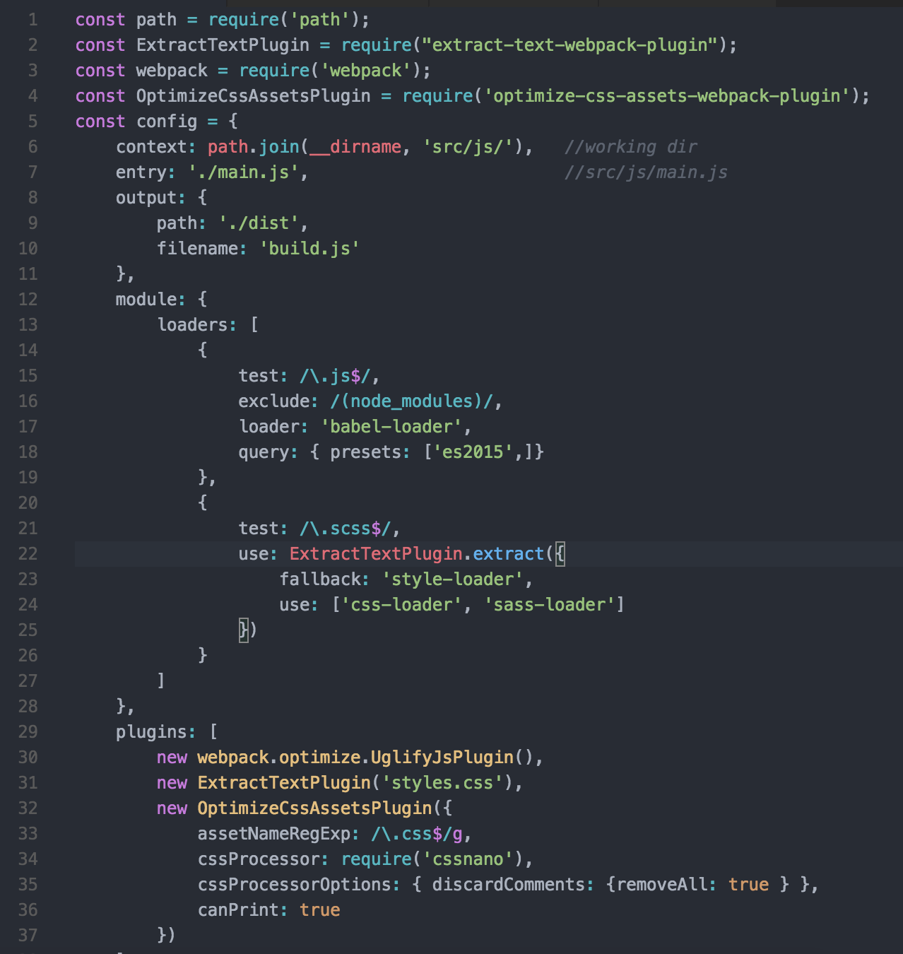
Notes:
1)end configuration

Slide 30
Links
http://webpack.github.io/
webpack.js.org Webpack 2.x official web site
Youtube: The net ninja "Webpack Tutorials for Beginners"

