Slide 1
Chapter 10
ENTREPRENEURIAL FINANCE
Leach & Melicher
Valuing early-stage ventures
© 2015 South-Western Cengage Learning

Slide 2
Chapter 10 Learning Objectives
Explain why it is important to look to the future when determining a venture’s value
Describe how the time pattern of cash flows relates to venture value
Understand the need to consider both forecast period and terminal value cash flows when determining a venture’s value
Understand the difference between required cash and surplus cash
Describe the process for developing the projected financial statements used in a valuation
Describe how pseudo dividends are incorporated into the discounted cash flows equity valuation method
Understand the differences between accounting and equity valuation cash flow

Slide 3
What is a Venture Theoretically Worth?
Present value (PV): value today of all future cash flows discounted to the present at the investor’s required rate of return
“Investors pay for the future; entrepreneurs pay for the past.”
“If you’re not using estimates, you’re not doing a valuation.”

Slide 4
Basic Mechanics Of Valuation
Discounted cash flow (DCF):
valuation approach involving discounting future cash flows for risk and delay
Explicit forecast period:
two- to ten-year period in which the venture’s financial statements are explicitly forecast
Terminal (or horizon) value:
value of the venture at the end of the explicit forecast period
Stepping stone year:
first year after the explicit forecast period

Slide 5
Divide and Conquer: Terminal

Slide 6
Brewpub Example:

Slide 7
Useful Terms
Capitalization (cap) Rate:
spread between the discount rate and the growth rate of cash flow in terminal value period (r∞ – g)
Reversion value:
present value of the terminal value
Pre-Money Valuation:
present value of a venture prior to a new money investment
Post-Money Valuation:
pre-money valuation of a venture plus money injected by new investors

Slide 8
More Useful Terms
Net Present Value (NPV):
present value of a set of future flows plus the current undiscounted flow
Required Cash:
amount of cash needed to cover a venture’s day-to-day operations
Surplus Cash:
cash remaining after required cash, all operating expenses, and reinvestments are made

Slide 9
Required vs. Surplus Cash
Required Cash:
amount of cash needed to cover a venture’s day-to-day operations
Surplus Cash:
cash remaining after required cash, all operating expenses, and reinvestments are made
Example: in Table 10.1, PDC has only required cash prior to July and then has 6,487 of surplus cash in July.

Slide 10
Equity Valuation: Pseudo Dividend Approach
Project PDC out five years assuming that a “surplus cash” account “plugs” the balance sheet (catching all remaining cash)
Calculate pseudo dividends by making sure that required investments in working capital do not include surplus cash
Discount the resulting pseudo dividends to get a value for the venture’s equity ownership

Slide 11
Pseudo Dividends (Equity VCFs)
Pseudo Dividend (Equity Valuation Cash Flow)
= Net Income
+ Depreciation and Amortization Expense
- Change in Net Operating Working Capital
(w/o surplus cash)
- Capital Expenditures
+ Net Debt Issues

Slide 12
Exclude Surplus Cash in Working Capital
For example, the NOWC calculation for PDC from March to July:
Current assets
July balance 175,307
March balance –174,340
Change in current assets 967
Surplus cash
July amount 6,487
March amount –0
Change in surplus cash 6,487
Current liabilities
July amount 45,310
March amount –48,415
Change in current liabilities –3,105
Change in net operating working capital –2,415
(= 967 – 6,487 + 3,105)
(= 967 – 6,487 + 3,105)

Slide 13
PDC Equity Valuation Cash Flow)
March to July Pseudo Dividend (Equity VCF) for PDC is:
Net Income $6,372
+ Deprec. & Amort. Exp. +4,600
- Change in NOWC (w/o surplus cash) +2,415
- Capital Expenditures - 6,900
+ Net Debt Issues - 0
= Equity Valuation Cash Flow $6,487

Slide 14
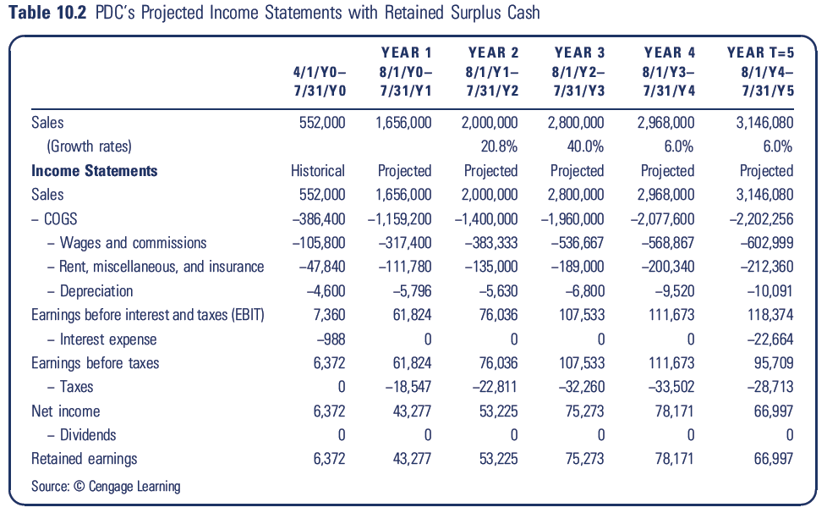
After July, project for 5 years

Slide 15
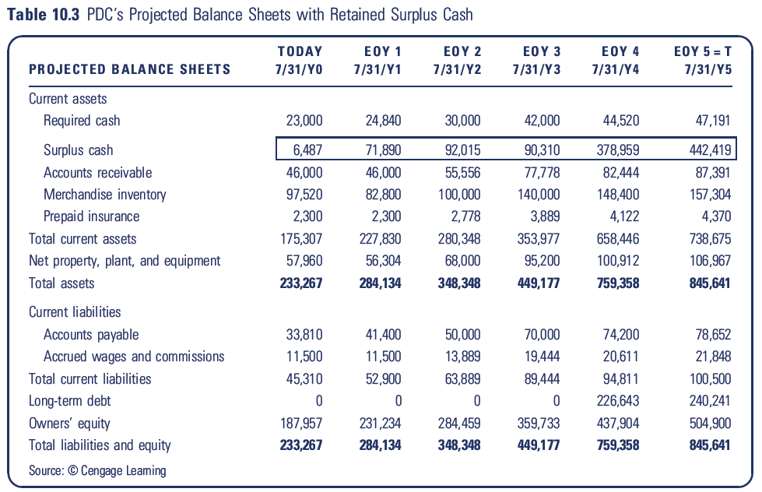
Balance Sheets with Surplus Cash “Plug”

Slide 16
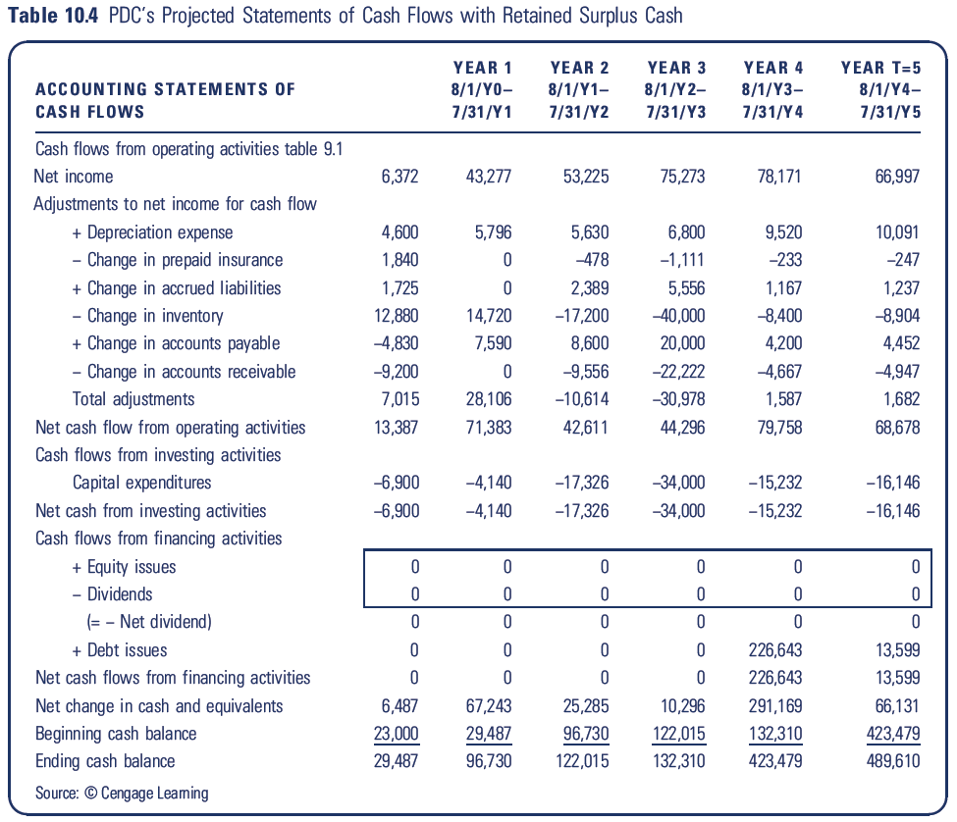

Slide 17
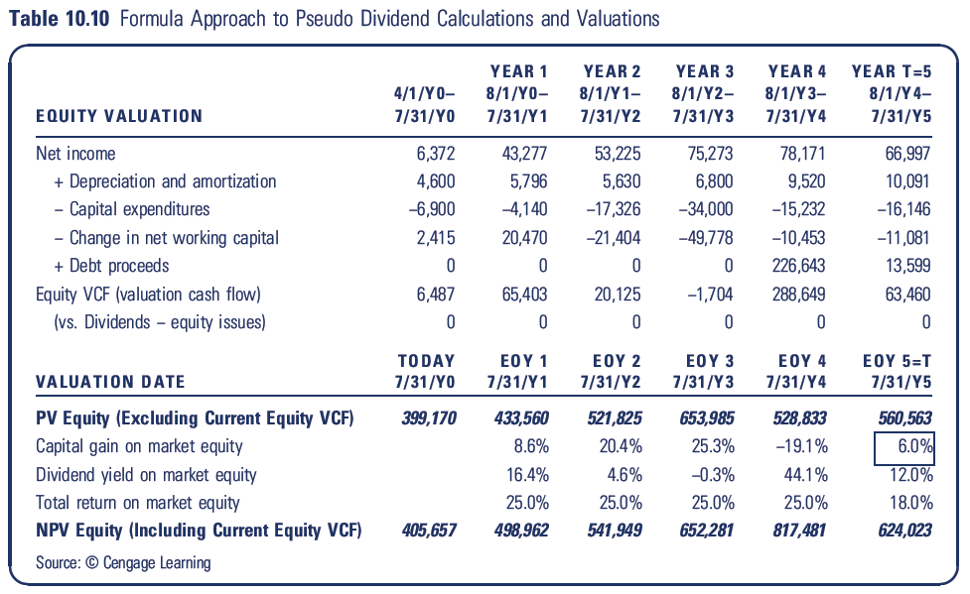
Calculating the Pseudo Dividends (Equity VCFs) with NOWC Calculations

Slide 18
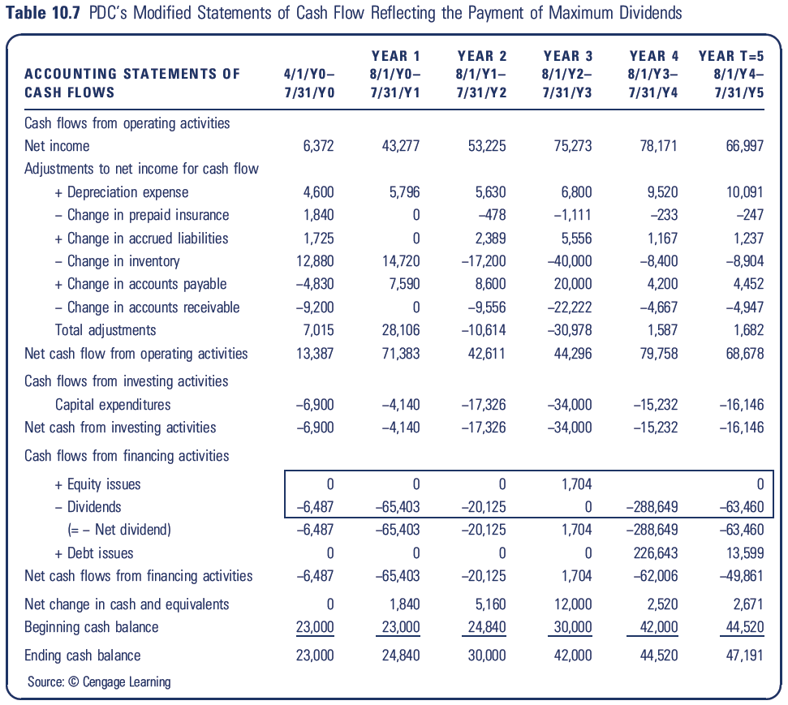
The Real Economics …

Slide 19
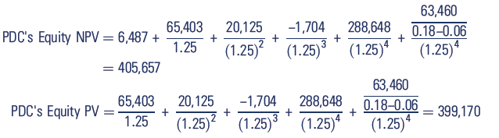
… The Present Value of Those Projected Maximum Dividends

Slide 20
