Slide 1
Chapter 1
ENTREPRENEURIAL FINANCE
Leach & Melicher
INTRODUCTION to Finance for Entrepreneurs
© 2015 South-Western Cengage Learning

Slide 2
Chapter 1: Learning Objectives
Characterize the entrepreneurial process
Describe entrepreneurship and some characteristics of entrepreneurs
Indicate three megatrends providing waves of entrepreneurial opportunities
List and describe the seven principles of entrepreneurial finance
Discuss entrepreneurial finance and the role of the financial manager
Describe the various stages of a successful venture’s life cycle
Identify, by life cycle stage, the relevant types of financing and investors
Understand the life cycle approach used in the book

Slide 3
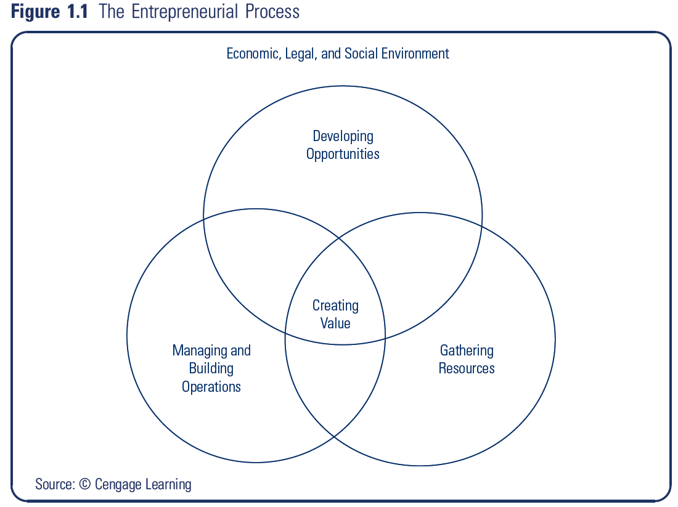
The Entrepreneurial Process
Process:
Developing opportunities
Gathering resources
Managing and building operations
Goal:
Creating value

Slide 4
Entrepreneurship Fundamentals
Entrepreneurship:
process of changing ideas into commercial opportunities and creating value
Entrepreneur:
individual who thinks, reasons, and acts to convert ideas into commercial opportunities and to create value

Slide 5
Entrepreneurial Traits or Characteristics
A successful entrepreneur:
Sees and seizes a commercial opportunity
Tends to be doggedly optimistic (perhaps even to a fault)
Plans to obtain the physical, financial, and human resources needed for the venture to succeed
Success is unlikely if you:
“are seldom able to see an opportunity, until it ceases to be one” (Mark Twain)
“view the glass as being half empty instead of half-full” (unknown)
are paralyzed by a fear of failure

Slide 6
Opportunities Exist but Not Without Risks
New U.S. business formations in the millions annually
small firms provide over 80 percent of net new jobs
Firms with less than 500 employees
represent over 99 percent of all employers
account for about one-half of the national workforce

Slide 7
Opportunities Exist but Not Without Risks
Risks:
“Small Business Facts”: 1/3 gone in 2 years; 1/2 gone in five
For new firms, a representative study (Headd) found:
one-third of new employer firms endure < 2 years
one-half endure < 4 years
60 percent endure < 6 years
but, about one-third were “successful” at closing

Slide 8
Sources of Entrepreneurial Opportunities
Research (J. Case) suggests
12% of Inc. 500 success is due to extraordinary idea
88% due to exceptional execution of ordinary idea
Trends suggesting possible entrepreneurial innovations
Societal changes
Demographic changes
Technological changes
Emerging economies and global changes
Crises and bubbles

Slide 9
Societal Changes
Naisbitt’s reflections still relevant! (Megatrends,1982)
“Industrial Society” to “Information Society”
Suggested focus on human response to information
Global economy
Awareness of international innovation and sourcing

Slide 10
Demographic Changes
Dent’s Generations – The Baby Boom
Spending wave (1990’s)
behind the stock and bond market booms
Power wave (to peak in the 2020’s)
aging baby boomers with great business influence
aging baby boomers provide business opportunities – creating them, financing them, using them

Slide 11
Technological Changes
Information Age
Internet
Wireless
Cross-functionality
Truly global in reach and competition

Slide 12
Crises and Bubbles
2007-09 Financial crisis changed the game
Cloudy times almost always have silver linings
Cost containment innovations
Alternative energy
Government stimulus

Slide 13
E-Finance Principle #1
Real, Human, and Financial Capital Must be Rented from Owners
Money has owners and therefore costs
Time value
Risk
Expect to provide a return or the venture will not survive in a market economy

Slide 14
E-Finance Principle #2
Risk and Expected Reward Go Hand in Hand
Time value is not the only cost when using others’ funds
More risk => More expected reward
How much more? Market-determined!

Slide 15
E-Finance Principle #3
While Accounting is the Language of Business, Cash is the Currency
Two important reasons to employ accounting
Tracking and accountability for actions taken
Quantifying different visions of the future
But, remember cash flow is a new venture’s lifeblood
“Get enough accounting to see through the accruals to the cash account”
Cash burn: gap between cash being spent and that being collected
Cash build: excess of cash receipts over cash distributions

Slide 16
E-Finance Principle #4
New Venture Financing Involves Search, Negotiation, and Privacy
Public Financial Markets: standard contracts traded on organized exchanges
Private Financial Markets: customized contracts bought and infrequently sold in inefficient private negotiations

Slide 17
E-Finance Principle #5
A Venture’s Financial Objective is to Increase Value
Many objectives including personal ones
But, the unifying financial objective is to increase value
rather than price, margin or sales
rather than profit, return or net worth
(Market) Value derives from the ability to generate cash to pay capital providers for their capital

Slide 18
E-Finance Principle #6
It is Dangerous to Assume that People Act Against Their Own Self-Interest
Aligning incentives (investors, founders, employees, spouses, etc.) is critical
As situations change, incentives diverge and renegotiation is important
Owner-manager conflicts: differences between a manager’s self-interest and that of the owners who hired him/her
Owner-debtholder agency conflict: divergence of the owners’ and lenders’ self-interests as the firm gets close to bankruptcy

Slide 19
E-Finance Principle #7
Venture Character and Reputation Can be Assets or Liabilities
Ventures have character that can be different from the individuals who founded or manage it
Many entrepreneurs state that high ethical standards are one of a venture’s most important assets and are critical to long-term success and value
Ventures can - and do - make meaningful societal contributions
Many successful entrepreneurs are financially and personally involved in charitable endeavors

Slide 20
Role of Entrepreneurial Finance
Entrepreneurial Finance
application and adaptation of financial tools and techniques to the planning, funding, operation, and valuation of an entrepreneurial venture
focuses on the financial management of a venture as it moves through its life cycle, beginning with its development stage & continuing through to when the entrepreneur exists or harvests the venture

Slide 21
Successful Venture Life Cycle
Venture Life Cycle: stages of a successful venture’s life from development through various stages of revenue growth)
Development Stage:
period involving the progression from an idea to a promising business opportunity
Startup Stage:
period when the venture is organized, developed, and an initial revenue model is put in place

Slide 22
Successful Venture Life Cycle
Survival Stage:
period when revenues start to grow and help pay some, but typically not all, of the expenses
Rapid-Growth Stage:
period of very rapid revenue and cash flow growth
Maturity Stage:
period when the growth of revenue and cash flow continues but at a much slower rate than in the rapid-growth stage

Slide 23
Financing Through the Successful Venture Life Cycle
Development Stage
Developing opportunities and seed financing
Startup Stage
Gathering resources and startup financing
Survival Stage
Gathering resources, managing and building operations and first-round financing
Rapid-Growth Stage
Managing and building operations and second-round mezzanine, & liquidity stage financing
Early Maturity Stage
Managing and building operations and obtaining bank loans, issuing bonds, & issuing stock

Slide 24
Selected Financing Definitions
Seed Financing:
funds needed to determine whether the idea can be converted into a viable business opportunity
Startup Financing:
funds needed to take the venture from having established a viable business opportunity to initial production and sales

Slide 25
Selected Financing Definitions
Venture Capital:
early-stage financial capital often involving substantial risk of total loss
Venture Capitalists:
individuals who join in formal, organized firms to raise and distribute venture capital to new and fast-growing ventures
Business Angels:
wealthy individuals operating as informal or private investors who provide venture financing for small businesses
Investment Banker:
individual working for an investment bank who advises and assists corporations in their security financing decisions and regarding mergers and acquisitions

Slide 26
Selected Financing Definitions
First Round Financing:
equity funds provided during the survival stage to cover the cash shortfall when expenses and investments exceed revenues
Second Round Financing:
financing for ventures in their rapid-growth stage to support investments in working capital
Mezzanine Financing:
funds for plant expansion, marketing expenditures, working capital, and product or service improvements

Slide 27
Selected Financing Definitions
Bridge Financing:
temporary financing needed to keep the venture afloat until the next offering
Initial Public Offering (IPO):
a corporation’s first sale of common stock to the investing public
Seasoned Securities Offering:
the offering of securities by a firm that has previously offered the same or substantially similar securities

Slide 28
Life Cycle Approach to Teaching Entrepreneurial Finance
Background & Environment
Organizing & Operating the Venture
Planning for the Future
Creating & Recognizing Venture Value
Structuring Financing for the Growing Venture
Exit and Turnaround Strategies

