Slide 1
Chapter 2
ENTREPRENEURIAL FINANCE
Leach & Melicher
Developing the Business IdEA
© 2015 South-Western Cengage Learning

Slide 2
Chapter 2: Learning Objectives
Describe the process of moving from an idea to a business model/plan
Understand the components of a sound business model
Identify some of the best practices for high-growth, high-performance firms
Understand the importance of timing in venture success
Describe the use of a SWOT analysis as an initial “litmus test”
Identify the types of questions that a reasonable feasibility assessment addresses
Identify quantitative criteria that assist in helping assess a new venture’s feasibility and its ability to attract external financing
Describe the primary components of a typical business plan

Slide 3
Various Types of Firms
Salary-replacement firms: firms that provide their owners with income levels comparable to what they could have earned working for much larger firms
Lifestyle firms: firms that allow owners to pursue specific lifestyles while being paid for doing what they like to do
Entrepreneurial ventures: entrepreneurial firms that are flows- and performance-oriented as reflected in rapid value creation over time

Slide 4
Components of a Sound Business Model
Generate Revenues (You must have customers and sell them something)
Make Profits (You must eventually have revenues that exceed the expenses of generating those revenues)
Produce Free Cash Flows (You must generate cash inflows that exceed net working capital and capital expenditures)

Slide 5
Best Practices of High Growth & Performance Firms
Three Areas:
Marketing Practices
Financial Practices
Management Practices
[Note: While Operations/Production practices are not listed separately, they go hand-in-hand with high quality products and services, as well as on-time delivery]

Slide 6
Best Practices: Marketing
Deliver high quality products or services
Develop new products or services that are considered to be the best
Offer products or services that command higher prices and margins
Develop efficient distribution channels and superior service support facilities

Slide 7
Best Practices: Financial
Prepare detailed monthly financial plans for the next year and annual financial plans for the next five years
Anticipate and obtain multiple rounds of financing as the venture grows
Efficiently and effectively manage the firm’s assets, financial resources, and operating performance
Plan an exit strategy consistent with the entrepreneur’s objectives and business plan

Slide 8
Best Practices: Management
Assemble a management team balanced in functional area coverage and industry/market knowledge
Employ a decision-making style that is viewed as being collaborative
Identify and develop managers that support entrepreneurial endeavors
Assemble a board of directors balanced in terms of internal and external members

Slide 9
Time-to-Market and Other Timing Implications
Business opportunities exist in real time
Most ideas have a relatively narrow window of opportunity to become a successful business venture
Sometimes ideas are ahead of their time
Of course, being “first to market” does not necessarily ensure success

Slide 10
Initial “Litmus Test”
A viable venture opportunity:
creates or meets a customer need, provides an initial competitive advantage, is timely in terms of time-to-market, and offers the expectation of added value to investors
SWOT analysis considers:
Unfilled customer need
Intellectual property rights
First mover
Lower costs and/or higher quality
Experience/expertise
Reputation value

Slide 11
Screening Venture Opportunities
Venture opportunity screening:
assessment of an idea’s commercial potential to produce revenue growth, financial performance, and value
Our approach:
Qualitative screening: Interview with the Founder
Quantitative screening: VOS IndicatorTM

Slide 12
Qualitative Screening: Interview
Four Factor Categories Initially Evaluating a Potential Venture’s Attractiveness:
The Big Picture
Know Thy Customer
Production and Development Challenges
Financial Fortune-Telling

Slide 13
Quantitative Screening: VOSTM Indicator
Attempt to quantify the following areas
Industry/Market
Pricing/Profitability
Financial/Harvest
Management Team
Supplement to, rather than replacement of, basic qualitative Q&A approach

Slide 14
Factor Category: Industry/Market
Potential Attractiveness:
Market Size Potential Average: $20-$100 million
Venture Growth Rate Average: 10%-30%
Market Share (Year 3) Average: 5%-20%
Entry Barriers Average: Timing/Size

Slide 15
Factor Category: Pricing/Profitability
Potential Attractiveness:
Gross Margins Average: 20%-50%
After-Tax Margins Average: 10%-20%
Asset Intensity Average: 1.0-3.0 turnover
Return on Assets Average: 10%-25%

Slide 16
Selected Accounting Terms
Cost of Goods Sold:
direct costs of producing a product or providing a service
Gross Profit:
revenues less the cost of goods sold
Gross Profit Margin:
gross profit divided by revenues
Net Profit:
dollar profit left after all expenses, including financing costs and taxes, have been deducted from the firm’s revenues

Slide 17
Return on Assets (ROA) Model
Net Profit Margin (NPM):
net profit divided by revenues
Asset Intensity:
total assets divided by revenues, the reciprocal of asset turnover (so ATO = Revenues/Total Assets)
Return on Assets (ROA):
net after-tax profit divided by total assets
ROA Model:
ROA = NPM x ATO

Slide 18
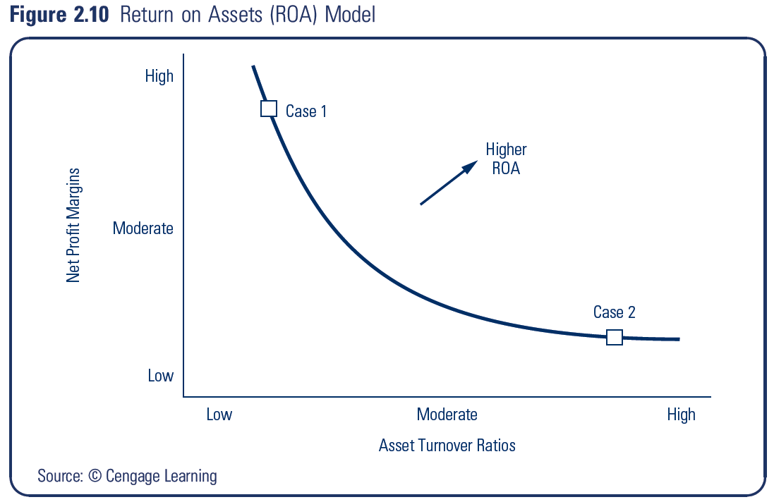
ROA Model Considerations
Case 1: High Profit Margins & Low Asset Turnovers Examples: products and services based on technological innovations
Case 2: Low Profit Margins & High Asset Turnovers Examples: commodity-type products and services

Slide 19
More Selected Financial Terms
Operating Cash Flow:
cash flow from producing and selling a product or providing a service
Free Cash Flow to Equity:
cash remaining after operating cash outflows, financing and tax cash flows, investment in assets needed to sustain the venture’s growth, and net increases in debt capital
Internal Rate of Return (IRR):
compound rate of return that equates the present value of the cash inflows received with the initial investment

Slide 20
Factor Category: Financial/Harvest
Potential Attractiveness:
Cash Flow Breakeven Average: 2-4 years
Rates of Return Average: 20%-50% per year
IPO Potential Average: 2-5 years
Founder’s Control Average: High Minority

Slide 21
Factor Category: Management Team
Potential Attractiveness:
Experience/Expertise Average: General/General
Functional Areas Average: Most Covered
Flexibility/Adaptability Able to Adapt
Entrepreneurial Focus Average: Founder

Slide 22
VOS Indicator™ Average Scores
High Potential (average scores of 2.34-3.00)
ideas that have the potential to become high-growth, high-performance ventures or “home runs”
Average Potential (average scores of 1.67-2.33)
Low Potential (average scores of 1.00-1.66)

Slide 23
Key Elements of a Business Plan
Business Plan:
written document that describes the proposed product or service opportunity, current resources, and financial projections
Cover Page:
should identify the venture and provide the name, address, and phone number of the entrepreneur or other contact person

Slide 24
Key Elements of a Business Plan
Confidentiality Statement:
Example: “This business plan contains information that (the firm) considers proprietary. By accepting this business plan the recipient acknowledges the proprietary nature of this information contained herein and agrees to keep confidential all such information.”

Slide 25
A Typical Business Plan Outline
Executive Summary
Business Description
Description of the product/service
Industry background
Venture or firm background
Goals and milestone objectives

Slide 26
Business Plan Outline (cont’d)
Marketing Plan and Strategy
Target market and customers
Competition and market share
Pricing strategy
Promotion and distribution
Operations and Support
Quality targets
Technology requirements
Service support

Slide 27
Business Plan Outline (cont’d)
Management Team
Experience and expertise
Organizational structure
Intellectual property rights
Financial Plans and Projections
Income statements & balance sheets
Statements of cash flows
Break-even analysis
Funding needs and sources

Slide 28
Business Plan Outline (cont’d)
Risks and Opportunities
Possible problems and risks
Real option opportunities
Appendix
Detailed support for financial forecasts
Timeline and milestones

