Slide 1
Chapter 4
ENTREPRENEURIAL FINANCE
Leach & Melicher
Preparing and using financial statements
© 2015 South-Western Cengage Learning

Slide 2
Chapter 4: Learning Objectives
Describe the process for obtaining and recording resources needed for an early-stage venture
Describe and prepare a basic balance sheet
Describe and prepare a basic income statement
Explain the use of internal statements as they relate to formal financial statements
Briefly describe the cost of production schedule and the inventories schedule
Prepare a cash flow statement and explain how it helps monitor a venture’s cash position
Describe operating breakeven analysis in terms of EBDAT breakeven (survival) revenues
Identify major drivers on the amount of revenues needed to survive
Describe operating breakeven analysis in terms of NOPAT breakeven revenues

Slide 3
Basic Accounting Concepts
Generally Accepted Accounting Principles (GAAP):
guidelines that set out the manner and form for presenting accounting information
Accrual Accounting:
the practice of recording economic activity when recognized rather than waiting until realized

Slide 4
Basic Accounting Concepts (cont’d)
Depreciation:
reduction in value of a fixed asset over its expected life intended to reflect the usage of wearing out of the asset
Accumulated Depreciation:
sum of all previous depreciation amounts charged to fixed assets

Slide 5
Basic Balance Sheet Terms & Concepts
Balance Sheet:
financial statement that provides a snapshot of a venture’s financial position as of a specific date
Balance Sheet Equation:
Total Assets = Total Liabilities + Owners’ Equity
Assets:
financial, physical and intangible items owned or controlled by the business

Slide 6
Basic Balance Sheet Terms & Concepts (cont’d)
Listing Order of Assets:
assets are listed in declining order of liquidity, or how quickly the asset can be converted into cash
Liabilities:
short-term liabilities are listed first followed by long-term debts owed by the venture
Owners’ Equity:
equity capital contributed by the owners of the venture is shown after listing all liabilities

Slide 7
Types of Balance Sheet Assets
Current Assets:
cash & other assets that are expected to be converted into cash in less than one year
Fixed Assets:
assets with expected lives of greater than one year

Slide 8
Types of Current Assets
Cash:
amount of coin, currency, and checking account balances
Receivables:
credit sales made to customers
Inventories:
raw materials, work-in-process, and finished products which the venture hopes to sell

Slide 9
Types of Current Liabilities
Payables:
short-term liabilities owed to suppliers for purchases made on credit
Accrued Wages:
liabilities owned to employees for previously completed work
Bank Loan:
interest-bearing loan of one year or less from a commercial bank

Slide 10
Types of Long-Term Liabilities
Long-Term Debts:
loans that have maturities of longer than one year
Capital Leases:
long-term, noncancelable leases whereby the owner receives payments that cover the cost of the equipment plus a return on investment in the equipment

Slide 11
Off-Balance-Sheet Financing: Operating Leases
Operating Leases:
provide maintenance in addition to financing and are also usually cancelable
Computers, copiers, and automobiles are often financed through operating leases
Balance sheet impact: for operating leases, no assets or lease liabilities are recorded on the balance sheet

Slide 12
Basic Income Statement Terms and Concepts
Income Statement:
financial statement that reports the revenues generated and expenses incurred over an accounting period
Sales or Revenues:
funds earned from selling a product or providing a service
Gross Earnings:
net sales (after deducting returns and allowances) minus the cost of production

Slide 13
Basic Income Statement Terms & Concepts (cont’d)
Operating Income or Earnings Before Interest and Taxes (EBIT):
indicates a firm’s profit after operating expenses, excluding financing costs, have been deducted from net sales
Net Income (or Profit):
bottom line measure after all operating expenses, financing costs, and taxes have been deducted from net sales

Slide 14
Internal Operating Schedules
Cost of Production Schedule
important for preparing the income statement
Cost of Goods Sold Schedule
important for preparing the income statement
Inventories Schedule
important for preparing the balance sheet

Slide 15
Statement of Cash Flows: Definition and Use
Statement of Cash Flows:
shows how cash, reflected in accrual accounting, flowed into and out of a firm during a specific period of operation
Can be used to determine if a venture has been building or burning cash
“Net Cash Burn” occurs when the sum of cash flows from “operations” and “investing” is negative

Slide 16
Operating Breakeven Analysis: Basic Terms
Variable Expenses:
costs or expenses that vary directly with revenues
Fixed Expenses:
costs that are expected to remain constant over a range of revenues for a specific time period
EBITDA:
earnings before interest, taxes, and depreciation & amortization

Slide 17
Operating Breakeven Analysis: Basic Terms (cont’d)
EBDAT:
earnings before depreciation, amortization, & taxes
EBDAT Breakeven:
amount of revenues (survival) needed to cover cash operating expenses
Cash Flow Breakeven:
cash flow at zero for a specific period (EBDAT = 0)

Slide 18
Survival Breakeven Analysis: Some Basics
Basic Equation:
EBDAT = Revenues (R) - Variable Costs (VC) – Cash Fixed Costs (CFC)
Where:
CFC includes both fixed operating (e.g., general and administrative, and possibly marketing expenses) and fixed financing (interest) costs
When EBDAT is Zero:
R = VC + CFC

Slide 19
Solving for Breakeven Level of Survival Revenues
Starting Point:
Ratio of variable costs (VC) to revenues (R) is a constant (VC/R) and is called the Variable Cost Revenue Ratio (VCRR)
Survival Revenues (SR) = VC + CFC
Rewriting, CFC = SR – VC
By substitution, CFC = SR[1 – (VCRR)]
Solving for SR, SR = [CFC/(1 – VCRR)]

Slide 20
Survival Revenues Breakeven: An Example
If the PSA venture were expecting:
Revenues = $1,000,000
Cost of Goods Sold = $650,000
Administrative Expenses = $200,000
Marketing Expenses = $180,000
Depreciation Expenses = $100,000
Interest Expenses = $20,000
Tax Rate = 33%

Slide 21
Survival Revenues Breakeven: An Example (cont’d)
Note: only Cost of Goods Sold is expected to vary directly with Sales
VCRR = $650,000/$1,000,000 = .65
CFC = $200,000 + $180,000 + $20,000 = $400,000
SR = $400,000/(1 - .65) = $1,143,000 rounded

Slide 22
Survival Revenues Breakeven: An Example (cont’d)
Check:
Survival Revenues $1,143,000
Cost of Goods Sold (65%) -743,000
Gross Profit 400,000
Administrative Expenses -200,000
Marketing Expenses -180,000
Interest Expenses -20,000
EBDAT $0

Slide 23
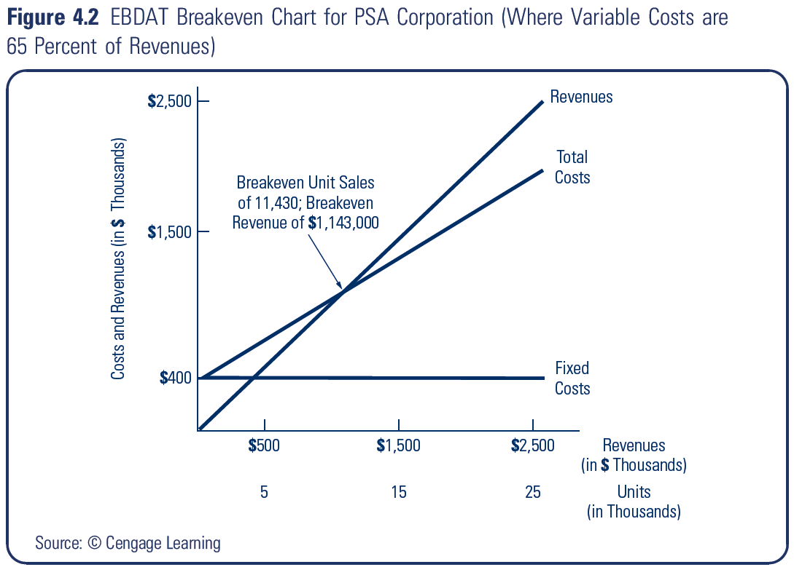
Graphically

Slide 24

Variable Costs at 60% of Revenues

Slide 25
Identifying Breakeven Drivers in Revenue Projections
1. Contribution Profit Margin = 1 – VCRR
higher contribution profit margins mean lower levels of survival revenues are needed to break even (EBDAT = 0)
Example:
Assume cash fixed costs are $400,000 & the VCRR declines from 65% to 60%
[A]: SR = $400,000/(1 - .65) = $1,143,000
[B]: SR = $400,000/(1 - .60) = $1,000,000

Slide 26
Identifying B.E. Drivers in Revenue Projections (cont’d)
2. Amount of Cash Fixed Costs
lower cash fixed costs result in lower levels of survival revenues needed to breakeven (EBDAT = 0)
Example:
Assume cash fixed costs decline from $400,000 to $350,000 and the VCRR is 65%
[A]: SR = $400,000/(1 - .65) = $1,143,000
[B]: SR = $350,000/(1 - .65) = $1,000,000

Slide 27
NOPAT Breakeven: Terms & Concepts
Economic Value Added (EVA):
measure of a firm’s economic profit over a specified time period
NOPAT:
net operating profit after taxes or EBIT times one minus the firm’s tax rate
NOPAT Breakeven Revenues (NR):
amount of revenues needed to cover a venture’s total operating costs

Slide 28
NOPAT Breakeven: Terms & Concepts (cont’d)
Basic Equation:
NR = TOFC/(1 – VCRR)
Where:
TOFC is the total operating fixed costs which consist of cash operating fixed costs (excluding interest expenses) plus noncash fixed costs (e.g., depreciation)

Slide 29
NOPAT Breakeven: An Example
Note: Find the NOPAT Breakeven Revenues (NR) for the PSA venture example
NR = ($200,000 + $180,000 + $100,000)/(1 - $650,000/$1,000,000)
= $480,000/.35 = $1,371,000 rounded

Slide 30
NOPAT Breakeven: An Example
Check:
Revenues $1,371,000
Cost of Goods Sold (65%) -891,000
Administrative Expenses -200,000
Marketing Expenses -180,000
Depreciation -100,000
EBIT $0
NOPAT = [$0 x (1 - .33)] = $0

