Slide 1
Chapter 5
ENTREPRENEURIAL FINANCE
Leach & Melicher
EVALUATING Operating AND FINANCIAL PERFORMANCE
© 2015 South-Western Cengage Learning

Slide 2
CHAPTER 5: Learning Objectives
Understand important operating and financial performance measures and their users, by life cycle stage
Describe how financial ratios are used to monitor a venture’s performance
Identify specific cash burn rate measures and liquidity ratios and explain how they are calculated and used by an entrepreneur
Identify specific leverage ratios and explain their usage by lenders and creditors
Identify and describe measures of profitability and efficiency that are important to the entrepreneur and equity investors
Describe limitations when using financial ratios

Slide 3
Financial Measure by Life Cycle

Slide 4
Financial Ratio & Analysis
Financial Ratios:
show the relationship between two or more financial variables
Trend Analysis:
used to examine a venture’s performance over time
Cross-sectional Analysis:
used to compare a venture’s performance against another firm at the same point in time
Industry Comparables Analysis:
used to compare a venture’s performance against the average performance in the same industry

Slide 5
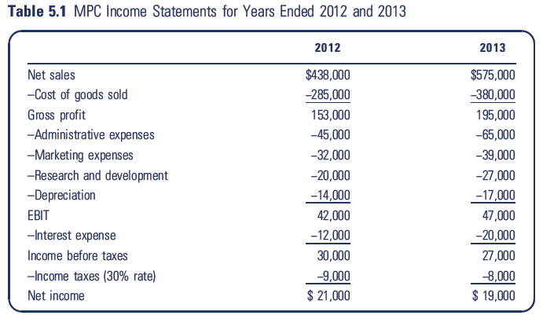
MPC Income Statements

Slide 6
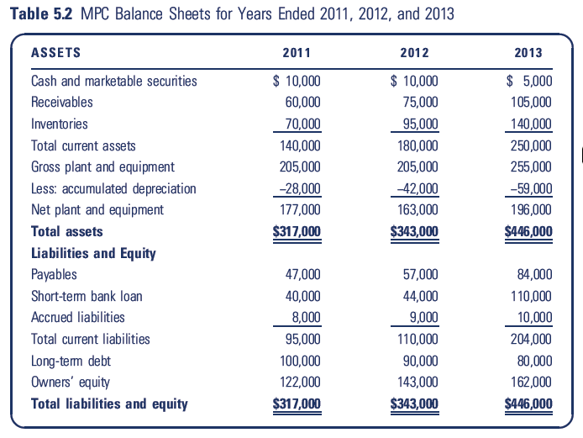
MPC Balance Sheets

Slide 7
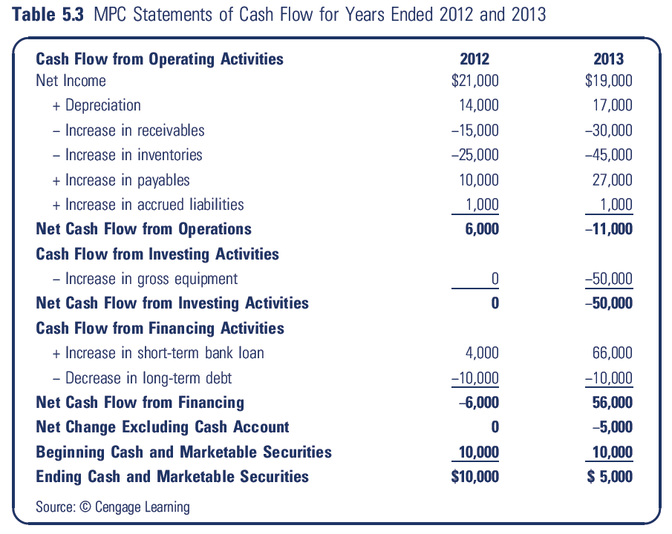
MPC Statements Of Cash Flow

Slide 8
Cash Burn
Cash Burn:
cash a venture expends on its operating and financing expenses and its investments in assets
Cash Burn Rate:
cash burn for a fixed period of time, typically a month

Slide 9
Cash Burn / Build / Burn Rate
Cash Burn =
Inventory-related expenses + Admin expenses + Marketing expenses + R& D expense + Interest expenses + Change in prepaid expenses – (Change in accrued liabilities + Change in payables) + Capital investment + Taxes
MPC for 2013:
Cash burn = 425,000 + 65,000 + 39,000 + 27,000 + 20,000 + 0 – (1,000 + 27,000) +50,000 + 8,000 = 606,000
Note 425,000 = 380,000 (COGS) + 45,000 (Change in Inv.)

Slide 10
Cash Burn / Build / Burn Rate
Cash Build = Net sales – Change in receivables
MPC for 2013:
Cash build = 575,000 - 30,000 = 545,000
Cash Build Rate:
Cash build for a fixed period of time, typically a month
Net Cash Burn = Cash burn – Cash build
= 606,000 - 545,000 = 61,000

Slide 11
Liquidity Ratios
Indicate the ability to pay short-term liabilities when they come due
Current Ratio:
= Average current assets/Average current liabilities
= (250,000+180,000)/2
(204,000+110,000)/2
= 1.37

Slide 12
Liquidity Ratios
Liquid assets:
sum of a venture’s cash and marketable securities plus its receivables
Quick Ratio:
= Average current assets – Average inventories
Average current liabilities
= (250,000 +180,000)/2 – (140,000+95,000)/2
(204,000 + 110,000)/2
= .62

Slide 13
Liquidity Ratios
Net working capital (NWC):
current assets minus current liabilities
NWC – to – Total – Assets Ratio:
= Ave. current assets – Ave. current liabilities
Ave. total assets
= (250,000+180,000)/2 – (204,000+110,000)/2
(446,000 + 343,000)/2
=.147 or 14.7%

Slide 14
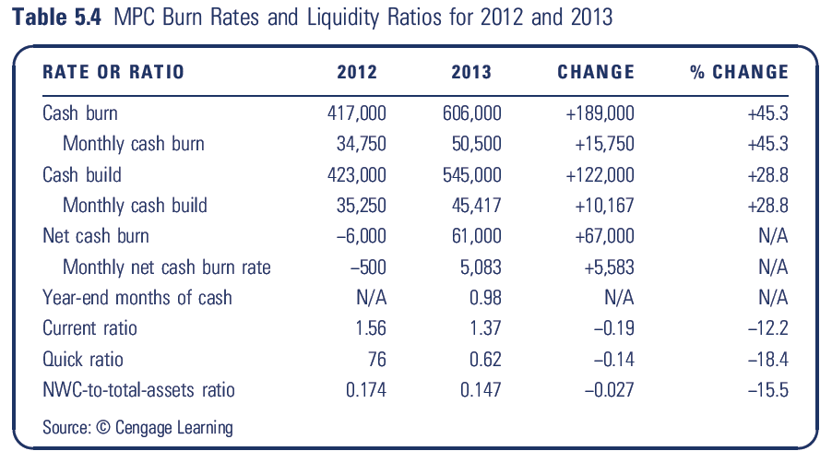
MPC Burn Rates & Liquidity Ratios

Slide 15
Leverage Ratios
Leverage Ratio:
indicates the extent to which the venture is in debt and its ability to repay its debt obligations
Loan Principal Amount:
dollar amount borrowed from a lender
Interest:
dollar amount paid on the loan to a lender as compensation for making the loan

Slide 16
Measuring Financial Leverage
Total-Debt-to-Total-Asset Ratio:
= Ave total debt / Ave total assets
= (204,000 +110,000)/2 + (80,000 +90,000)/2
(446,000 + 343,000)/2
= .6134 or 61.34%

Slide 17
Measuring Financial Leverage
Equity Multiplier:
= Ave total assets / Ave owners’ equity
= (446,000 + 343,000)/2
(162,000 + 143,000)/2
= 2.587 times

Slide 18
Measuring Financial Leverage
Current-Liabilities-to-Total-Debt Ratio:
= Ave. current liabilities / Ave. total debt
= (204,000 + 110,000)/2
(284,000 + 200,000)/2
= .6488 or 64.88%

Slide 19
Measuring Financial Leverage
Interest Coverage Ratio:
= EBITDA / Interest
= 47,000 + 17,000/2
20,000
= 3.20 times

Slide 20
Measuring Financial Leverage
Fixed Charge Coverage:
= EBITDA + Lease payments .
Interest + Lease payments + [Debt repayments / (1-T)]
= 64,000 + 0 .
(20,000 + 0 + [10,000/(1-.30)])
= 1.87 times

Slide 21
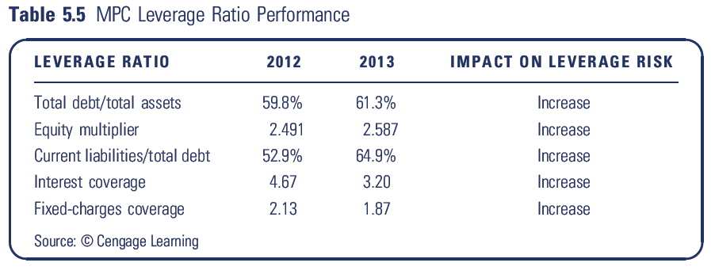
MPC Leverage Ratio Performance

Slide 22
Profitability & Efficiency Ratios
Profitability Ratios:
indicate how efficiently a venture controls its expenses
Efficiency Ratios:
indicate how efficiently a venture uses its assets in producing sales

Slide 23
Measuring Profitability & Efficiency
Gross Profit Margin:
= Net Sales – COGS
Net Sales
= 195,000/575,000
= .3391 or 33.91%

Slide 24
Measuring Profitability & Efficiency
Operating Profit Margin:
= EBIT .
Net Sales
= 47,000/575,000
= .0817 or 8.17%

Slide 25
Measuring Profitability & Efficiency
Net Profit Margin:
= Net Profit
Net Sales
= 19,000/575,000
= .0330 or 3.30%

Slide 26
Measuring Profitability & Efficiency
Interest Tax Shield:
proportion of a venture’s interest payment paid by the government because interest is deductible before taxes are paid
NOPAT Margin:
= EBIT (1 – tax rate)
Net Sales
= 47,000 (1 - .30)
575,000
= .0572 or 5.72%

Slide 27
Measuring Profitability & Efficiency
Sales-to-Total-Assets Ratio:
= Net Sales .
Ave total assets
= 575,000 .
(446,000 + 343,000)/2
= 1.458 times

Slide 28
Measuring Profitability & Efficiency
Return on Total Assets (ROA):
= Net profit .
Ave total assets
= 19,000 .
(446,000 + 343,000)/2
= .048 or 4.8%

Slide 29
Measuring Profitability & Efficiency
ROA Model:
the decomposition of ROA into the product of the net profit margin and the sales-to-total-assets ratio
ROA
= (Net profit / sales) x (Net sales / Ave. total assets)
= (19,000/575,000) x (575,000/ (446,000 + 343,000)/2)
=.0330 x 1.458 = .048 or 4.8%

Slide 30
Measuring Profitability & Efficiency
Return on Equity (ROE):
= Net Income .
Ave owners’ equity
= 19,000 .
(162,000 + 143,000)/2
= .1246 or 12.46% (or 12.5% rounded)

Slide 31
Measuring Profitability & Efficiency
ROE Model:
the decomposition of ROE into the product of the net profit margin, sales-to-total-assets ratio, and equity multiplier
ROE
= (Net profit / sales) x (Net sales / Ave. total assets) x (Ave. total assets / Ave. equity)
= 3.3% x 1.46% x 2.59% = 12.5%

Slide 32
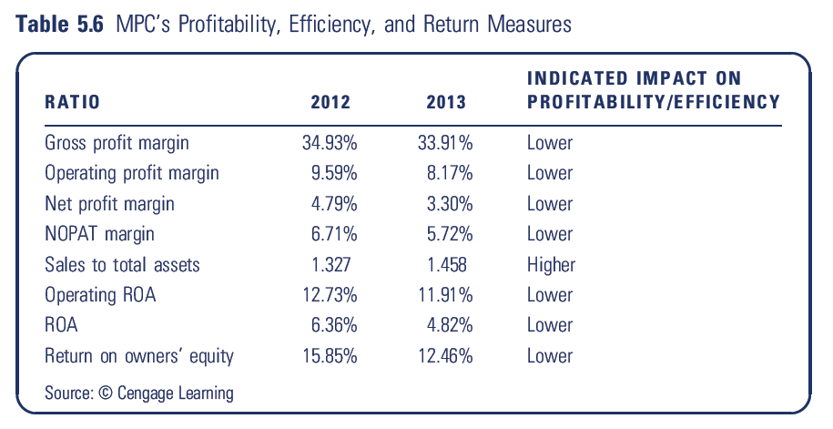
MPC Profitability & Efficiency Performance

Slide 33
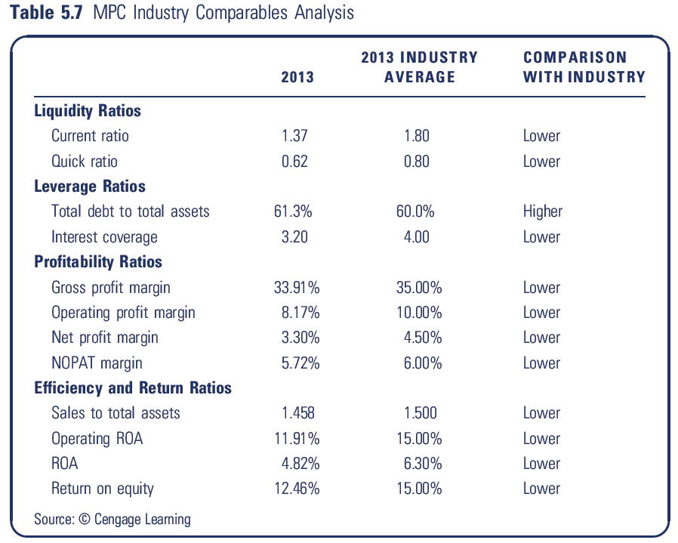
MPC Industry Comparables Analysis

