Slide 1
Chapter 6
ENTREPRENEURIAL FINANCE
Leach & Melicher
Managing cash flow
© 2015 South-Western Cengage Learning

Slide 2
CHAPTER 6: Learning Objectives
Construct a cash budget and determine the timing and amount of any monthly cash needs
Describe how short-term projected statements of cash flows relate to cash budgets
Explain why short-term projected statements of cash flow are important to the entrepreneur
Identify and describe the use and value of conversion period ratios to the entrepreneur

Slide 3
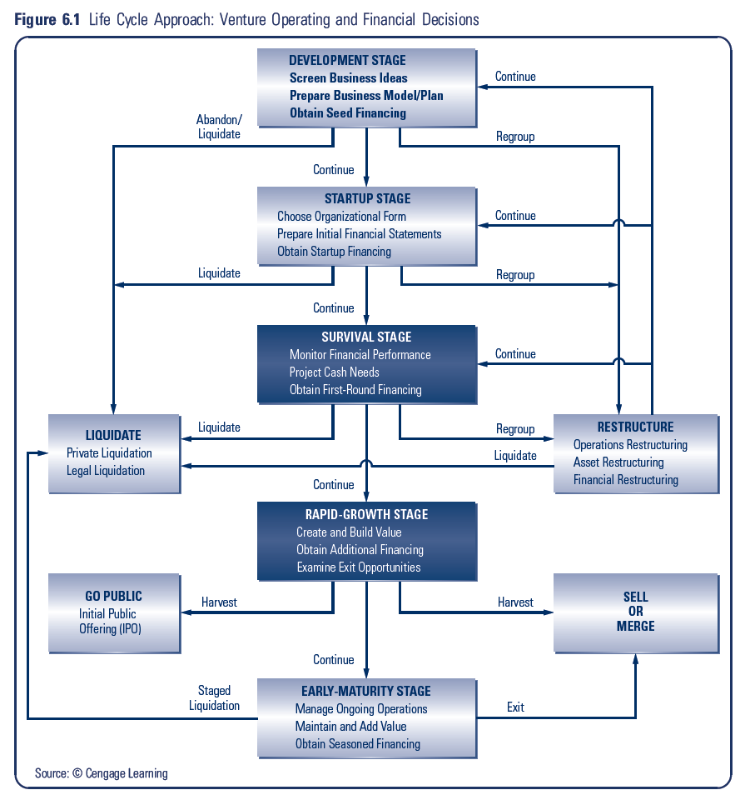

Slide 4
Venture Life Cycle: Operating And Financial Decisions
Development Stage:
Screen Business Ideas
Prepare Business Plan
Obtain Seed Financing
Startup Stage:
Choose Organizational Form
Prepare Initial Financial Statements
Obtain First Round Financing

Slide 5
Venture Life Cycle: Operating And Financial Decisions
Survival Stage:
Monitor Financial Performance
Project Cash Needs
Obtain First Round Financing
Possible Actions: Liquidate v. Restructure
Rapid Growth Stage:
Create and Build Value
Obtain Additional Financing
Examine Exit Opportunities
Possible Actions: Go Public v. Sell/Merge

Slide 6
Venture Life Cycle: Operating And Financial Decisions
Early-Maturity Stage:
Manage Ongoing Operations
Maintain and Add Value
Obtain Seasoned Financing

Slide 7
Short-term Cash Planning Tools
Sales Schedule
Purchase Schedule
Wages and Commission Schedule
Cash Budget

Slide 8
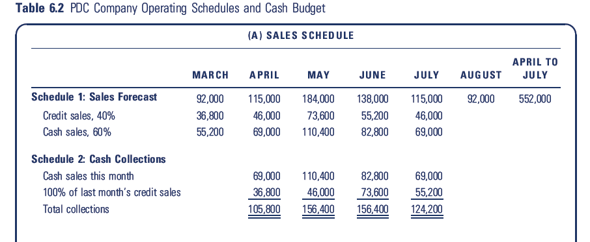
PDC Company Operating & Cash Budget

Slide 9
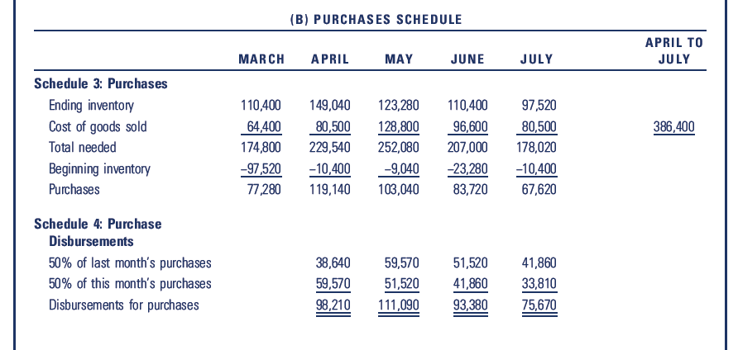
PDC Company Operating & Cash Budget

Slide 10
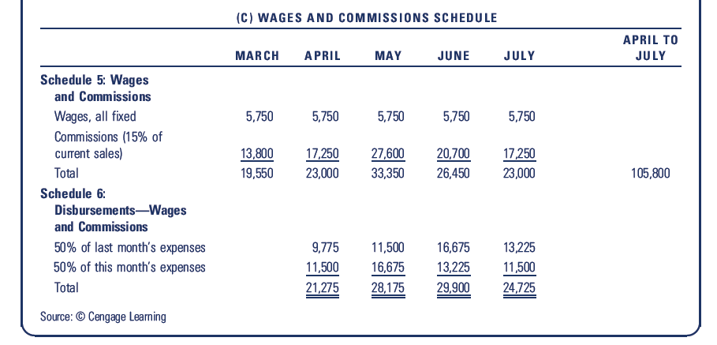
PDC Company Operating & Cash Budget

Slide 11
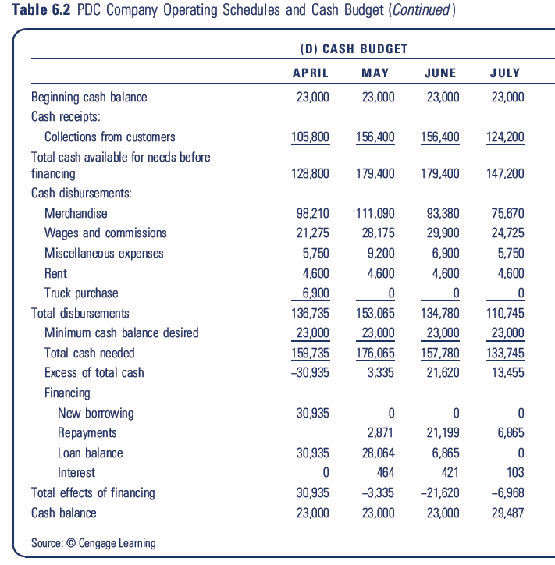

Slide 12
Check With Projected Financials
As a check on the cash budget, you can get the exact same cash balance by constructing a full set of financial statements. See Exhibits 6.3 – 6.5 in the textbook.

Slide 13
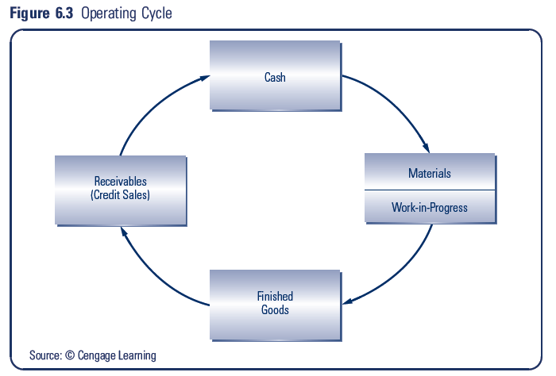
Operating Cycle

Slide 14
Conversion Period Ratios
Conversion Period Ratio:
indicates the average time it takes in days to convert certain current assets and current liability accounts into cash
Operating Cycle:
time it takes to purchase, produce, and sell the venture’s products plus the time needed to collect receivables if the sales are on credit
Cash Conversion Cycle:
sum of the inventory-to-sale conversion period and the sales-to-cash conversion period less the purchase-to-payment conversion period

Slide 15
Measuring Conversion Times
Inventory-to-Sale Conversion Period
= Ave. Inventories
(CGS / 365)
= (140,000 + 95,000)/2 = 117,500
380,000/365 1041
= 112.9 days

Slide 16
Measuring Conversion Times
Given New I-to-S, Can Solve for New Average Inventories
= Inventory-to-Sale Conversion Period
x (COGS/365)
= 105.7 X $1,041
= $110,000 (rounded)

Slide 17
Measuring Conversion Times
Sale-to-Cash Conversion Period:
= Ave Receivables
(Net Sales/365)
= (105,000 + 75,000)/2
575,000/365
= 57.1 days

Slide 18
Measuring Conversion Times
Purchase-to-Payment Conversion Period:
= Ave Payables + Ave Accrued Liabilities
(COGS / 365)
= (84,000+57,000)/2 + (10,000+9,000)/2
380,000/365
= 76.8 days

Slide 19
Measuring Conversion Times
Cash Conversion Cycle
= Inventory-to-Sale Conversion Period
+ Sale-to-Cash Conversion Period
– Purchase-to-Payment Conversion
= 112.9 days + 57.1 days – 76.8 days
= 93.2 days

Slide 20
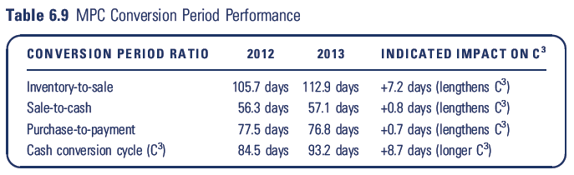
MPC Conversion Period Performance

