Slide 1
Chapter 7
ENTREPRENEURIAL FINANCE
Leach & Melicher
TYPES AND COSTS OF FINANCIAL CAPITAL
© 2015 South-Western Cengage Learning

Slide 2
CHAPTER 7: Learning Objectives
Understand some basic characteristics of the financial markets
Understand how risk-free securities prices reflect risk-free borrowing rates
Explain how corporate debt prices reflect higher interest rates when a borrower may default
Explain investment risk
Estimate the cost of publicly traded equity capital (e.g., exchange-listed common stocks)
Estimate the cost of private equity capital
Explain how capital costs combine into a weighted average cost of capital (WACC)
Understand venture investors’ target returns and their relation to capital costs

Slide 3
Types & Costs of Financial Capital
Implicit Versus Explicit Financial Capital Costs
Formal historical accounting procedures include explicit records of debt (interest and principal) and dividend capital costs
However, no provision is made to record the less tangible expenses of equity capital (i.e., required capital gains to complement the dividends)

Slide 4
Financial Markets
Public Financial Markets:
markets for the creation, sale and trade of liquid securities having standardized features
Private Financial Markets:
markets for the creation, sale and trade of illiquid securities having less standardized negotiated features

Slide 5
Determining Cost Of Debt Capital
Interest Rate:
price paid to borrow funds
Default Risk:
risk that a borrower will not pay the interest and/or principal on a loan

Slide 6
Determining Cost Of Debt Capital
Nominal Interest Rate (rd):
observed or stated interest rate
Real Interest Rate (RR):
interest one would face in the absence of inflation, risk, illiquidity, and any other factors determining the appropriate interest
Risk-free Interest Rate (rf):
interest rate on debt that is virtually free of default risk
Inflation:
rising prices not offset by increasing quality of the goods or services being purchased

Slide 7
Determining Cost Of Debt Capital
Inflation premium (IP):
average expected inflation rate over the life of a risk-free loan
Default Risk Premium (DRP):
additional interest rate premium required to compensate the lender for the probability that a borrower will default on a loan
Liquidity Premium (LP):
charged when a debt instrument cannot be converted to cash quickly at its existing value
Maturity Premium (MP):
premium to reflect increased uncertainty associated with long-term debt

Slide 8
Interest Rate Relationships
rf = RR + IP
for debt by effectively default-free borrowers (e.g. U.S. government)
rd = RR + IP + DRP +LP +MP
more generally, for more complicated risky debt securities at various maturities and liquidities
Can think of rd = rf + DRP + LP + MP

Slide 9
Determining Cost Of Debt Capital
Prime Rate:
interest rate charged by banks to their highest quality (lowest default risk) business customers
Bond Rating:
reflects the default risk of a firm’s bonds as judged by a bond rating agency
Senior Debt:
debt secured by a venture’s assets
Subordinated Debt:
debt with an inferior claim (relative to senior debt) to venture assets

Slide 10
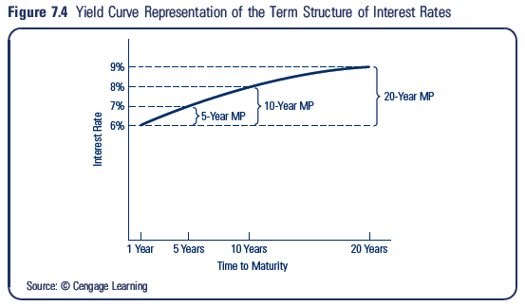
Determining Cost Of Debt Capital
Term Structure of Interest Rates:
relationship between nominal interest rates and time to maturity when default risk is held constant

Slide 11
Determining Market Interest Rates
rd = RR + IP + DRP +LP +MP
Suppose:
Real interest rate = 3%
Inflation expectation = 3%
Default risk = 5%
Liquidity premium = 3%
Maturity premium = 2%
Then:
rd = 3% + 3% + 5% + 3% + 2% = 16%

Slide 12
What Is Investment Risk?
Investment Risk:
chance or probability of financial loss from a venture investment
Debt, equity, and founding investors all assume investment risk
A widely accepted measure of risk is the dispersion of possible outcomes around the expected return of an investment – the standard deviation of possible investment returns

Slide 13
Calculating a Possible Return
Suppose
Buy stock at $100
Receive $10 dividend
Ending stock value = $110
Then:

Slide 14
Calculating an Expected Return
Expected Rate of Return:
probability-weighted average of all possible rate of return outcomes

Slide 15
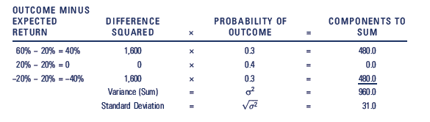
Risk as a Dispersion Around an Average
Calculating Standard Deviation:
Calculate the expected rate of return based on estimates of possible returns and probabilities associated with those returns
Subtract the expected value from each outcome to determine deviations from the expected value
Square each difference or deviation
Multiply each squared deviation by the probability of the outcome and sum the weighted squared deviation to get the variance
Calculate the square root of the variance to get standard deviation

Slide 16
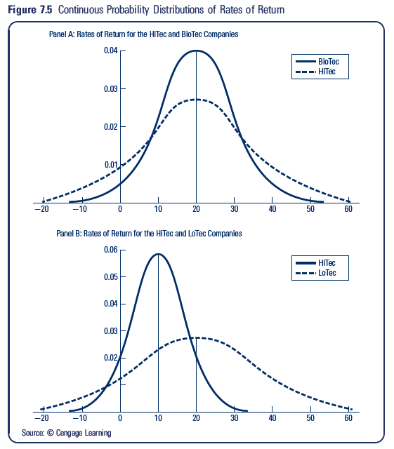

Slide 17
Combining risk and expected return
Coefficient of Variation:
Standard Deviation / Expected Return
Coefficient of Variation: shows the dispersion risk per unit of expected rate of return – a ratio of risk to reward

Slide 18
Estimating the Cost of Equity
Private Equity Investors
owners of proprietorships, partners in partnerships, and owners in closely held corporations
Closely Held Corporations
corporations whose stock is not publicly traded
Publicly Traded Stock Investors
equity investors of firms whose stocks trade in public markets such as the over-the-counter market or an organized securities exchange

Slide 19
Estimating the Cost of Equity
Organized Securities Exchange:
a formally organized exchange typically having a physical location with a trading floor where trades take place under rules set by the exchange
Over-the-Counter (OTC) Market:
network of brokers and dealers that interact electronically without having a formal location
Market Capitalization (market cap):
determined by multiplying a firm’s current stock price by the number of shares that are outstanding

Slide 20
Public Corporation Cost of Equity
re = rf + IRP = RR + IP + IRP
where:
re = cost of common equity
rf = risk-free interest rate
RR = real rate of interest
IP = inflation premium
IRP = equity investment risk premium
IRP:
additional return expected by investors in a risky publicly traded common stock

Slide 21
Public Corporation cost of Equity
Expected Return on Venture’s Equity (re) using the Security Market Line (SML):
re = rf + [rm – rf] b
where
rf = risk-free interest rate
rm = expected annual rate of return on stock market
b (beta) = systematic risk of firm to the overall stock market

Slide 22
Public Corporation Cost of Equity
Expected Return on Venture’s Equity (re) using the Security Market Line (SML):
re = rf + [MRP] b
MRP:
market risk premium = excess average annual return of common stocks over long-term government bonds

Slide 23
Private Venture Cost of Equity
Venture Hubris:
optimism expressed in business plan projections that ignore the possibility of failure or underperformance
What do we do with such projections? Use
rv = re + AP + LP + HPP
where:
rv = rate of return for venture investors
re = cost of common equity
AP = advisory premium
LP = liquidity risk
HPP = hubris projections premium

Slide 24
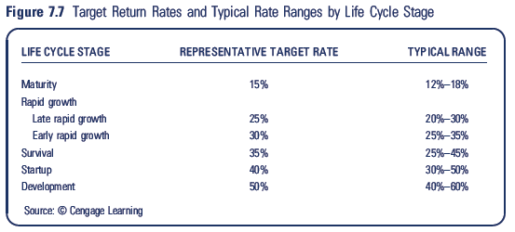
Target Return Comparison

Slide 25
Weighted Average Cost of Capital (WACC)
WACC:
weighted average cost of the individual components of interest-bearing debt and common equity capital
After-tax WACC:
= (1 – tax rate) x (debt rate) x (debt–to– value) +
equity rate x (1 – debt–to–value)

Slide 26
Weighted Average Cost of Capital (WACC)
WACC Example for $1 Venture with:
$.50 of debt
$.50 of equity
debt interest rate = 10%
tax rate = 30%
required return to equity holders = 20%
After-tax WACC
= (1 – tax rate) x (debt rate) x (debt–to–value) +
equity rate x (1 – debt–to–value)
= (.70 x .10 x .5) + (.20 x .5)
= .135 or 13.5%

Slide 27
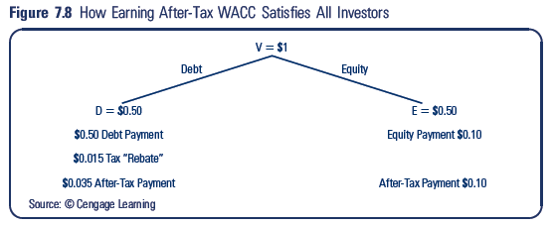
Graphically,

Slide 28
Appendix: Using WACC to Complete Calibration of EVA
EVA:
Net Operating Profit After Taxes (NOPAT) – After-tax Dollar Cost of Financial Capital Used
NOPAT = EBIT(1- Effective Tax Rate)
After-Tax Dollar Cost of Financial Capital Used = amount of financial capital x WACC

Slide 29
Appendix: Using WACC to Complete Calibration of EVA
Beta Omega Corp
EBIT = $500,000
Amount of Financial Capital = $1,600,000
WACC = 19.0%
Tax = 30%
NOPAT = [$500,000 x (1-.30)] = $350,000
After-Tax Cost of Financial Capital Used =
$1,600,000 x .19 = $304,000
EVA = $350,000 - $304,000 = $46,000

