Slide 1
Chapter 8
ENTREPRENEURIAL FINANCE
Leach & Melicher
SECURITIES LAW CONSIDERATIONS WHEN OBTAINING VENTURE FINANCING
© 2015 South-Western Cengage Learning

Slide 2
Chapter 8: Learning Objectives
Identify four relevant components of the federal securities laws
Explain what is meant by blue-sky laws
Define “security” according to the Securities Act of 1933 and explain why such a designation matters
Describe what is involved in registering securities with the Securities & Exchange Commission (SEC)
Identify some of the securities that are exempt from registration with the SEC
Identify some transaction exemptions granted under the Securities Act of 1933
Describe and discuss how the SEC’s Regulation D serves as a securities registration “safe harbor”
Explain how Rules 504, 505, and 506 of Regulation D differ from one another
Describe what Regulation A is & explain how and when it is used

Slide 3
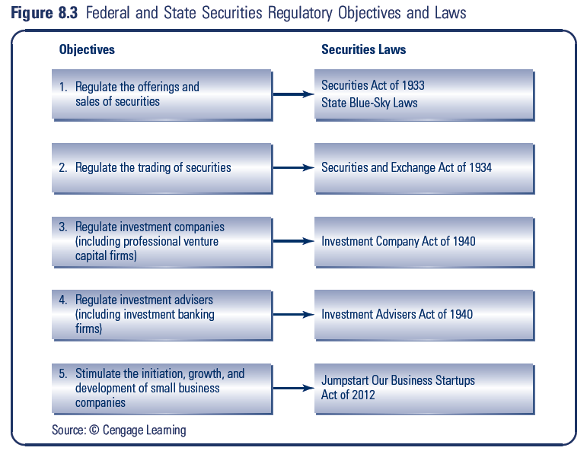
Overview of Federal Securities Laws

Slide 4
Overview (cont.)
Securities Act of 1933:
main body of federal law governing the creation and sale of securities
Securities Exchange Act of 1934:
deals with the mechanisms and standards for public security trading
Investment Company Act of 1940:
provides a definition of “investment company”
Investment Advisers Act of 1940:
focuses on people and organizations that seek to provide financial advice to investors and defines “investment adviser”

Slide 5
State Securities Regulations
In addition to federal restrictions, issuers must also consider restrictions imposed by the various states
State Securities Regulations are referred to as “Blue Sky” Laws
State laws are designed to protect individuals from investing in fraudulent security offerings

Slide 6
Role of Federal Securities Law
Federal laws frequently are predicated on some offending behavior’s affecting more than one state (e.g., fraudulent interstate transactions).
This focus is due to “state-rights” traditions and the notion that an infraction confined to one state is a state, not a federal, matter.

Slide 7
Federal: Securities Act of 1933
Important aspects of the act relate to securities fraud
1933 Act sets requirements for registering securities with federal government
1933 Act sets nature and authority of the Securities Exchange Commission (SEC) with whom registrations are filed

Slide 8
What is a Security?
The term “security” means any note, stock, treasury stock, bond, debenture, evidence of indebtedness, investment contract, put and call options….
One need not actually sell a security to trigger the securities laws, one need only offer to sell the security

Slide 9
Why Does “Security” Designation Matter?
Securities Act of 1933 sets formal rules required in offering and selling securities
Unless your security is exempted, Section 5 of the 1933 Act requires you to file a registration statement with the SEC
Unless a registration statement is in effect, it shall be unlawful for any person to make use of any means of transportation or communication in interstate commerce or of the mails to sell a security through the use of any prospectus, or to deliver such security

Slide 10
Registering Securities with SEC
Costly and time-consuming process
Usually done with investment banking professionals and legal counsel
Common “remedy” for a “fouled up” securities offering is a “rescission “ of the offering—where all funds are returned to the investors
To avoid rescission—either register or make sure you are exempted from registration

Slide 11
Important Points to Remember
In securities law, “ignorance is no defense”
Security regulators may alter your investment agreement to the benefit of the investors
Securities Act of 1933 gives the SEC broad civil and some criminal procedures to use in enforcement
It is worth your time to investigate whether securities can be issued under an exemption from the registration requirement

Slide 12
Digression: What is Securities Fraud?
It is unlawful for a person in the offer or sale of securities:
to employ any device, scheme, or artifice to defraud
to obtain money or property by means of any untrue statement of a material fact or any omission to state a material fact
to engage in any transaction, practice, or course of business which operates as a fraud or deceit upon the purchaser

Slide 13
Securities Fraud Digression (Continued)
It shall be unlawful for any person…to publish, give publicity to, or circulate any notice, advertisement, article….which, though not purporting to offer a security for sale, describes such security for consideration received from an issuer, underwriter, or dealer without fully disclosing the receipt of such consideration
Securities otherwise exempted from registration are not exempted from fraud provisions

Slide 14
JOBS Act of 2012
Summary of Relevant Innovations:
Class of firms designated “Emerging Growth Company” face different registration requirements (less transparency)
General advertising and solicitation allowed for Reg D 506 offerings (more information to come on 506 offerings)
Internet “crowdfunding” for securities up to $1 million
“Regulation A Plus” as competitor to Regulation A
Forced registration limit raised from 500 to 2000 shareholders

Slide 15
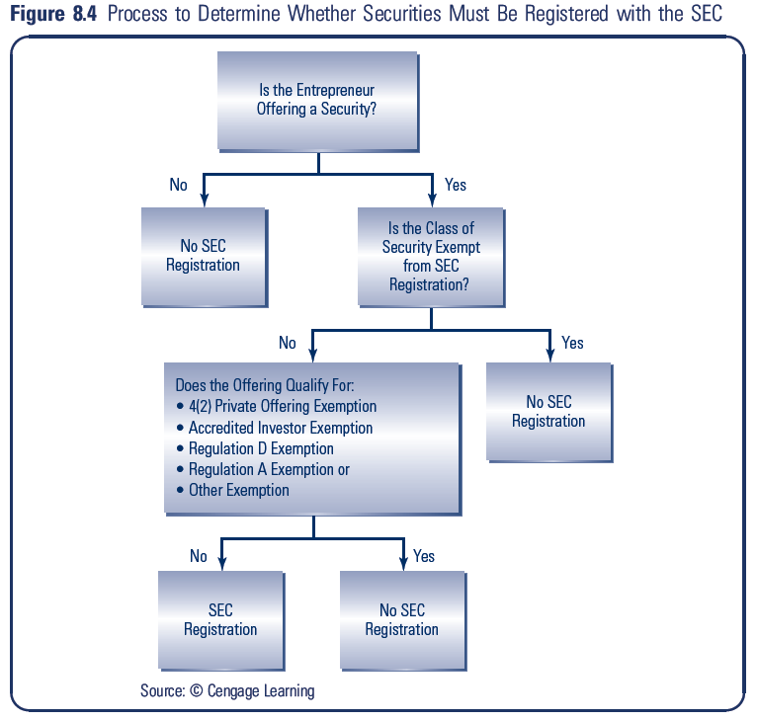
Overview

Slide 16
Back to SEC Registration: Exemptions
Two Basic Types of Exemptions
Security
Transaction
Security Exemptions
Government securities
Securities issued by banks and thrift institutions
Certain securities issued by insurance companies
Certain not-for-profit organization securities
Certain securities involved in bankruptcy proceedings
Intrastate Offering Exemption (issuer must assure that offerees and purchasers are in the issuer’s home state)

Slide 17
Registration Exemptions (Continued)
Transaction Exemptions
Private Offering Exemption (transactions by an issuer not involving any public offering are exempted)
Accredited Investor Exemption (investors who have sufficient financial expertise and wherewithal to make intelligent informed investment decisions are exempted)

Slide 18
SEC Versus Murphy Case (1980)
Considerations identified in determining an offering is a private placement:
Number of offerees must be limited
Offerees must be sophisticated
Size and manner of offering must not indicate widespread solicitation
Some relationship between offerees and issuer must be present

Slide 19
Accredited Investor Exemption
Accredited Investor Definition Includes:
Banks, insurance companies, investment companies
Any person who qualifies as an accredited investor (on the basis of financial sophistication, net worth, knowledge, and experience in financial matters)

Slide 20
Private Placements: SEC’s Regulation D
Because of the uncertainty about what constitutes a non-public offering, the SEC provides some “safe harbor” conditions that, when met, result in guaranteed exemption as a private placement
Regulation D (or Reg D for short) took effect in 1982 and provides the basis for “safe harbor” as a private placement

Slide 21
(Appendix) Regulation D: Rule 501
Covers Definitions and Terms
Monetary Requirements for Individuals or Natural Persons as Accredited Investors
Net worth greater than $1,000,000 excluding residence or
Individual annual income greater than $200,000 (greater than $300,000 if joint income is used)

Slide 22
(Appendix) Regulation D: Rule 502
Deals with Four General Conditions:
Integration (when multiple issues count as one)
Note: Because Rules 504 and 505 have limits on the dollar amount of money that can be raised, to assure non-integration keep the 12 months around a Reg D offering clear of offerings of the same type of security
Information (what you need to disclose when you must formally disclose)
Note: Information to be disclosed varies by the venture’s status and size. For example for offerings up to $2,000,000, balance sheets must be audited. Larger offerings require more information

Slide 23
(Appendix) Regulation D: Rule 502 (cont’d)
Solicitation (what you can’t do when promoting the offering)
Note: Two-way communication with investors is required. For example, investors must have the opportunity to ask questions and receive answers concerning the terms/conditions of the offering.
Resale (serious restrictions)
Note: Restricting resale opportunities is consistent with the goal of keeping the placement private.

Slide 24
Reg D Exemptions: Rules 504, 505, & 506
Reg D exemptions for limited offerings and sales of securities
Rule 504: $1,000,000 financing limit
Rule 505: $5,000,000 financing limit
Rule 506: No limit to offering amount
Note: There is a limit of 35 unaccredited investors under Rules 505 & 506 (no unaccredited investor limit for Rule 504)

Slide 25
Small Business Alternatives
Regulation A
Technically considered an exemption from registration
Shorter and simpler securities filing relative to a full registration with the SEC
A public offering rather than a private placement
Limited to raising $5,000,000
No limit on the number or sophistication of offerees
Cannot be used by SEC reporting companies
Can “test the waters” concerning investor interest prior to preparing the offering circular

Slide 26
(Appendix) Small Business Alternatives
Regulation SB
Reference here is for small business compliance with, not exemption from, the 1933 Act’s registration requirements
The intent is to simplify the registration process for small businesses seeking modest capital from the public markets

Slide 27
(Appendix) Other Registration Exemptions
Rule 701:
Covers issuing securities as part of the compensation package for key employees
Rule 1001:
State of California effort to provide a more general definition of an accredited investor at its state level

