Slide 1
Chapter 9
ENTREPRENEURIAL FINANCE
Leach & Melicher
Projecting Financial Statements
© 2015 South-Western Cengage Learning

Slide 2
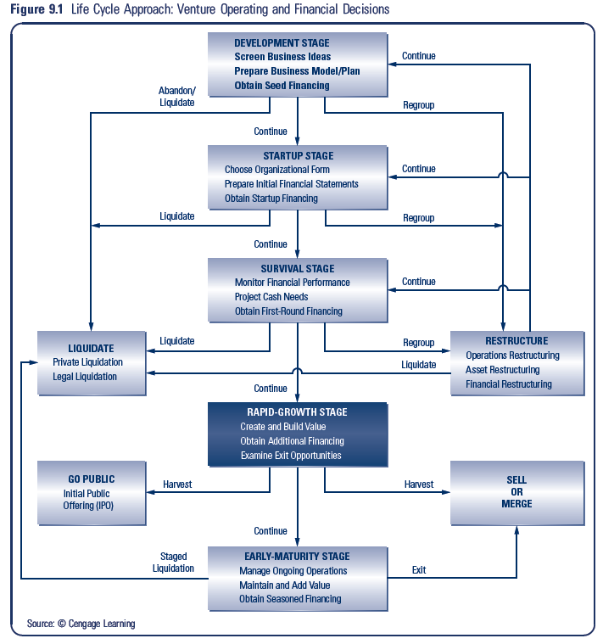

Slide 3
Chapter 9: Learning Objectives
Explain the differences in forecasting sales for seasoned firms versus early-stage firms
Understand the concept of sustainable sales growth rate
Understand the process of identifying the quantity and timing of additional funds needed to support the venture’s sales forecasts
Connect sales growth rates to the amount and timing of additional funds needed
Describe the percent-of-sales method for preparing financial plans

Slide 4
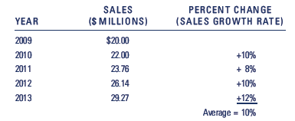
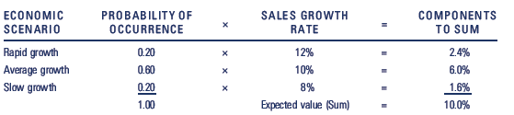
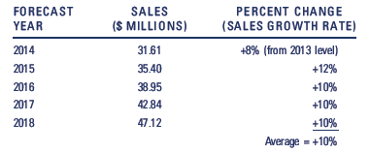
Seasoned Firm ForeCasting

Slide 5
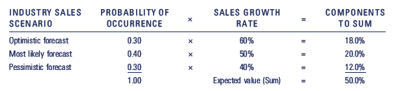
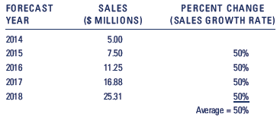
Early-Stage Forecasting

Slide 6
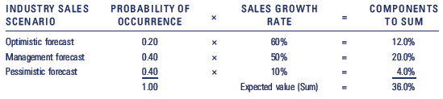
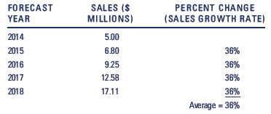
Knocking Back Those Growth Rates

Slide 7
Sustainable Sales Growth Rates
Internally Generated Funds:
Net income or profits after taxes earned over an accounting period
Sustainable Sales Growth Rate:
Rate at which a firm can grow sales based on the retention of profits in the business

Slide 8
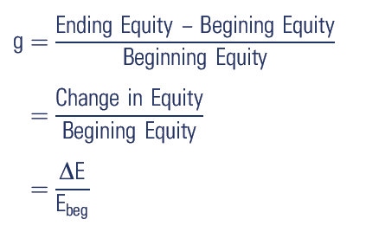



Sustainable Sales Growth Rates

Slide 9
Sustainable Sales Growth Rates

Slide 10
Additional Financing Needed
Financing Capital Needed (FCN):
financial funds needed to acquire assets necessary to support a firm’s sales growth
Spontaneously Generated Funds:
increases in accounts payables and accruals (wages and taxes) that occur with a sales increase

Slide 11
Additional Funds Needed
Additional Funds Needed (AFN):
gap remaining between the financial capital needed and that funded by spontaneously generated funds and retained earnings, or,
AFN =
Required Increase in Assets
– Spontaneously Generated Funds
– Increase in Retained Earnings

Slide 12
AFN Equation

Slide 13
AFN Calculation Example
Sales last year = $1,600,000
Asset investment = $1,000,000
Net Income = $160,000
Current Assets = $520,000
Fixed Assets = $480,000
Accounts Payable = $48,000
Accrued Liabilities = $32,000
Projected next year sales = $2,080,000

Slide 14
Projecting Financial Statements
Percent of Sales Method:
make projections based on the assumption that certain costs and selected balance sheet items are best expressed as a percentage of sales
Constant Ratio Method:
variant of the percent of sales method that projects selected cost and balance items at the same growth rate as sales

Slide 15
Projecting Financial Statements
Financial Forecasting Process To Project Financial Statements
1. Forecast sales
2. Project income statement
3. Project balance sheet
4. Project statement of cash flows

Slide 16
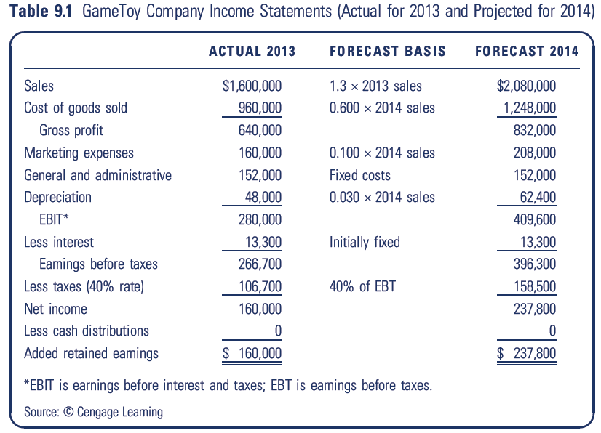
Projected Income Statements

Slide 17
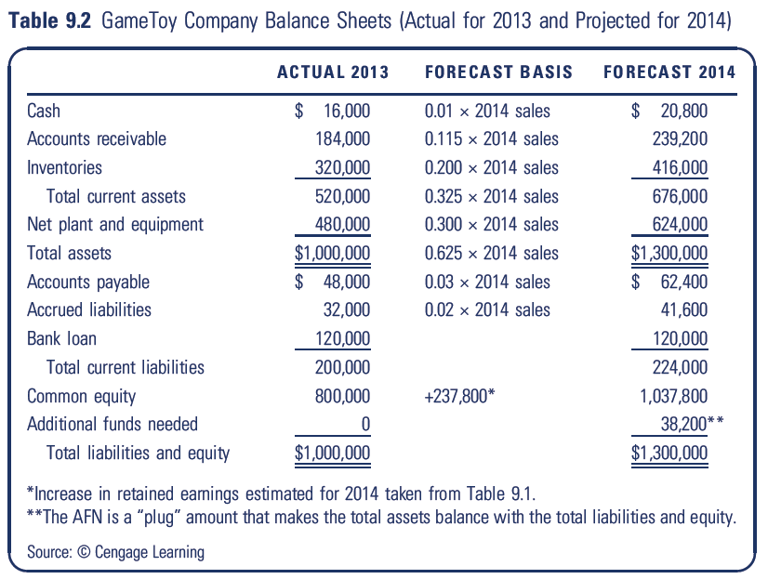
Projected Balance Sheets

Slide 18
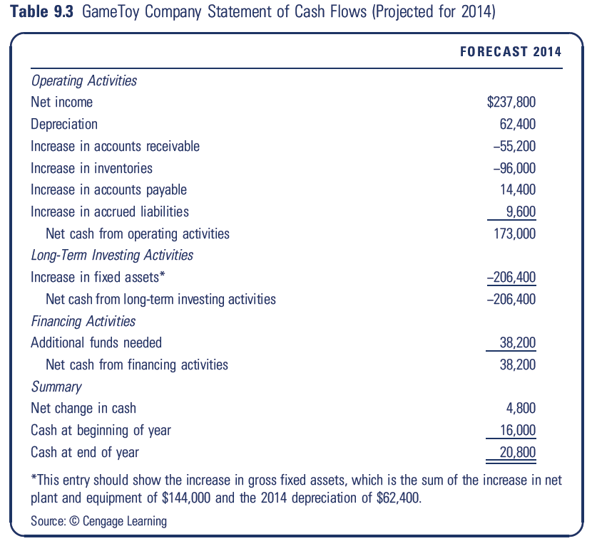
Projected Statements of Cash Flow

