Slide 1


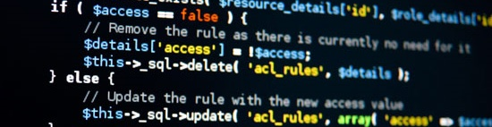
PHP Blog Presentation
Powered by Team Spike
Software University
http://softuni.bg

Slide 2



Team Spike
Dobromir Stefanov (Dstefanow)
Ivan Vishanov (IvanVishanov)
Anton Borisov (AntonBogdanov92)

Slide 3



Structure of the site
Data Base
Pages
Logic

Slide 4
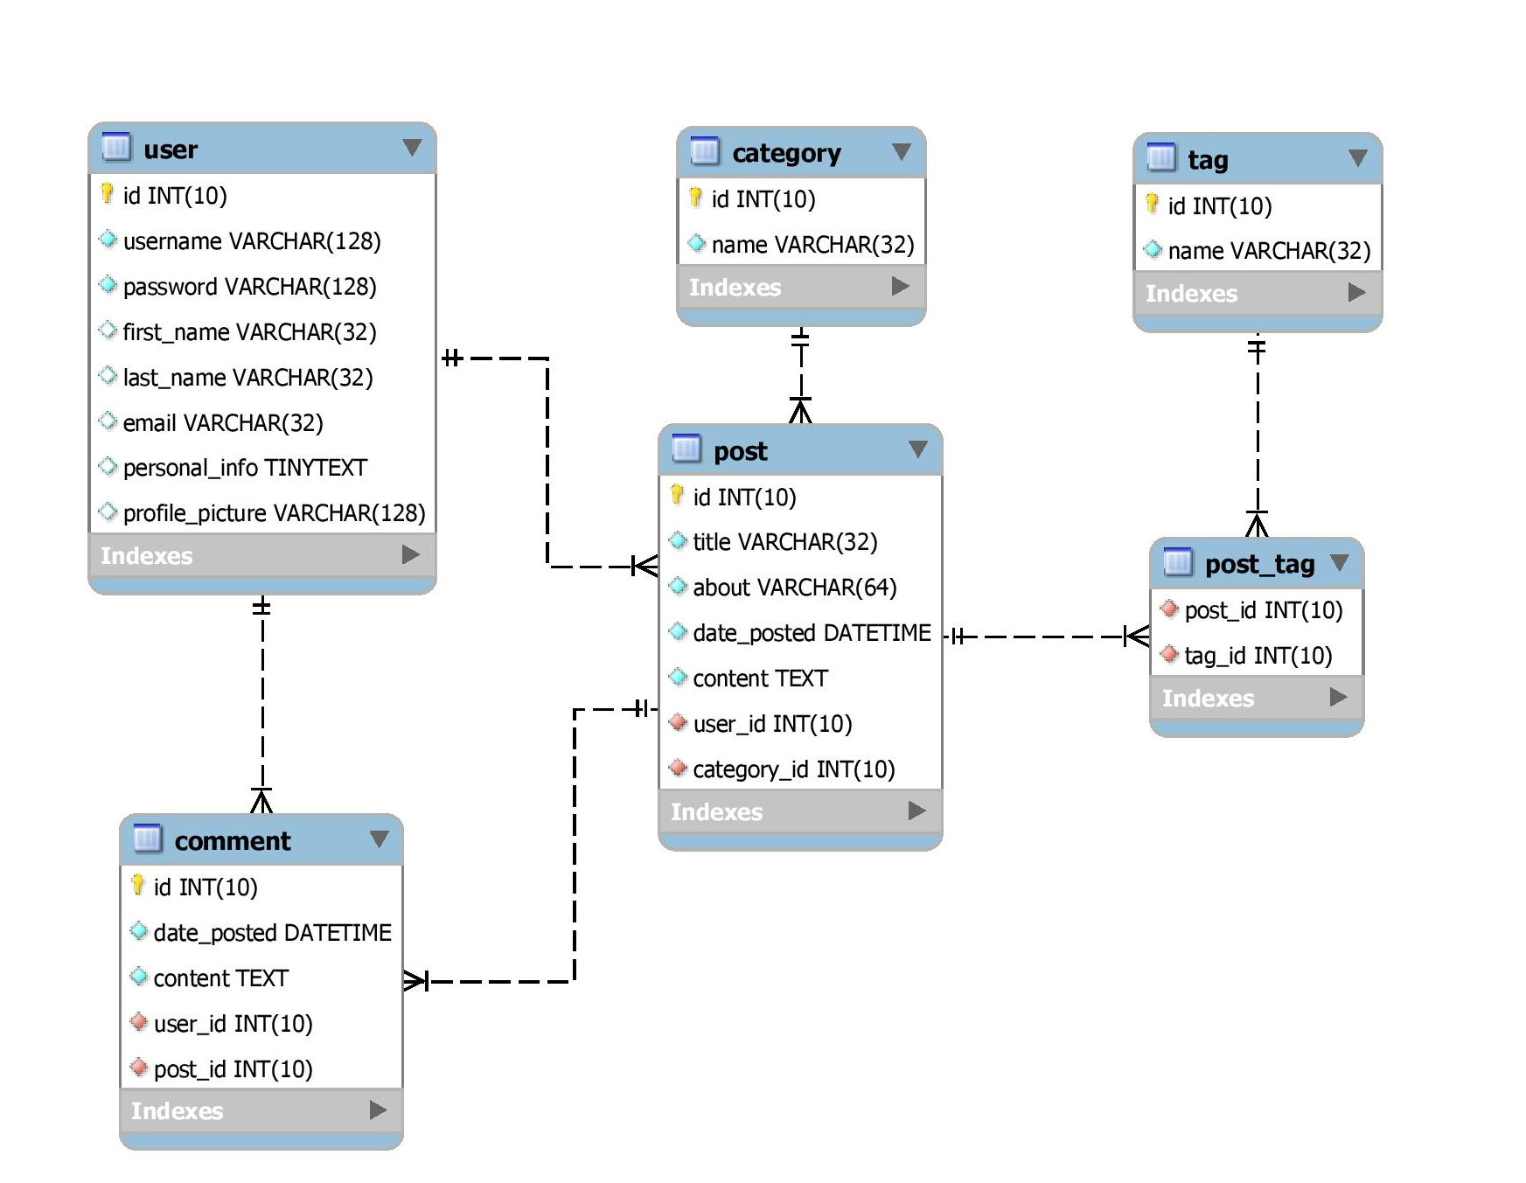
Data Base
Err Diagram

Slide 5
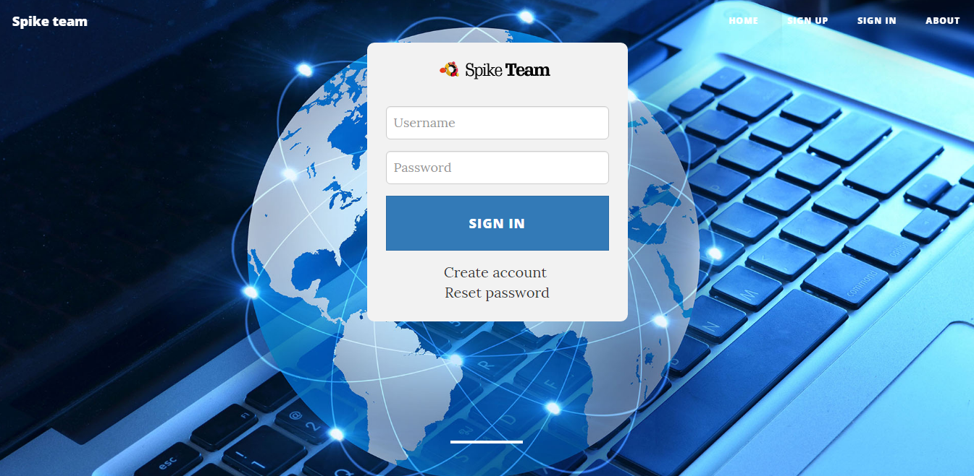
Front end part
Login
Register
Create Post
Edit Post
Profile

Slide 6
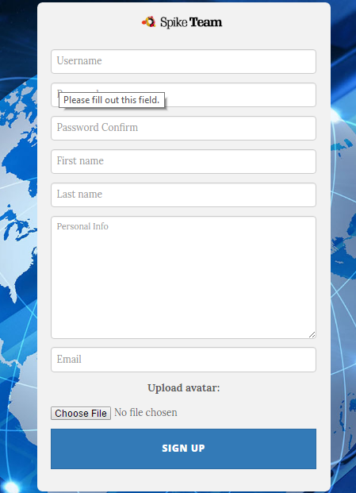
Sign up

Slide 7
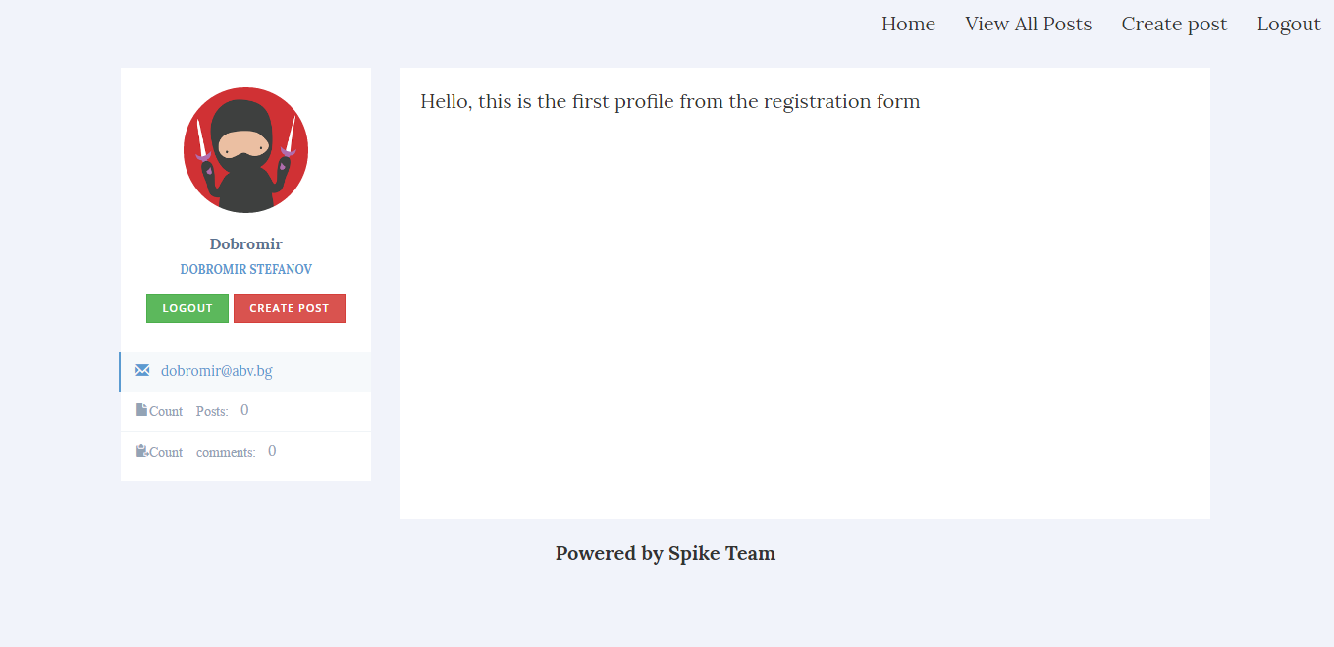
Profile

Slide 8
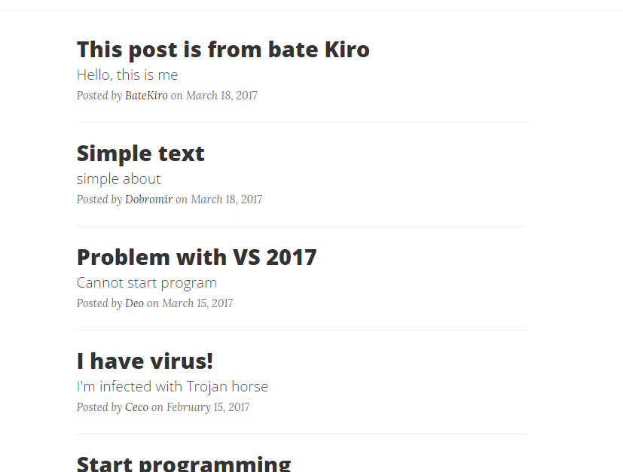
Posts

Slide 9
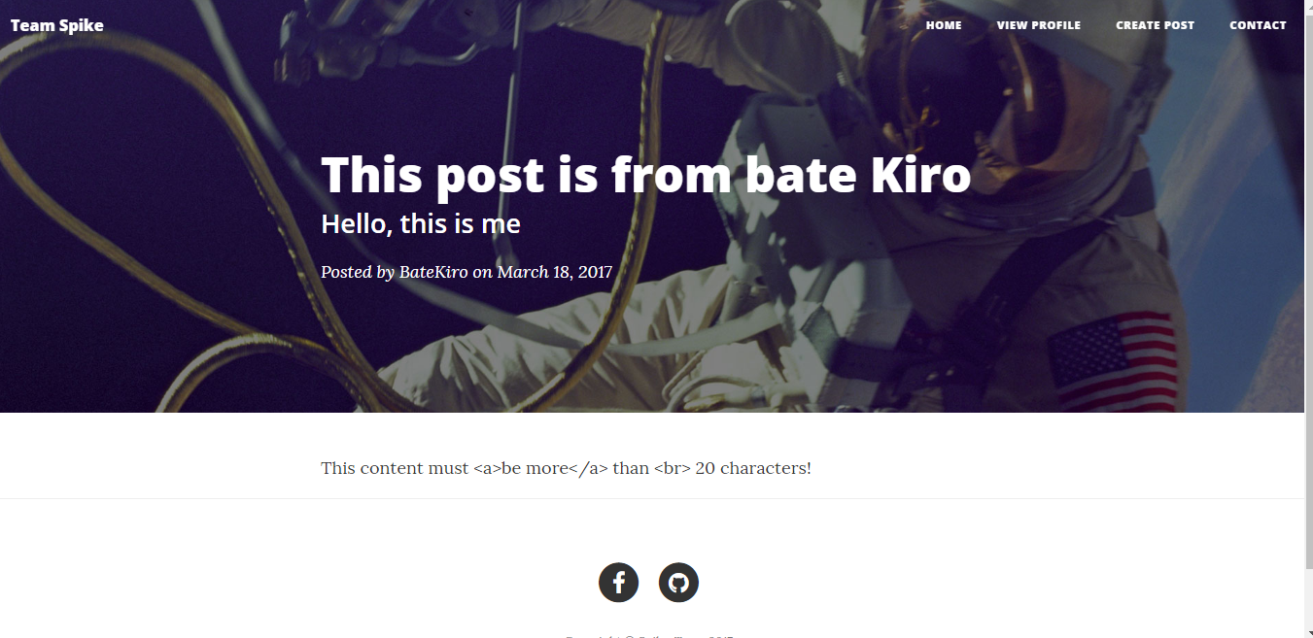
Current post

Slide 10
Back end part
Adapter:
Interfaces: IdataBase, IdataBaseStatement;
Classes: PdoDataBase, PdoDataBaseStatement;
Config:
Classes: DbConfig, DtConfig;
Core:
Classes: Application;

Slide 11
Back end part (2)
Models:
Classes: AllPosts, Posts, Post, User;
Services:
Types: Encrypt, Post, Upload, User;
Pictures and the connection files:
Files: app, register, create_post, index, about and etc.

