Slide 1
Preliminary results on image processing & ML

Slide 2
Plan of attack:
Get GeoTiffs from the client / SkyMatics / Web storage*.
Tile the images using Gdal library and gdal2tiles.py
The result – folder structure with tiles of different zoom level (‘image pyramid’)
Work on the tiles from now on.

Slide 3
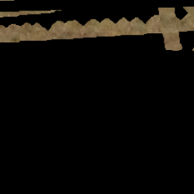
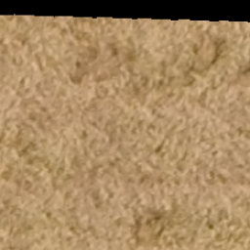
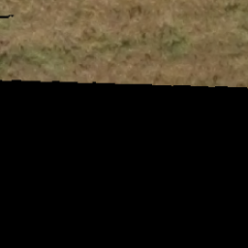
Processing of the tiles
Image dimensionality reduction – use K-means to decrease the dimension 3-fold
Remove the border images (black) using color histogram
Transform the image to grayscale, normalize, turn to binary (optional)

Slide 4
Processing of the tiles
Pick the set of features calculated from the grayscale images, descriptive of pattern
Transform the image into the feature space, further reducing the dimensionality
Run unsupervised learning (clustering) to identify families of related tiles
Manually label the tiles, name the classes

Slide 5
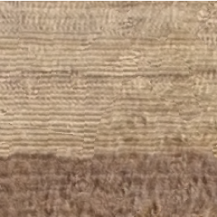
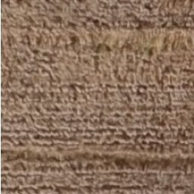
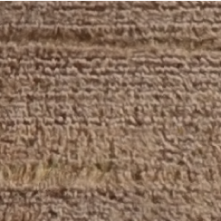
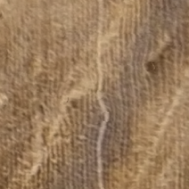
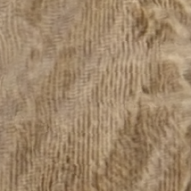
Identified clusters
Plowed (regular pattern):

Slide 6
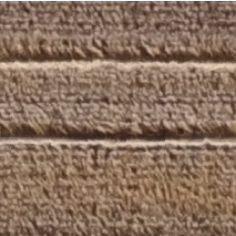
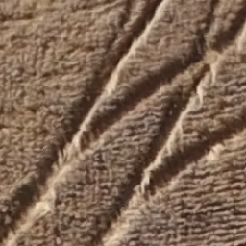
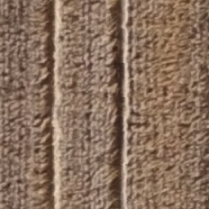
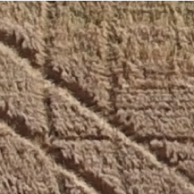
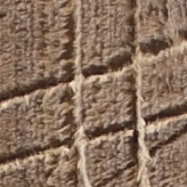
Identified clusters
Roads (thick pattern, twists):

Slide 7
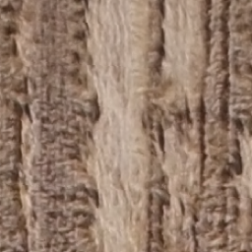
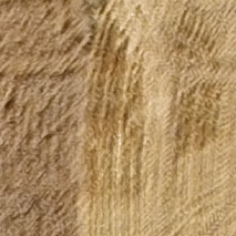
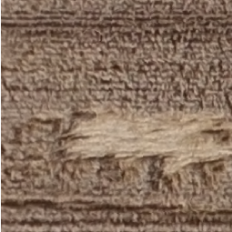
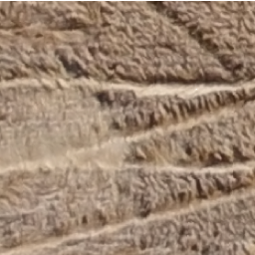
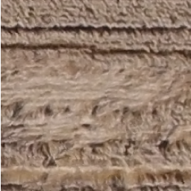
Identified clusters
White spots (damage?):

Slide 8
Supervised learning
With manually labeled data, train a classifier
As more data is acquired, the complexity of the classifier can be increased
Re-train the classifier as the new types of data are coming (canola, wheat, rye) with different patterns and color distributions

Slide 9
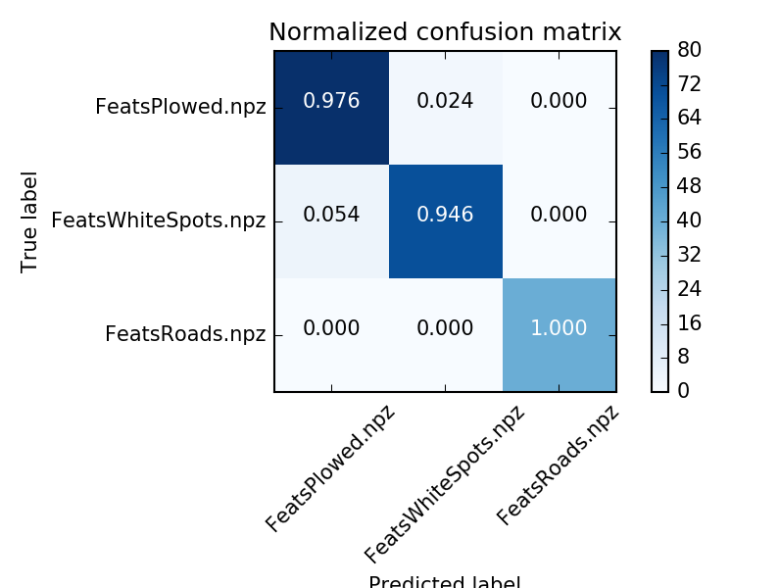
Supervised classification

Slide 10
Future work
Populate the dataset with images from other sources
Train a higher customizable classifier
When the damage pattern is defined rigorously, switch to TensorFlow / Neural networks.

Slide 11
Fur

