Slide 1
Data collection
01. Scraping
02. Preparing
Scriptslug
Removing white space and leading spaces
IMSDB
Removing white space and leading spaces
Assign Key
Remove missing
Append data frames
Scripts
Removing white space and leading spaces
Various sources
Removing white space and leading spaces
Generating raw scripts

Slide 2
Text processing
External data
Removing all names
Processing
Remove nonalpha keep apostrophes
Remove stop words
Remove names
Stem and tokenize
Words counts for analysis
Manual intervention
Remove “ï” and “â”

Slide 3
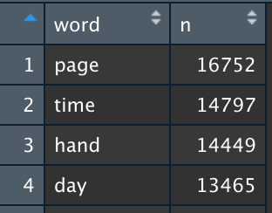
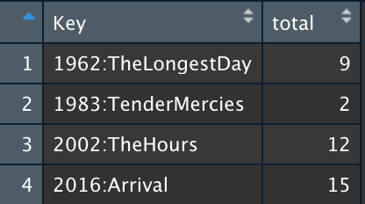
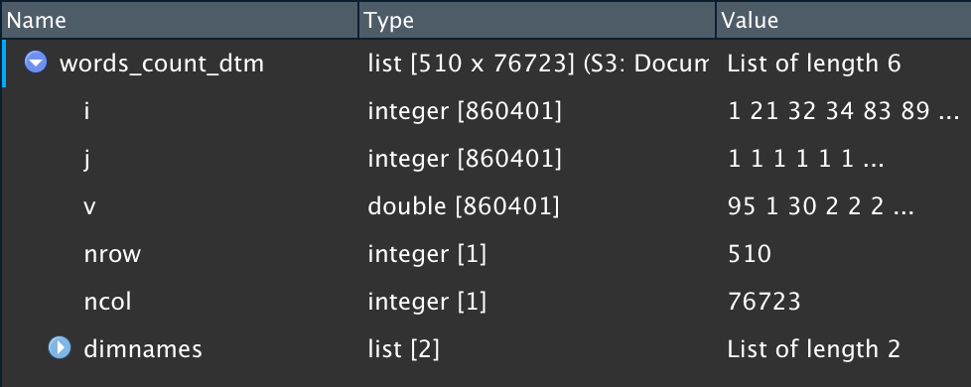
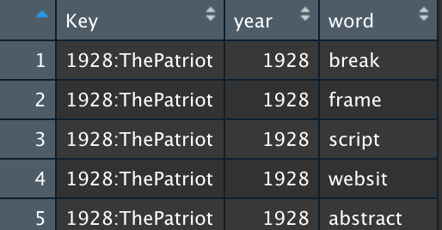
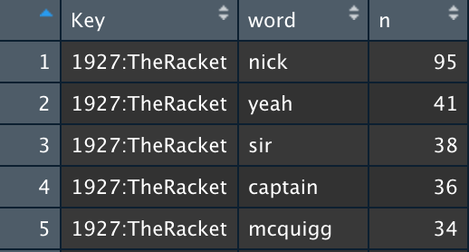
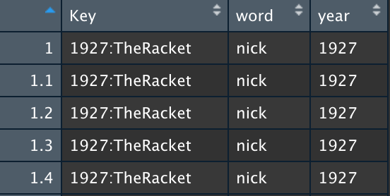
Aggregating data
Interpretation of words
Wordcount pr. Movie pr. word
Sum total words pr. movie
Create DTM
Remove words with 2 characters
Tidy_movies data frame for LDA analysis
02. word_count_script.csv
Words_count_overall
Words_count
Remove movies with few words
Remove common and sparse terms
Tidy_movies_sentiment data frame for sentiment
02.words_script_sentiment.csv
Words_count

Slide 4
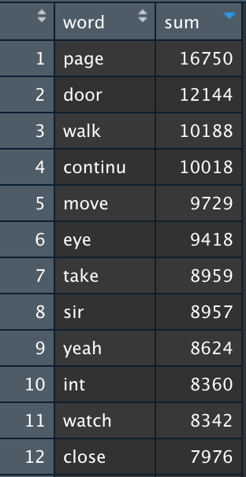
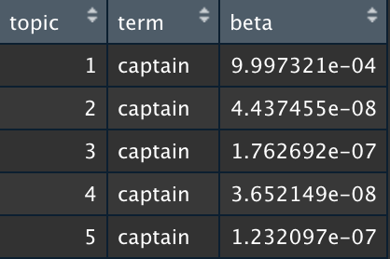
Analysis
15 Topic model
Too general
Extract Gamma values
Load
Create DTM
Do LDA
50 Topic model
Ranking topics pr. movie
script_lda_tidy
02. word_count_script.csv
Scripts_lda
Representative
Extract Beta values
Remove very frequent words (>7900)
100 Topic model
Lda_topics
Too specific

