Slide 1
Choosing the place for gym in Yekaterinburg
Author: Miniazev Anton

Slide 2
Overview
The success of service business depends on the location of it
Machine learning techniques may provide possible investors with useful for decision-making process data
This work is focused on finding such a place to open a gym business in Yekaterinburg
The approach used in this work can be adapted to other types of services (café, barbershops, beauty shops)

Slide 3
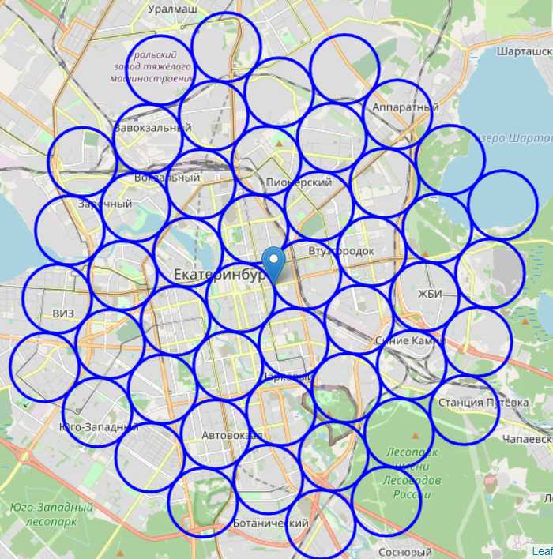
The left map represents the combination of neighbourhoods with the radius of 800 meters around the center of Yekaterinburg
Investigation of these areas will provide me with possible addresses where gyms are not opened yet, so it is possible to create a business in this area

Slide 4
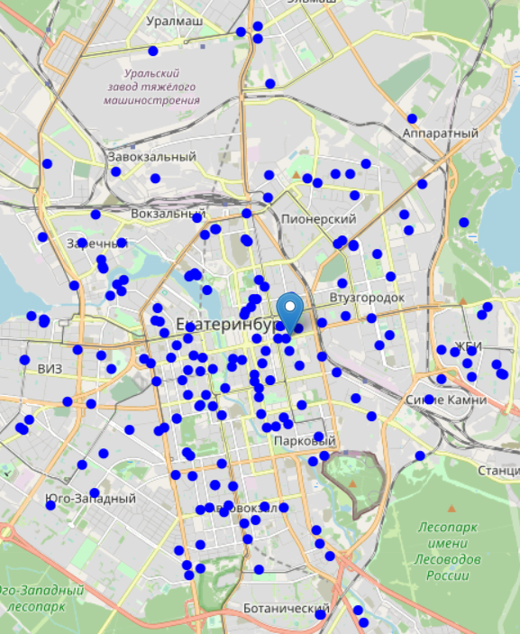
Placing gyms from Foursquare we see:
the city center is full of such businesses
some regions are irrelevant because of manufactures around

Slide 5
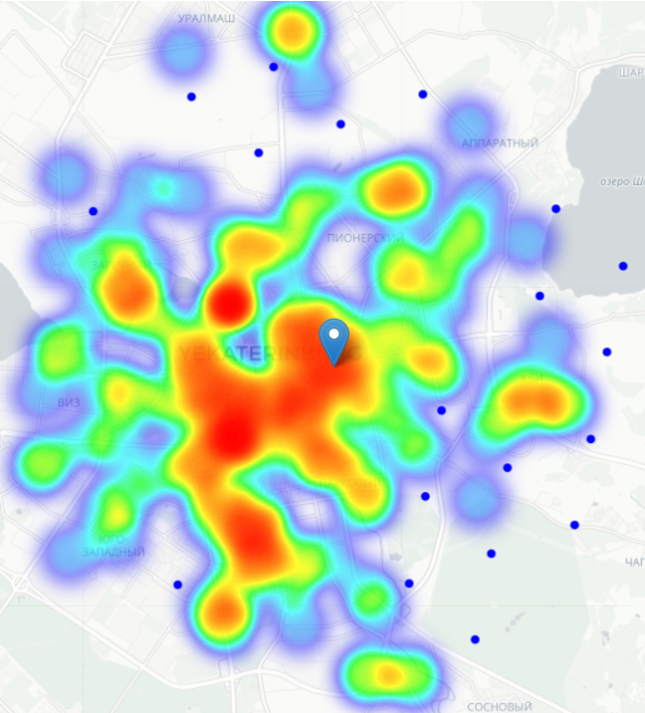
Initial analysis of Yekaterinburg shows 19 possible areas where gyms can be opened. Such areas:
Do not have gyms in the radius of 600m from the center, and
Contain less than 2 gyms

Slide 6
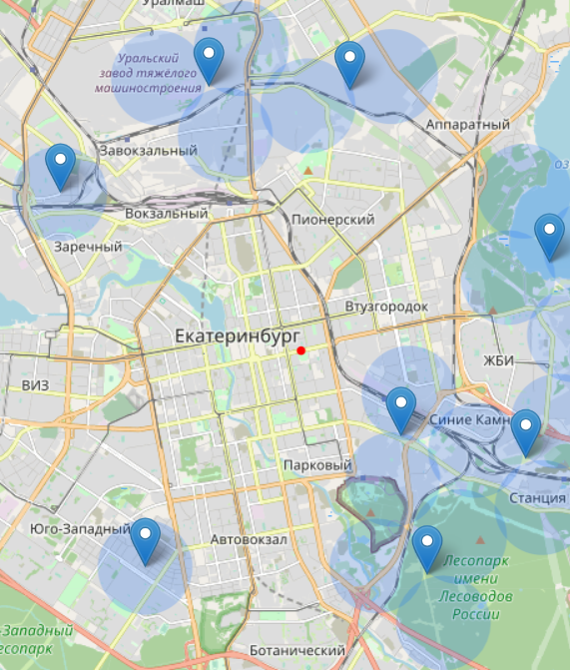
Neighbourhoods with low concentration of gyms can be organized into 8 clusters. Their centers represent starting points from which the search of a place for a new gym should be started.
This centers include:
Sibirskiy Trakt, 14
Ulitsa Otdykha, 107
Ulitsa Raskovoy, 56
Ulitsa Ol'khovskaya, 52
Ulitsa Prostornaya, 148
Ulitsa Frontovykh Brigad, 18 Corp 2
Ulitsa Istochnaya, 2а
Basovyi pereulok

Slide 7
Conclusion
During the analysis I found 8 places where can be found an effective place for gym
The approach is adjustable, so other types of business in different cities can be found
There is room for development, including:
Investigation of people’s flow to combine analysis of customers with analysis of competitors
Auto-drop of irrelevant places (lakes, manufactures)

