Slide 1
Batt: 57%
Mode: MAN
Alt: 57m LIM
STS: NO
Comm: 60%
Setup Menu
Manual Control Menu
Auto Control Menu
About
Exit
Selected Menu screen

Slide 2
Batt: 57%
Mode: MAN
Alt: 57m LIM
STS: NO
Comm: 60%
Setup Menu
Manual Control Menu
Auto Control Menu
About
Exit
Setup Menu
Keyboard Setup
Keyboard Setup
Communication setup
Log File
Up:
Z
Throttle up:
+
Address:
1
Save flight data:
Y/N?
Down:
X
Throttle down:
-
Channel:
1
Go Left:
A
On/Off
O
Power:
0
Y
Go Right:
D
Comm port:
4
Turn Left:
Q
Turn Right:
E
Forward:
W
Back:
S
Control Sensitivity:
Save settings

Slide 3
Batt: 57%
Mode: MAN
Alt: 57m LIM
STS: NO
Comm: 60%
Setup Menu
Manual Control Menu
Auto Control Menu
About
Exit
Manual Control
Position Status
Drone Video
Heading
70
Engine Status
Distance
200.7
Vel Up
Pitch
Eng1 rpm
100
2.3
7.1
Eng2 rpm
Lat
100
Vel Left
Roll
100
-5.7
Attitude indicator
Eng3 rpm
100
Long
Vel Fwd
1
300
Eng4 rpm
100
10.3
Altitude
57.6
Throttle
TL
FWD
TR
Comm on/off
UP
LFT
BCK
RHT
Auto Land
Vid on/off
Get Cel Pos
Find Runway
On/Off
DWN

Slide 4
Batt: 57%
Mode: MAN
Alt: 57m LIM
STS: NO
Comm: 60%
Setup Menu
Manual Control Menu
Auto Control Menu
About
Exit
Auto Control
TBD

Slide 5
Batt: 57%
Mode: MAN
Alt: 57m LIM
STS: NO
Comm: 60%
Setup Menu
Manual Control Menu
Auto Control Menu
About
Exit
About
Ground Control Version: V1.0
Developer: Anton Kipiatkov

Slide 6
Batt: 57%
Mode: MAN
Alt: 57m LIM
STS: NO
Comm: 60%
Setup Menu
Manual Control Menu
Auto Control Menu
About
Exit
Manual Control
Position Status
Drone Video
Heading
70
Engine Status
Exit?
Vel Up
Pitch
Distance
200.7
Eng1 rpm
100
2.3
7.1
Eng2 rpm
Lat
100
Vel Left
Roll
100
-5.7
Attitude indicator
Eng3 rpm
100
Long
Vel Fwd
1
300
Yes
No
Eng4 rpm
100
10.3
Altitude
57.6
Throttle
TL
FWD
TR
Comm on/off
UP
LFT
BCK
RHT
Auto Land
Vid on/off
Get Cel Pos
Find Runway
On/Off
DWN

Slide 7

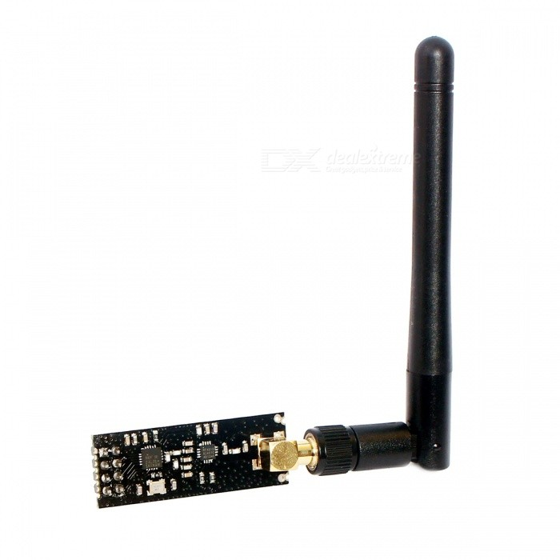
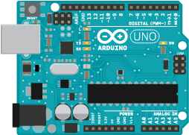
USB (serial)
SPI

