Slide 1

Welcome to the 3rd Annual meeting of the Open Reflectometry Standards Organisation

Slide 2
What is ORSO
“ORSO is an open group of reflectometry scientists from across the globe that are interested in improving our field through collaboration.”
i.e. we would like to collaborate to…
define standards
facilitate reproducible measurement and analysis
ensure consistency across analysis packages
help people do better experiments
promote the technique
educate new users & be a useful resource for experienced users
THIS WILL ONLY WORK IF THE COMMUNITY CONTRIBUTES

Slide 3
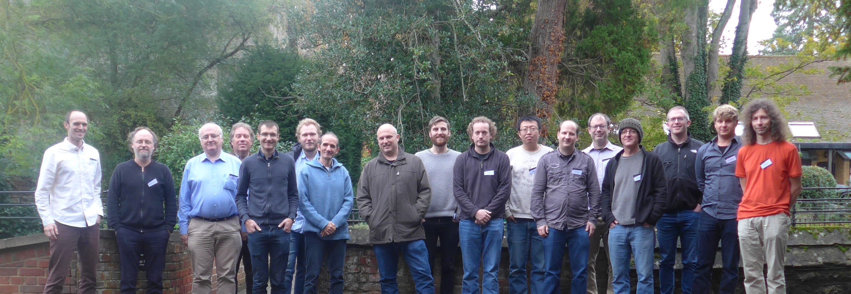
A short history of ORSO
1st Meeting: October 2019 Abingdon, UK.
Established the working groups and nominated 4 chairs.
Organized by: Joshaniel Cooper , Andrew McCluskey, Tim Snow, Robert Dalgliesh

Slide 4
A short history of ORSO
2nd meeting May 2020
Moved online
24 discussion sessions across the 4 working groups
Over 40 attendees
Learned the difficulty in running a meeting over “all” time zones
Established some issues that are now tracked using GitHub:
https://github.com/reflectivity
Recruited 4 more chairs

Slide 5
How will this meeting work
Today: 2 Plenary sessions with scientific talks relevant to the reflectometry community and the working group discussions
Talks will be recorded and posted on the website
The rest of the week – working group discussions
Tuesday 15th June: Data Formats Working Group
Wednesday 16th June: Reproducibility Working Group
Thursday 17th June: Data Analysis Working Group
Friday 18th June: Education and Outreach Working Group
Friday: Final plenary session
Summary of the conclusions from Working groups
3 talks on application of AI / Machine Learning to Reflectometry
Sessions may need volunteers to take minutes and report the conclusions at the final plenary

