Slide 1

Multi-Agent Decision Support System for Space Mission Operations
Master’s Degree in AI & Robotics Antonio Lissa Lattanzio (2154208)
Academic Year 2025/2026
Advisor
Prof. Danilo Comminiello
Co-Advisor
Daniele Baldassini

Slide 2
Presentation Outline
Foundation and Existing Approaches
System Evaluation
05
01
02
03
04
Operative Context
Proposed System
Conclusions and Future Work

Slide 3
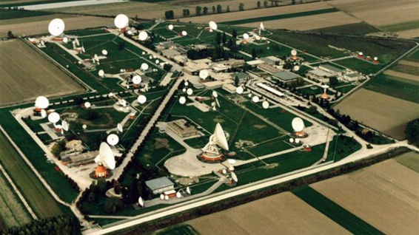
Ground Segment Organization
Satellite Control Center: spacecraft monitoring and command execution.
Mission Planning Center: planning of operational activities and mission tasks.
TT&C: telemetry acquisition, spacecraft tracking and command uplink
Flight Dynamics: orbit determination, maneuver planning and analysis.
...
Although each system performs a well-defined function, mission operations emerge from their continuous interaction.
Mission Manager: The person responsible for supervising the overall execution and state of the mission.

Slide 4


Mission Manager’s Role & Challenges
Situational Awareness
Information Fragmentation
Supervise the mission execution and anomaly responses.
Evaluate operational events
Coordinate the responses of many teams
Support of decision-making during nominal and contingency scenarios.
Integrate informations from multiple sources.
The evidence are heterogeneous, asynchronous, incomplete or even conflicting.
Rapid identification of important informations and their implications.

Slide 5

Research Questions
01
Autonomous LLM Capabilities
To what extent can Large Language Models autonomously conduct cross-domain reasoning while maintaining accuracy and robustness?
02
Retrieval Pipeline
Can a specialized agentic retrieval pipeline improve the quality of the decision support task compared to a general purpose LLM?

Slide 6
Foundation and Existing Approaches
Foundation and Existing Approaches
System Evaluation
05
05
03
01
03
04
02
04
Operative Context
Proposed System
Conclusions and Future Work

Slide 7
Current SOTA for DSS in space missions
Kaisheng et al. | Autonomous EVA [2026]
Earth-independent DSS for deep space operations.
Agentic AI integrating fine-tuned LLMs, RAG and physics based simulations.
Maranto et al. | LLMSAT [2024]
High-level mission planning and decision support for space exploration.
Hierarchical LLM integrating RAG, flight-software interfaces and simulation based planning.
Research GAP
Existing solutions remain domain specific and prototype oriented, with limited integration of heterogeneous operational data and knowledge.

Slide 8
Proposed system
Foundation and Existing Approaches
System Evaluation
05
01
02
03
04
Operative Context
Proposed System
Conclusions and Future Work

Slide 9
FUNES System
Custom RAG system
CI-5 Storage
SM config
The FUNES system is designed to be an intermediate layer between existing mission operational systems and human operators.
It does not replace mission operators, it supports human decision-making by improving situational awareness, reducing information fragmentation, and providing recommendations.
External data sources
RAG data
Inference results
CI-1 Data Processing
CI-2 AI Module
AI config
Normalized
data
Inference results
Operators
interactions
Queries
CI-3 UI
Config settings
CI-4 Config & Model Management
DPM config

Slide 10
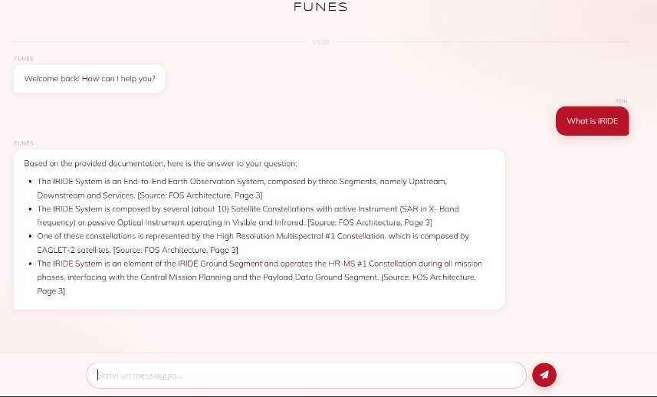
FUNES System – PoC Chat capability

Slide 11
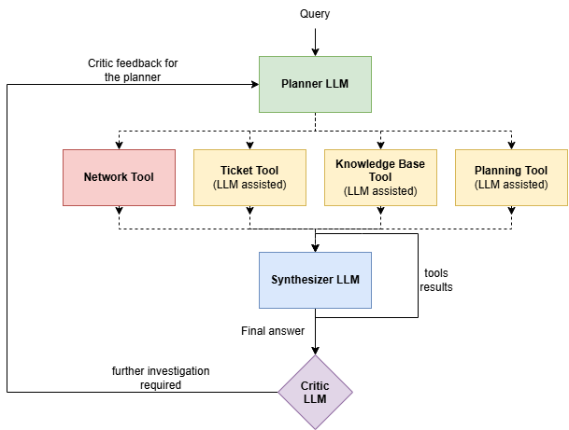

FUNES PoC - AI Module
Multi-Agent Graph-Based Architecture (LangGraph): The system decomposes the decision-making process into specialized LLM components, coordinated through a shared execution state.
Role Specialization and Separation: Agents are divided into core-orchestration roles and tool-support agents, ensuring evidence-grounded assessments with structured JSON outputs.
Every LLM is constrained to follow a specific JSON answer model.
Notes:
The AI module is based on a multi agent graph based architecture developed in langgraph.
The systen decomposes the decision-making process into specialized agents that are divided into core-orchestration agents: Planner, synthesizer and critic. And tool-support agents.
It works in the following way:
- the mm makes a question
- the question is given to the planner llm which makes a step-by-step plan of how the question can be resolved, so it decides what toolsa re needed and what input to give to each tool.
- the infromations returned by the tools are gathered and given to the synthesizer that is the most important LLM because it is the one that performs the correlations between the evidences and provides the final answer to the MM.
- the critic gets the tools results and the answer and checks if further investigation is required, if so it will give a feedback to the planner on what extra tool is needed ant the process is repeated.
So for example the MM can ask something banal like "tell me whats going on with the network", the Planner will call the network tool, but maybe the tool returns that there is an error with an antenna, so the critic in this case would tell the planner to include the ticket tool in order to check if the problem is known and if it is beign addressed.
This loop process can be repeated up to two times.

Slide 12
System Evaluation
Foundation and Existing Approaches
Foundation and Existing Approaches
System Evaluation
05
01
02
03
04
Introduction
Proposed System
Conclusions and Future Work

Slide 13
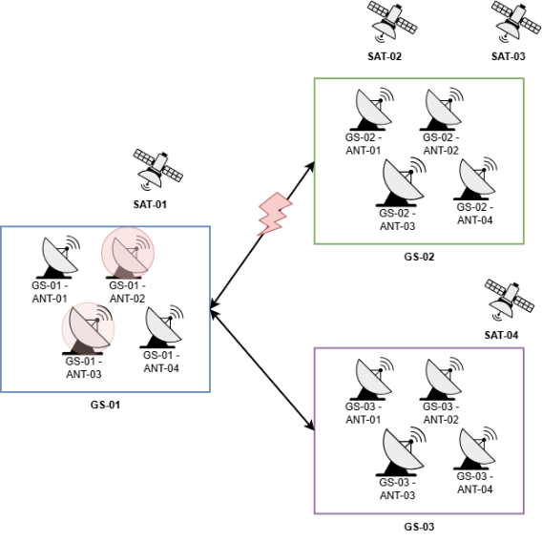
Proposed Scenario
Planning: 32 hrs of planning data for each satellite
Network State:
      GS-01 is degraded: ANT-02 offline, ANT-03 exhibits latency and packet loss.
      GS-01 ↔ GS-02 degraded
32 operational tickets:
3 are related to the malfunctions
1 is for preventive maintenance on GS-02/ANT-02 that requires replanning
1 is about an urgent acquisition that requires replanning of activities
Knowledge base: 20 documents in the RAG system

Slide 14
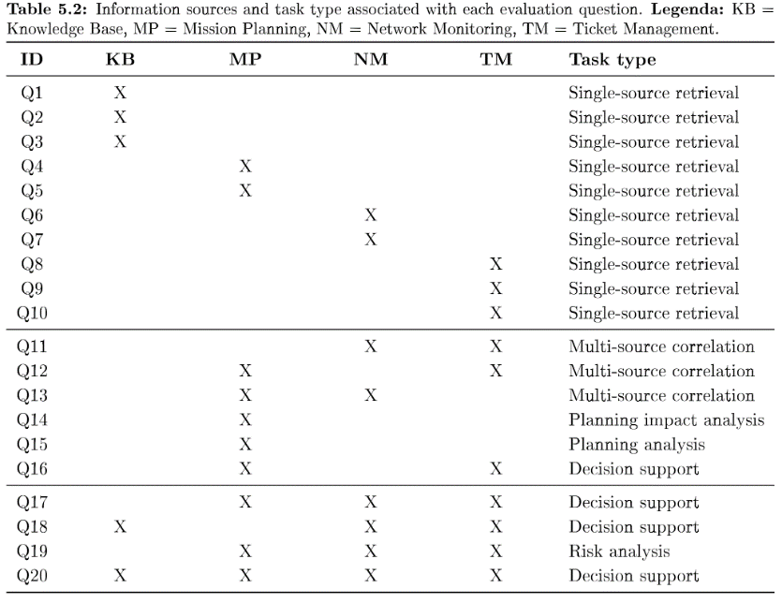
Evaluation Benchmark
10 Easy
6 Medium
4 Hard

Slide 15
Evaluation Benchmark – Some examples
Difficulty | Question | Required Ability
Easy | What are the requirements for software validation according to ECSS? | RAG search
Easy | When is satellite SAT-01 next pass on GS-01? | Tool calling
Medium | How many acquisitions do we lose if ANT-01 is unavailable from 10:00 to 12:00? | Multi-source corr. Predictive reasoning
Medium | Why is GS-01 degraded? | Multi-source corr.
Hard | What operational issues require immediate attention and what mitigation actions should be applied? | Multi-source corr. Impact Analysis Decision Support
Hard | Summarize current anomalies, explain operational impact and recommend next actions. | Multi-source corr. Impact Analysis Decision Support

Slide 16
Evaluation Methodology
VS
FUNES
LLM as a judge
Llama 3.3 70B
Query
Retrieved useful context
Query
Scenario description
Evaluation instructions
Answers
Query
Full context of 24K tokens
Answer correctness
Anomaly Identification
Evidence Correlation
Correctly addressing of the question given the operational knowledge.
Identify and characterize operational anomalies.
Establish correct correlations between evidences from different sources.
Noise Filtering
DSS Role Adherence
Op. Reccom. Quality
Distinguish relevant from unrelated informations.
Correct answer behaviour.
Quality of reccomendations when actions are required.

Slide 17
Evaluation Methodology – Scoring Instructions
Score 0 - Incorrect
Score 1 - Partially correct
Score 2 - Fully correct
Assigned for material, factual or operational errors affecting the criterion (e.g., false statements, operational contradictions, incorrect correlations, or incompatible recommendations).
Minor imprecisions or isolated omissions were not sufficient to warrant a score of 0.
Assigned when the answer was substantially correct but had significant limitations... (e.g., omission of relevant info, partial correlations, generic recommendations).
It indicated the answer was useful but did not fully meet the requirements.
Assigned when the answer fully satisfied the criterion... by providing all requested info, correctly incorporating operational evidence, establishing supported correlations, and giving appropriate, evidence-consistent recommendations.
The judge is not blindly assigning a score!

Slide 18
Evaluation Results
(+50%)
(+15%)
(+12%)
+27%
Notes:
The overall results indicate that funes provides a substantial improvement in the evaluation score of the proposed benchmark.
Since the baseline receives the full 24K token context with all the avaiable data, the performance difference cannot be attributed to the baseline lacking access to specific pieces of informations, but rather they indicate that providing the full context to a general purpose LLM does not always result in the most effective use of it.
The improvement is consistent with the hypothesis that selective information restrieval and filtering is highly effective, which is also the main objective of the proposed architecture: information flow and control.
The results by task complexity show a quite large gap in the easy task questions where FUNES surpasses the baseline of 50% points, this gap however tends to diminish as the task complexity gets higher.
This is mostly for three reasons:
1. The easy questions are very specific, this means that for the baseline is difficult to focus to the right part of the whole context.
2. The number of questions and thus scoring gets lower since for medium and hard task we have a smaller set of questions.
3. Hard tasks shift the challenge from information filtering to advanced reasoning and logical synthesis. Since both systems utilize the same underlying reasoning engine (Llama 3.3), their ultimate cognitive constraints align.

Slide 19
Conclusions, Limitations and Future Work
Foundation and Existing Approaches
System Evaluation
05
01
02
03
04
Operative Context
Proposed System
Conclusions and Future Work

Slide 20
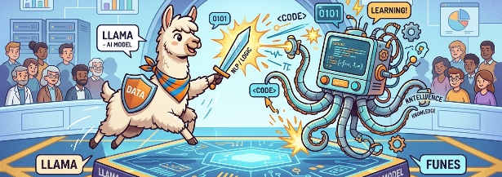
Conclusions
The system successfully validated our core research, surpassing the baseline by +27% points on our benchmark.
The performance gap diminishes on complex questions that require more informations and context.
The observations must be interpreted within the limits of the proposed benchmark.
They do not establish a general rule for task-dependent performances.

Slide 21
Future Work
Benchmark Scaling
Expand the benchmark with larger datasets, complex temporal dependencies and ambiguities
Human in the Loop
Evaluate real-world usability, operational trust and impact metrics like time-to-decision.
LLM Efficiency
Evaluate FUNES across diverse model sizes and families.
Synthesis & Validation
Extend the critic agent to check the synthesizer answer.
Evidence Grounding
Introduce evidence graphs for full end-to-end treceability of the whole system reasoning steps.

Slide 22

Thank you for your Attention
Any Questions?

