Slide 1

Multi-Agent Decision Support System for Space Mission Operations
Master’s Degree in AI & Robotics Antonio Lissa Lattanzio (2154208)
Academic Year 2025/2026
Advisor
Prof. Danilo Comminiello
Co-Advisor
Daniele Baldassini

Slide 2
Presentation Outline
Foundation and Existing Approaches
System Evaluation
05
01
02
03
04
Operative Context
Conclusions, Limitations and Future Work
Proposed System

Slide 3
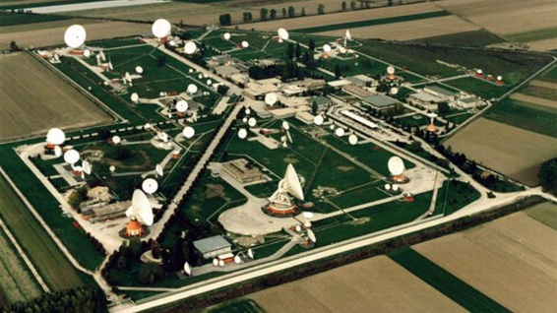
Ground Segment Organization
Satellite Control Center: spacecraft monitoring and command execution.
Mission Planning Center: planning of operational activities and mission tasks.
TT&C: telemetry acquisition, spacecraft tracking and command uplink
Flight Dynamics: orbit determination, maneuver planning and analysis.
...
Although each system performs a well-defined function, mission operations emerge from their continuous interaction.
Mission Manager: The person responsible for supervising the overall execution and state of the mission.

Slide 4


Mission Manager’s Role & Challenges
Situational Awareness
Information Fragmentation
Supervising mission execution and anomaly responses.
Operational events evaluation.
Response coordination of different teams.
Support of decision-making during nominal and contingency scenarios.
Integrate informations from multiple sources.
The evidence are heterogeneous, asynchronous, incomplete or even conflicting.
Rapid identification of important informations and their implications.

Slide 5

Research Questions
01
Autonomous LLM Capabilities
To what extent can Large Language Models autonomously conduct cross-domain reasoning while maintaining accuracy and robustness?
02
Retrieval Pipeline
Can a specialized agentic retrieval pipeline improve the quality of the decision support task compared to a general purpose LLM?

Slide 6
Foundation and Existing Approaches
Foundation and Existing Approaches
System Evaluation
05
05
03
01
03
04
02
04
Operative Context
Conclusions, Limitations and Future Work
Proposed System

Slide 7
Current SOTA for DSS in space missions
Kaisheng et al. | Autonomous EVA [2026]
Earth-independent DSS for deep space operations.
Agentic AI integrating fine-tuned LLMs, RAG and physics based simulations.
Maranto et al. | LLMSAT [2024]
High-level mission planning and decision support for space exploration.
Hierarchical LLM integrating RAG, flight-software interfaces and simulation based planning.
Research GAP
Existing solutions remain domain specific and prototype oriented, with limited integration of heterogeneous operational data and knowledge.

Slide 8
Proposed system
Foundation and Existing Approaches
System Evaluation
05
01
02
03
04
Operative Context
Conclusions, Limitations and Future Work
Proposed System

Slide 9
FUNES System
Custom RAG system
CI-5 Storage
SM config
The FUNES system is designed to be an intermediate layer between existing mission operational systems and human operators.
It does not replace mission operators, it supports human decision-making by improving situational awareness, reducing information fragmentation, and providing recommendations.
External data sources
RAG data
Inference results
CI-1 Data Processing
CI-2 AI Module
AI config
Normalized
data
Inference results
Operators
interactions
Queries
CI-3 UI
Config settings
CI-4 Config & Model Management
DPM config

Slide 10
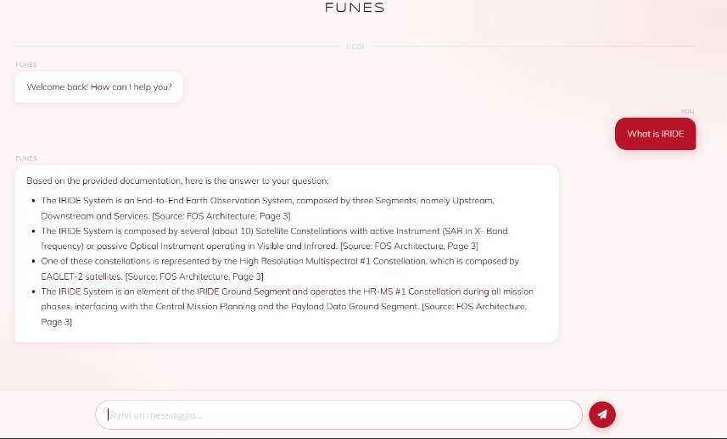
FUNES System – PoC Chat capability

Slide 11
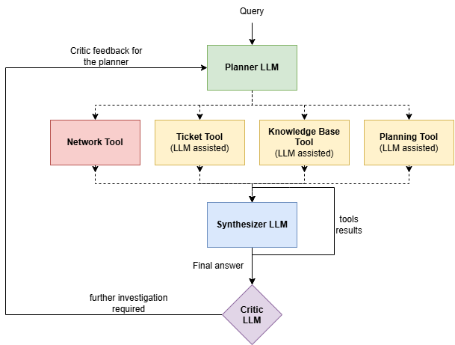

FUNES PoC - AI Module
Multi-Agent Graph-Based Architecture (LangGraph): The system decomposes the decision-making process into specialized LLM components, coordinated through a shared execution state.
Role Specialization and Separation: Agents are divided into core-orchestration roles and tool-support agents, ensuring evidence-grounded assessments with structured JSON outputs.
Every LLM is constrained to follow a specific JSON answer model.

Slide 12
System Evaluation
Foundation and Existing Approaches
Foundation and Existing Approaches
System Evaluation
05
01
02
03
04
Conclusions, Limitations and Future Work
Introduction
Proposed System

Slide 13
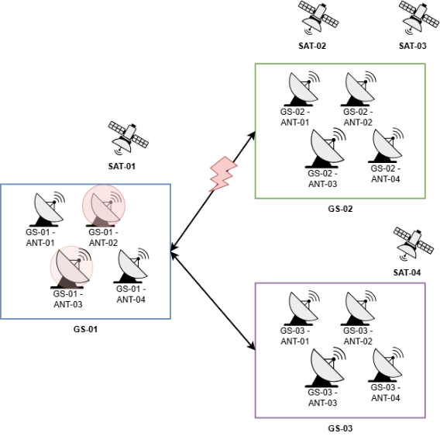
Proposed Scenario
Planning: 32 hrs of planning data for each satellite
Network State:
      GS-01 is degraded: ANT-02 offline, ANT-03 exhibits latency and packet loss.
      GS-01 ↔ GS-02 degraded
32 operational tickets:
3 are related to the malfunctions
1 is for preventive maintenance on GS-02/ANT-02 that requires replanning
1 is about an urgent acquisition that requires replanning of activities
Knowledge base: 20 documents in the RAG system

Slide 14
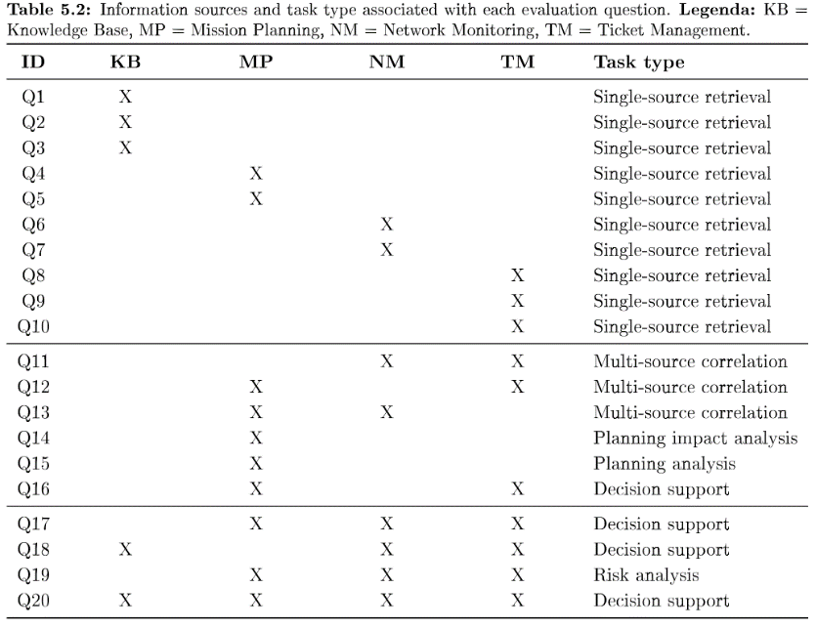
Evaluation Benchmark
10 Easy
6 Medium
4 Hard

Slide 15
Evaluation Methodology
VS
FUNES
LLM as a judge
Llama 3.3 70B
Query
Retrieved useful context
Query
Scenario description
Evaluation instructions
Answers
Query
Full context of 24K tokens
Answer correctness
Anomaly Identification
Evidence Correlation
Correctly addressing of the question given the operational knowledge.
Identify and characterize operational anomalies.
Establish correct correlations between evidences from different sources.
Noise Filtering
DSS Role Adherence
Op. Reccom. Quality
Distinguish relevant from unrelated informations.
Correct answer behaviour (evidence-based situational awareness etc…).
Quality of reccomendations when actions are required.

Slide 16
Evaluation Methodology – Scoring Instructions
Score 0 - Incorrect
Score 1 - Partially correct
Score 2 - Fully correct
Assigned for material, factual or operational errors affecting the criterion (e.g., false statements, operational contradictions, incorrect correlations, or incompatible recommendations).
Minor imprecisions or isolated omissions were not sufficient to warrant a score of 0.
Assigned when the answer was substantially correct but had significant limitations... (e.g., omission of relevant info, partial correlations, generic recommendations).
It indicated the answer was useful but did not fully meet the requirements.
Assigned when the answer fully satisfied the criterion... by providing all requested info, correctly incorporating operational evidence, establishing supported correlations, and giving appropriate, evidence-consistent recommendations.
The judge is not blindly assigning a score!

Slide 17
Evaluation Results

Slide 18
Evaluation Results – Some cases
Q5: How many passes does satellite SAT-02 have on 2026-05-26 on GS-02?
Model | AC | NF | Total
Llama | 0 | 0 | 0/4
FUNES | 2 | 2 | 4/4
Q19: Identify risks for planned activities on 2026-05-26 and report the affected activities with their corresponding datetime.
Model | AC | AI | EC | NF | DSS | Total
Llama | 2 | 2 | 2 | 2 | 2 | 10/10
FUNES | 1 | 2 | 1 | 1 | 2 | 7/10

Slide 19
Conclusions, Limitations and Future Work
Foundation and Existing Approaches
System Evaluation
05
01
02
03
04
Operative Context
Conclusions, Limitations and Future Work
Proposed System

Slide 20
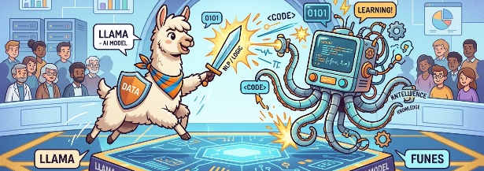
Conclusions
The results indicate that the benefits of FUNES depend on the type of reasoning required by the task.
The system is effective at limiting the required information but this does not always translate to the ability of fully answering the query.
The advantages diminishes on complex questions that require more informations and context.
The observations must be interpreted within the limits of the proposed benchmark.
They do not establish a general rule for task-dependent performances.

Slide 21
Limitations
Benchmark Scope & sample size
The evaluation is limited to 20 questions in a single scenario, limiting statistical robustness.
Single baseline
The evaluation compare FUNES against a single model, general superiority over other LLMs must be studied.
API Constraint
Groq API rate/token limits restricted repeated runs under identical experimental conditions.
Evaluation and Metrics Constraints
The LLM as a judge and unweighted criteria may introduce bias and ignore criticality of specific metrics.
Ablation Study
The system is evaluated as a complete architecture, preventing isolation of individual contributions.

Slide 22
Future Work
Synthesis & Validation
Extend the critic agent to check the synthesizer answer.
LLM Efficiency
Evaluate FUNES across diverse model sizes. (The orchestration can compensate smaller models)
Human in the Loop
Evaluate real-world usability, operational trust and impact metrics like time-to-decision.
Benchmark Scaling
Expand the benchmark with larger datasets, complex temporal dependencies and ambiguities
Evidence Grounding
Introduce evidence graphs for full e2e treceability of the whole system reasoning steps.

Slide 23

Thank you for your Attention
Any Questions?

