Slide 1
The Technology Value Stream
Understanding Lead Time and DevOps Practices
Anton DeCesare
Mod 2 - CSD 430
May 29, 2025

Slide 2
Introduction
The Technology Value Stream encompasses the entire process from a customer's request to the delivery of value.
Key metrics to understand and improve this stream include Lead Time and Process Time.
Optimizing these metrics is essential for enhancing efficiency and customer satisfaction.

Slide 3
Lead Time vs. Process Time
Lead Time: Total time from when a request is made until it is fulfilled, encompassing all stages including waiting periods.
Process Time: Actual time spent actively working on the request, excluding any waiting time.
Understanding the distinction helps identify inefficiencies in the workflow.

Slide 4
Challenges with Long Deployment Lead Times
Traditional IT environments often experience deployment lead times spanning several months.
Common Issues:
Siloed teams and lack of collaboration.
Manual testing and deployment processes.
Lengthy approval and compliance procedures.
These challenges lead to delayed value delivery and increased operational costs.

Slide 5

The DevOps Ideal - Deployment in Minutes
DevOps practices aim to reduce deployment lead times from months to minutes.
Key Strategies:
Implementing Continuous Integration/Continuous Deployment (CI/CD) pipelines.
Automating testing and deployment processes.
Fostering a culture of collaboration between development and operations teams.
Achieving this ideal enhances agility and responsiveness to customer needs.

Slide 6
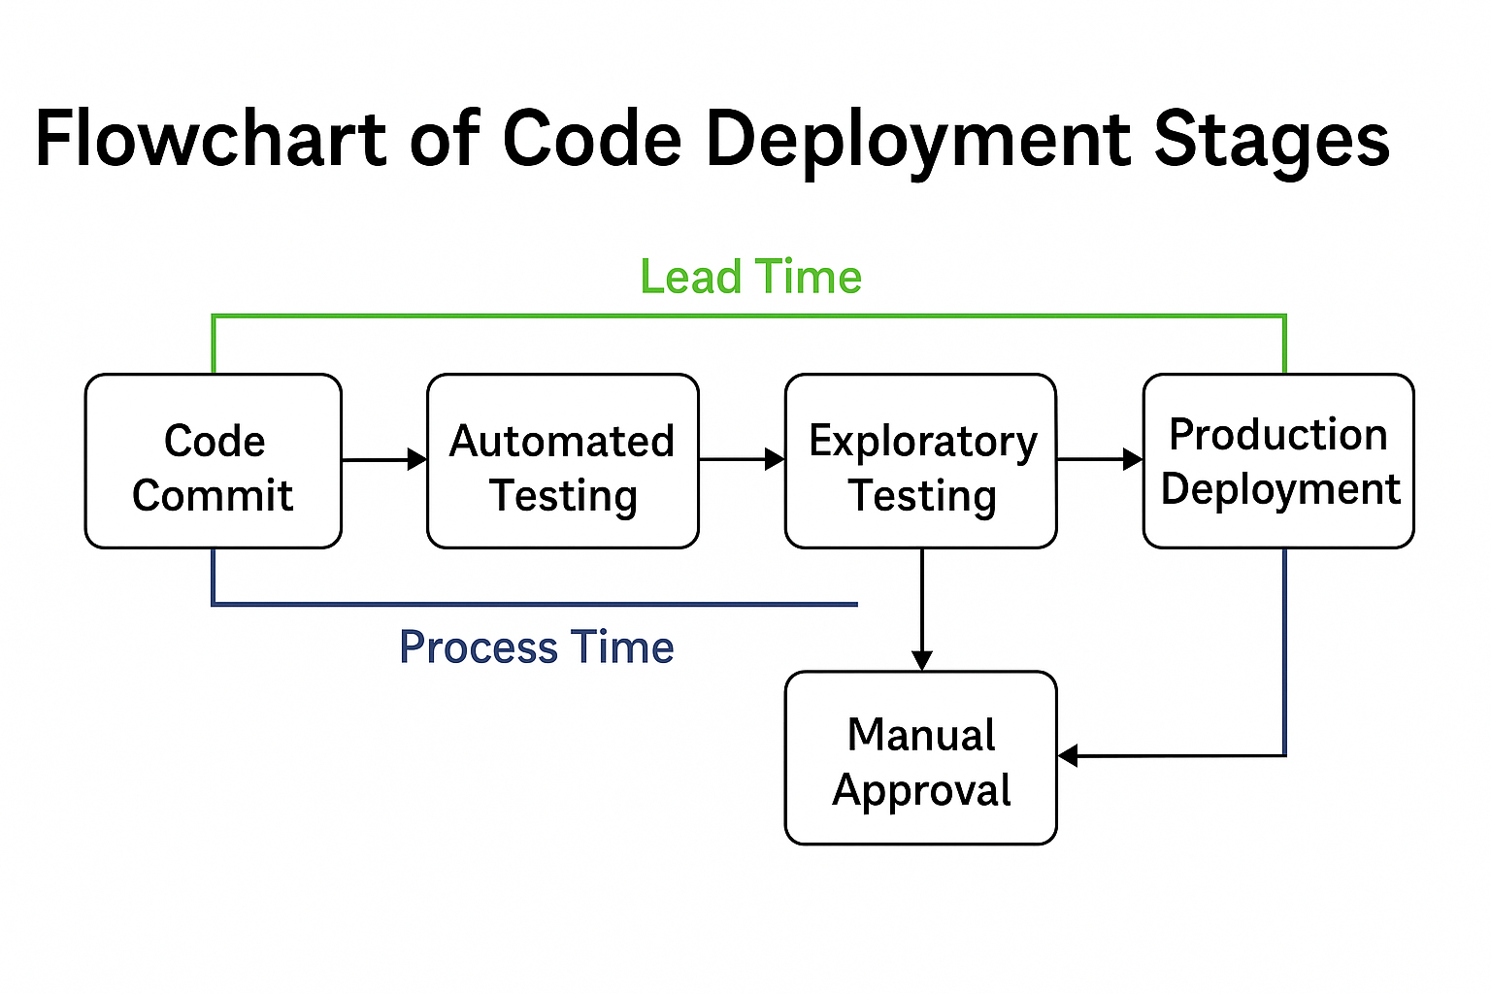
Visualizing the Code Deployment Stages

Slide 7

Conclusion & Key Takeaways
Reducing lead time is critical for delivering value efficiently.
Adopting DevOps practices transforms the Technology Value Stream, enabling faster and more reliable deployments.
Continuous measurement and improvement of key metrics like lead time and process time drive organizational success.

Slide 8

References
Atlassian. (n.d.). 4 Key DevOps Metrics to Know. Retrieved from https://www.atlassian.com/devops/frameworks/devops-metrics
IT Revolution. (n.d.). Cycle Time vs. Lead Time: A Comprehensive Guide. Retrieved from https://itrevolution.com/articles/cycle-time-vs-lead-time/
ITPro. (2025, April 23). Software deployments are plagued by delays... Retrieved from https://www.itpro.com/software/software-deployments-are-plagued-by-delays-rampant-skills-shortages-and-underinvestment-are-slowing-down-processes-and-its-costing-businesses-big

