Slide 1

Barriers & Challenges to Implementing a Just Culture in DevOps
Overview: A just culture encourages learning from failure without fear of punishment. Goal: Understand what makes it hard to adopt in real-world software teams. Focus: DevOps environments and modern development practices.

Slide 2
What is a Just Culture?
A just culture is a mindset where errors are viewed as opportunities for learning—not blame.
It differentiates between human error, risky behavior, and negligence, treating each accordingly.
Encourages open incident reporting, psychological safety, and transparency.
In DevOps, it helps teams learn from outages, bugs, and failures to improve reliability.

Slide 3
Barrier: Lack of Psychological Safety
Team members may hesitate to report mistakes if they fear judgment or reprisal.
Without psychological safety, developers may hide problems or avoid root cause analysis.
Common symptoms include vague postmortems, blame-filled retrospectives, or lack of constructive feedback.
DevOps thrives on early failure detection, so a fear-based culture undermines the model.

Slide 4

Barrier: Hierarchies and Silos
Organizations with strict hierarchy may prevent junior engineers from speaking up.
Dev and Ops teams often have different incentives and communication patterns.
These silos prevent effective collaboration and sharing of critical incident context.
Teams may hoard knowledge or resist transparency out of turf protection or fear of retribution.

Slide 5

Barrier: Structural & Policy Constraints
Legacy compliance frameworks may still require written approvals and punitive logs.
Organizations focused on control over learning will struggle to empower engineers.
Systems may lack anonymous reporting tools, safe feedback mechanisms, or action tracking.
Without proper tooling and processes, even the best culture can’t take root.

Slide 6
Barrier: Weak or Resistant Leadership
Leadership sets the tone—if they respond to failures by assigning blame, others follow suit.
1
Some leaders resist change, clinging to “command and control” practices.
2
Others may endorse just culture in words but fail to follow through in decisions.
3
Without active modeling by management, team members won’t believe change is genuine.
4

Slide 7
Overcoming Challenges
Foster
Foster psychological safety with inclusive retrospectives and blameless postmortems.
Invest in
Invest in cross-functional DevOps teams to break down silos.
Revise
Revise internal processes to support learning (e.g., track near-misses, not just failures).
Train
Train leaders to respond to error with curiosity, not criticism.
Shift
Gradually shift policies from control toward enablement with risk-aware experimentation.

Slide 8
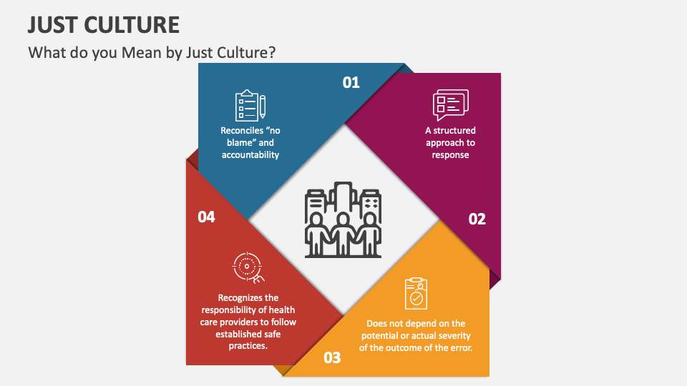

Slide 9
Conclusion & Call to Action
A just culture doesn’t emerge by accident—it requires strategic intent.
It’s critical to remove barriers such as fear, silos, and policy misalignment.
DevOps success depends on trust, resilience, and learning from failure.
Leaders must create space for transparency and engineer empowerment.

Slide 10
References
Psych Safety. (n.d.). Just Culture: How to Build a Culture That Learns From Mistakes. From https://psychsafety.com/just-culture/
DevOps.com. (2021). How SRE Creates a Blameless Culture. From https://devops.com/how-sre-creates-a-blameless-culture/

