Slide 1
Move Semantics: Some things to consider

Slide 2
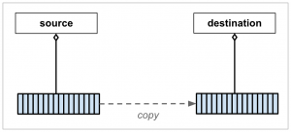
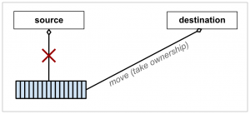
Move semantics in a nutshell:

Slide 3
1. Special member function generation
(has become more complicated)
→ See Effective Modern C++ Item 17
Example: Declaration of destructor deletes default move operations
Move-assignment

Slide 4
1. Special member function generation
(has become more complicated)
→ See Effective Modern C++ Item 17
Example: Declaration of destructor deletes default move operations
Copy-assignment
Rule of 5
default and delete

Slide 5
2. Unintended conversion
Method overloading via lvalue and rvalue references:
Example:

