Slide 1

Challenge 1
I Hear Voices in my Factory

Slide 2
Data preprocessing

Slide 3
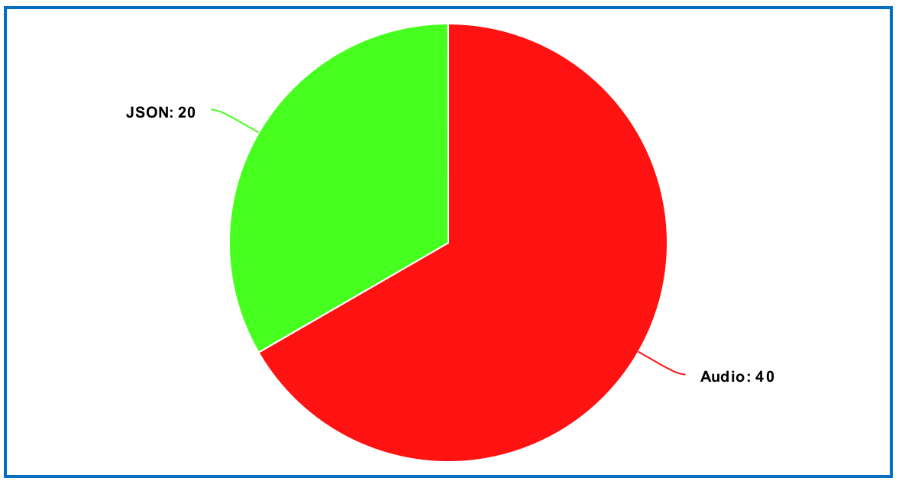
What we have in the start

Slide 4
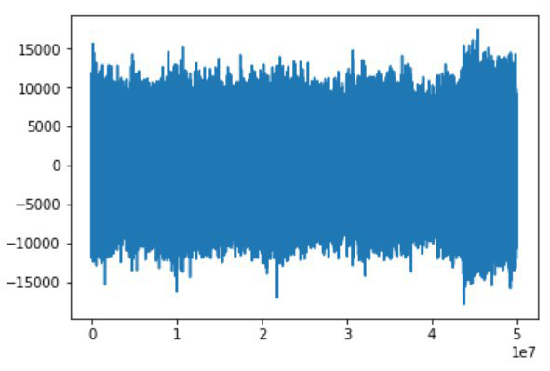

Which data from audio was used

Slide 5
Audio preprocessing
Split file on chunks of length 1 minute
For each chunk calculate set of features:
Statistical features: mean, median, different percentiles, min, max
Fourier transform coefficient: first 10 coefficients
The energy of sound

Slide 6
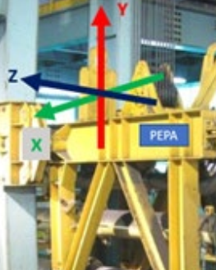
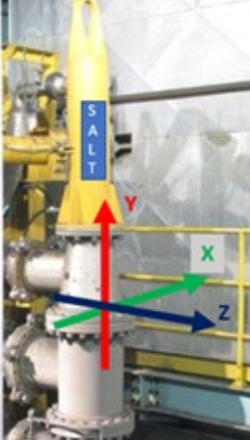
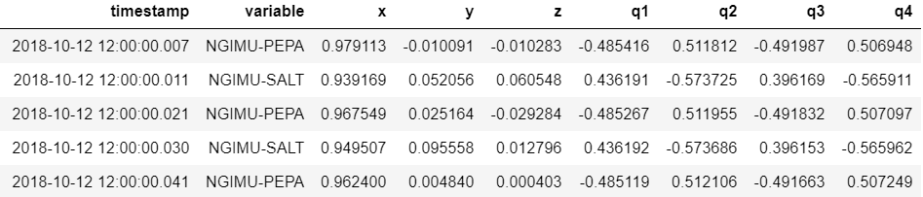
Which data from json was used
Timestamp – time of measurement
Variable – equipment: SALT or PEPA
Acceleration parameters: x, y, z
Quaternion parameters: q1, q2, q3, q4

Slide 7
JSON preprocessing
Split file on chunks of length 15 seconds
For each chunk calculate set of features:
Statistical features: mean, median, standard deviation, different percentiles, min, max
Fourier transform coefficient: first 10 coefficients
The energy of motion

Slide 8
Data understanding

Slide 9
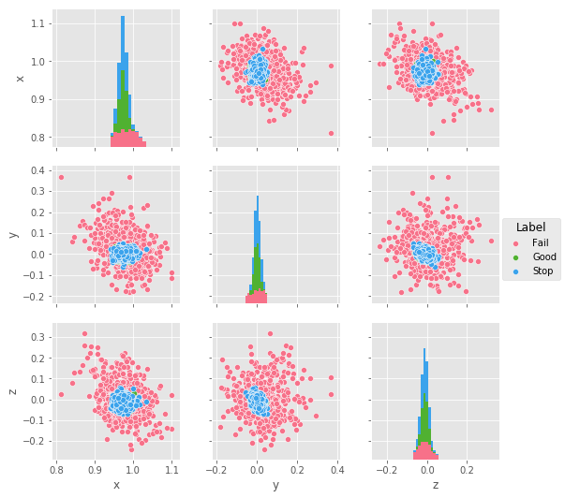
Acceleration parameters’ pairwise plots

Slide 10
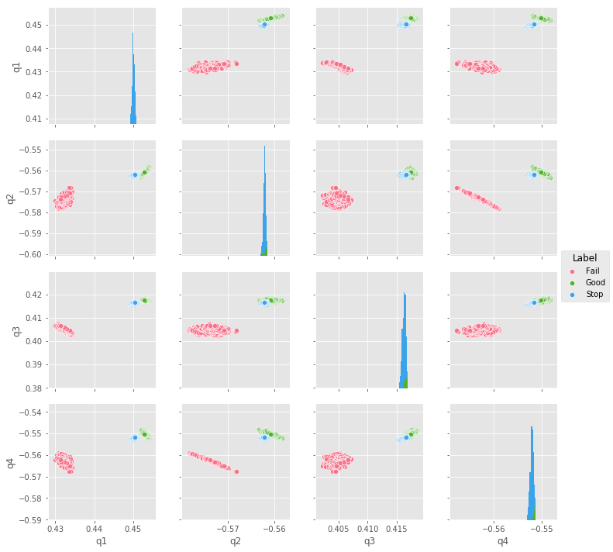
Quaternion parameters’ pairwise plots

Slide 11
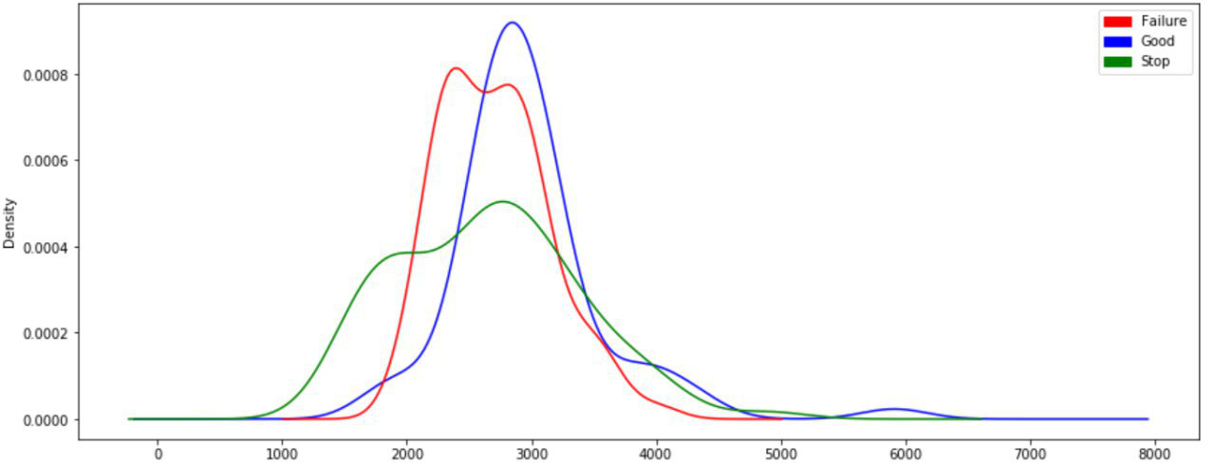
Density of sound volume for different categories

Slide 12
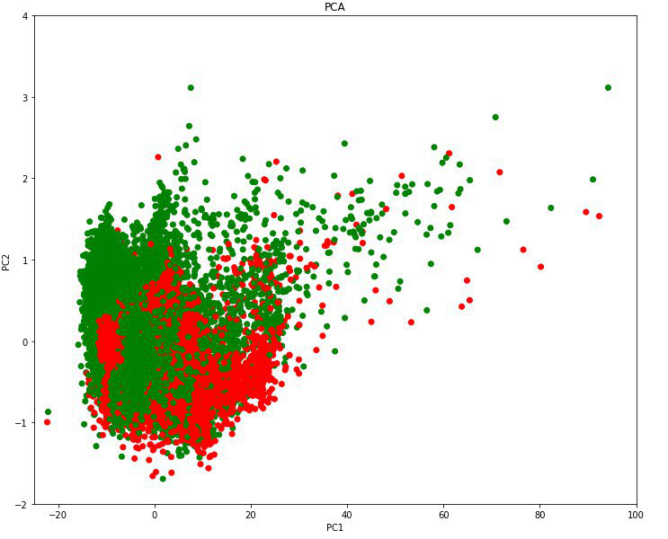
Principal Component Analyses
Explained variance: 0.9994

Slide 13
Classification model

Slide 14
labeling
We assigned label to audio and json instances according to pre-labeled .xlsx file with measurements of time, when on factory was fail, stop, or everything was okay
Success and Stop were labeled as 1
Failure was labeled as 0

Slide 15
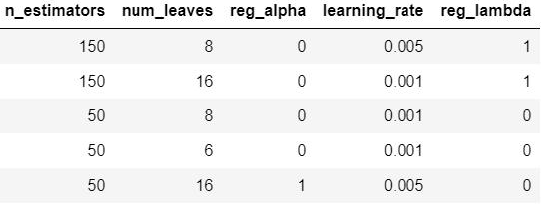
Model
Use LightGBM (Light Gradient Boosting Machine)
LightGBM is a gradient boosting framework that uses tree based learning algorithms
Tune hyperparameters

Slide 16
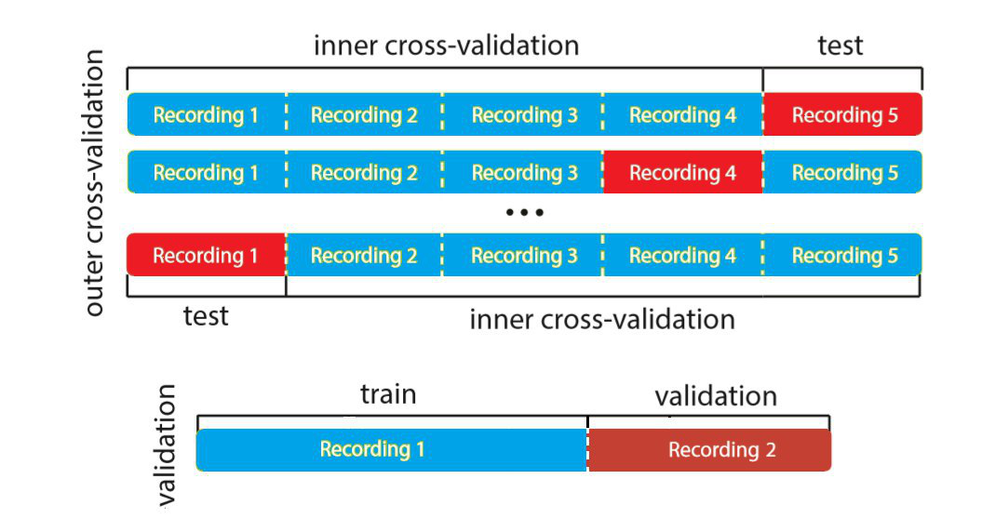
validation

Slide 17
results

Slide 18
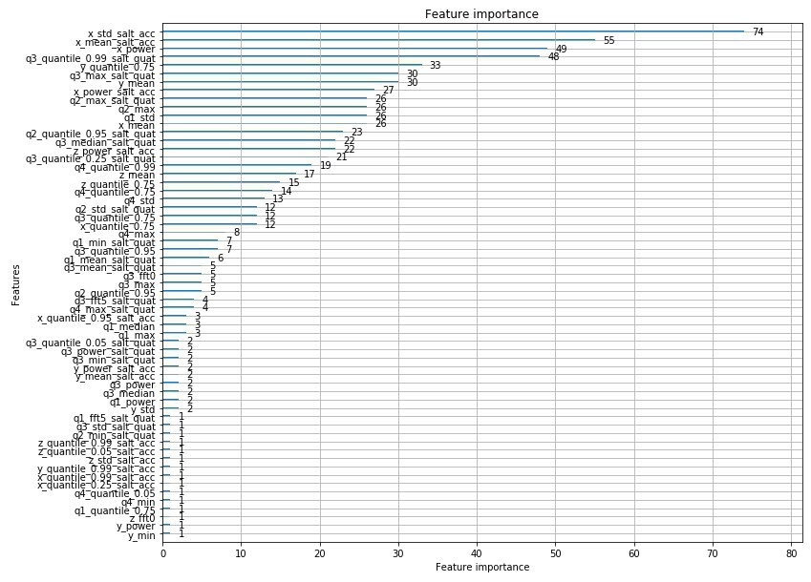
Results: feature importance

Slide 19
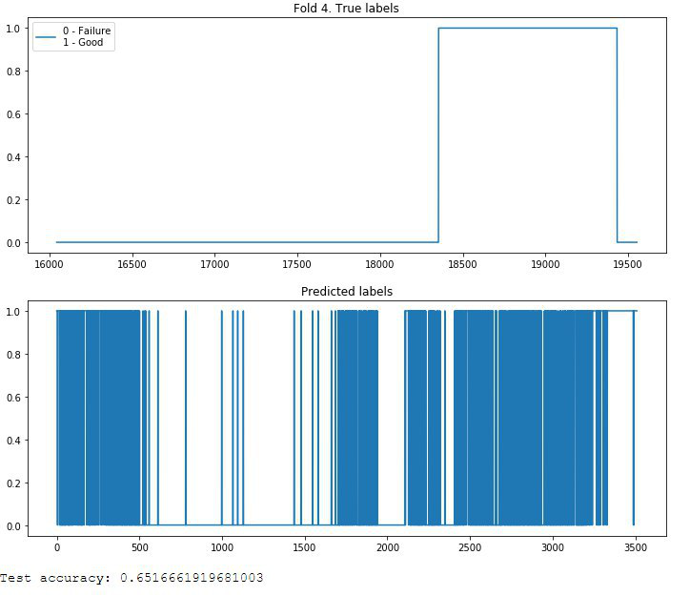

Slide 20
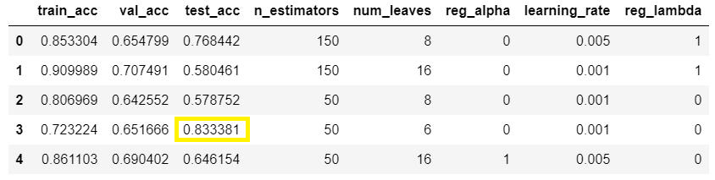
Accuracy of different folds

Slide 21
THANK YOU!

