Slide 1
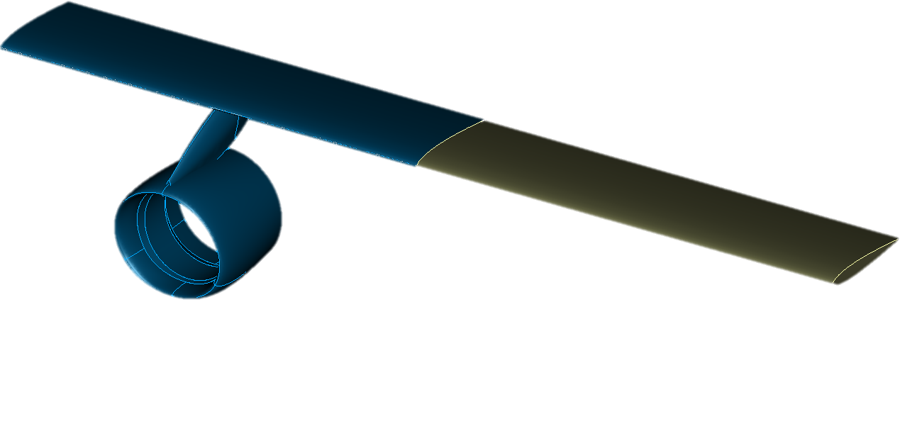
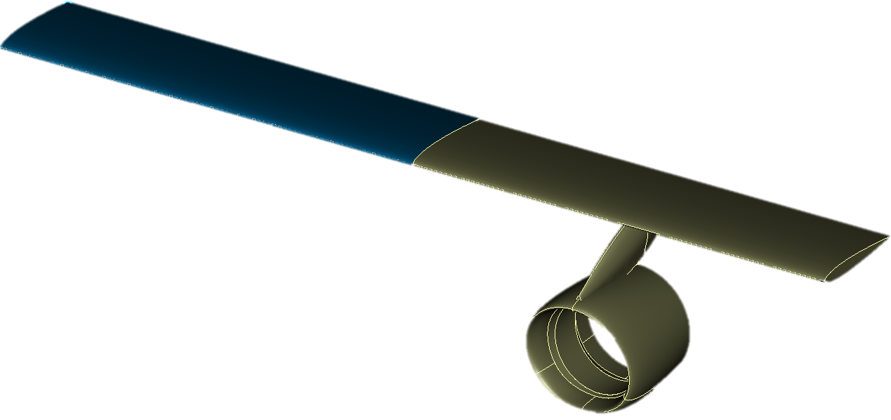
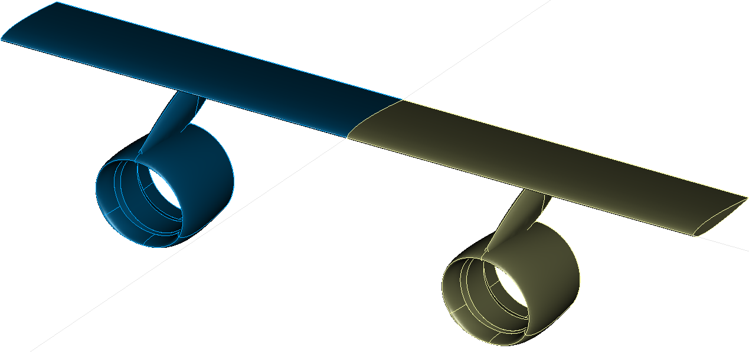
<wing symmetry="x-z-plane">
<parentUID symmetry="def">wing</parentUID>
<parentUID symmetry="symm">wing</parentUID>
<parentUID symmetry="full">wing</parentUID>

