Slide 1
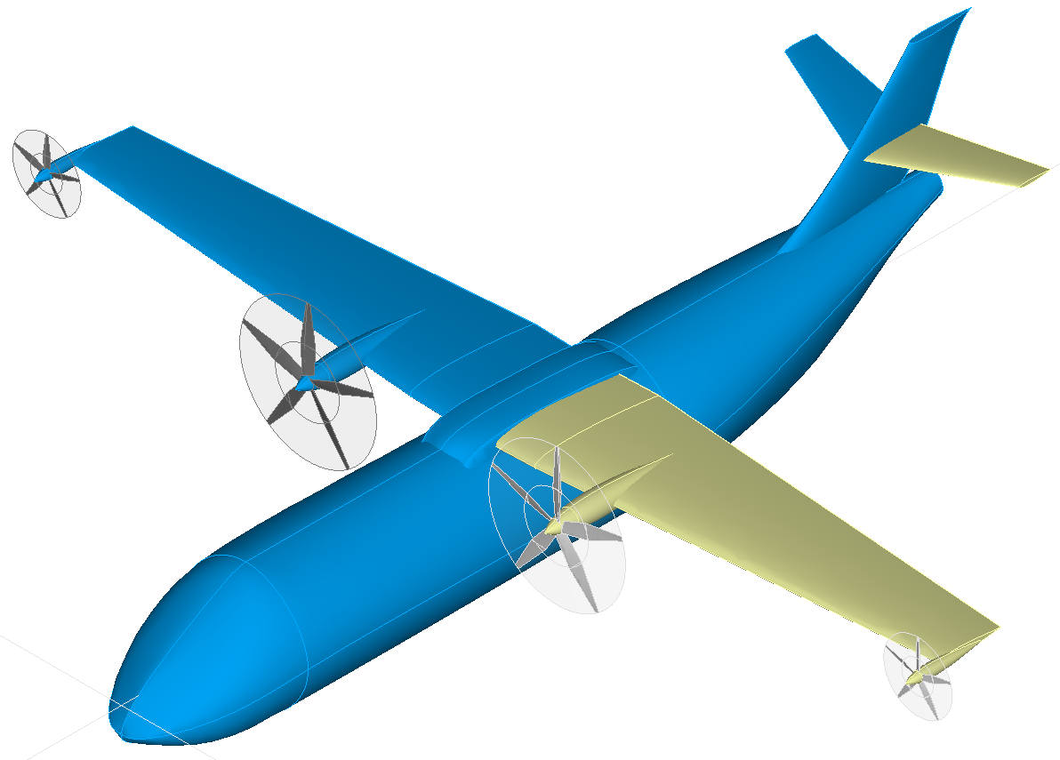
<enginePylon uID=“outerEnginePylon">
<name>outer engine pylon</name>
<parentUID>wing</parentUID>
<transformation>
<translation refType="absLocal">
…
</translation>
</transformation>
<wing uID="horizontalTailplane" symmetry="x-z-plane">
<name>horizontal tailplane</name>
<parentUID>verticalTailplane</parentUID>
<transformation>
<translation refType="absLocal">
…
</translation>
</transformation>
<wing uID="verticalTailplane">
<name>vertical tailplane</name>
<parentUID>fuselage</parentUID>
<transformation>
<translation refType="absLocal">
…
</translation>
</transformation>
global (CPACS) coordinate system
fuselage
local coordinate system
main wing
<enginePylon uID=“innerEnginePylon">
<name>inner engine pylon</name>
<parentUID>wing</parentUID>
<transformation>
<translation refType="absLocal">
…
</translation>
</transformation>
fairing
<wing uID=“wing" symmetry="x-z-plane">
<name>main wing</name>
<parentUID>fuselage</parentUID>
<transformation>
<translation refType="absLocal">
…
</translation>
</transformation>
outer engine pylon
inner engine pylon
<fuselage uID="fuselage">
<name>fuselage</name>
vertical tailplane
horizontal tailplane
<fuselage uID="fairing" symmetry="none">
<name>fairing</name>
<parentUID>wing</parentUID>
<transformation>
<translation refType="absLocal">
…
</translation>
</transformation>

