Slide 1
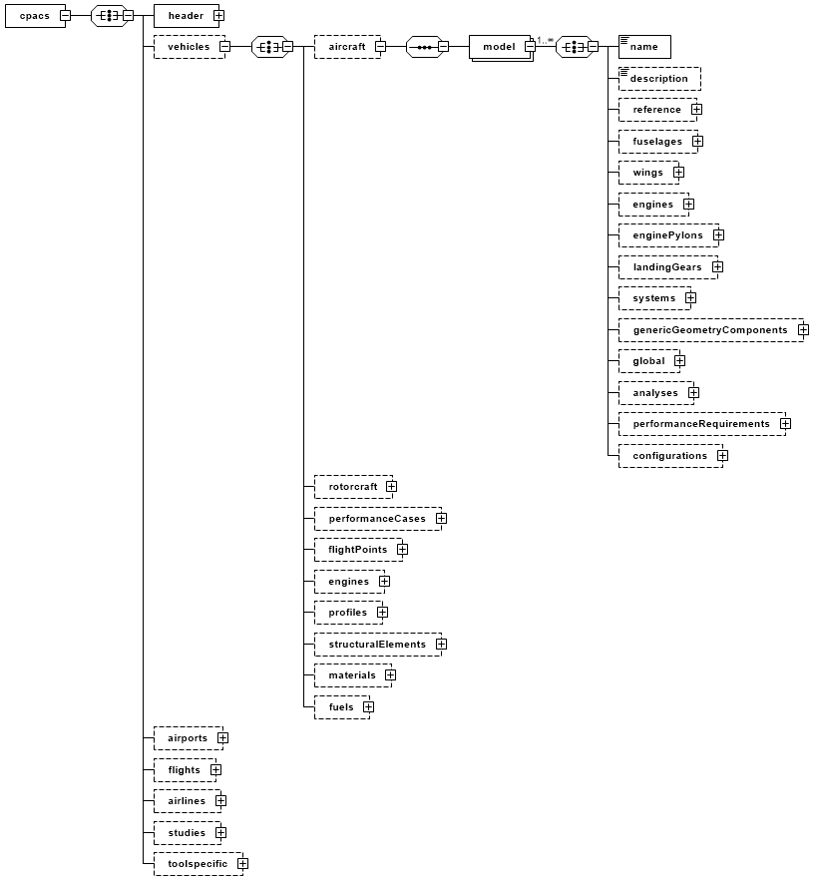
Component level
The actual vehicle instances
Further information about this model
Data which can be used to define aircraft or helicopter (library)

