Slide 1
Conflict in Cyberspace
Week 05
Seminar: Technology Steps in
Lecture: Understanding Cyberspace
Graduate Seminar, Fall 2023
Anton Sobolev

Slide 2
New TA: Min Shi
Min Shi (class materials, focus on coding)
Office Hours: Tuesday, 5-7 pm, G.R.3.314: https://minshi.youcanbook.me
Forum / Emails: 9-10 AM
Kashmiri Medhi (class materials, focus on readings)
Office Hours: Thursday, 5-7 pm:
Forum / Emails: 6-7 PM

Slide 3
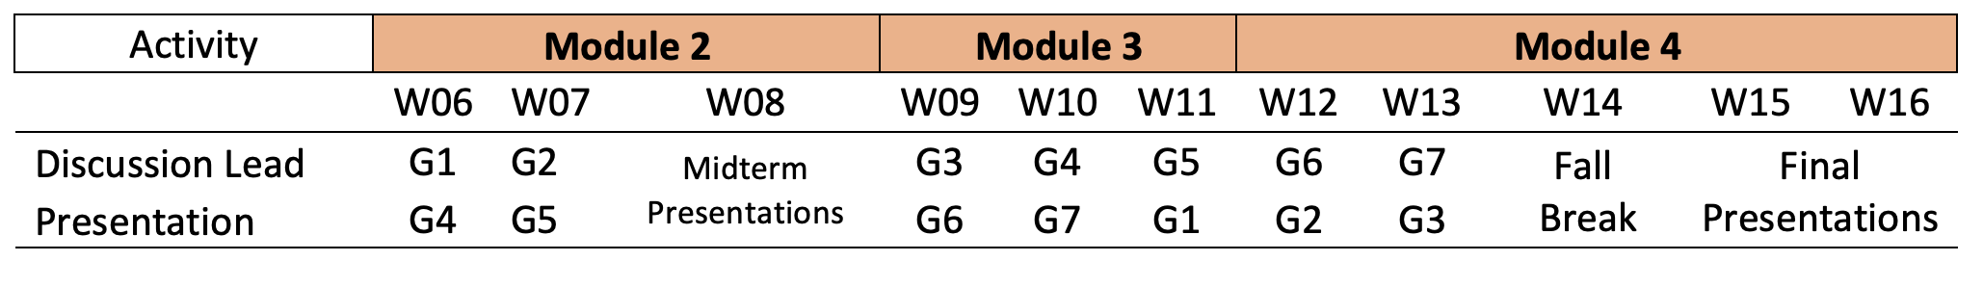
Group Activities Schedule

Slide 4
Group Activities Schedule
Group 1 |  | Group 3 |  | Group 5
Ajay |  | Bhuvan |  | Will
Shubham |  | Adela |  | Raul
Suraesh Krishnaa |  | Hoorain |  | Keerthana
Chirag |  | Vasantha Rani
 |  |  |  | Group 6
Group 2 |  | Group 4 |  | Esther
Boenna |  | Aminul |  | Glenn
Ashby |  | James Alexander |  | Swayam
Aayush |  | Sahil Sanjay
Aaron |  | Ishani |  | Group 7
 |  |  |  | Folasade
 |  |  |  | Nutchasorn
 |  |  |  | Arth

Slide 5
Groups
 | Module 2. Cyberspace: The Current Scene
W05 | Governing Cyberspace
W06 | Cyber Strategy
 | Activity | Discussion lead (G1) | Presentation (G4) How to work with conflict-related data: Workshop
 |  | Midterm Conference Guidelines
 | New Topic | Cyber Strategy
W07 | De-Coding Cyber Strategy: Midterm Conference Preparation
 | Due
 | Activity | Discussion lead (G1) | Presentation (G4) CyberSpace & Military Operations
W08 | Political map of cyberspace: Mini-conference

Slide 6
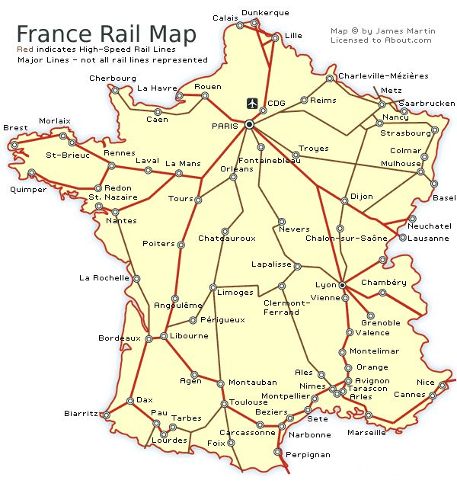
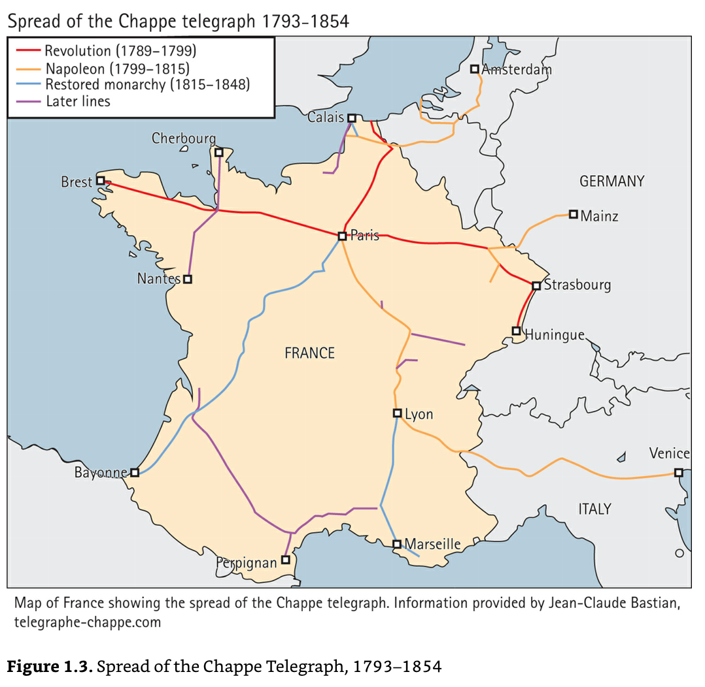
ICT: Similarities in Spatial Diffusion
Overlap In:
☐ Roads ☐ Telegraph
☐ Fiber
Wireless Signal Diffusion: Change in patterns?
☐ Radio | TV stations locations

Slide 7
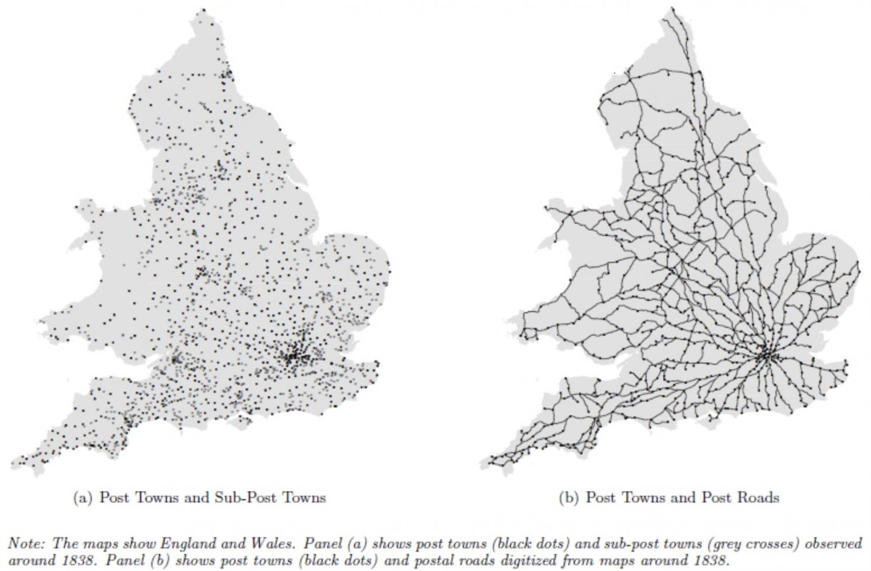
Cont’d: Coincidence?
Figure 2 Post towns, sub-post towns, and post roads in the UK around 1838

Slide 8
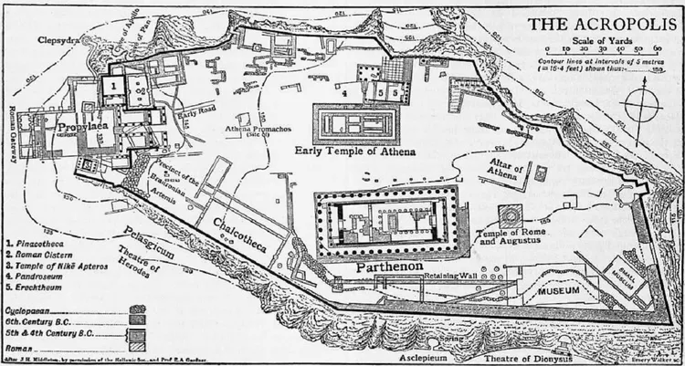
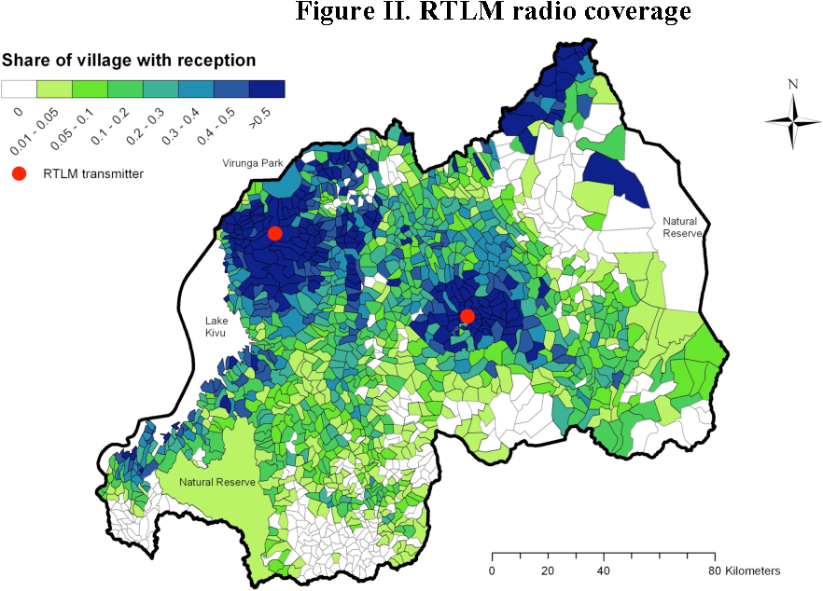
Cyber Space & Nature of Coercion:
☐ Role of Borders & Walls
☐ Technology restricts
☐ Costs of Territorial Control
☐ Equilibrium level of Violence

Slide 9
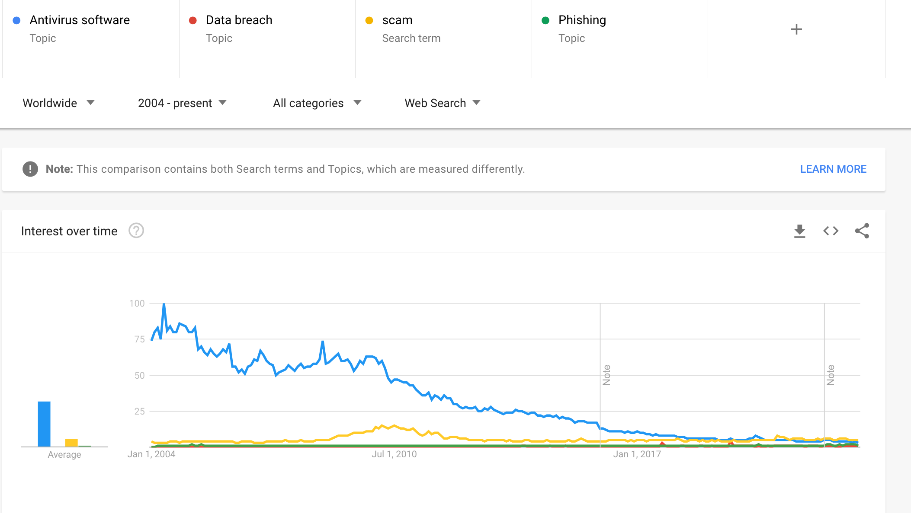
Same Process? Monopolization in Cyberspace
Although this perspective was looked different 15 years ago: Viruses and Antivirus Companies as Protection-Racket Business

