Slide 1

Discord
Imagine a place

Slide 2
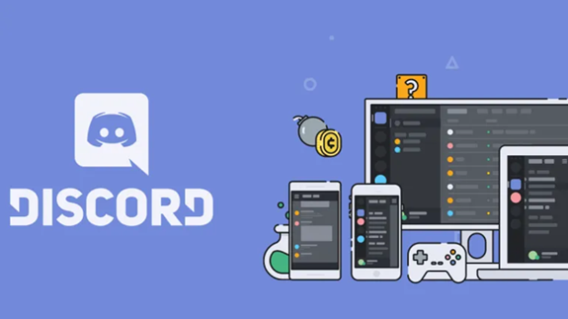

What is Discord?
Discord is a communication application, originally designed for the gamer community but wich has evolved over the years to serve a large number of users and communities for various purposes.

Slide 3
Origin and development
It was created by Jason Citron and Stan Vishnevskiy and was launched in 2015. Before Discord, online communication was somewhat chaotic, so the idea was born from the need for an efficient communication tool mainly for gamers, but it quickly expanded to other sectors.

Slide 4

Availability
This application is avaliable for Android, iOS, Windows, macOS, Linux, web browsers, Playstation, allowing it to be used on any device without losing functionality.
It is designed for anyone or any group that needs to communicate online in educational, work or entertainment environments.

Slide 5
Plans
It is a free aplication but it offers two premium plans called Discord Nitro Basic and Nitro:
Nitro Basic | Nitro
2.99€/month | 9.99€/month
Image uploads 50MB | Image uploads 500MB
Emoji customization | Emoji customization
Limited super reactions | HD transmision
Nitro badge in profile | 2 server boosts
 | More..

Slide 6
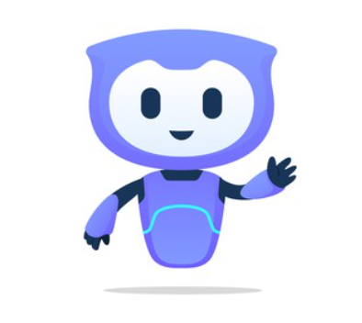
Key features
Discord has several key features that set it apart and make it unique like:
Voice and video chat
Servers and channels
Bots and customization

Slide 7

Voice and video chat
Discord allows you to communicate by voice and video with high quality and low latency, ideal for meetings, classes or gaming. Its screen sharing feature makes collaboration easy, and dynamic voice channels allow you to join and leave conversations without invitations, making communication more flexible and simple.

Slide 8


Servers and channels
This is the main feature that characterizes Discord.
You are allowed to create servers, which are virtual spaces to organize communities and with different text and voice channels that enables conversations to be organized by topic.

Slide 9
Bots and customization
Another notable feature is the possibility of customizing servers with bots that automate tasks such as chat moderation, play music and event management, improving the user experience.
In addition, it offers advanced options such as role assignment, giving permissions and exclusive emojis, allowing each community to adapt their space according to their needs.

Slide 10


UI and UX
Its UI is clean and has a modern design, easy to use even for beginners.
The UX its good. The navigation is intuitive and allows easy management of servers and channels.

Slide 11
Exploring Discord
Below we can see a video browsing the app and showing the main functionalities.
Watch video
Watch video bot

Slide 12
Critical analysis
With all this, we can see some advantages and disadvantages about Discord.
Advantages | Disadvantages
Free platform with many functionalities on all devices. Very versatile, useful for many tasks in various communities and for many areas. Good quality in calls and videos and a high level of customization. | High RAM consume on lower-capacity devices. It can be overwhelming for beginners due to its many features. Some servers may have management issues if not handled or moderated properly.

Slide 13
Comparison with other Apps
WhatsApp/Telegram: Focused on personal and group messaging. Discord is ideal for large communities with organized channels and better stability in voice/video calls.
Zoom/Microsoft Teams: Excellent for professional video conferencing, but Discord stands out for its social flexibility and continuous communication without the need for formal meeting.
Slack: Compared to this work-oriented app, Discord offers more free features and a more user-friendly interface, perfect for non-work users, and with no message history limitations(they hide after a while without pro plan).
Google Meet: Less structured than Discord and lacks customization options. Discord makes spontaneous communication easier without the need for links or access codes.

Slide 14
Summary
Discord has stablished itself as a powerful and versatile platform for online communication, offering intuitive tools that create a smooth and adaptable user experience and although it started as an option targeted at gamers, its evolution has transformed it into an ideal tool for a wide variety of communities and online groups.

Slide 15

Would I recommend it?
And to finish definitely yes. In my opinion, it is the best option for a complete communication platform, whether for friends, work or study. It’s specially recommended for gamers, students, workers, content creators like streamers or for anyone who wants to communicate online. Its potential, ease of use and wide of range of features make it a top choice for smooth and efficient communication.

Slide 16

END
Thank you for pay atention!

