Slide 1
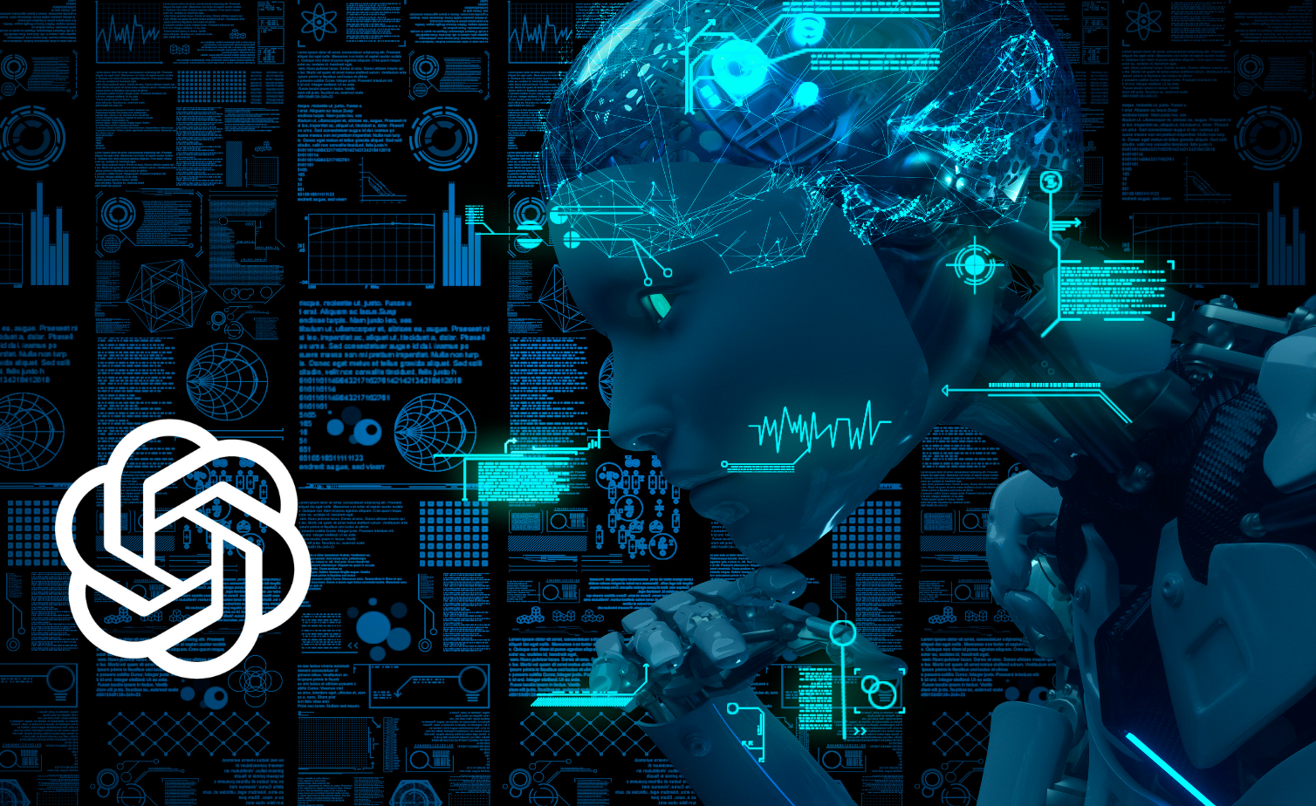
GPT
OPEN AI

Slide 2
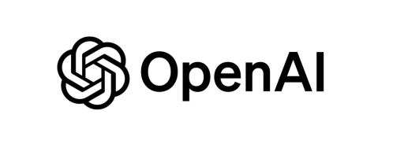

  GPT
GPT (Generative Pre-trained Transformer) is an artificial intelligence model developed by OpenAI. It is trained to understand natural language and answer questions, maintain dialogues, generate ideas, or help with tasks such as writing and programming, all based on the text it receives. In the latest versions, you can speak with it and maintain a conversation without long waits, or even send photos for it to help answer questions.
Open AI is a US company that dedicated to investigation and deployment of artificial intelligence. It was founded in 2015. One of its founders is Elon Musk.. In a first time, this company didn't have profit motive (animo de lucro), its mission was that the intelligence artificial should benefit for the all people.
In 2019 the company transformed to hibrid that it has entity that doesn't have profit motive and other entity that it has profit. This change occurred because, since then, it has attracted investors like Microsoft, which invested a lot of millions of dollars."
ChatGPT currently has over 180.5 million users, which is up 80% from the 100 million it had in January of 2023.
In Spain Chat GPT has 12,7 millions of users.

Slide 3
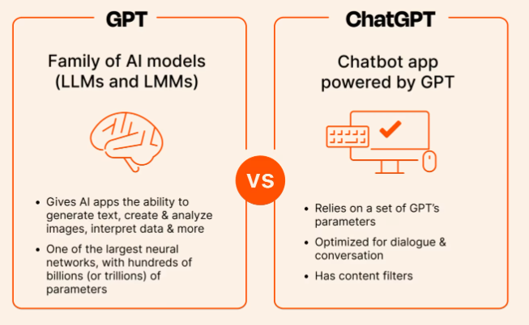
  Difference between GPT and ChatGpt
GPT is a family of AI models trained on terabytes of internet data that give artificial intelligence (AI) applications the ability to generate coherent and contextually relevant responses based on user input.
ChatGPT is an AI chatbot that uses GPT's models to interact with humans

Slide 4

  The Potential of ChatGPT
ChatGPT can be used on PC or mobile devices. It is compatible with:
Text or with files: You can ask questions by typing in the chat or
by inquiring about a file you've attached.
Image: It can process images and interact with them. It recognizes objects and text.
Audio: You can use your voice to interact with it
GPTs: you can create specialized GPTs focused on specific themes

Slide 5
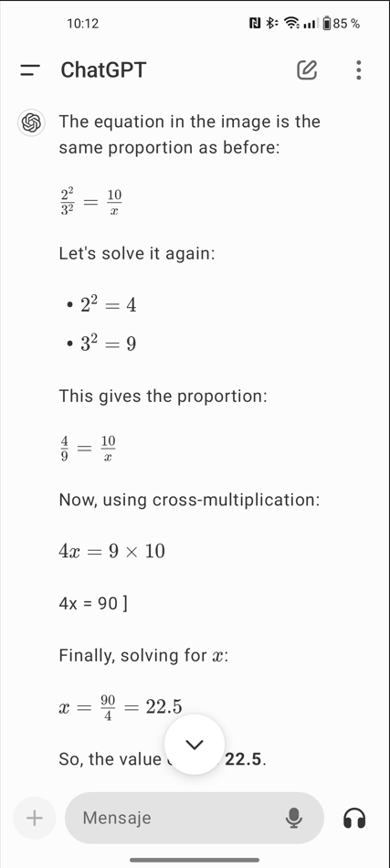
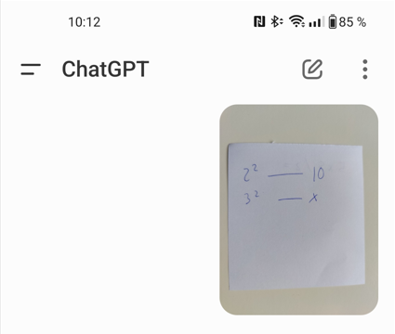
  The Potential of ChatGPT
It has the capability to view an image through the camera and recognize what’s in it.

Slide 6
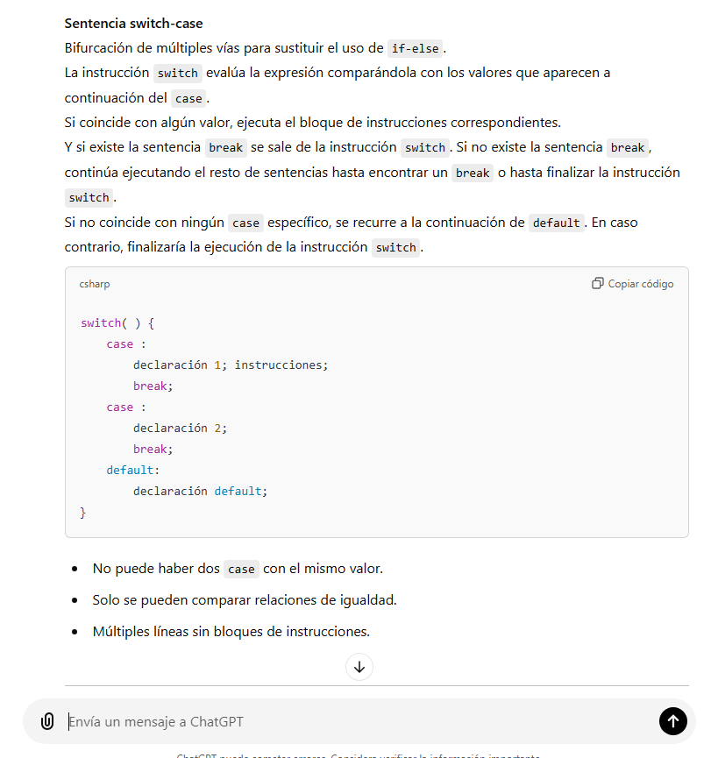
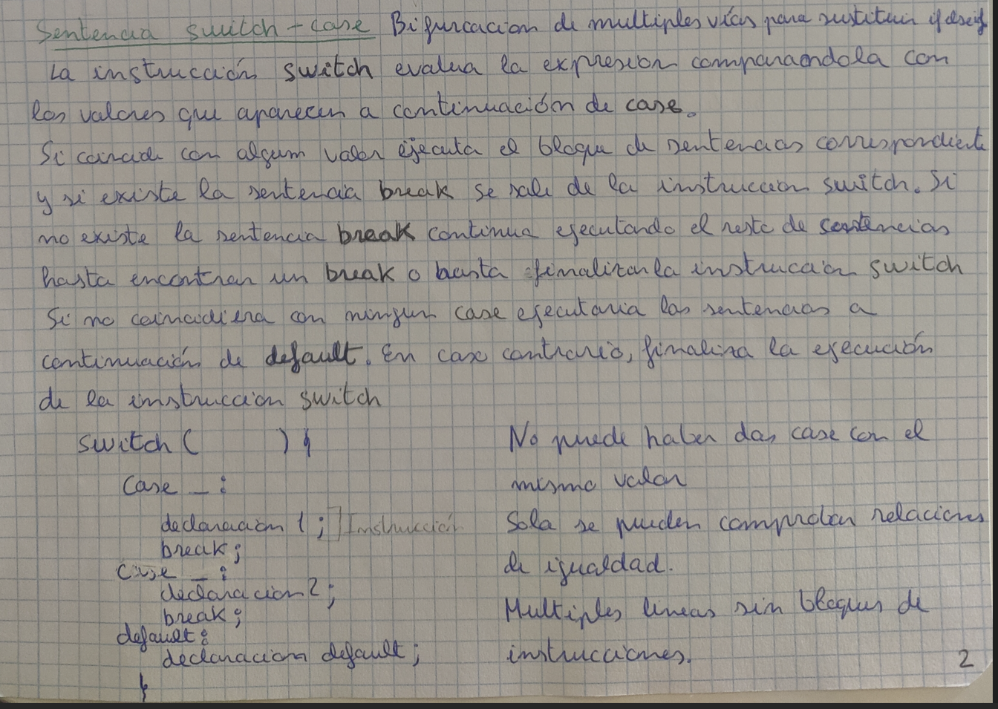
  The Potential of ChatGPT
These are some notes I took last year on programming, handwritten and and ChatGPT allows me to convert them into a digital format easily.
I think that my handwriting isn´t very good but it can still do the job

Slide 7
  The Potential of ChatGPT
For the presentation of ChatGPT 4.0, OpenAI published some compatibility details in short videos like the following:
Video1
In the presentation, the presenters, one speaking English and the other speaking Italian, were conversing using the ChatGPT mobile app as a translator and its very fast in the traductions.
You can have a conversation with it and this IA has zero latency in its responses. It is more natural and expressive, as it can convey sentiments, emoctions…

Slide 8
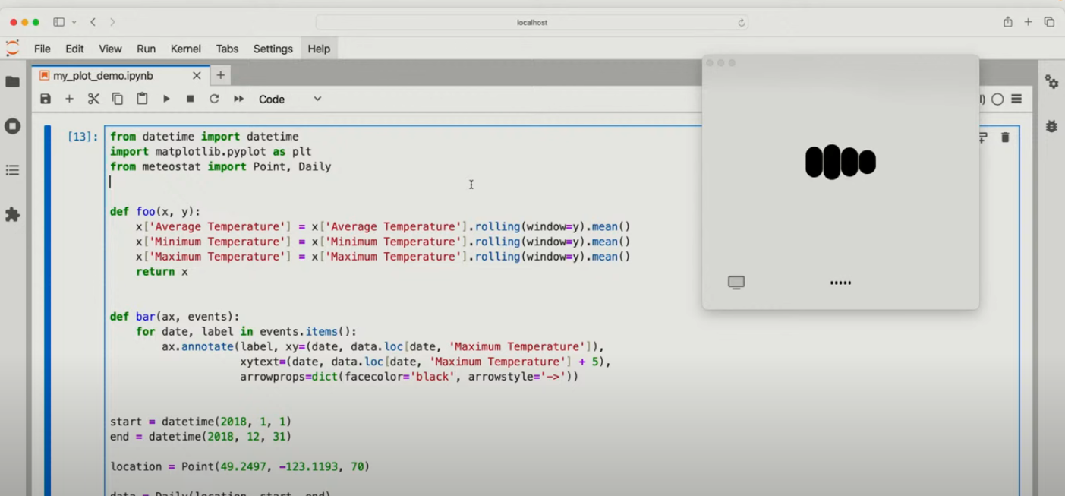
  The Potential of ChatGPT
Share your work on your PC: In the presentation of ChatGPT-4.0, the presenters explained that you can share the code from your PC, and ChatGPT can help you or explain it.
https://www.youtube.com/watch?v=DQacCB9tDaw

Slide 9
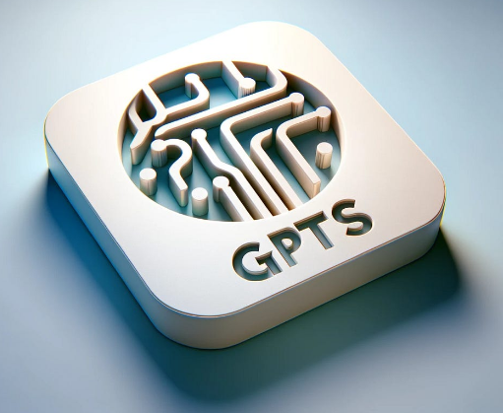
  The Potential of ChatGPT
GPTs: you can create specialized GPTs focused on specific themes, and you can interconnect them to perform tasks in your company, for example: Customer service, data Analysis, project management, content creation…
For example a business can create a GPT focused on customer service. This GPT can handle frequently asked questions, resolve common issues, and escalate complex queries to human agents when necessary. By interfacing this GPT with a sales-oriented GPT, they can provide personalized recommendations based on customer queries, improving the overall customer experience.

Slide 10
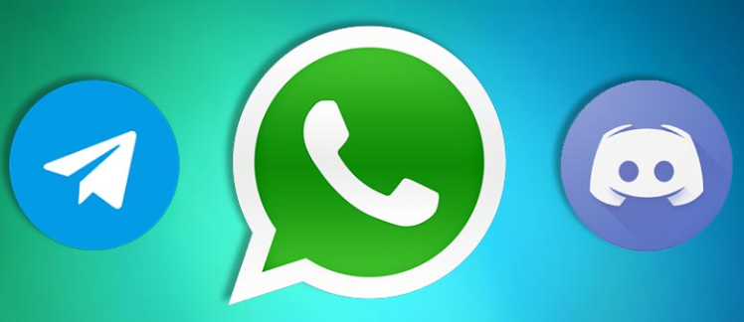
  Integration in another platforms
ChatGPT is available on other third-party platforms:
Discord: Various bots have been created with ChatGPT to help users with their questions in community servers.
Other applications: We can use the API that OpenAI provides to integrate ChatGPT into our applications. For example, it can create descriptions for your products in the app, and it can serve as a virtual assistant in the app.
CRM use this IA for automate response in client attention.
WhatsApp and Telegram use implementations of this tool with APIs, allowing companies to offer automated customer service to their clients

Slide 11
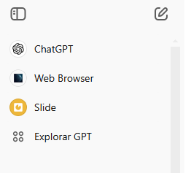
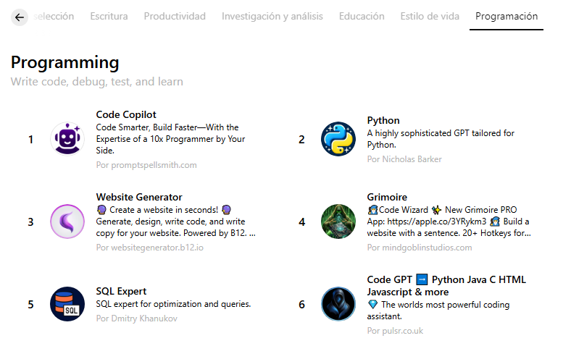
  GPTs more especialized
You can use more specialized GPT models, and these models offer capabilities that are more focused and adapted to specific areas or domains. These GPTs are only available with the paid version of ChatGPT, or there may be a limit on the number of questions you can ask in the free version

Slide 12
  Plans
ChatGPT offers several pricing plans:
- Free Version: You can use ChatGPT for free, which includes access to the GPT-3.5 model. However, there are limits on daily usage, especially during peak times.
- ChatGPT Plus: This subscription costs $20 per month. It provides access to the more advanced GPT-4 model, faster response times, priority access during high traffic periods, and other premium features​.
- ChatGPT Team: Designed for organizations, this plan costs $30 per user per month (or $25 per user per month if billed annually). It includes all the features of ChatGPT Plus, along with tools for team management and collaboration​.
- ChatGPT Enterprise: This is a custom plan for larger organizations, typically priced at $60 per user per month.

Slide 13
  Plans
For individuals just getting started with ChatGPT | For individuals looking to amplify their productivity
Assistance with writing, problem solving and more | Access to OpenAI o1-preview, OpenAI o1-mini
Access to GPT-4o mini | Access to GPT-4, GPT-4o, GPT-4o mini
Limited access to GPT-4o | Up to 5x more messages for GPT-4o
Limited access to data analysis, file uploads, vision, web browsing, and image generation | Access to data analysis, file uploads, vision, and web browsing
Use custom GPTs | Access to Advanced Voice Mode
 | DALL·E image generation
 | Create and use custom GPTs
 | Early access to new features
$0/ month | $20/ month

Slide 14
  Plans
Team | Enterprise
For fast-moving teams and organizations ready to supercharge work | For global companies looking to enable their workforce with AI
Everything included in Plus | Everything included in Team
Unlimited access to GPT-4o mini and higher message limits on GPT-4, GPT-4o, and tools like DALL·E, web browsing, data analysis, and more | Unlimited, high speed access to GPT-4, GPT-4o, GPT-4o mini, and tools like DALL·E, web browsing, data analysis, and more…
Create and share GPTs with your workspace | Expanded context window for longer inputs
Admin console for workspace management | Enterprise data excluded from training by default & custom data retention windows…
Team data excluded from training by default… | Admin controls, domain verification, and analytics
 | Enhanced support & ongoing account management
$25per user / month billed annually $30per user / month billed monthly

Slide 15
  Ours opinion about this type of tools
Advantage:
We think that this tool is good for helping with repetitive tasks without wasting time.
If you don’t understand anything this tool can help you with a explication about it.
These tools can help you resolve errors in a program more efficiently.
We think that this IA will become a useful assistant for you because it is very fast in its responses and it know abouts all topics.
This tool made errors: A study conducted by Purdue University found that ChatGPT made programming errors in 52% of its answers. The questions were taken from Stack Overflow, and out of 517 questions, a significant number of answers contained errors. I think that it´s good because it will never replace the programmers.
Disadvantage:
We believe that it is dangerous if you don’t know how to use it, because it is not always used correctly. If you end up just copying and pasting, you won’t learn anything and you run the risk of using information with errors.

Slide 16

  The winner
We believe that, at this moment, GPT is the best AI.
Blackbox AI and GitHub Copilot are good for programming, but they are not as useful for other tasks, while ChatGPT is versatile and compatible with all tasks.
Ollama is an AI that allows you to run it locally and free without an internet connection, ChatGPT also offers a free version that is sufficient for moderate use although it requires an internet connection. You can use ChatGPT on all devices and Ollama cannot. ChatGPT supports all languages, including Galician, while Ollama does not. ChatGPT uses terabytes of data, and we don’t believe the portable version of Ollama is on the same level as ChatGPT.

