Slide 1
R for sustainable agriculute
Reproducible research and digital landscapes Anton Urfels

Slide 2
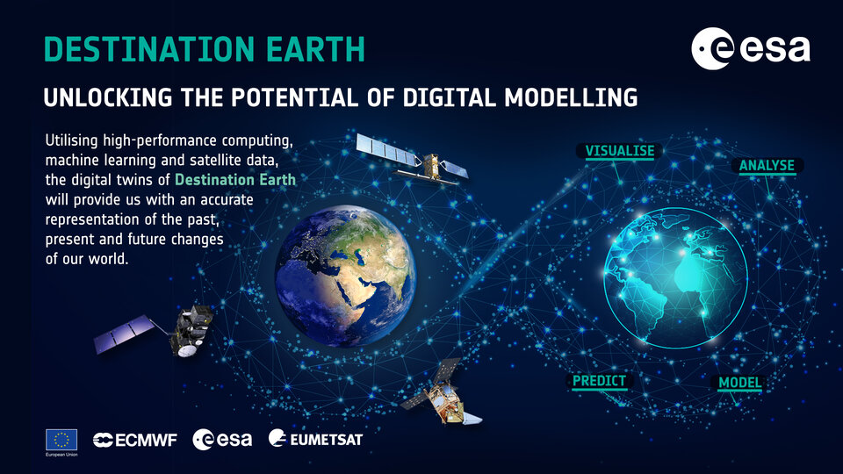
The destination
Digital twins of our agro-ecological landscapes.

Slide 3
Digital landscapes for sustainable agri-food systems
We need to ensure our foundations a solid
Data is the backbone of these developments
But data without knowledge will not suffice
We are well placed to work at this interface

