Slide 2
Automated Tree Mapping and Measurement
Group 6
Biesemans Hannes, Ceule Alexander, Hendrickx Quinten, Ünal Kâni, Wannijn Anton

Slide 3
Table of Contents
Introduction
Overview – System Workflow
Camera Calibration & Tree Detection
Tree Tracking & ID Assignment
Path Reconstruction
3D Localization & DBH Estimation
Results
Conclusion & Future Work
Biesemans Hannes - Ceule Alexander - Hendrickx Quinten - Ünal Kâni - Wannijn Anton

Slide 4
Introduction

Slide 5
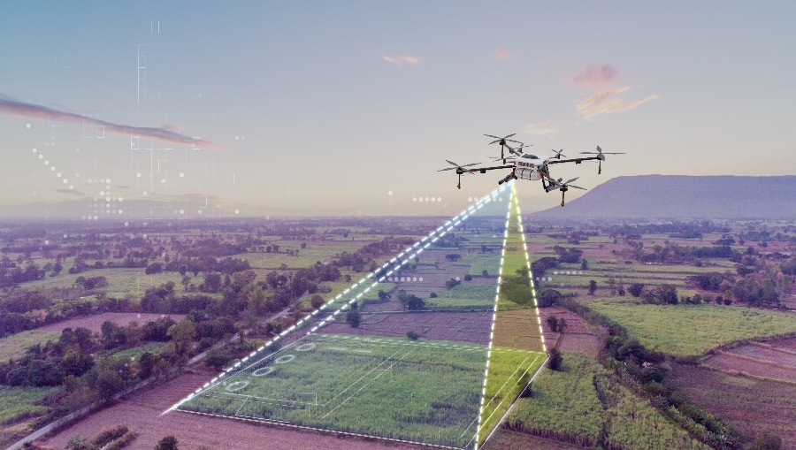
Introduction
The Urgency of Tree Monitoring
Limits of Traditional Methods
Vison-Based Smart Mapping
Towards Scalable Eco-Intelligence
Mapping farming fields using drones (Dukowitz, 2024)
Biesemans Hannes - Ceule Alexander - Hendrickx Quinten - Ünal Kâni - Wannijn Anton

Slide 6
Overview

Slide 7
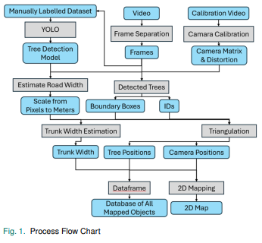
Overview
System Workflow
Preprocessing
Camera Calibration & Tree Detection
2D Mapping & 3D Localization
DBH Estimation
Biesemans Hannes - Ceule Alexander - Hendrickx Quinten - Ünal Kâni - Wannijn Anton

Slide 8
Methodology

Slide 9
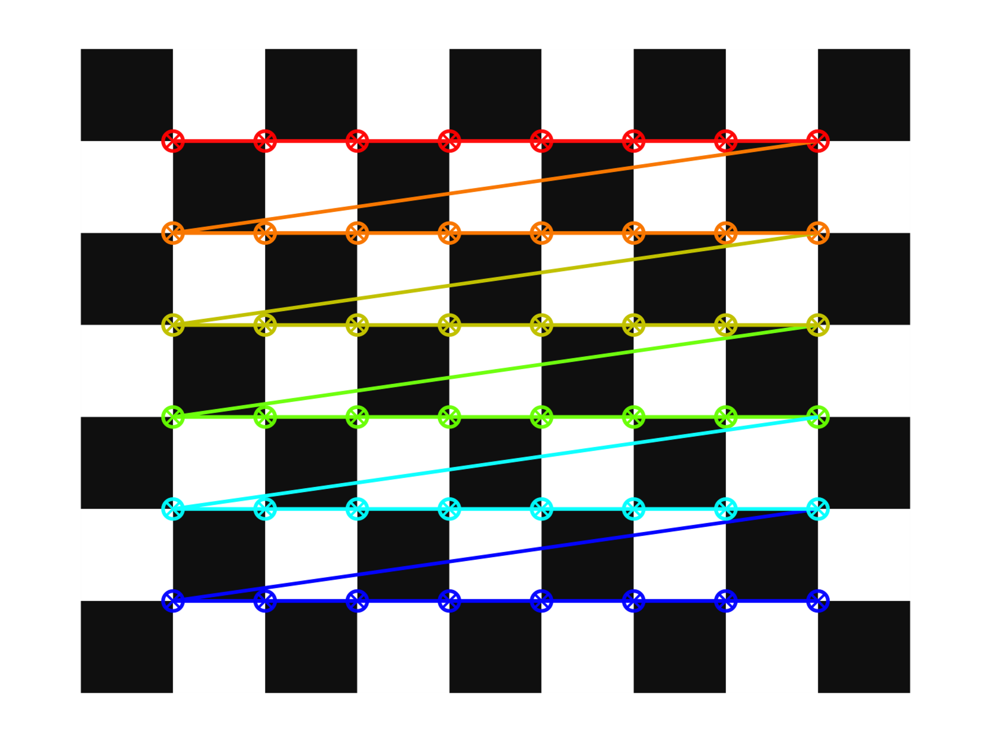
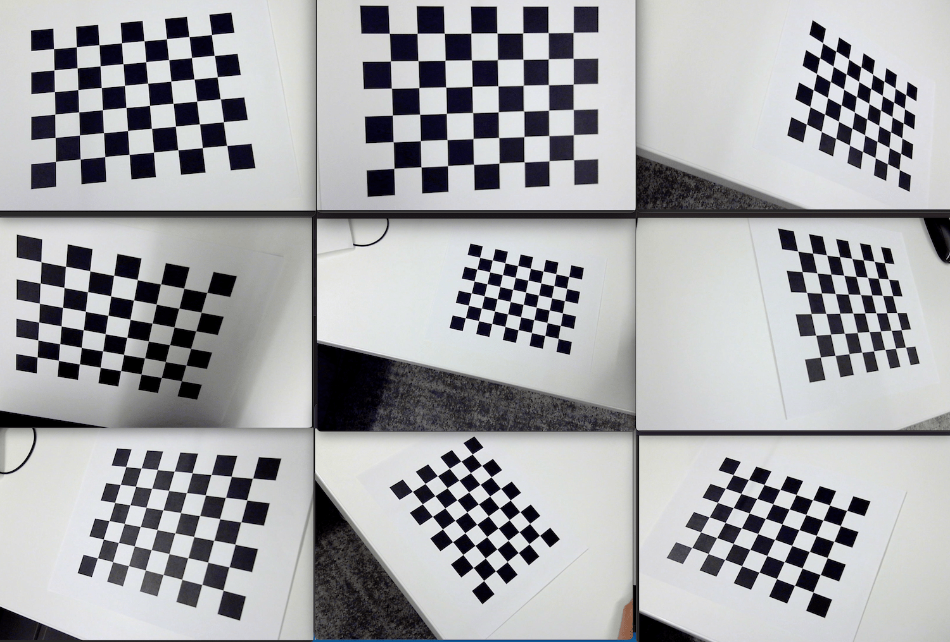
Methodology
Camera Calibration
Camera’s internal characteristics
checkerboard pattern
Image and point undistortion
Biesemans Hannes - Ceule Alexander - Hendrickx Quinten - Ünal Kâni - Wannijn Anton

Slide 10
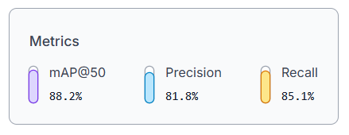
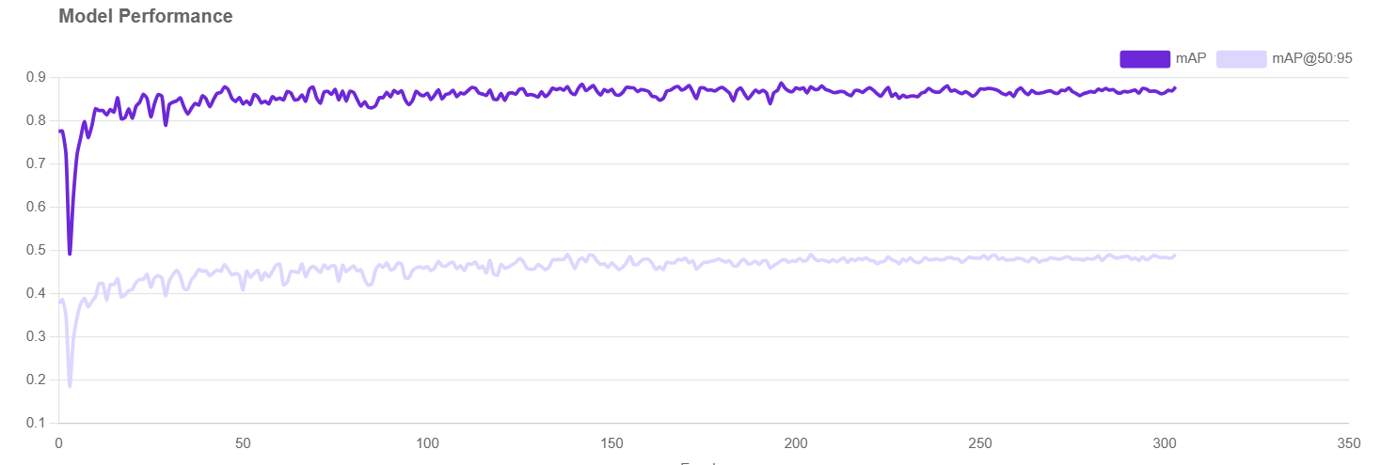
Methodology
Tree Detection
Dataset Curation and Annotation
Data Augmentation
Model Selection and Fine-Tuning
Model Output
Biesemans Hannes - Ceule Alexander - Hendrickx Quinten - Ünal Kâni - Wannijn Anton

Slide 11
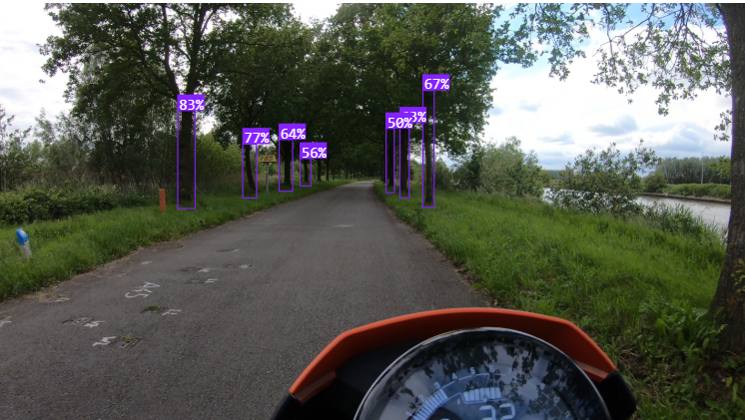
Methodology
Tree Detection

Slide 12
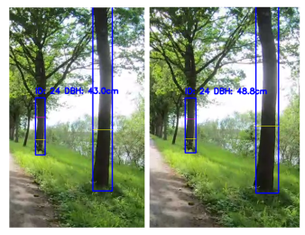
Methodology
Tree Tracking & ID Assignment
Mechanism: BasicTracker Module
Intersection over Union (IoU) metric
The track’s bbox is updated to the coordinates of the matched new detection.
Its staleness counter is reset to zero, indicating it has been successfully re-identified.
The frames_seen counter is incremented.
Biesemans Hannes - Ceule Alexander - Hendrickx Quinten - Ünal Kâni - Wannijn Anton

Slide 13
Methodology
Path Reconstruction
SIFT keypoints
Feature matching
Essential matrix decomposition
Metric scale recovery
Global pose estimation
Output
Biesemans Hannes - Ceule Alexander - Hendrickx Quinten - Ünal Kâni - Wannijn Anton

Slide 14

Methodology
3D Localization & DBH Estimation
3D Localization
Triangulation
2D image coordinates from 2 views
Scaled camera poses
DBH Estimation
Find Tree Base
Project DBH Height ​$Δv=\frac{f_{y} ∙ H}{Z_{base}}$
Measure Pixel Width
Convert to Meters ​$W_{real}=\frac{w_{px} ∙ Z_{DBH}}{f_{x}}$
Biesemans Hannes - Ceule Alexander - Hendrickx Quinten - Ünal Kâni - Wannijn Anton

Slide 15
Results

Slide 16
Results
Demo with video
Top-down map
Csv file
Biesemans Hannes - Ceule Alexander - Hendrickx Quinten - Ünal Kâni - Wannijn Anton

Slide 17
Conclusion & Future Expansion

Slide 18
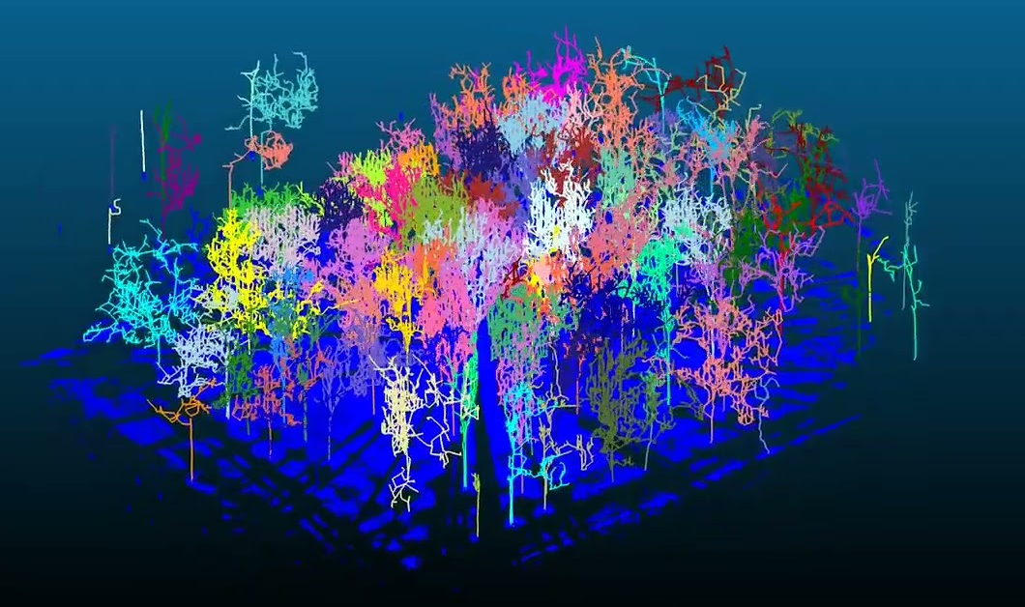
Conclusion & Future Expansion
Proof of Concept Success
Low-Cost, Scalable Potential
Current Limitations
Future Expansion Paths
Automatic Forest Mapping (Gilles, 2024)
Biesemans Hannes - Ceule Alexander - Hendrickx Quinten - Ünal Kâni - Wannijn Anton

Slide 19
References
[1] Dukowitz, Z. (2024, December 17). A Guide to Drone Mapping: Use Cases, Software, and Key Terminology [Updated for 2024]. Drone Pilot Ground School. https://www.dronepilotgroundschool.com/drone-mapping-software/
[2] Gilles, N. E. (2024, July 23). Purdue team introduces advance in automatic forest mapping technology - News. News. https://www.purdue.edu/newsroom/2022/Q4/purdue-team-introduces-advance-in-automatic-forest-mapping- technology/

Slide 20
UGhent Faculty of Engineering and Architecture
Computervision Project
Automated Tree Mapping and Measurement
Group 6
Biesemans Hannes - Ceule Alexander - Hendrickx Quinten - Ünal Kâni - Wannijn Anton

