Slide 1


Software and Cloud Engineering Bootcamp
Sacchon project
Team 3
Members: Konstantina Tsechelidou
Theodoros Antonaros
Barbara Grigoriadou

Slide 2



Team Members
Theodoros Antonaros
MEng Electrical and Computer Engineering, Aristotle University of Thessaloniki
For this project :
Java, IntelliJ
Angular, Visual Studio Code
MSSQL Server
AWS

Slide 3
Team Members
Konstantina Tsechelidou
MEng Electrical and Computer Engineering, Aristotle University of Thessaloniki
MSc Artificial Intelligence, Aristotle University of Thessaloniki (currently)
For this project :
Java, IntelliJ
Angular, Visual Studio Code
MSSQL Server
AWS

Slide 4
Team Members
Barbara Grigoriadou
BSc Mathematics, University of Ioannina
MSc Biostatistics, National Kapodistrian of Athens
For this project :
Java, IntelliJ
Angular, Visual Studio Code

Slide 5
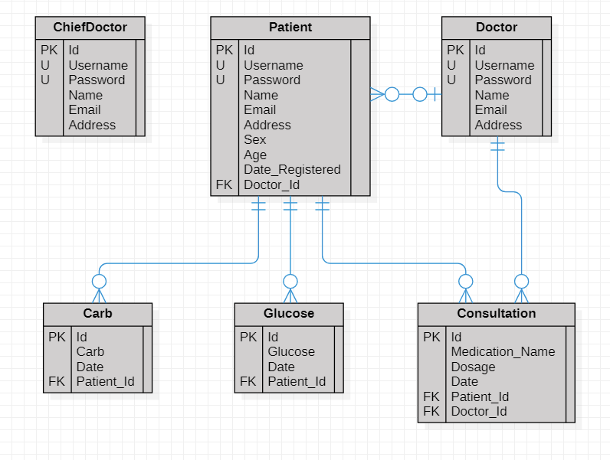
Class diagram

Slide 6
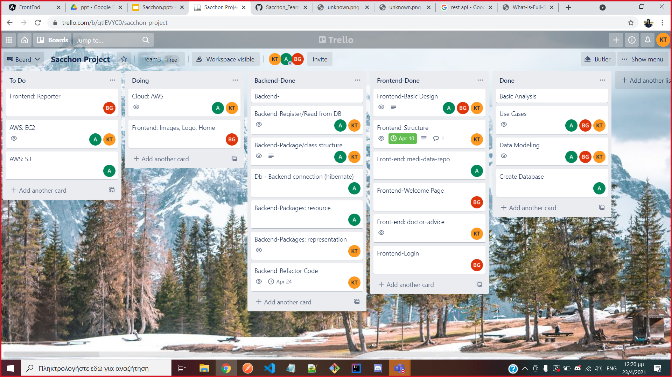
Trello

Slide 7



Platforms
Postman
Git version Control: Master, Development, feature branches
Social Media Platforms: Teams, Discord, Signal

Slide 8
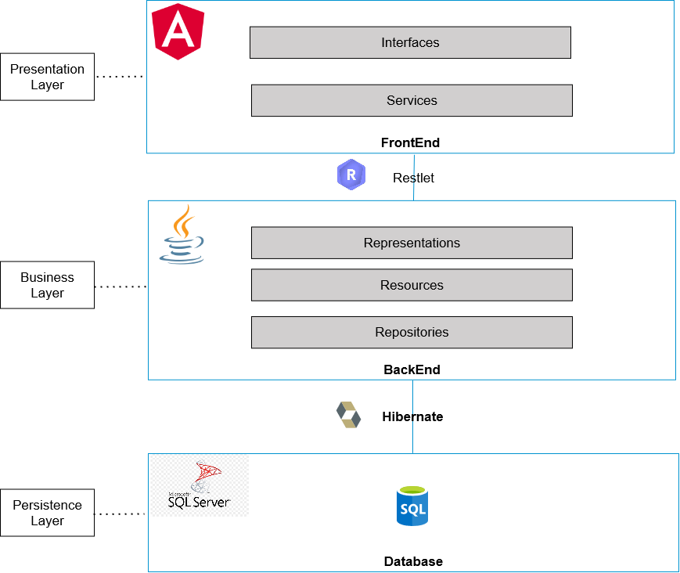

Slide 9
Live Demo
http://team3sacchon.s3-website.eu-central-1.amazonaws.com/

Slide 10
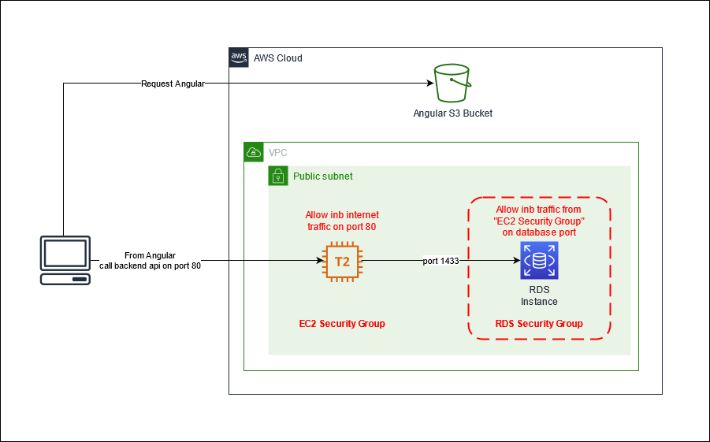
AWS

Slide 11

Reflection
What we should improve
Styling
Security
Design Patterns
Our best work
AWS
Code Quality
Fulfilled Business Requirements
Team Cooperation
What we omitted
- Keep deleted entry
- Better data visualization, statistics

Slide 12


Reflection-Future Goals
Advanced analysis in patients measurements
Classification
Prediction
Robust security
IAM users and roles
Security groups
Notes:
Classification and prediction

Slide 13

Thank your for your attention!

