Slide 1

Nobite Analytics
Pests under control. Now your reports are too !
Le Wagon Data Analytics · Antonella Lundwall
Notes:
Open with energy. Nobite protects people from insects and ticks — Nobite Analytics protects the business from blind spots in its own data. Introduce yourself and the project in one sentence, then move straight into the idea.

Slide 2





One click. Three answers.
Every month, Nobite gets sales & inventory files from SK Pharma. Nobite Analytics turns them into instant answers !
Upload files
Auto clean & combine
Instant insights
Drag in this month's
sales & inventory exports
Validated, structured,
ready in seconds
Pick a view, see the
numbers that matter
Powered by two files:
Umsatzstatistik (sales)
Lagerliste (inventory)
Notes:
This is the whole idea in one picture: upload, the app cleans and combines automatically, and Papi gets straight to insights — no manual Excel work every month. Two files power it: the Umsatzstatistik (sales) and the Lagerliste (inventory) — postal codes aren't a separate file, so no third icon needed there.

Slide 3
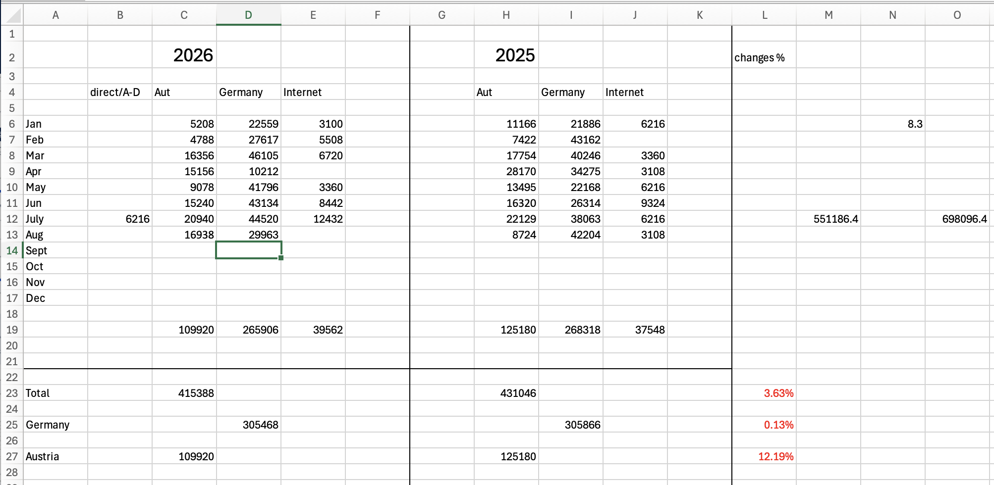
TODAY
This is what the report looks like today
Built by hand every month — formulas spread across a dozen columns, no automatic year-over-year or regional view.
Covers wholesale orders (Großhändler) across Germany — plus a few Excel quirks, like postal codes losing their leading zero, that we already know how to fix.
Notes:
This is the real spreadsheet Papi rebuilds by hand every month — manual formulas, easy to break, no automatic year-over-year or regional comparison. Mention briefly: this covers wholesale orders (Großhändler) across Germany, and yes, a couple of Excel quirks (like postal codes losing their leading zero) — small, already-solved details. Then move into the three views, and land the contrast at 'Demo day.'

Slide 4


From here, three views
Sales & Product
Performance
Customer & Regional
Performance
Inventory &
Demand
Revenue, top products, and trends vs. last year.
Top wholesale partners, regional breakdown across Germany, and outlier alerts.
Current stock vs. 3-month outflow, per product.
Notes:
After upload, Papi picks one of these three — each opens straight into that dashboard, and all three stay reachable from the top afterwards. The small badge on each card shows its source file: green = Umsatzstatistik (sales & customer data), amber = Lagerliste (inventory).

Slide 5
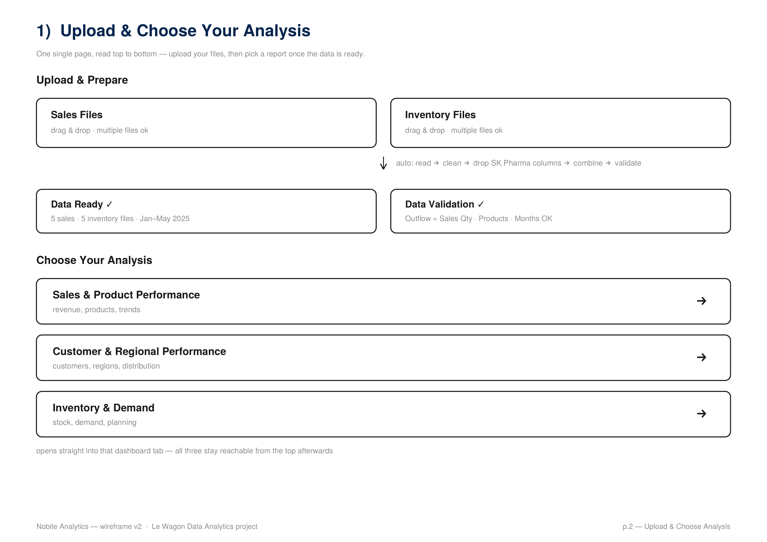
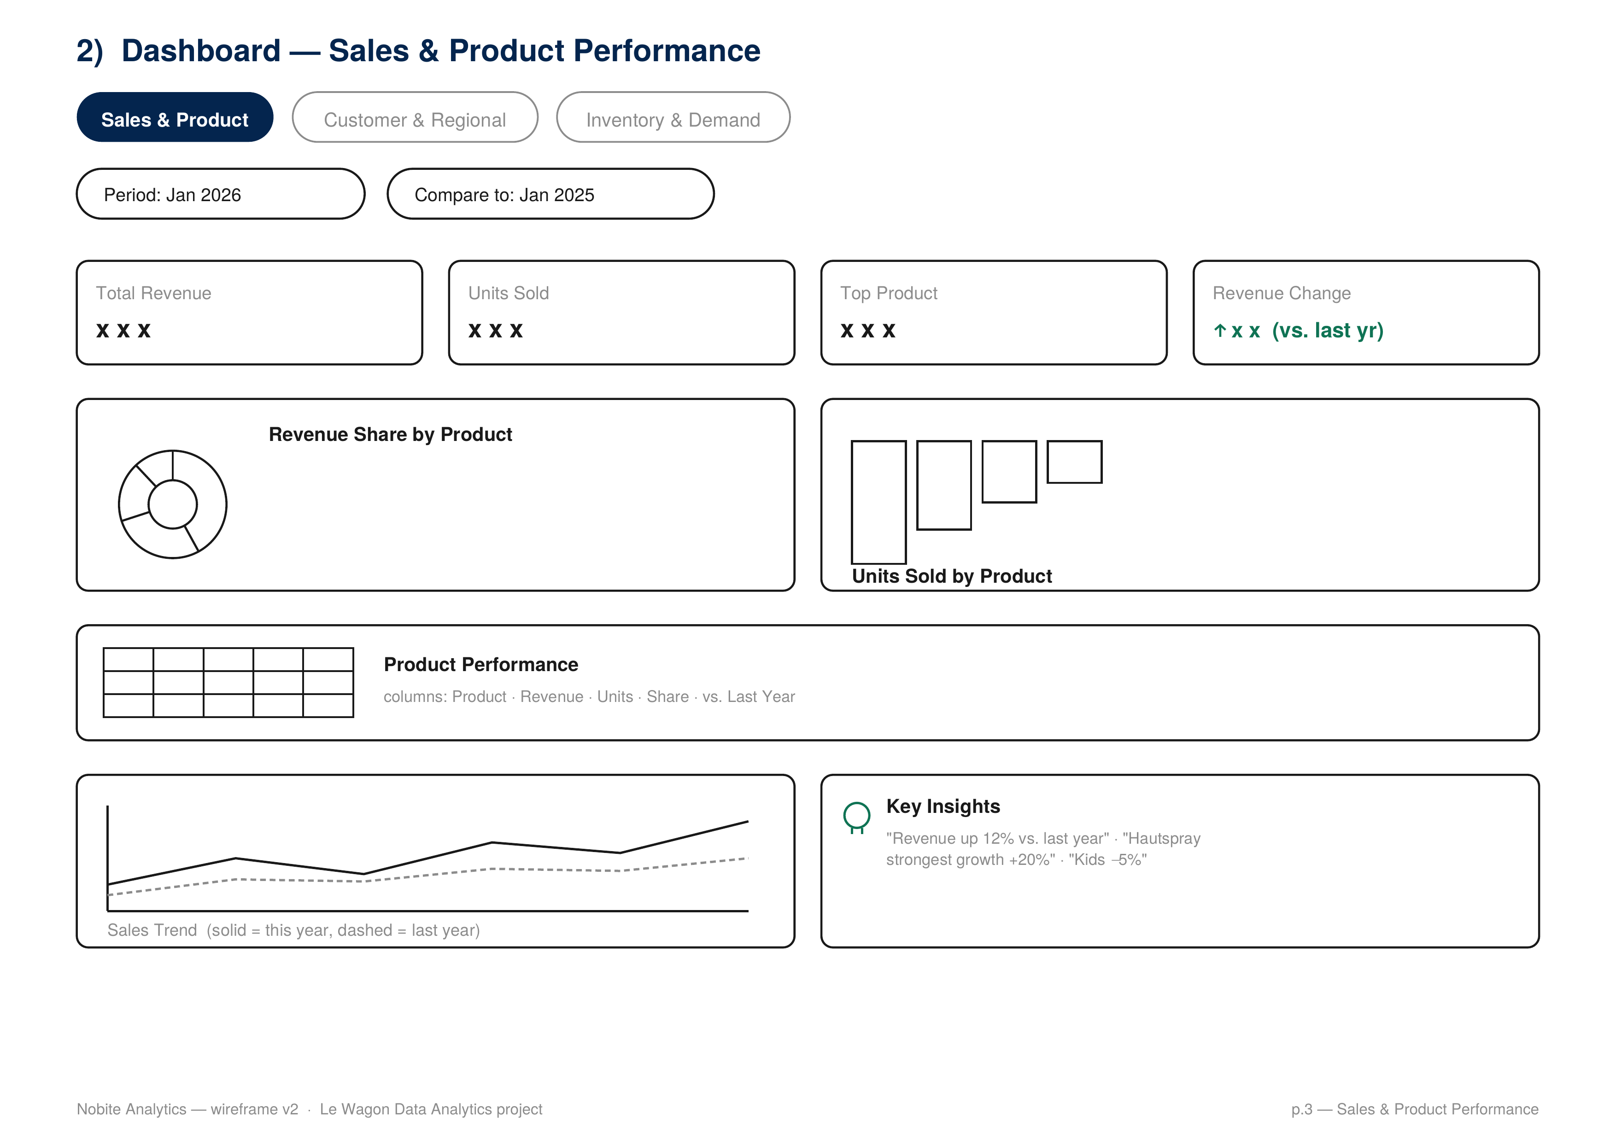
Demo day: what Papi will see
Upload & choose analysis
Sales & Product dashboard
Wireframe sketch — layout only, not final visual design.
Notes:
These are wireframes — the layout Dev asked for, not the final look. Walk through: upload two file types, the app validates them, then pick a report. Point out the KPI row, the chart, and the insights box.

Slide 6


Thank you.
Let's talk data.
Nobite Analytics · Le Wagon Data Analytics · Antonella Lundwall
Notes:
Close confidently. Invite questions, and offer to open the wireframe PDF if Dev wants to look closer at any single page.

