Slide 1
Development of genetic map for the muscadine grape and developing of population structure using RADseq data
Students: Antonets Svetlana, Raines Evgenii
Supervisor: Elizaveta Grigoreva

Slide 2
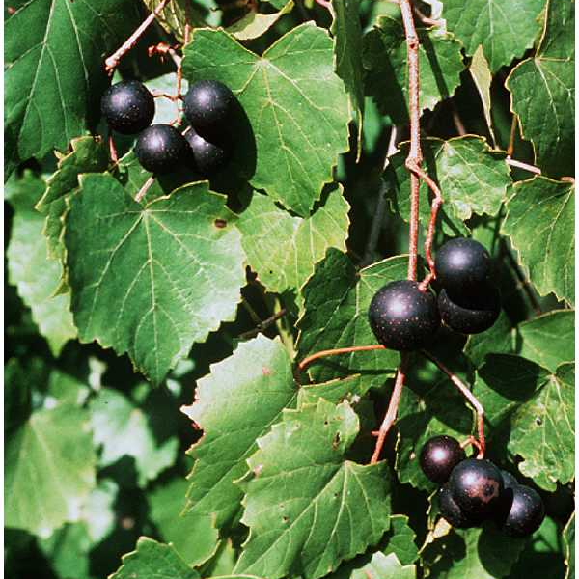
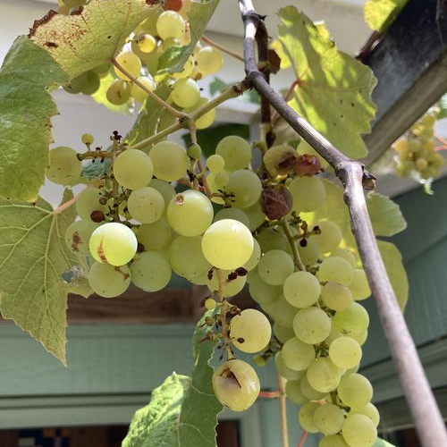
Introduction. F1 populations
Muscadinia rotundifolia Michx.
USDA SCS. Carl Hunter, 1991,
Southern wetland flora: Field office guide to plant species,
USDA NRCS Wetland Science Institute (WSI), Fort Worth.
Vitis Vinifera
iNaturalist contributors, iNaturalist (2021). iNaturalist
Research-grade Observations. iNaturalist.org. Occurrence
dataset https://doi.org/10.15468/ab3s5x accessed via GBIF.org
on 2021-12-19. https://www.gbif.org/occurrence/3039309542
1

Slide 3
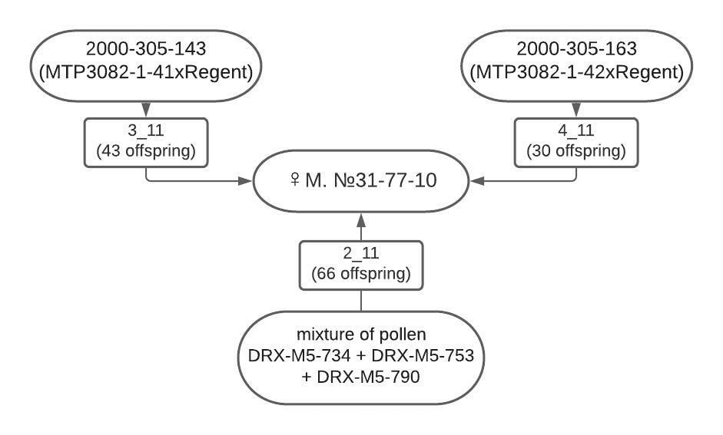
Introduction. Breeding of Winegrape with Mildew resistance
2

Slide 4
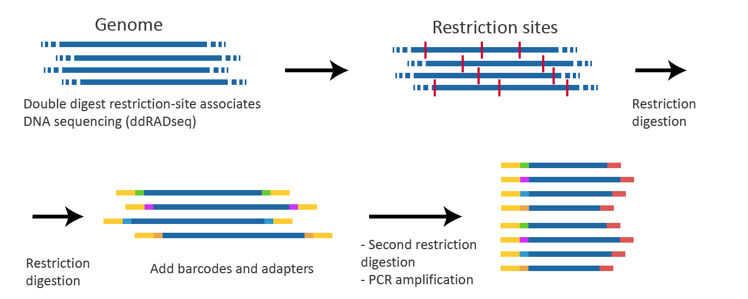
Experimental material
96 samples of F1 population and 192 samples of 3 hybrid populations.
Data were obtained by RADseq using Illumina HiSeq 2500.
3

Slide 5
Aim of the project
Evgenii Raines: Searching for muscadine grape (Muscadinia rotundifolia Michx.) genes related to resistance to Mildew by creating genetic map of self-polunating population.
Svetlana Antonets: Create population structure of populations (3-11, 4-11, and 2-11) and calculate the percentage of the M. rotundifolia genome carrying introgressions.
4

Slide 6
Tasks and tools
Tasks:
Process of raw data
Making pipeline
Genetic map (E. Raines) and population structure (S. Antonets) development
Tools:
Ctlab cluster with SLURM Workload manager
Commonly used python packages for biological data procession
5

Slide 7
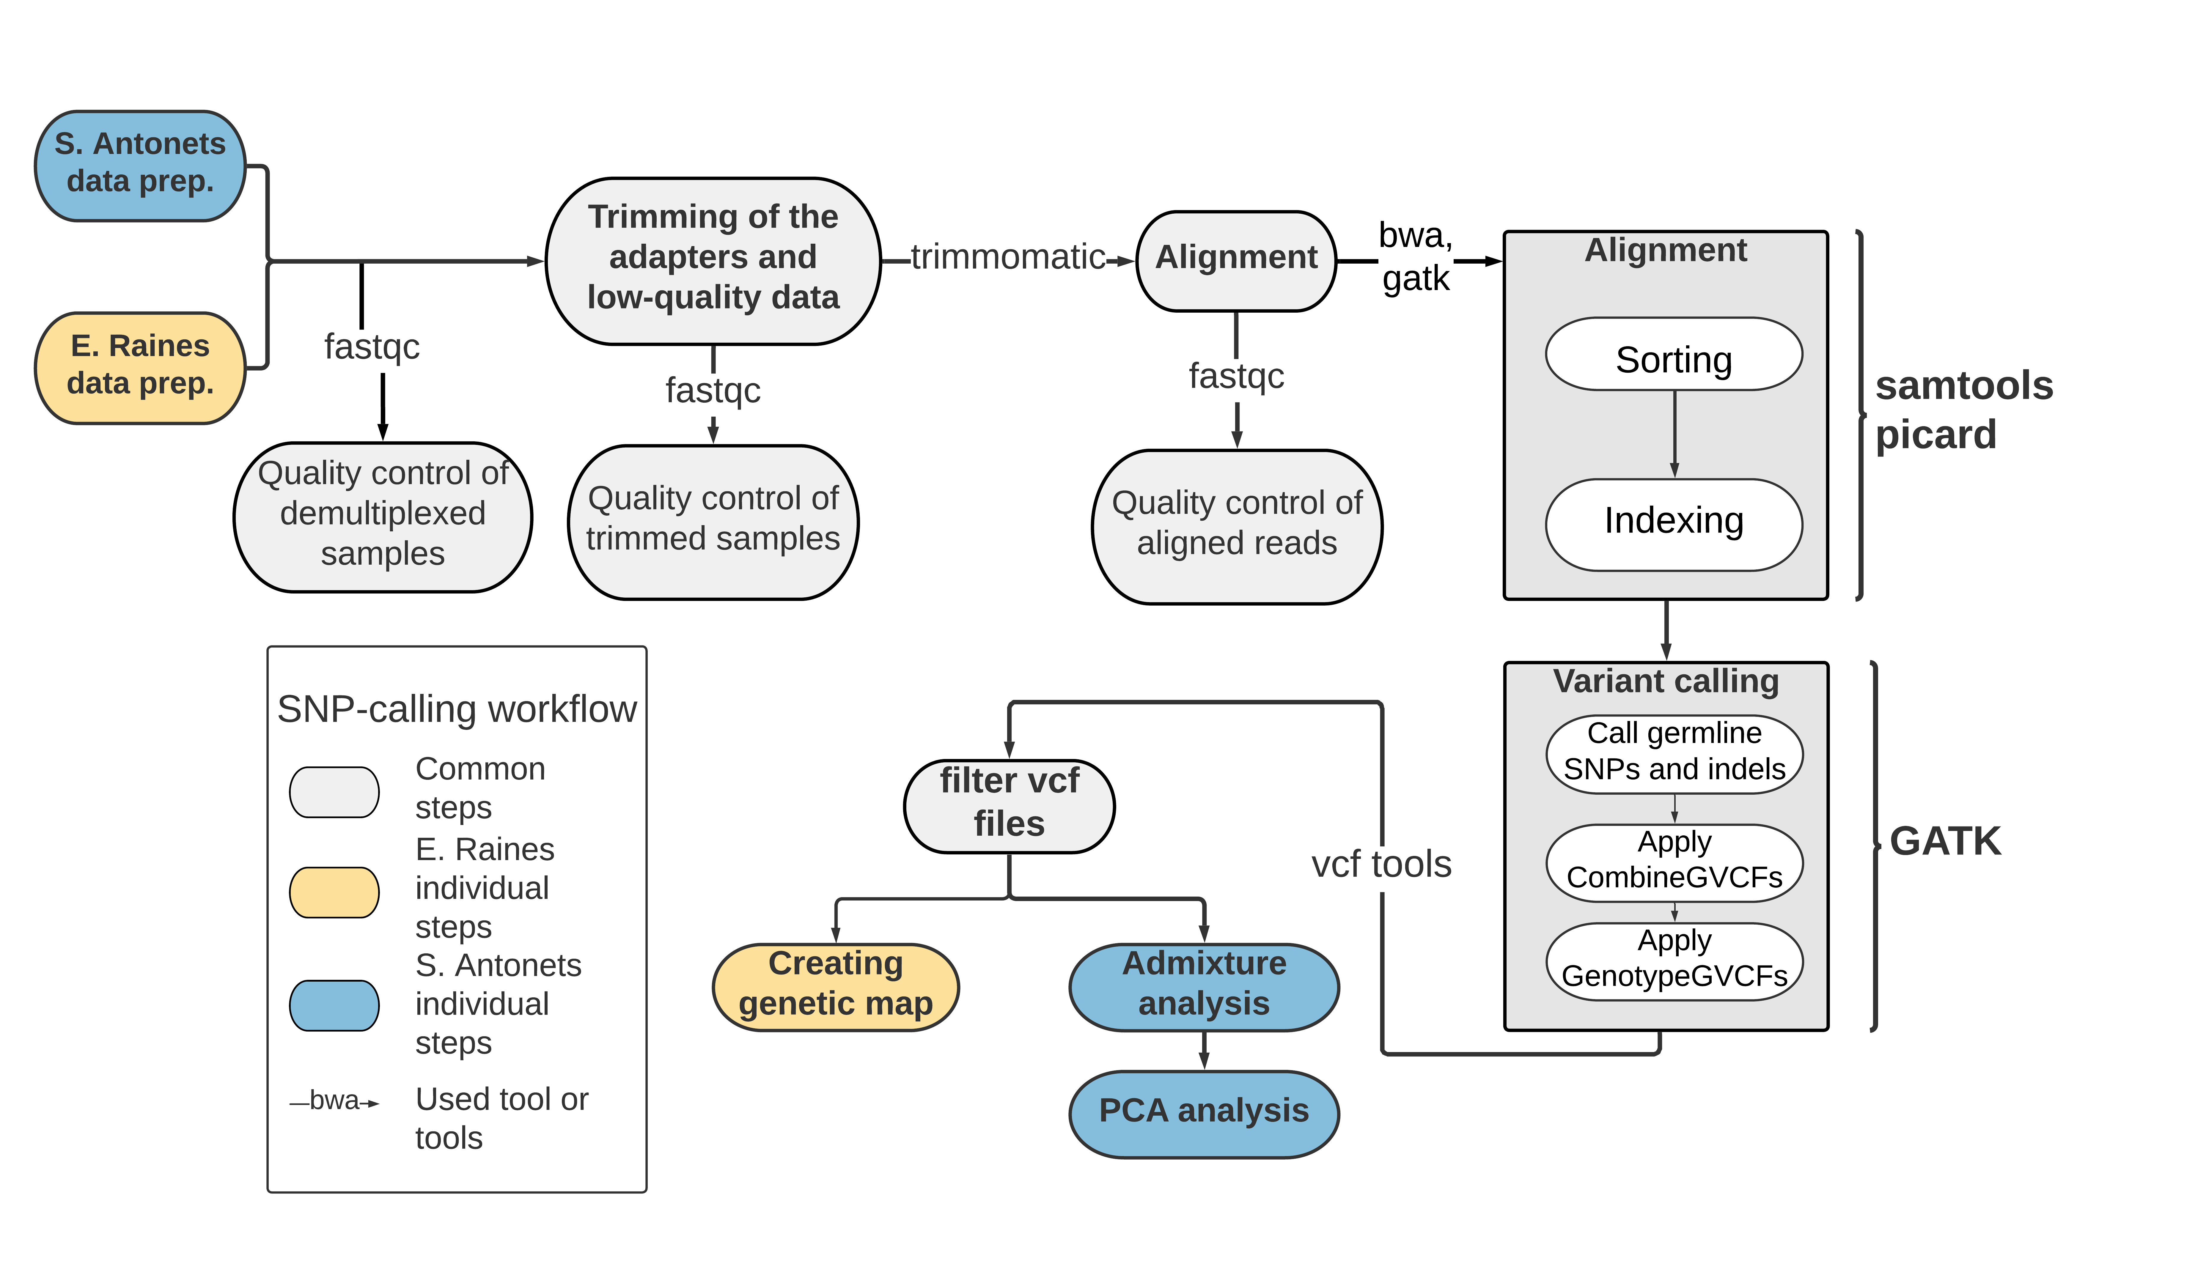
Pipeline
6

Slide 8
First results
1. Gained knowledge and skills in RADseq data processing
2. Gained knowledge and skills in working with SLURM manager and cluster
3. Processed quality control checks on raw sequence data , sequence data after trimming and data after alignment
4. Uploaded made tools to Github
7

Slide 9
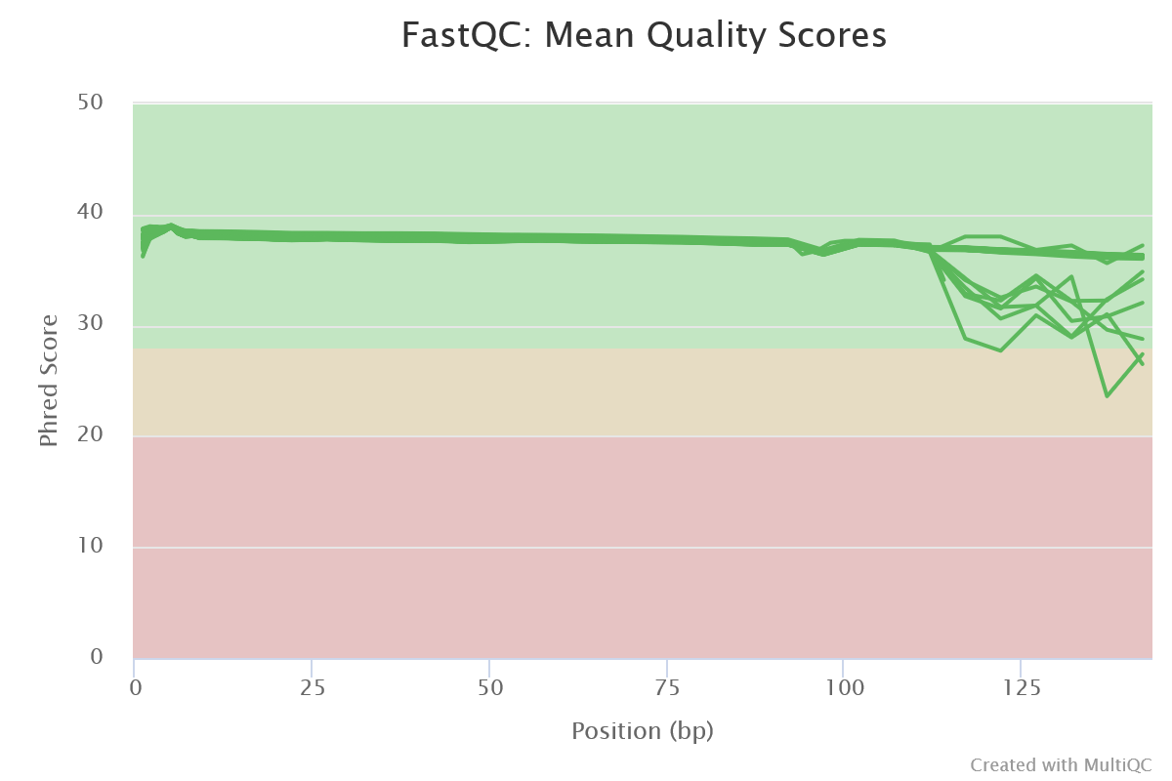
Quality control of raw data (E. Raines)
8

Slide 10
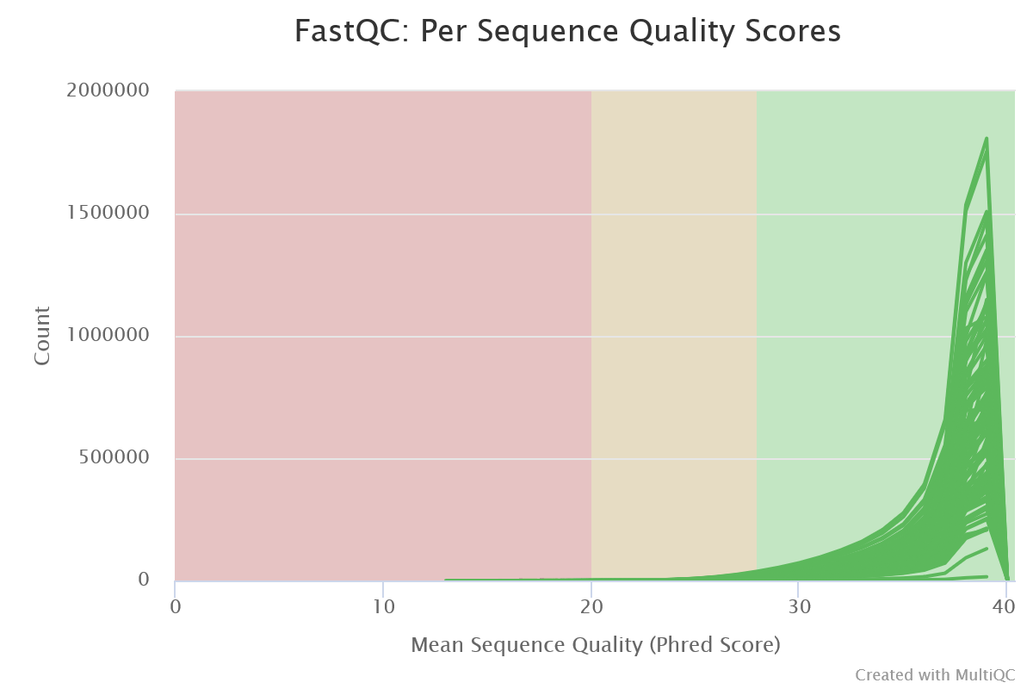
Quality control of raw data (E. Raines)
9

Slide 11
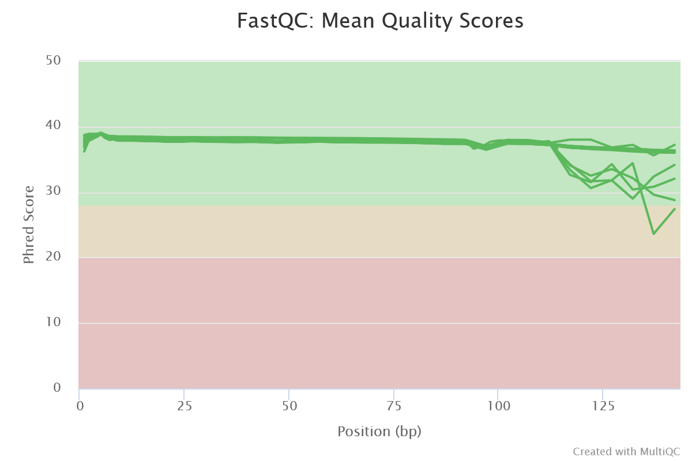
Quality control of trimmed data (E. Raines)
10

Slide 12

Quality control of trimmed data (E. Raines)
11

Slide 13
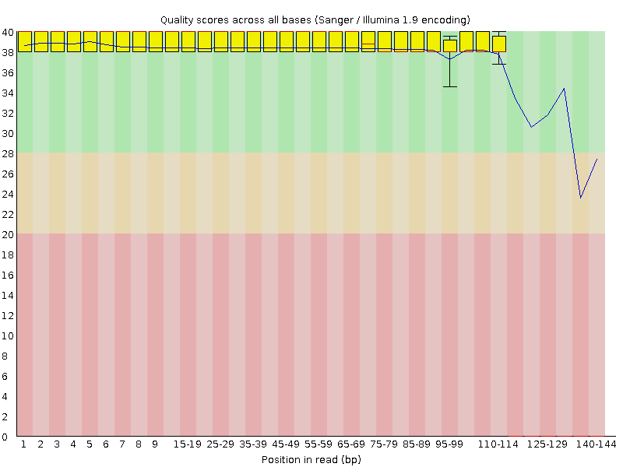
S_44 sample Quality control (Per base sequence quality) (E. Raines)
12

Slide 14
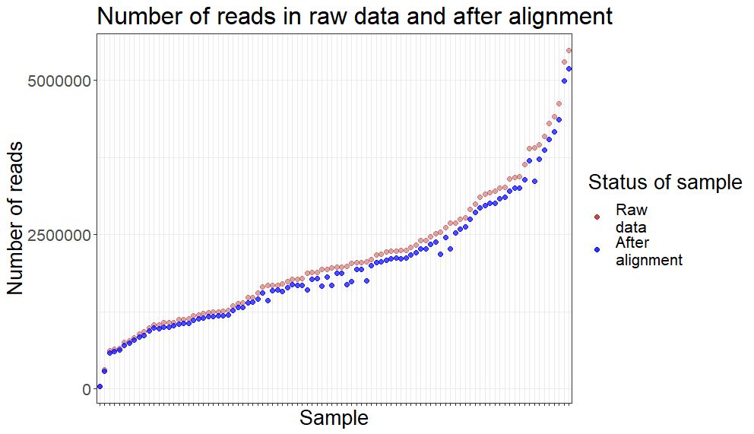
Number of reads (E. Raines)
13

Slide 15
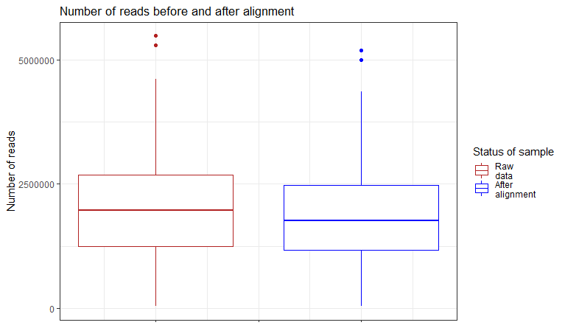
Number of reads (E. Raines)
14

Slide 16
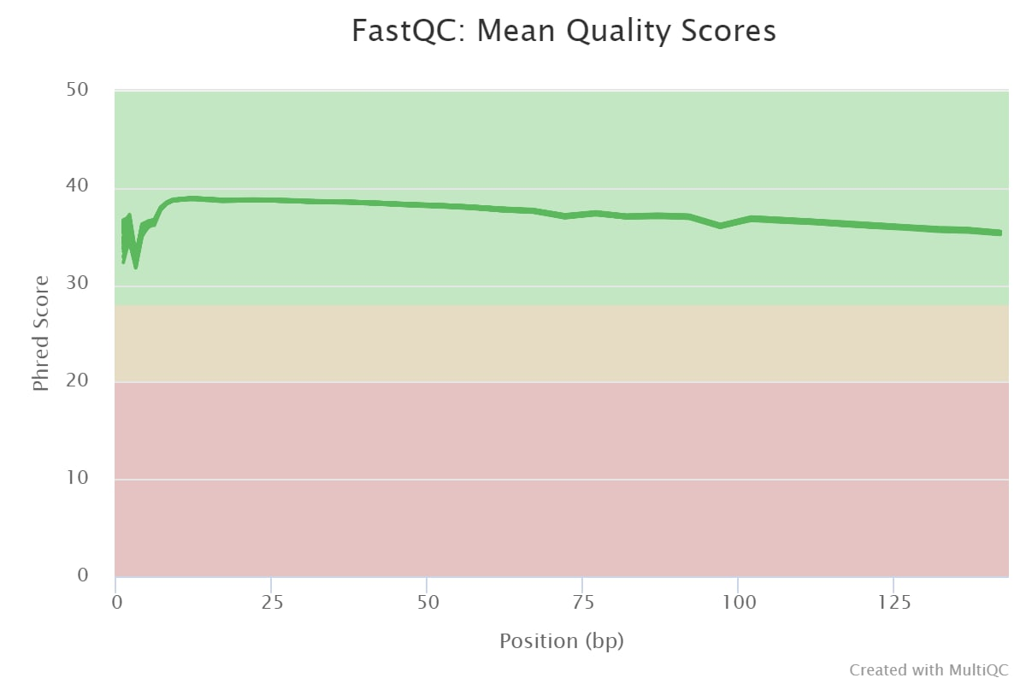
Quality control of raw data (S. Antonets)
15

Slide 17
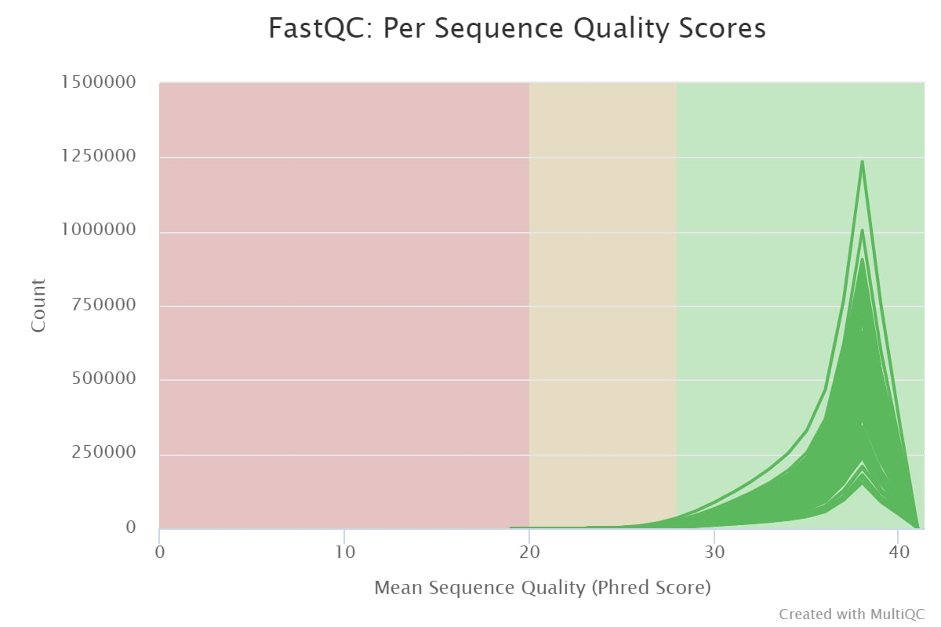
Quality control of raw data (S. Antonets)
16

Slide 18
Quality control of trimmed data (S. Antonets)
17

Slide 19
Quality control of trimmed data (S. Antonets)
18

Slide 20
Quality control of trimmed data (S. Antonets)
19

Slide 21
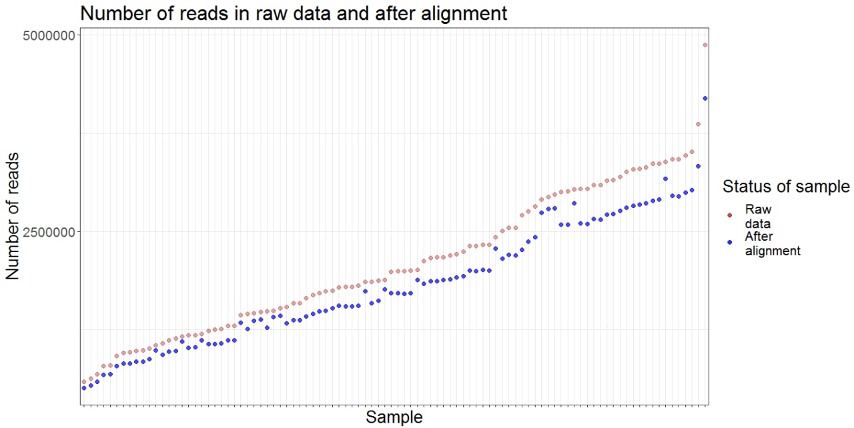
Number of reads (S. Antonets)
20

Slide 22
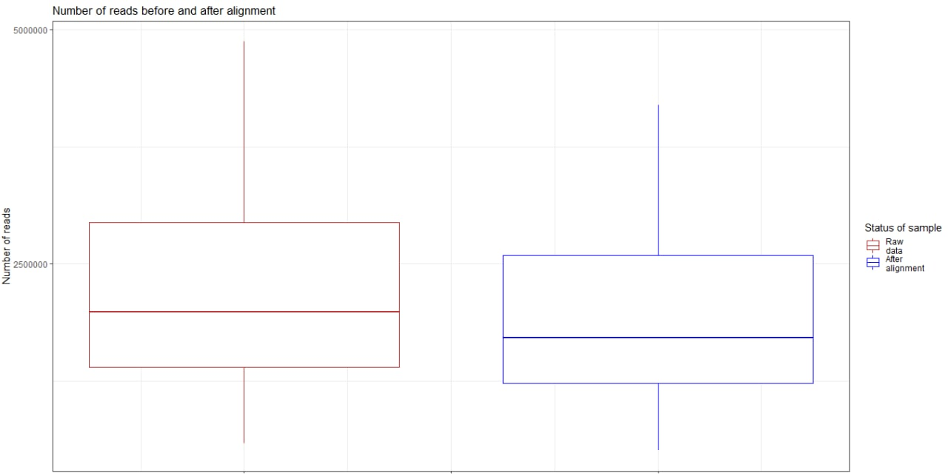
Number of reads (S. Antonets)
21

Slide 23
Github
12

Slide 24
Thank you!

