Slide 1
Microarchitectural Side-Channel Attacks
Yuval Yarom
The University of Adelaide and Data61

Slide 2
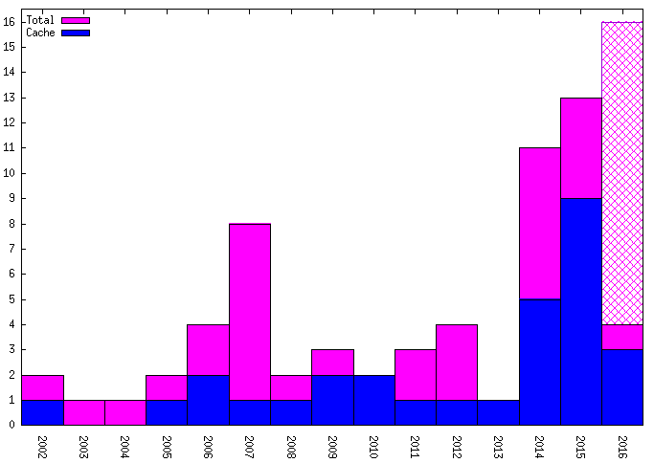
Publications on microarchitectural timing attacks
Data from [GYCH16]

Slide 3
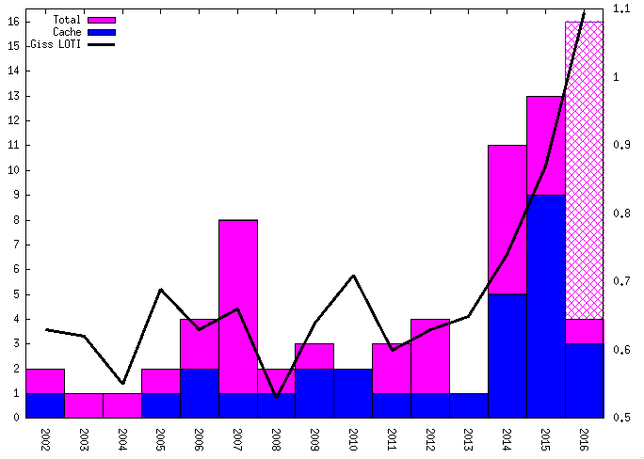
Publications and Global Temperature

Slide 4
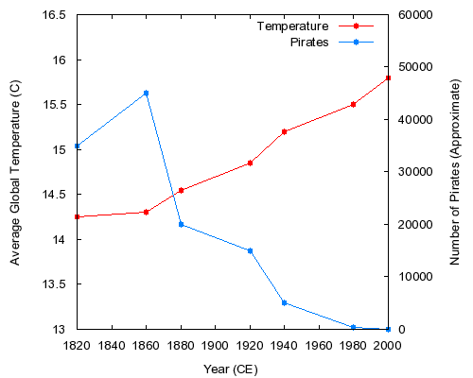
Global Average Temperatures Vs. Number of Pirates
Image from :http://sparrowism.soc.srcf.net/home/pirates.html

Slide 5

Pirates and publications on microarchitectural timing attacks
Pirate image By J.J. at the English language Wikipedia, CC BY-SA 3.0, https://commons.wikimedia.org/w/index.php?curid=665628

Slide 6
Still considered hard
OpenSSL
LOW Severity. This includes issues such as those that … or hard to exploit timing (side channel) attacks.
https://www.openssl.org/policies/secpolicy.html
At the same time
Publications are terse – technical details are often omitted
Generic tools do not exist

Slide 7
Still considered hard
OpenSSL
LOW Severity. This includes issues such as those that … or hard to exploit timing (side channel) attacks.
https://www.openssl.org/policies/secpolicy.html
Attacks are easy, but at the same time
Publications are terse – technical details are often omitted
Generic tools do not exist

Slide 8
Motivation
Reduce barriers to entry
Why?
Offensive research
A potential leak is nice. An exploit is better
Cipher development
Know your enemy
How?
Education – this tutorial
Tools – Mastik

Slide 9
Mastik
Extremely bad acronym for Micro-Architectural Side-channel ToolKit
Aims
Collate information on SC attacks
Improve our understanding of the domain
Provide somewhat-robust implementations of all known SC attack techniques for every architecture
Implementation of generic analysis techniques
Overcome the barrier to entry into the area
Shift focus to cryptanalysis

Slide 10
Mastik - Status
Reasonably solid implementation of four attacks
Prime+Probe on L1-D, L1-I and L3, Flush+Reload
Only Intel x86-64, on Linux and Mac
x86-32 and limited ARM currently working in the lab
Zero documentation, little testing
No user feedback

Slide 11
Outline
Background on and a taxonomy of microarchitectural side-channel attacks
The Flush+Reload attack and variants
The Prime+Probe attack
Countermeasures
Slides and sources available at http://cs.adelaide.edu.au/~yval/CHES16/

Slide 12
The Microarchitecture
An (Instruction Set) Architecture (ISA) can have multiple implementations
A microarchitecture is one such implementation
The ISA abstracts the implementation detail
The microarchitecture is functionally transparent
But contains hidden state that can be observed through program execution timing

Slide 13
The Microarchitecture
Software
ISA
Hardware
Image adapted from [GYCH16]

Slide 14
The Microarchitecture
An (Instruction Set) Architecture (ISA) can have multiple implementations
A microarchitecture is one such implementation
The ISA abstracts the implementation detail
The microarchitecture is functionally transparent
But contains hidden state that can be observed through program execution timing

Slide 15
Microarchitectural attacks
Create contention on microarchitectural components
Which results in timing variations
That are used to expose an intarnal state
Which depends on secret data
Allowing the attacker to infer said data

Slide 16
Attack taxonomy - level
Software
ISA
Hardware
Core shared
Package shared
System shared
Image adapted from [GYCH16]

Slide 17
Attack taxonomy – type [AS07]
Persistent-state attacks
Spatial contention on limited storage space
Example: most cache attacks
Transient-state attacks
Temporal contention on limited processing speed
Example: CacheBleed

Slide 18
Basic taxonomy
We focus on persistent-state at the package level (with some core)
 | Persistent-state | Transient-state
Core level | [Ber05,Per05, OST06] Others | [Lam73,Ber05, AS07,YGH16]
Package | [YF14,LYG+15,IES15] | ?
System | [PGM+16,IES16] | [WS12,WXW12]

Slide 19
Other classifications
Classical taxonomy [Pag03], [NS06]
Time-driven – measure complete execution time
Trace-driven – capture sequence of cache hits/misses
Access-driven – obtain some information on accessed memory addresses
Internal vs. external contention [AK09]
Degree of concurrency [GYCH16]
Multicore
Hyperthreading
Time slicing

Slide 20
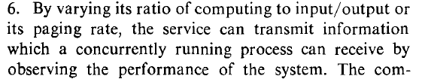
History
Lampson [Lam73]
Defines covert channels
Suggests the first micro-architectural timing channel:

Slide 21
History
Page [Pag02] – First theoretical cache-based attack
Tsunoo et al. [TTMM02] – First microarchitectural side-channel attack
Cache-based timing attack on Misty
Mostly forgotten
Tsunoo et al. [TSS+03]
Cache-based timing attack on DES

Slide 22
The (X86) Cache
Memory is slower than the processor
The cache utilises locality to bridge the gap
Divides memory into lines
Stores recently used lines
Shared caches improve performance for multi-core processors
Processor
Cache
Memory
Notes:
Another thing that changed since my Apple // days is the processor speed. My apple 2 ran at 1 MHz. My mac runs at 2GHz. Memory speed, however, has not fared so well. The memory on my apple needed half a clock cycle to produce data, whereas modern computers require about 200. When the processor reads from memory it needs to wait. <click> and if it needs to read from the same location again it needs to wait again. <click>. So, we have a speed gap between the processor and the memory.
The cache is the part of the processor that bridges this gap. It is a small memory that is included within the processor. Being small, being closer to the execution core and using more expensive technologies than the main memory mean that the cache is much faster than the memory. On intel the spead ranges from 4 to 50 cycles, depending on the level of cache.
Yada yada

Slide 23
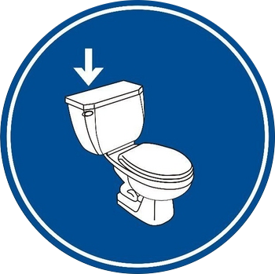
Cache Consistency
Memory and cache can be in inconsistent states
Rare, but possible
Solution: Flushing the cache contents
Ensures that the next load is served from the memory
Processor
Cache
Memory

Slide 24
The Flush+Reload Technique
Exploits cache behaviour to leak information on victim access to shared memory.
Spy monitors victim’s access to shared code
Spy can determine what victim does
Spy can infer the data the victim operates on

Slide 25
Detour - Virtual Memory
Processes execute within a virtual address space
Virtual pages map to physical frames

Slide 26
Sharing
Frames can be shared by multiple processes
Read only sharing maintains functional isolation
Protection using Copy-on-write

Slide 27
Causes of sharing
Content-aware sharing
Pages from the same file have identical content
Shared program or library code
Can also share constant data
Shared images in PaaS clouds
Content-based sharing (a.k.a. page deduplication)
The system identifies and coalesces identical pages
Implemented in many hypervisors and in most modern operating systems

Slide 28


Flush+Reload [GBK11,YF14]
Processor
Flush memory line
Wait a bit
Measure time to Reload line
slow-> no access
fast-> access
Repeat
Cache
Memory
Notes:
Reminder: Fast 50 cycles. Slow 200. Measurement adds about 30 cycles.
Wrap-up – the weakness is that the spy can monitor access to shared memory lines and consequently infer information about the data the victim processes

Slide 29
Flush+Reload code
mfence
rdtscp
mov %eax, %esi
mov (%ebx), %eax
rdtscp
sub %esi, %eax
clflush 0(%ebx)
Also need:
Wait
Data collection
Noise handling
Initial parsing

Slide 30
Demo
FR-1-file-access
FR-2-file-access
FR-threshold

Slide 31
Finding code
Use nm, gdb, objdump, etc.
Demo scripts functiondump.sh and debuginfo.sh
Remember the base address

Slide 32
Demo
FR-function-call

Slide 33
A closer look at F+R
flush
wait wait wait wait
Reload
flush
wait wait wait wait
Reload
flush
wait wait wait
Time

Slide 34
A closer look at F+R
Victim
working working
access
working working
Spy
flush
wait wait wait wait
Reload
flush
wait wait wait wait
flush
wait wait wait
Time

Slide 35
Timing matters
Victim
working working
access
working working
Spy
flush
wait wait wait wait
Reload
flush
wait wait wait wait
Reload
flush
wait wait wait
Time
Access missed due to temporal overlap

Slide 36
Demo
FR-function-call-nodelay

Slide 37
Probability of a probe miss [ABF+15]
Ratio of wait time to slot length

Slide 38
Handling misses
Probe function calls [YB14]
A cache line containing a function call is accessed once before the call and once on return
Except, maybe, when the return address is in the next cache line
The timings of the two accesses are not independent
Probe loops [YF14]

Slide 39
GnuPG 1.4.13 Modular Exponentiation
x ⟵1
for i ⟵|e|-1 downto 0 do
x ⟵x² mod n
if (e_{i} =1) then
x = xb mod n
endif
done
return x
Operation | res | i | e_{i}
 | 1 | 2 | 101
Square | 1 | 2 | 101
reduce | 1 | 2 | 101
Multiply | 11 | 2 | 101
reduce | 11 | 2 | 101
Square | 121 | 1 | 101
reduce | 21 | 1 | 101
Square | 441 | 0 | 101
reduce | 41 | 0 | 101
Multiply | 451 | 0 | 101
reduce | 51 | 0 | 101
The secret exponent is encoded in the sequence of operations !!!
Example:
11⁵ mod 100 =
161,051 mod 100 = 51
Notes:
Stress secret key

Slide 40
Demo
FR-gnupg-1.4.13

Slide 41
F+R Spatial Resolution
Cache line
Can't have two different probes on the same cache line
Cache line pairs
Probes on paired lines interfere with each other –Don't
Streaming
Use "random" order when probing multiple lines in the same page
Don't probe too many of those
Speculative execution
Probe rear end of functions

Slide 42
Improving temporal resolution
Scheduler trick [GBK11]
Monitoring each and every memory access
Requires hyperthreadings
Uses hundreds of threads
Amplification [ABF+15]
Flushing commonly used cache lines slows the victim

Slide 43
Demo
FR-flush

Slide 44
Flush+Reload Summary
Simple attack
Even without Mastik
High temporal resolution
Up to sub-micro-second
High accuracy
Few false positives
Increases as a function of spatial granularity
A bit more false negatives
Particularly when exploiting the high temporal resolution

Slide 45
Variants
Evict+Reload [GSM15]
Uses cache contention instead of clflush
Flush+Flush [GMWM16]
Measures variations in clflush timing between cached and non-cached data
Improved temporal and spatial resolution
Increased error rate
Invalidate+Transfer [IES16]
Use Flush+Reload on Intel or Evict+Reload on ARM to implement a cross-package attack
Flush+Reload on ARM [ZXZ16]
???

