Slide 1

MovieHut.com the Essential Movie Search Engine
M.EIC PRI 2023/2024
Group G72

Slide 2
Main Motivation
Nowadays, it’s IMPOSSIBLE to know every movie that’s currently available.
As we are living in the age of social media, it’s not uncommon, while we scroll through one of the many apps, to come across:
Quotes from
movies
Still images from
a movie scene
Full movies
divided in parts
that we have never heard of/know very little about.

Slide 3


Data Selection

Slide 4
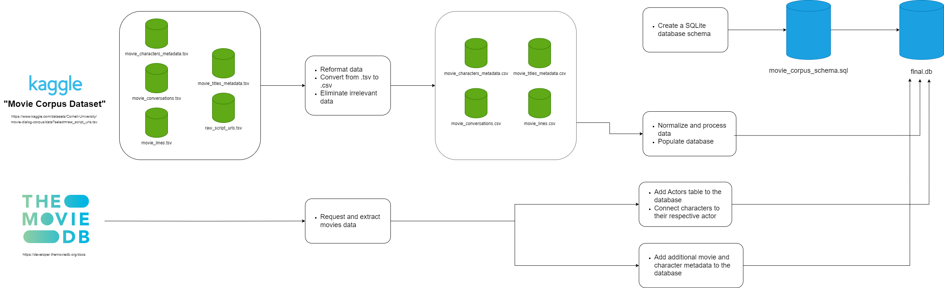
Data Processing and Pipeline

Slide 5
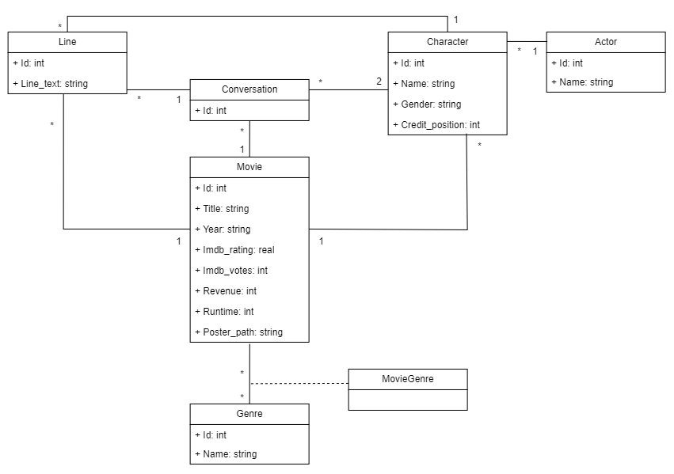
Data Conceptual Model

Slide 6
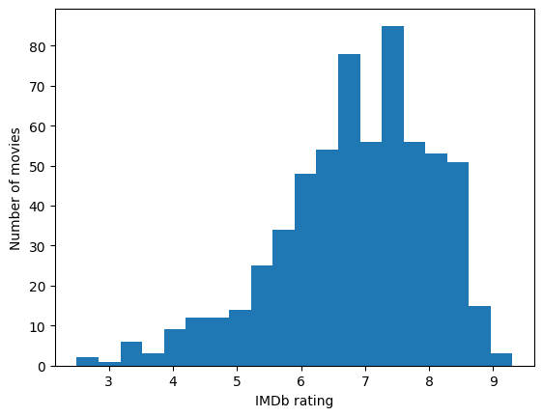
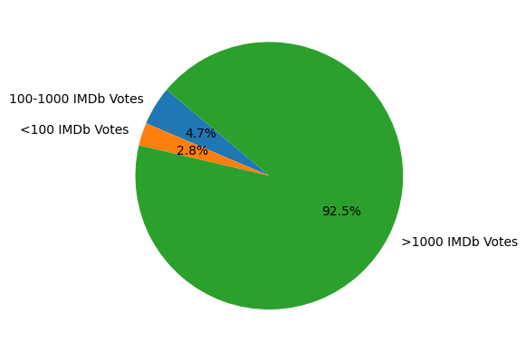
Data Characterization
Distribution of IMDb ratings
Distribution of the quantity of IMDb votes

Slide 7
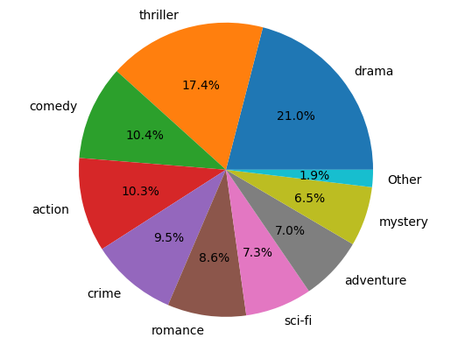
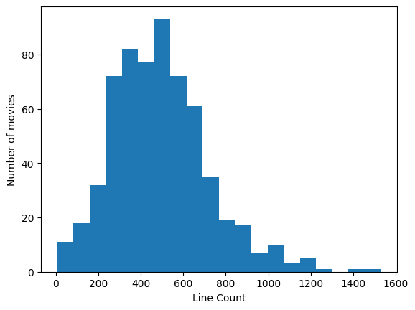
Data Characterization
Distribution of movie genres
Distribution of Lines in the Movies Dataset

Slide 8
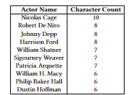
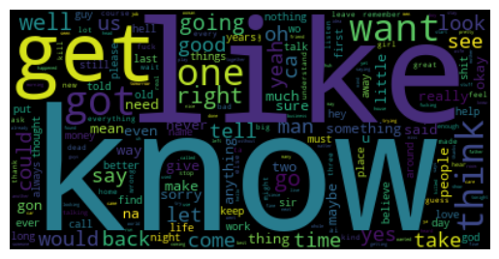
Data Characterization
Top 10 actors by character count
Word cloud of dialogue lines

Slide 9
Search Scenarios
“In what movie did the actor X say Y?”
“What character is played
by X in movie Y?”
“Who said X?”
“What movies did actor X play in?”
“What did X say to Y in movie Z?”

Slide 10
Document Description
Movie
Title
Characters
Cast
Genres
Poster
Runtime
Revenue
IMDb Rating
IMDb Votes
Actor
Name
Movies
Characters
Other Related Actors
Conversation
Lines
Movie
Characters
Cast
Previous Dialogue
Next Dialogue

