Slide 1
Chip planning
Jordi Cortadella

Slide 2
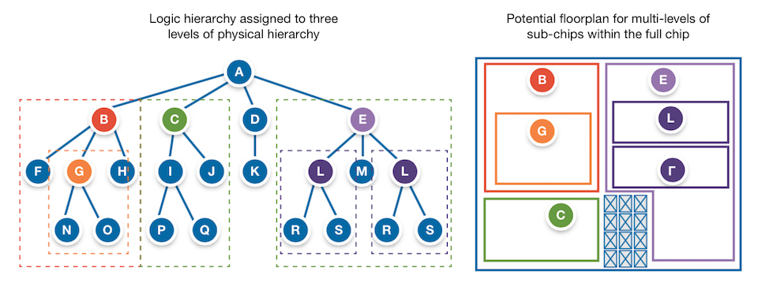
Chip planning
Source: Synopsys https://www.techdesignforums.com/practice/technique/floor-planning-complex-socs-with-multiple-levels-of-physical-hierarchy/

Slide 3
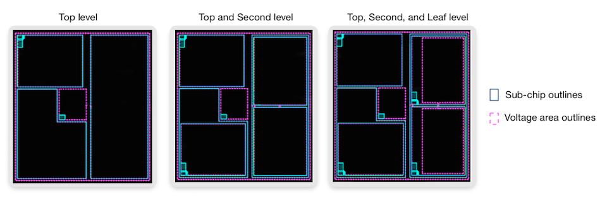
Chip planning
Source: Synopsys https://www.techdesignforums.com/practice/technique/floor-planning-complex-socs-with-multiple-levels-of-physical-hierarchy/

Slide 4
Floorplanning flow

Slide 5
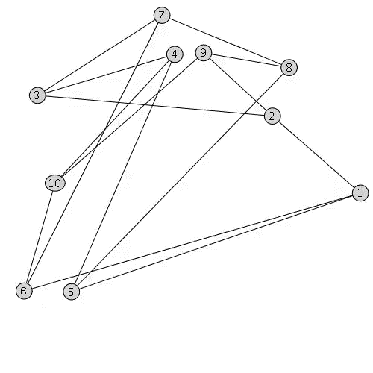
Global placement
Global placement using analytical (spectral) techniques

Slide 6
Global placement

Slide 7
Refined placement

Slide 8
Rectangle assignment

Slide 9
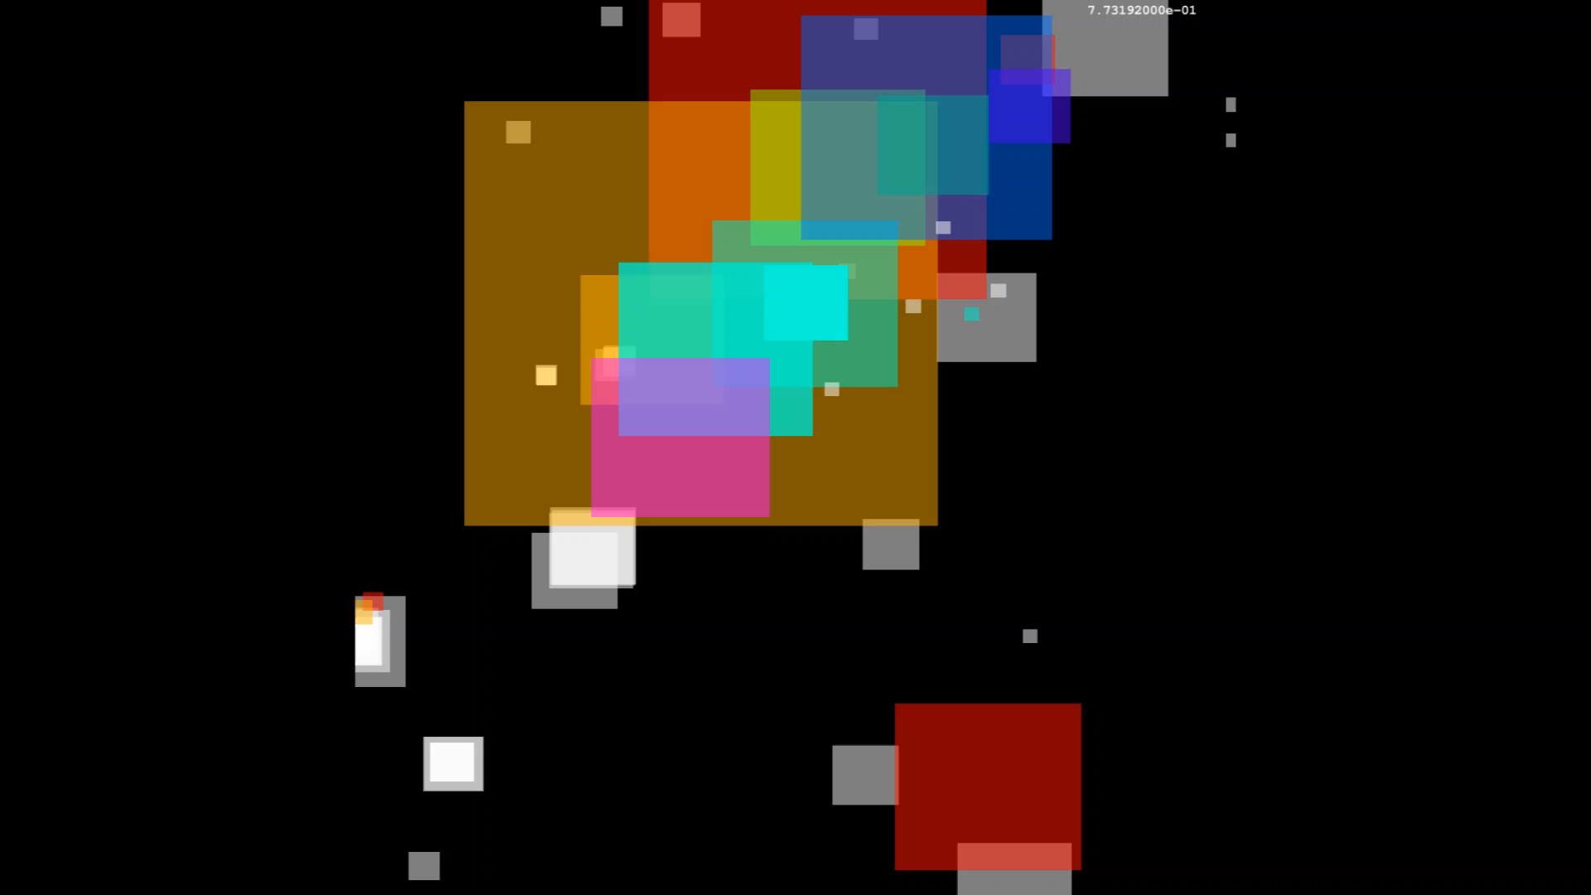
Legalization (via NLP)

Slide 10
Final chip planning

Slide 11
Backup

Slide 12

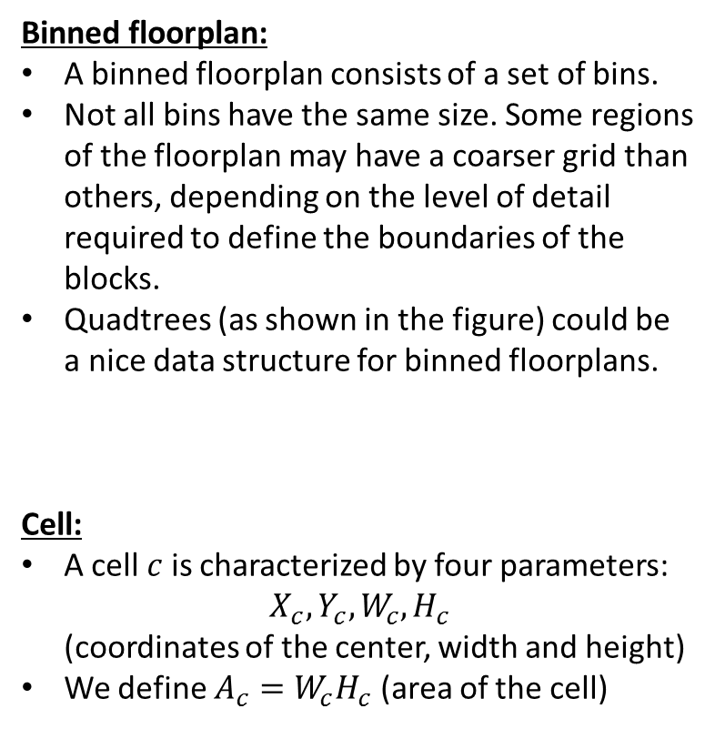


Binned floorplan (single resource)
Binned floorplan:
A binned floorplan consists of a set of bins.
Not all bins have the same size. Some regions of the floorplan may have a coarser grid than others, depending on the level of detail required to define the boundaries of the blocks.
Quadtrees (as shown in the figure) could be a nice data structure for binned floorplans.
Cell:
A cell $c$ is characterized by four parameters: $X_{c},Y_{c},W_{c},H_{c}$ (coordinates of the center, width and height)
We define $A_{c}=W_{c}H_{c}$ (area of the cell)
$$(X_{c},Y_{c})$$
$$H$$
$$W$$
Note: upper case: constants; lower case: variables.

Slide 13
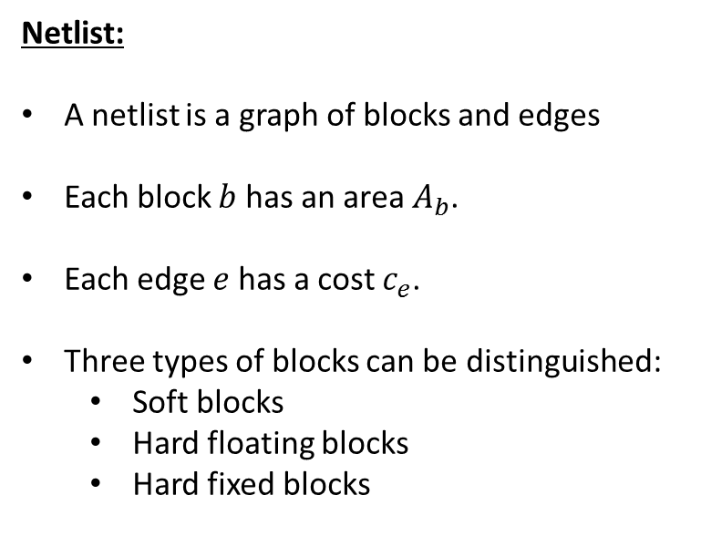
Binned floorplan (single resource)
Netlist:
A netlist is a graph of blocks and edges
Each block $b$ has an area $A_{b}$.
Each edge $e$ has a cost $c_{e}$.
Three types of blocks can be distinguished:
Soft blocks
Hard floating blocks
Hard fixed blocks
B1
B4
B3
B2

Slide 14
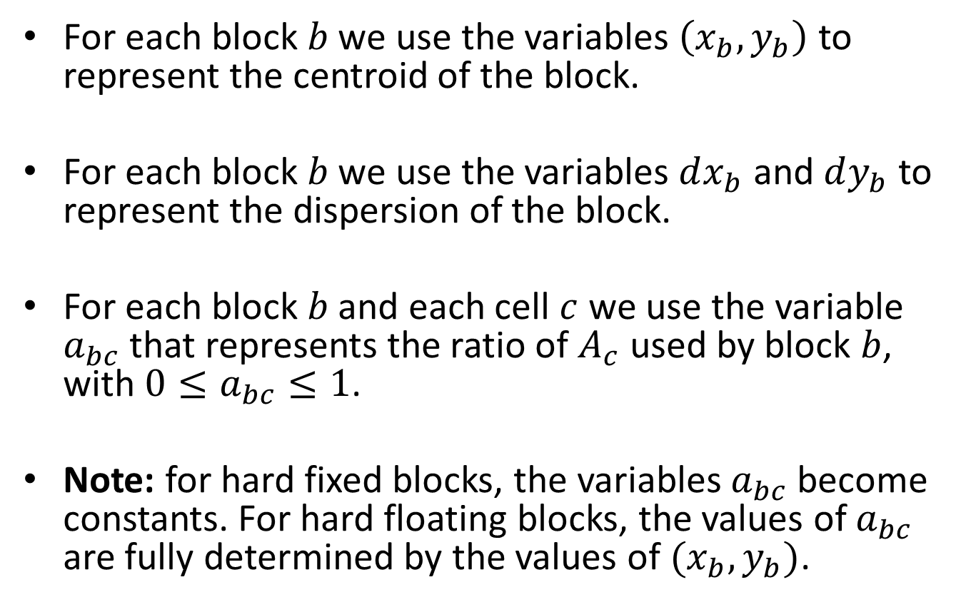
Variables of the model
For each block $b$ we use the variables $\left(x_{b},y_{b}\right)$ to represent the centroid of the block.
For each block $b$ we use the variables $dx_{b}$ and $dy_{b}$ to represent the dispersion of the block.
For each block $b$ and each cell $c$ we use the variable $a_{bc}$ that represents the ratio of $A_{c}$ used by block $b$, with $0≤a_{bc}≤1$.
Note: for hard fixed blocks, the variables $a_{bc}$ become constants. For hard floating blocks, the values of $a_{bc}$ are fully determined by the values of $(x_{b},y_{b})$.

Slide 15
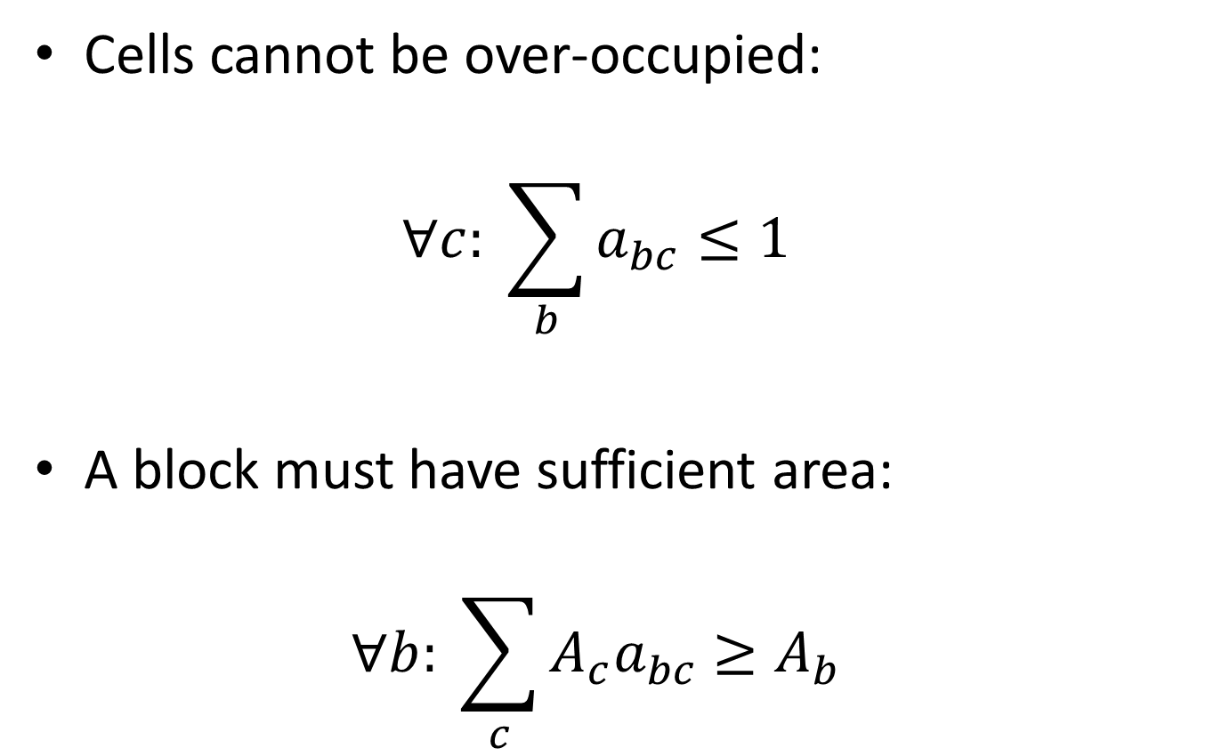
Constraints of the model
Cells cannot be over-occupied: $∀c: \sum_{b}{a_{bc}≤1}$
A block must have sufficient area: $∀b: \sum_{c}{{A_{c}a}_{bc}}≥A_{b}$

Slide 16
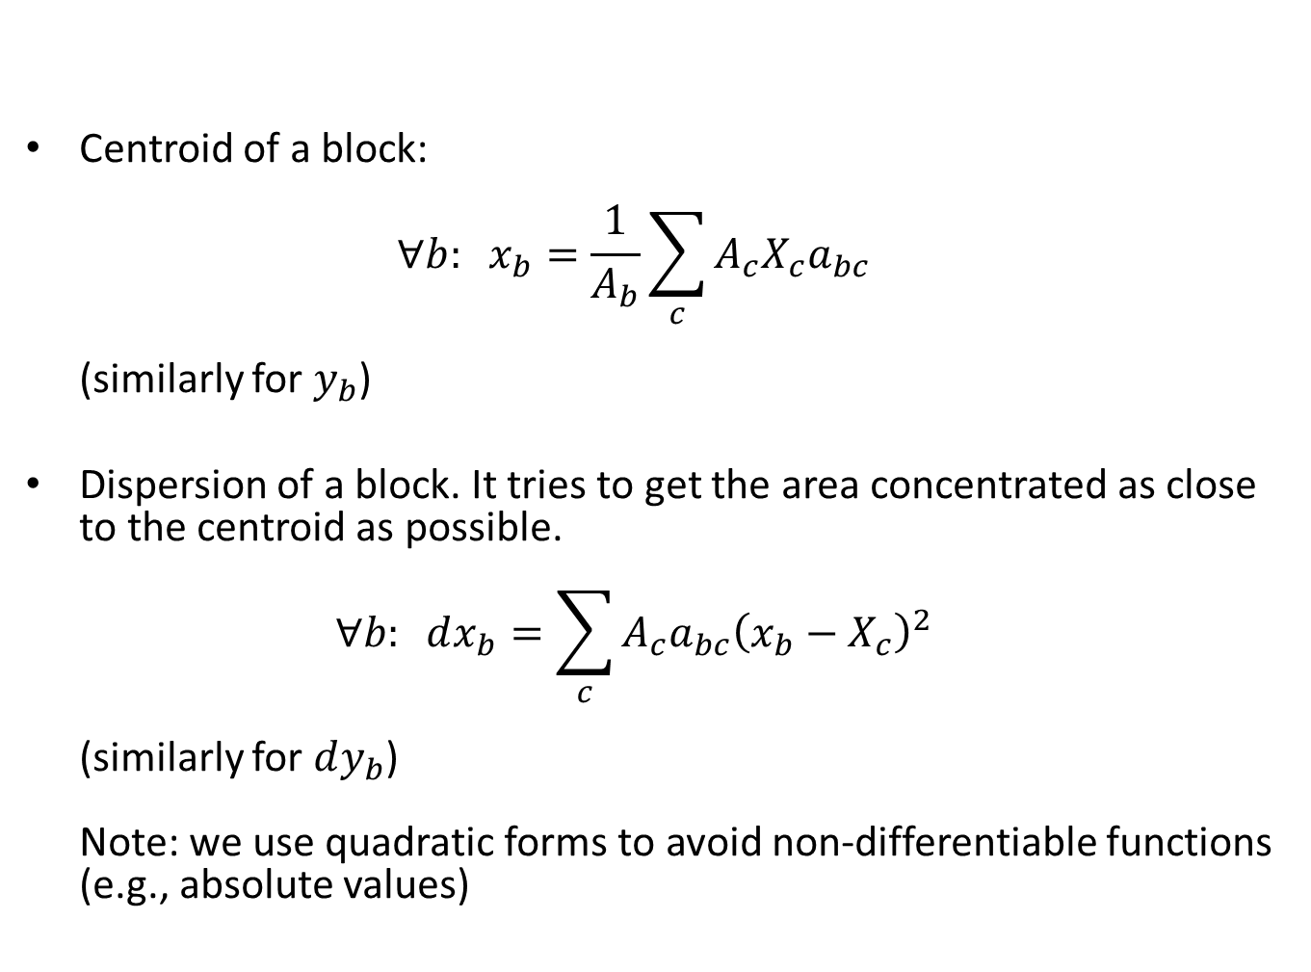
Constraints of the model
Centroid of a block: $∀b: x_{b}=\frac{1}{A_{b}}\sum_{c}{{A_{c}X_{c}a}_{bc}}$ (similarly for $y_{b}$)
Dispersion of a block. It tries to get the area concentrated as close to the centroid as possible. $∀b: dx_{b}=\sum_{c}{{A_{c}a}_{bc}{\left(x_{b}−X_{c}\right)}^{2}}$ (similarly for $dy_{b}$) Note: we use quadratic forms to avoid non-differentiable functions (e.g., absolute values)

Slide 17
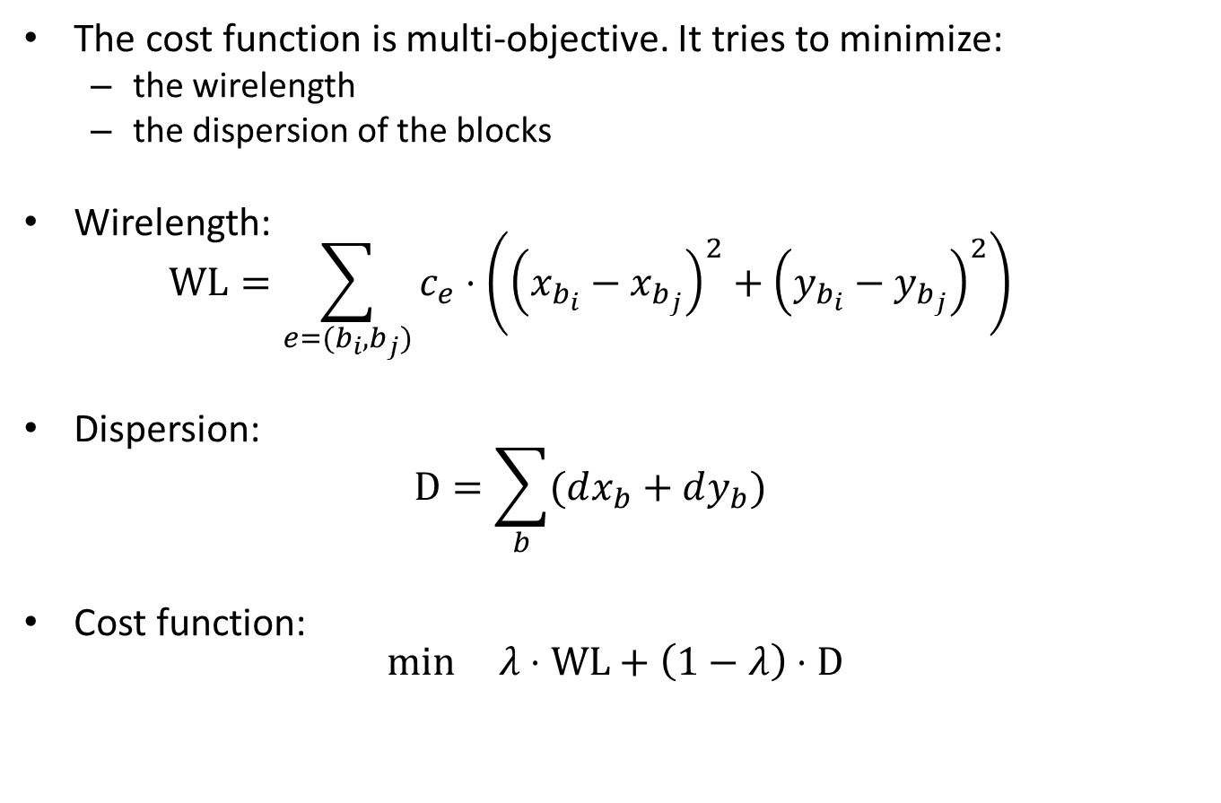
Cost function
The cost function is multi-objective. It tries to minimize:
the wirelength
the dispersion of the blocks
Wirelength: $\text{WL}=\sum_{e=(b_{i},b_{j})}{c_{e}⋅\left({\left(x_{b_{i}}−x_{b_{j}}\right)}^{2}+{\left(y_{b_{i}}−y_{b_{j}}\right)}^{2}\right)}$
Dispersion: $\text{D}=\sum_{b}{(dx_{b}+dy_{b})}$
Cost function: $\min_{ }{ λ⋅\text{WL}+\left(1−λ\right)⋅\text{D}}$

Slide 18
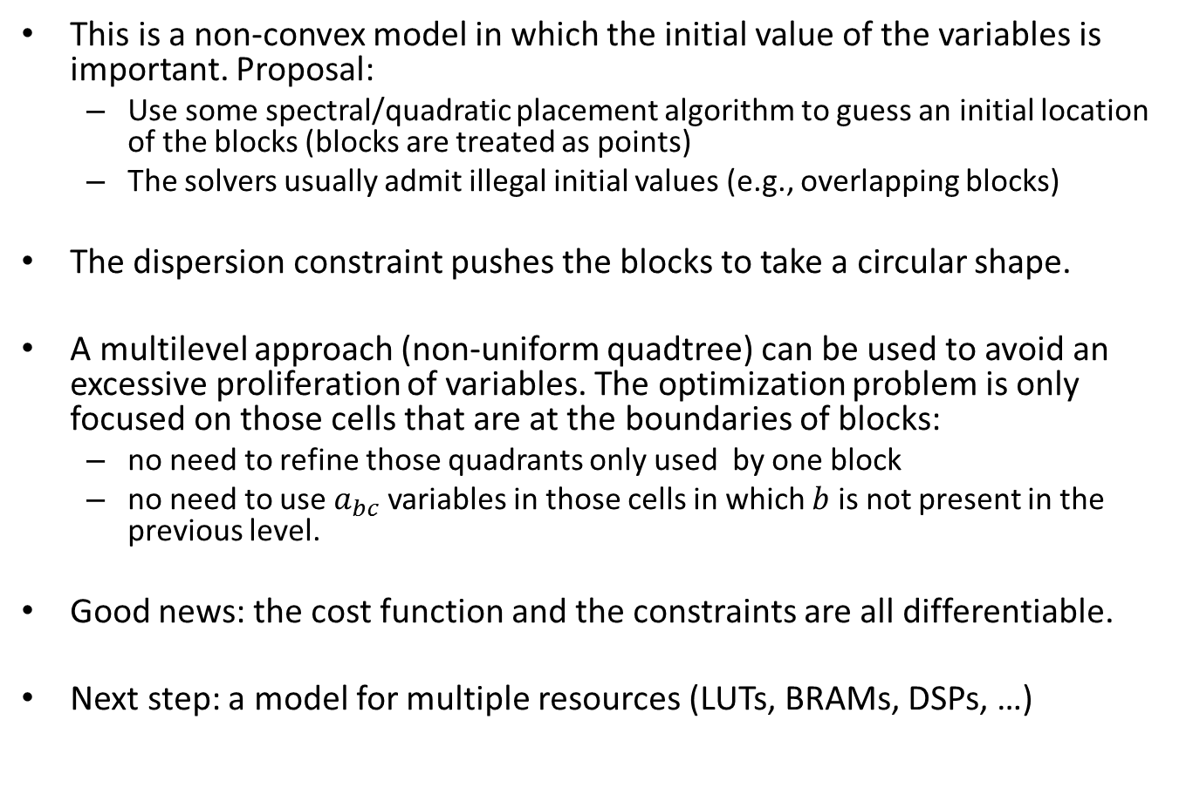
Discussion
This is a non-convex model in which the initial value of the variables is important. Proposal:
Use some spectral/quadratic placement algorithm to guess an initial location of the blocks (blocks are treated as points)
The solvers usually admit illegal initial values (e.g., overlapping blocks)
The dispersion constraint pushes the blocks to take a circular shape.
A multilevel approach (non-uniform quadtree) can be used to avoid an excessive proliferation of variables. The optimization problem is only focused on those cells that are at the boundaries of blocks:
no need to refine those quadrants only used by one block
no need to use $a_{bc}$ variables in those cells in which $b$ is not present in the previous level.
Good news: the cost function and the constraints are all differentiable.
Next step: a model for multiple resources (LUTs, BRAMs, DSPs, …)

Slide 19

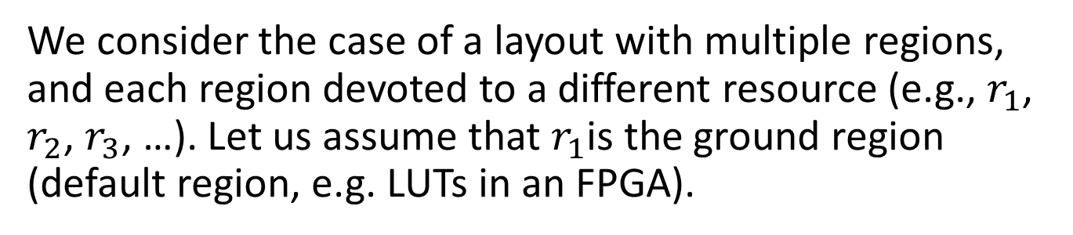



Binned floorplan (multiple resources)
We consider the case of a layout with multiple regions, and each region devoted to a different resource (e.g., $r_{1}$, $r_{2}$, $r_{3}$, …). Let us assume that $r_{1}$is the ground region (default region, e.g. LUTs in an FPGA).
$$r_{3}$$
$$r_{2}$$
$$r_{2}$$
$$r_{1}$$

Slide 20



Binned floorplan (multiple resources)
We split all regions into rectangles. The non-ground regions can be initially specified as rectangles (multiple rectangles for each region are possible). The ground region could be the one “by default”. The rectangles could be calculated automatically (some heuristic, not necessarily offering an optimum solution).
$$r_{3}$$
$$r_{2}$$
$$r_{2}$$
$$r_{1}$$

Slide 21
Binned floorplan (multiple resources)
The refinement could be done by splitting big rectangles into smaller rectangles, as shown in the figure. No need to have uniform regions represented as quadtrees.
$$r_{3}$$
$$r_{2}$$
$$r_{2}$$
$$r_{1}$$

Slide 22





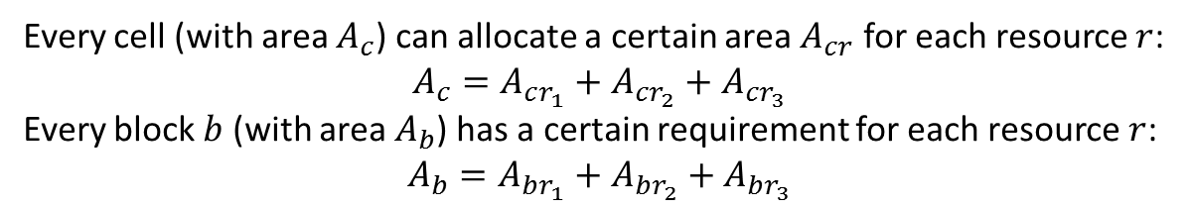

Binned floorplan (multiple resources)
$$A_{cr_{1}}$$
$$r_{1}$$
$$A_{cr_{3}}$$
$$A_{cr_{2}}$$
$$r_{2}$$
cell
$$r_{3}$$
Every cell (with area $A_{c}$) can allocate a certain area $A_{cr}$ for each resource $r$:
$$A_{c}=A_{cr_{1}}+A_{cr_{2}}+A_{cr_{3}}$$
Every block $b$ (with area $A_{b}$) has a certain requirement for each resource $r$:
$$A_{b}=A_{br_{1}}+A_{br_{2}}+A_{br_{3}}$$

Slide 23
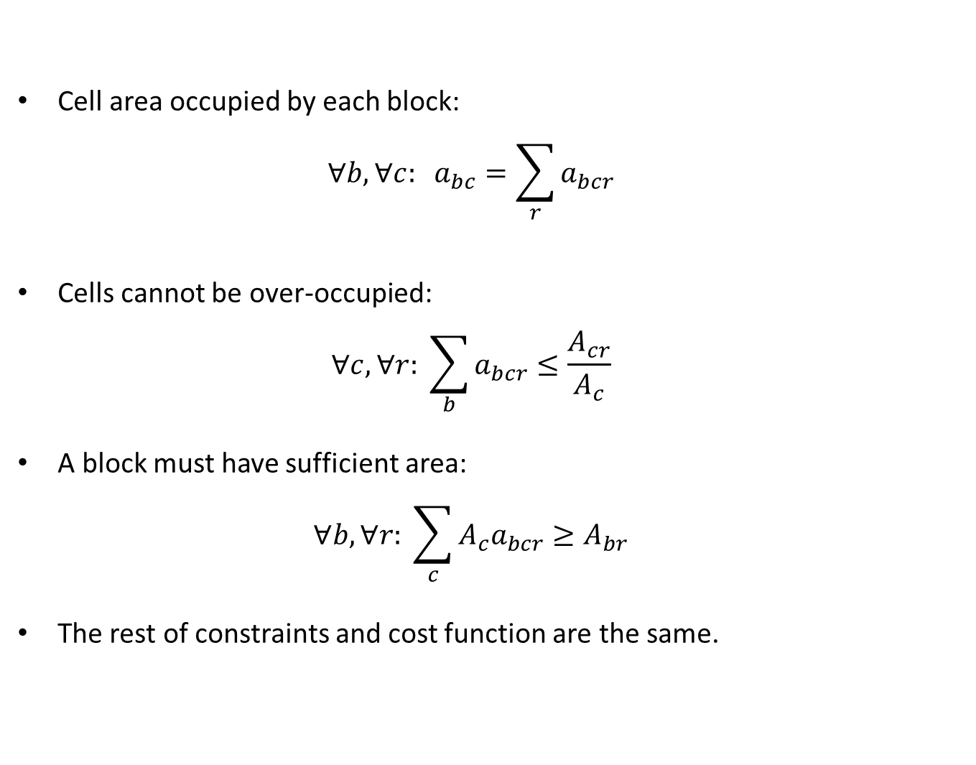
Redefinition of constraints
Cell area occupied by each block: $∀b,∀c: a_{bc}=\sum_{r}{a_{bcr}}$
Cells cannot be over-occupied: $∀c,∀r: \sum_{b}{a_{bcr}≤\frac{A_{cr}}{A_{c}}}$
A block must have sufficient area: $∀b,∀r: \sum_{c}{{A_{c}a}_{bcr}}≥A_{br}$
The rest of constraints and cost function are the same.

Slide 24
Scalability with quad-trees
At each level, a mathematical model is solved.
Only the cells with multiple blocks are refined, the rest are frozen.
In each cell, only the blocks participating in the parent cell are instantiated, i.e., not all blocks participate in each cell (this saves a lot of variables in the model).
Since it is only necessary to give "approximate regions" for the blocks, the number of levels can be bounded up to a certain granularity.
first model (solution)
second model (solution)
third model (solution)
B2 (1.0)
B1 (1.0)
B2 (1.0)
B1 (1.0)
B1 (0.5)
B2 (0.5)
frozen
B1 (1.0)
B1 (1.0)
B1 (1.0)
B2 (1.0)
B1 (1.0)
B2 (1.0)
B1 (1.0)
B1 (0.5) B3 (0.5)
B1 (0.5) B2 (0.5)
B1 (0.5) B2 (0.5)
B1(1.0)
B1(1.0)
B1(1.0)
B1(1.0)
B1(1.0)
B1(1.0)
B2 (1.0)
B2 (1.0)
B1 (0.125)
B2 (0.5) B3 (0.375)
B3(1.0)
B3(1.0)
B3(1.0)
B3(1.0)
B3(1.0)
B3(1.0)
B1 (0.25)
B3 (0.75)
B2 (1.0)
B3 (0.5)
B3 (0.5)
B3 (0.5)
B2 (1.0)
B3 (0.5)
B3 (0.5)
B3 (0.5)

Slide 25
Scalability with quad-trees
final solution
B1
B2
B3

Slide 26
Quad-trees and multiple resources
A slice can be modeled as a region dedicated to a specific resource.
Every cell in the quad-tree can have multiple resources.
Blocks cannot take more than the available resource at each cell.
The intersection of each region (slice) with each cell is known a priori.
100% R1
75% R1
25% R2
Resources
R1
100% R2
R2
75% R1
25% R2

Slide 27
Backup (for the future)

Slide 28
Rectilinear Polygons
A floorplan consists of rectilinear polygons: https://en.wikipedia.org/wiki/Rectilinear_polygon
Examples of rectilinear polygons:

Slide 29
Rectilinear Trees (RTs)
A TR is a Rectilinar Polygon composed of a set of adjacent rectangles with the following properties:
One of the rectangles is the trunk
The other rectangles are all adjacent to the trunk
The trunk has an orientation (horizontal or vertical) that determines the maximum height (for horizontal) or width (for vertical) for the bounding box of the TRP
Examples on the next slide

Slide 30
Rectilinear Trees: examples
Nomenclature: the trunk is in red. The H/V label means horizontal/vertical orientation.
But these are not RTs:
H
H
H
V
V
H
H
V

Slide 31
Blocks and rectangles
A floorplan contains blocks. Each block is a RT with one or more rectangles.
A block is characterized by:
An initial number of rectangles (typically 1 to 3).
An area. The sum of the areas of the rectangles must be the area of the block
A min width and height, meaning that each rectangle must honor the min width and height of the block.

Slide 32
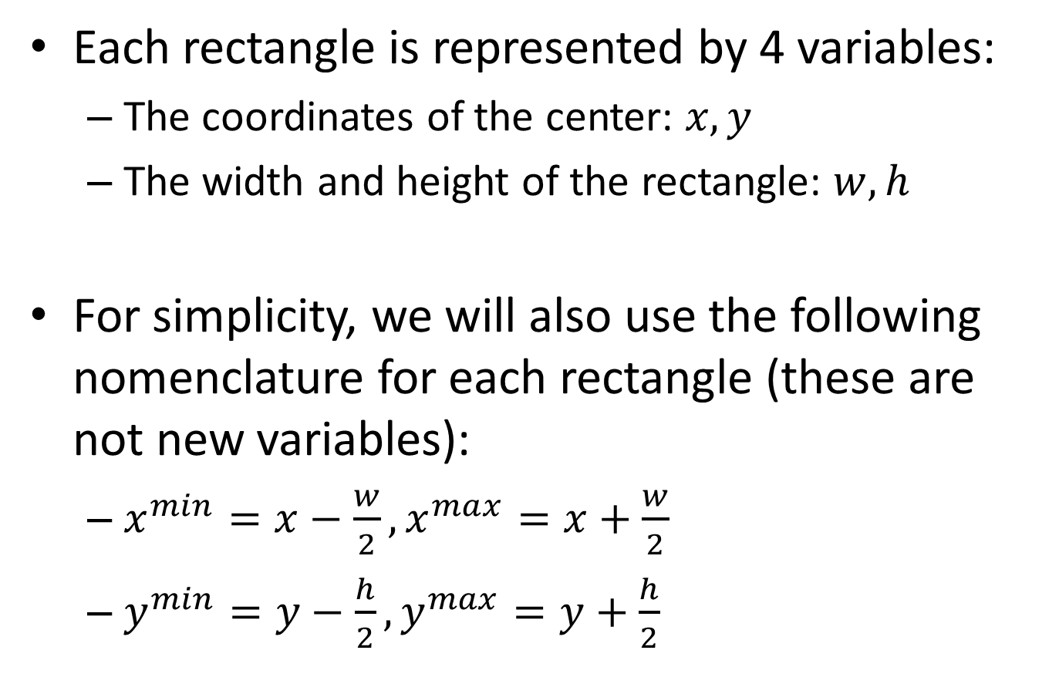
Rectangles
Each rectangle is represented by 4 variables:
The coordinates of the center: $x,y$
The width and height of the rectangle: $w,h$
For simplicity, we will also use the following nomenclature for each rectangle (these are not new variables):
$x^{min}=x−\frac{w}{2}, x^{max}=x+\frac{w}{2}$
$y^{min}=y−\frac{h}{2}, y^{max}=y+\frac{h}{2}$

