Slide 1
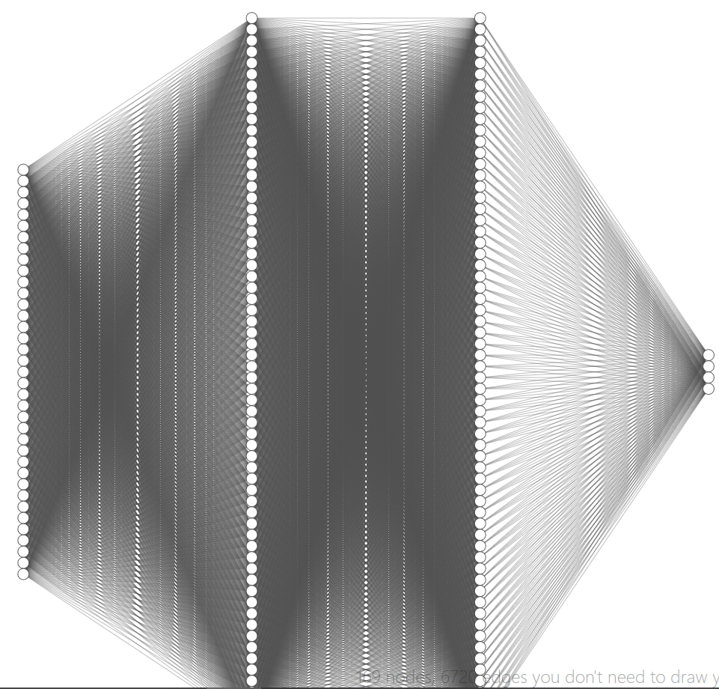
Hidden layer #1
Dimension = 64
Hidden layer #2
Dimension = 64
Input layer
input space = 37 (= state size)
ReLU
ReLU
ReLU
Output layer
output space = 4 (= action size)

