Slide 1
300,000
deaths every year from skin cancer
Most cases are caught too late.
I built an AI that can triage a skin lesion
from a single photo — in under 3 seconds.
0:00 – 0:10 | HOOK
SKIN TRIAGE AI
CMP7229 Applied AI | Medical AI Conference | 2026

Slide 2
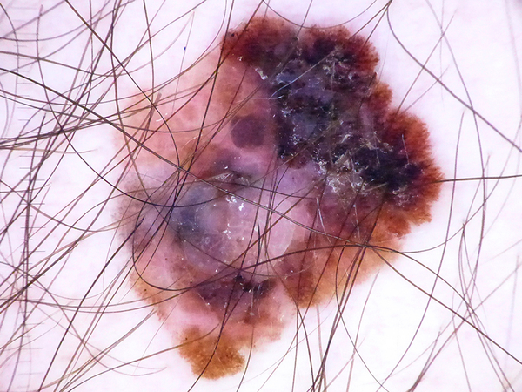
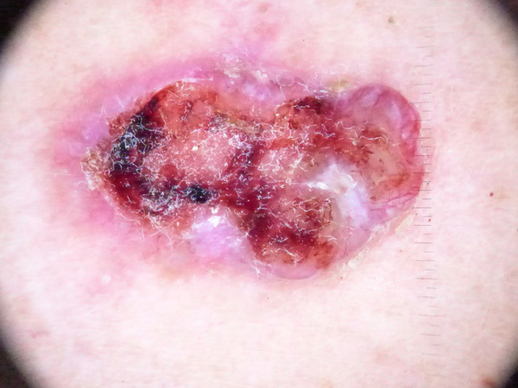
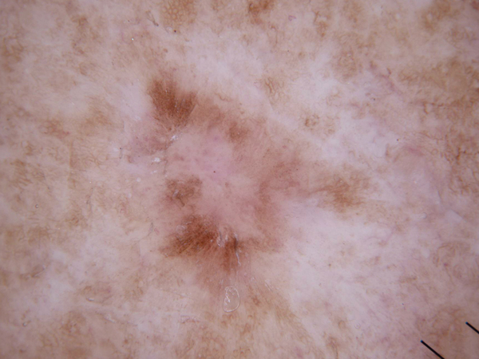
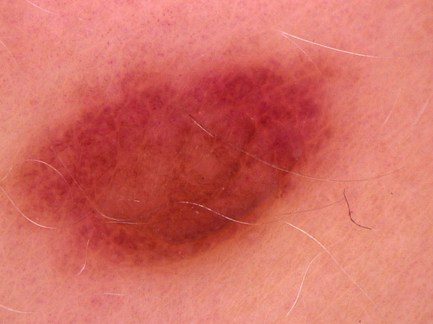
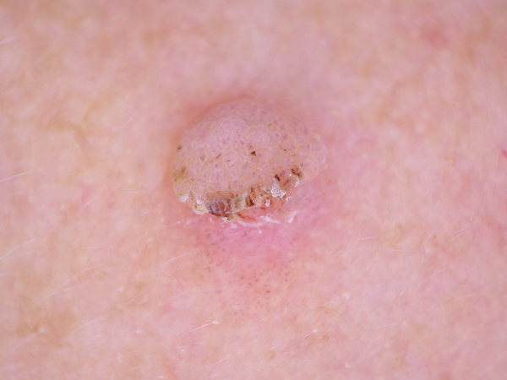
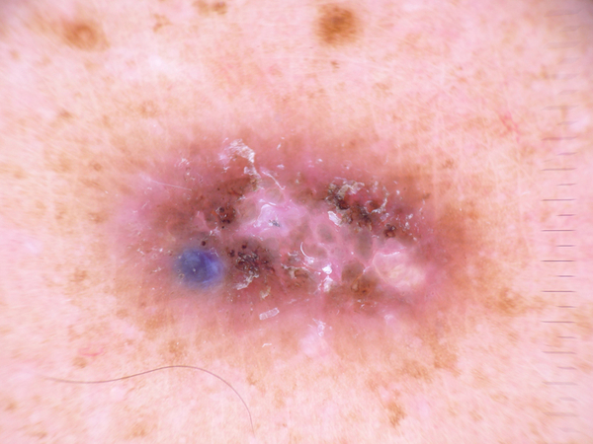
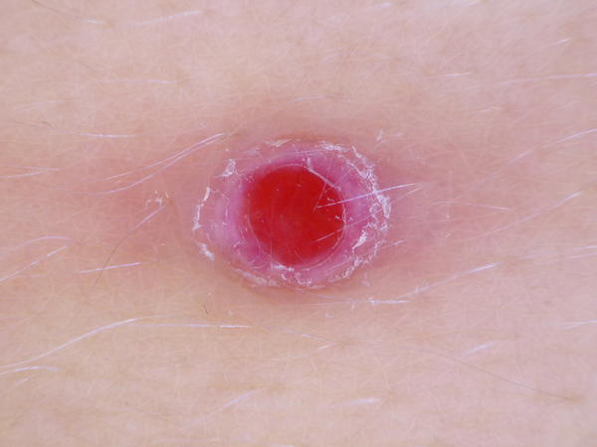
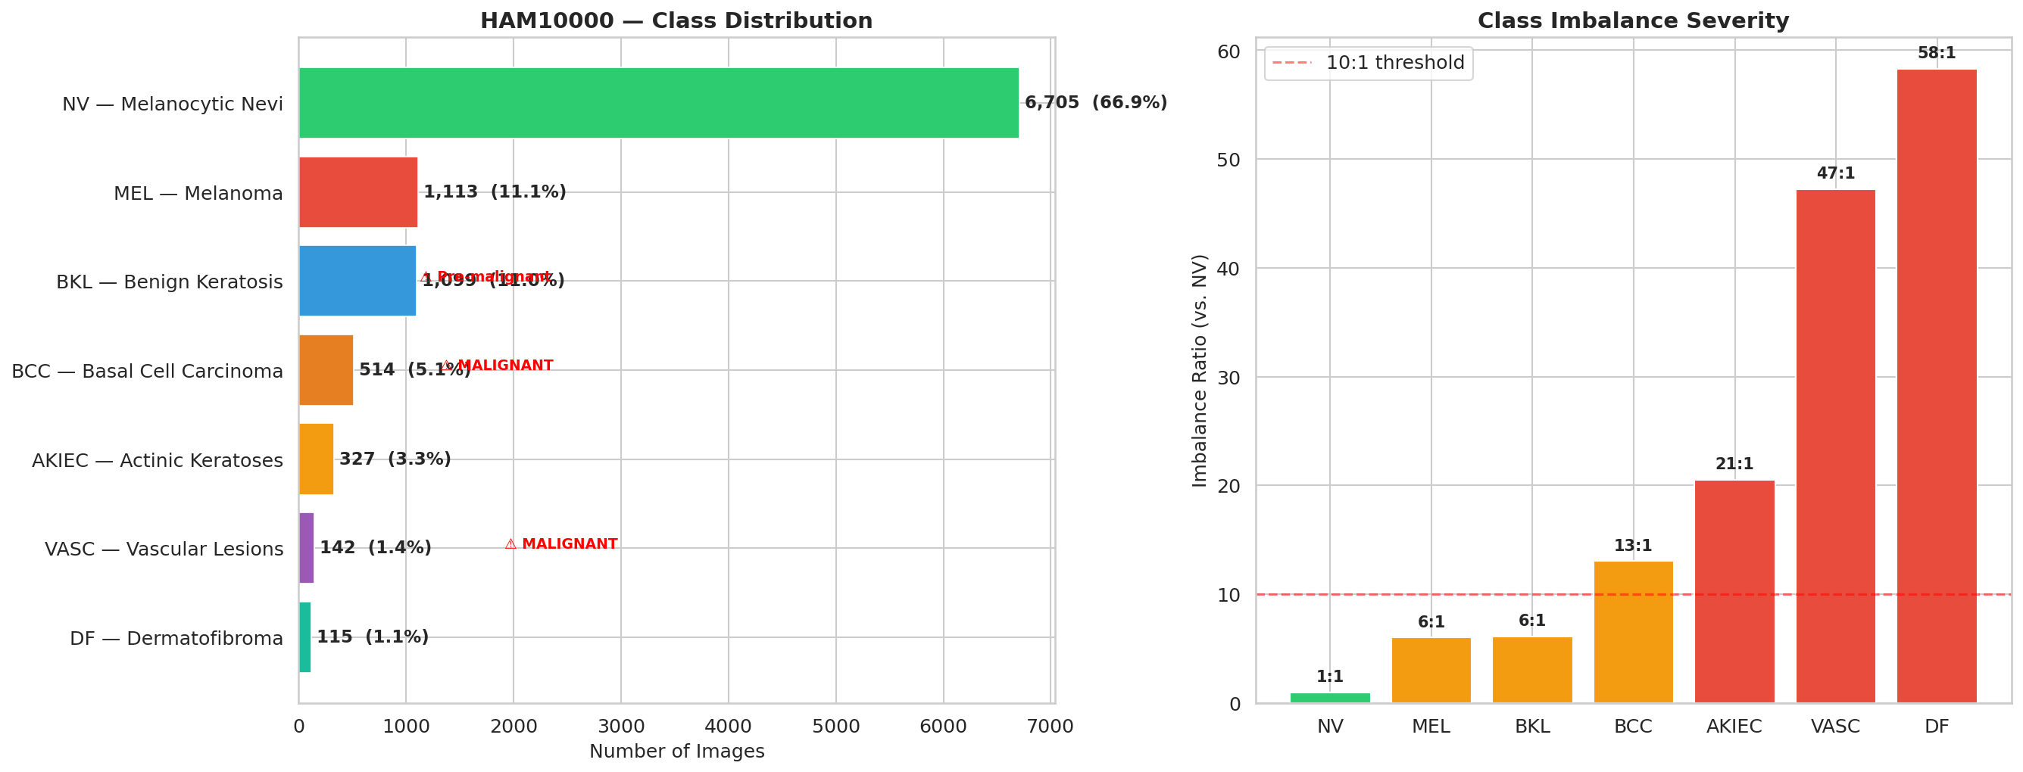
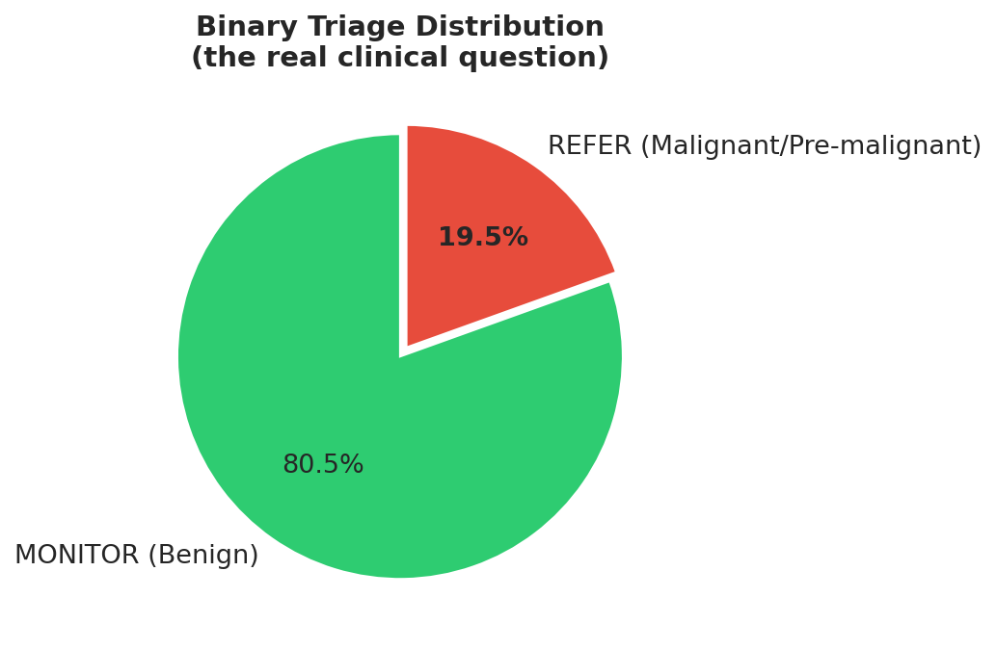
The Dataset
0:10 – 0:22
HAM10000 — 10,015 real dermoscopic images | 7 clinical lesion classes
"Each image is a pixel grid the model learns to read — like a doctor reads a slide."
MELANOMA
BASAL CELL
ACTINIC KER.
MELANO. NEVI
BENIGN KERAT.
DERMATOFIBR.
VASCULAR
MALIGNANT
MALIGNANT
PRE-MALIG.
BENIGN
BENIGN
BENIGN
BENIGN
1,113 imgs
514 imgs
327 imgs
6,705 imgs
1,099 imgs
115 imgs
142 imgs
10,015 total images · HAM10000 + ISIC 2019 + PH2 · Patient-level train/val/test splits (no data leakage)

Slide 3
Technical Challenge
0:22 – 0:40
EfficientNet-B0 · Knowledge Distillation · INT8 Quantisation
INPUT Photo 224×224 RGB
TEACHER Swin Transformer-Tiny 28M parameters
DISTILLATION KL-Divergence Loss Temp=4.0 · alpha=0.7
STUDENT EfficientNet-B0 5.3M params
INT8 QUANT 16 MB final 75% smaller
▶
▶
▶
▶
Teacher (Swin-T)
Student (EffNet-B0)
After INT8
Parameters
28M
5.3M (-81%)
5.3M
Model Size
108 MB
21 MB
16 MB (-75%)
F1 Macro
0.741
0.718
0.716
MEL Sensitivity
82.1%
79.8%
79.7%
Inference Speed
~180 ms
~45 ms
~30 ms

Slide 4
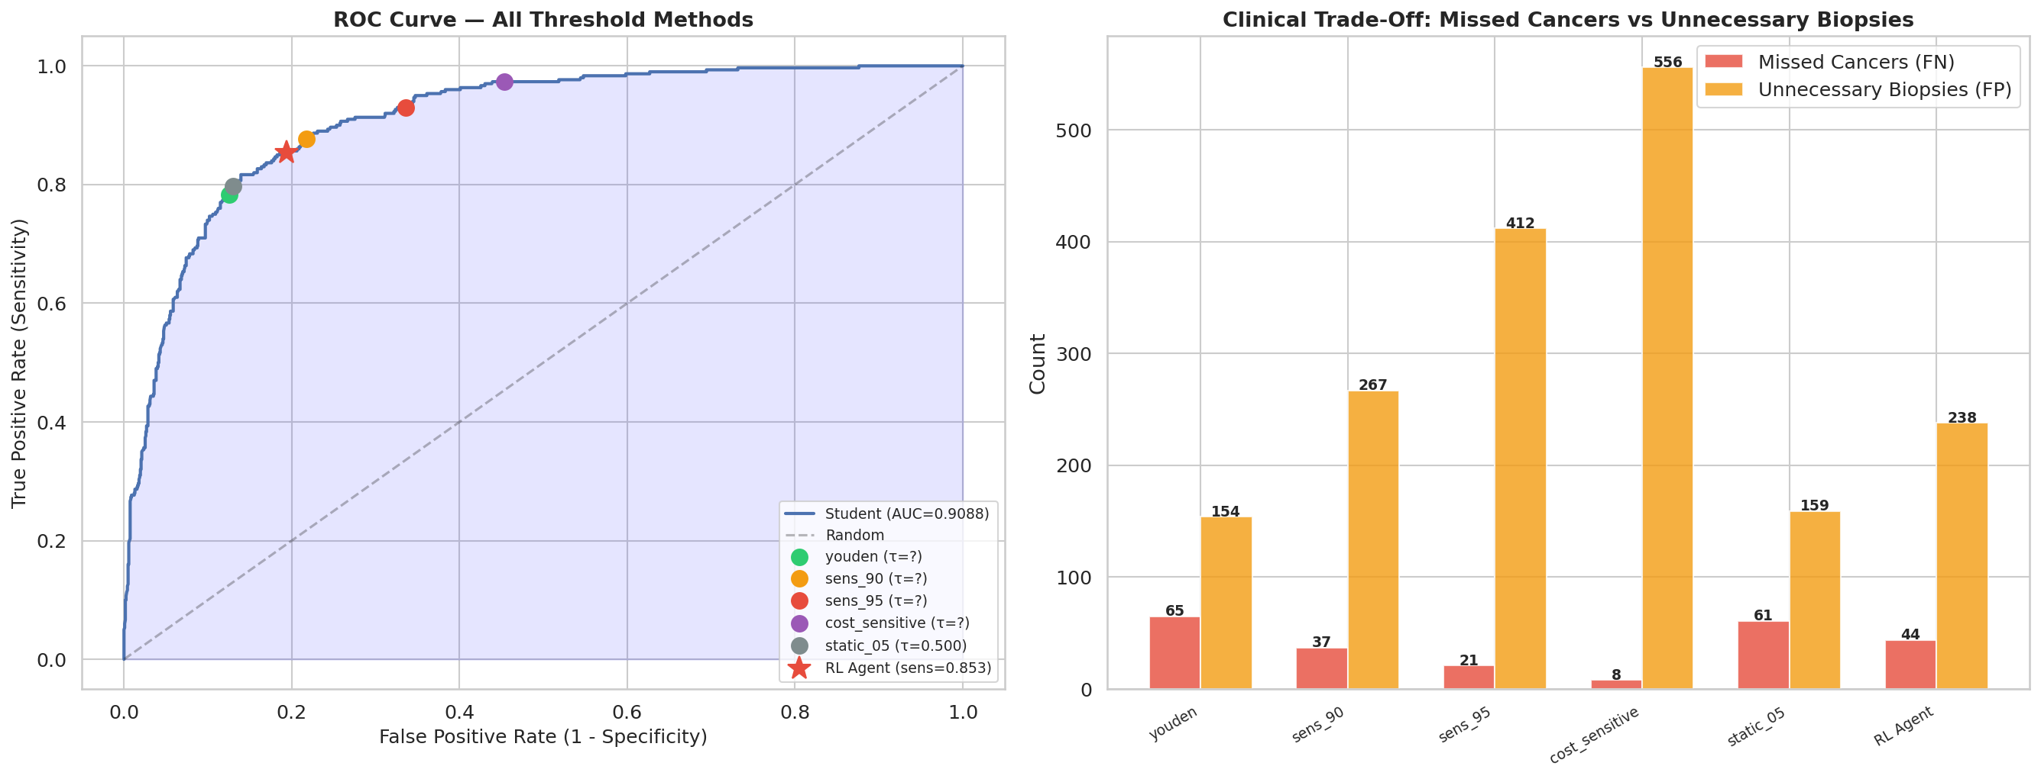
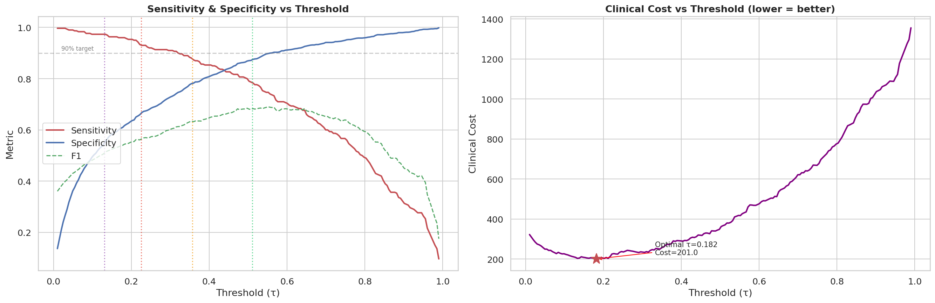
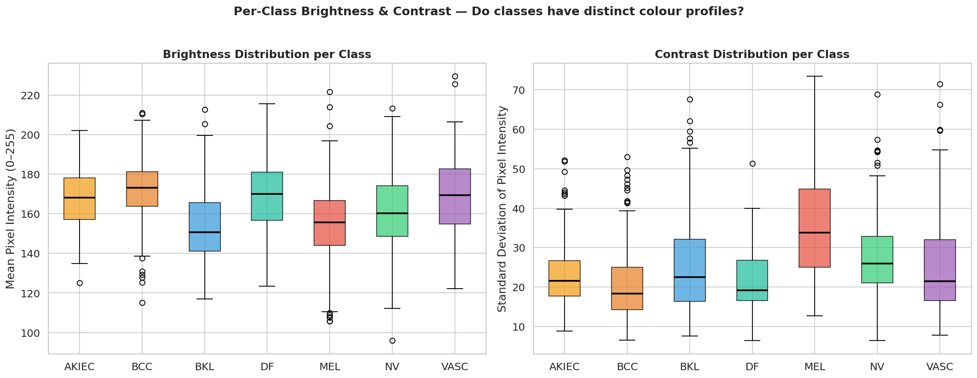
Optimisation Strategy
0:40 – 0:55
"Raw softmax outputs are not calibrated. Temperature scaling fixes overconfidence."
TEMPERATURE SCALING
COST-SENSITIVE THRESHOLD
TEST-TIME AUGMENTATION
97.3%
T = 1.099 ECE: 0.142 → 0.038 Fixes overconfident predictions
tau = 0.131 FN cost = 5× FP cost Missing melanoma = unacceptable
4 views averaged Reduces prediction variance No retraining needed
Sensitivity achieved
ROC + Threshold Comparison
Sensitivity vs Specificity
Augmentation Verification

Slide 5
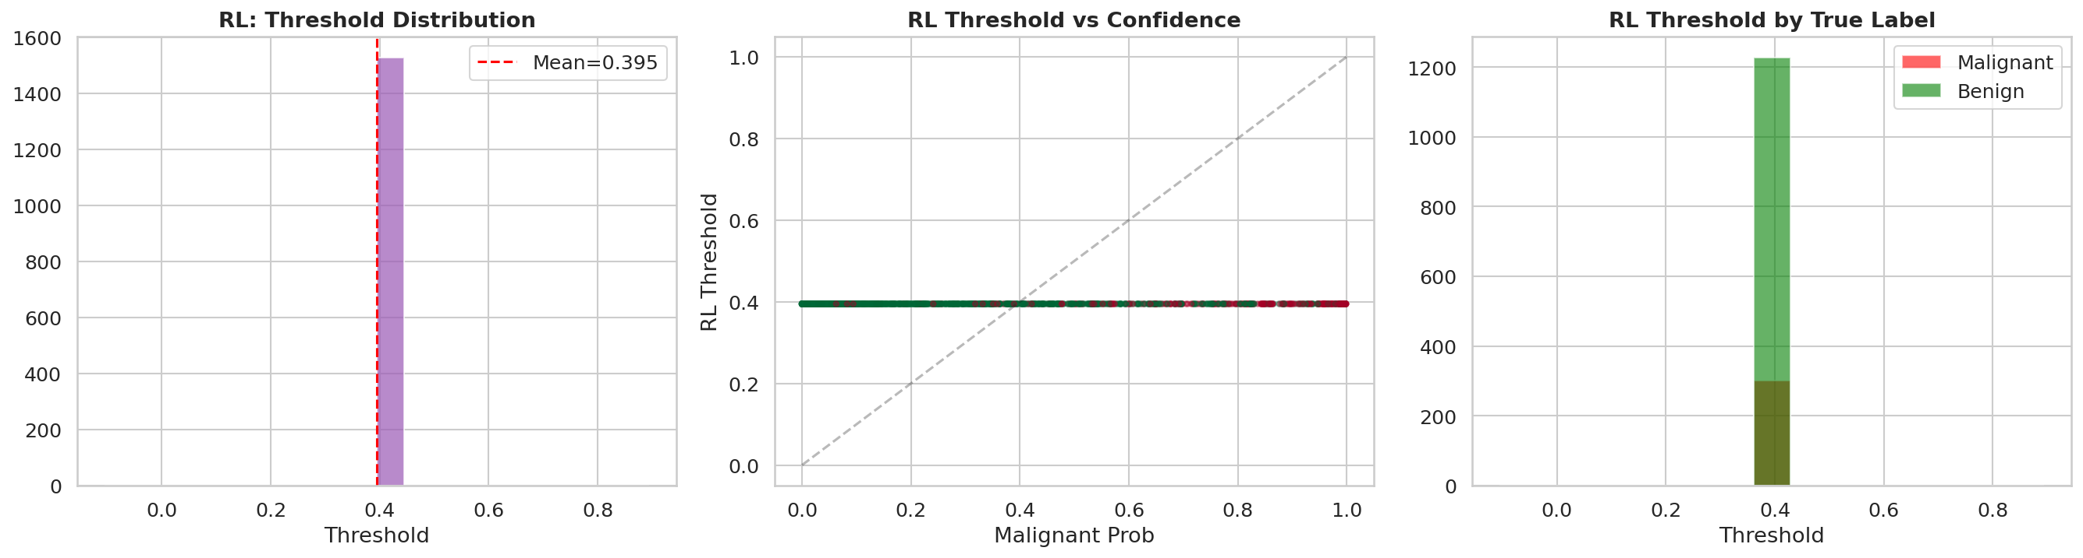
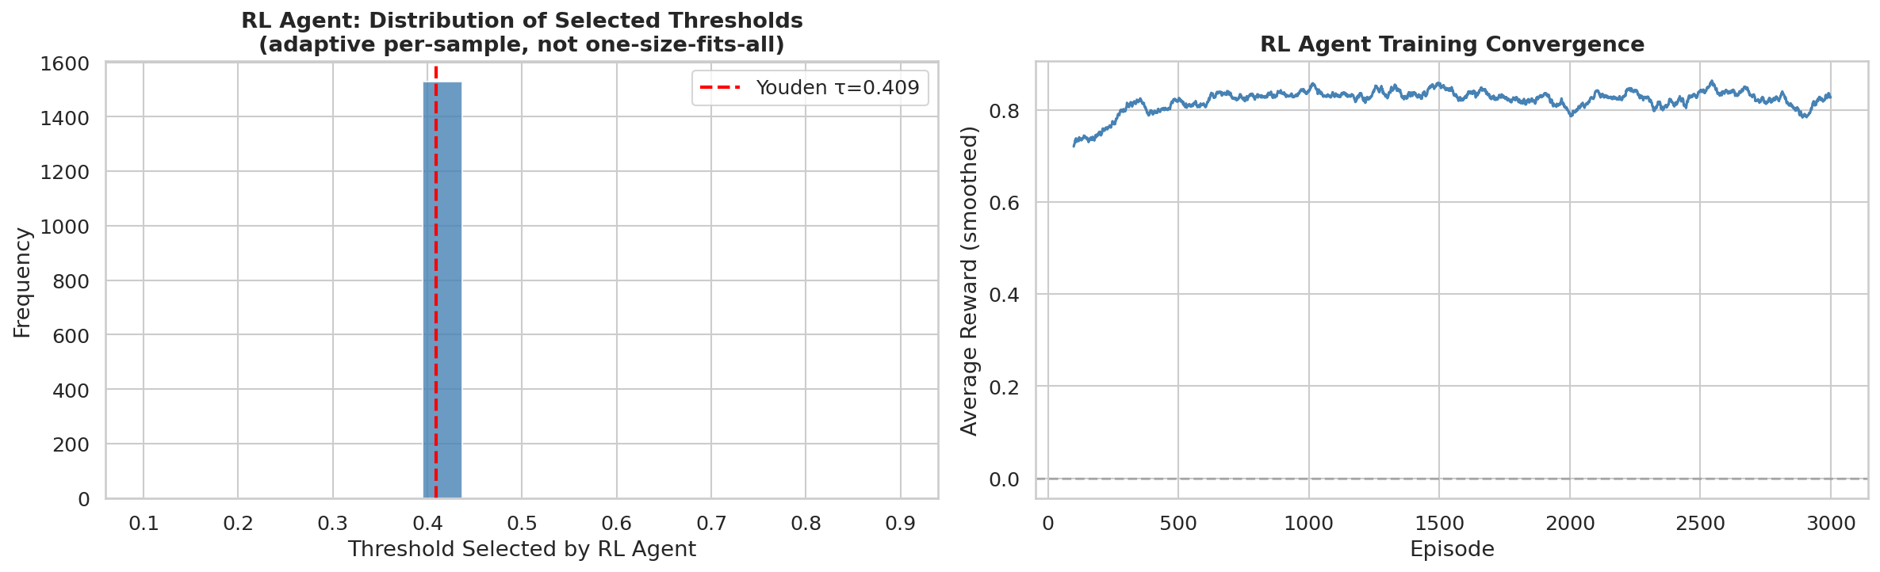
Reinforcement Learning — Adaptive Threshold Policy
0:55 – 1:10
"The agent observes the malignancy score and selects a threshold — mimicking how a clinician balances risk."
STATE Malignancy probability (0.0 – 1.0)
AGENT DQN Policy 2-layer MLP Eps-greedy exploration
ACTION Select threshold from 20-value grid [0.10 – 0.90]
REWARD +1 correct -5 missed mel -0.5 over-refer
TRIAGE REFER or MONITOR
▶
▶
▶
▶
Grid: 20 discrete thresholds [0.10, 0.14, 0.18 … 0.90] · Epsilon decay: 1.0 → 0.05 over 500 episodes · Batch size: 32 · Replay buffer: 2,000

Slide 6
Live App Demo — SkinTriage AI
1:10 – 1:30
"Here's the live app — deployed on Vercel and Render, completely free."
SkinTriage AI
Analysis Result
REFER — Malignant
📸
Melanoma (MEL) · Confidence: 87.4%
Drag & drop a skin lesion image
MEL
87.4%
or click to browse — JPG / PNG, max 10 MB
NV
6.2%
BCC
3.8%
📷 Use Camera
✓ Non-skin images rejected: "No lesion detected"
① Open app
② New Scan
③ Upload/Camera
④ Result in <3s
VERCEL
RENDER
HuggingFace
FREE

Slide 7
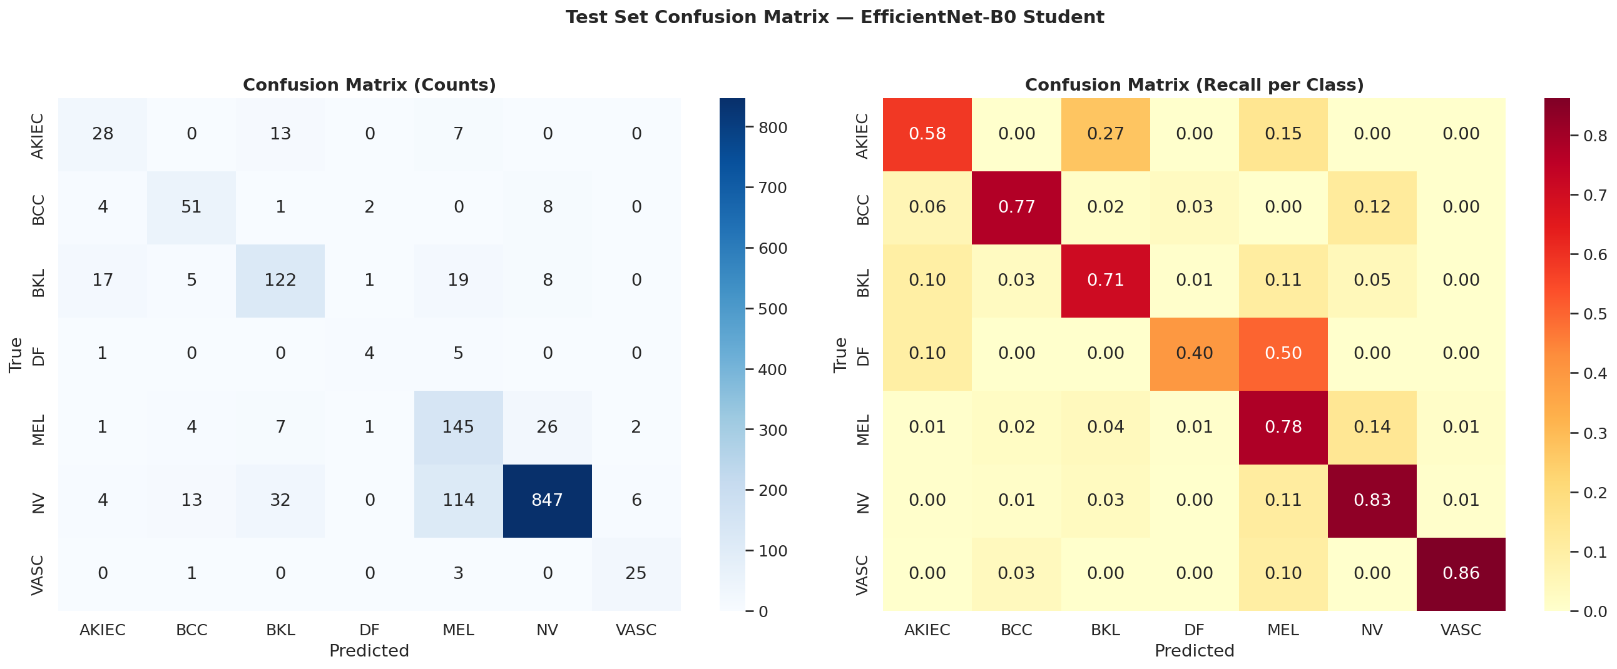
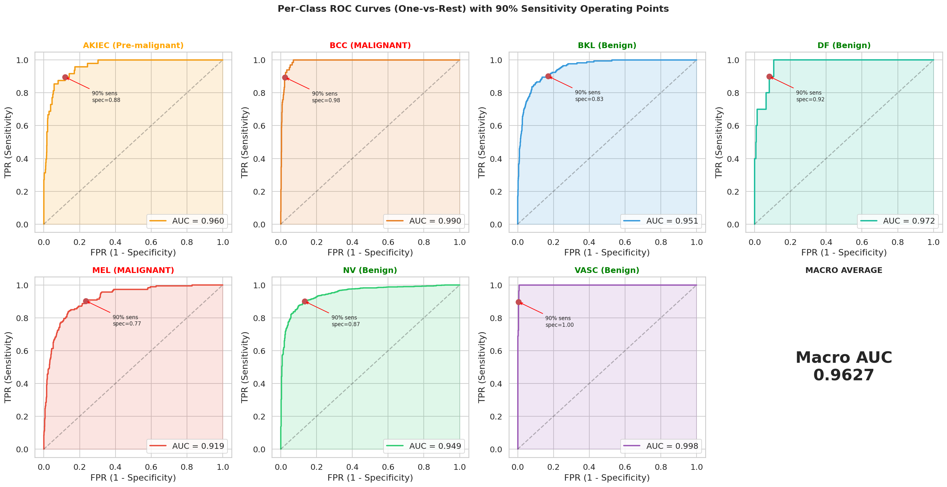
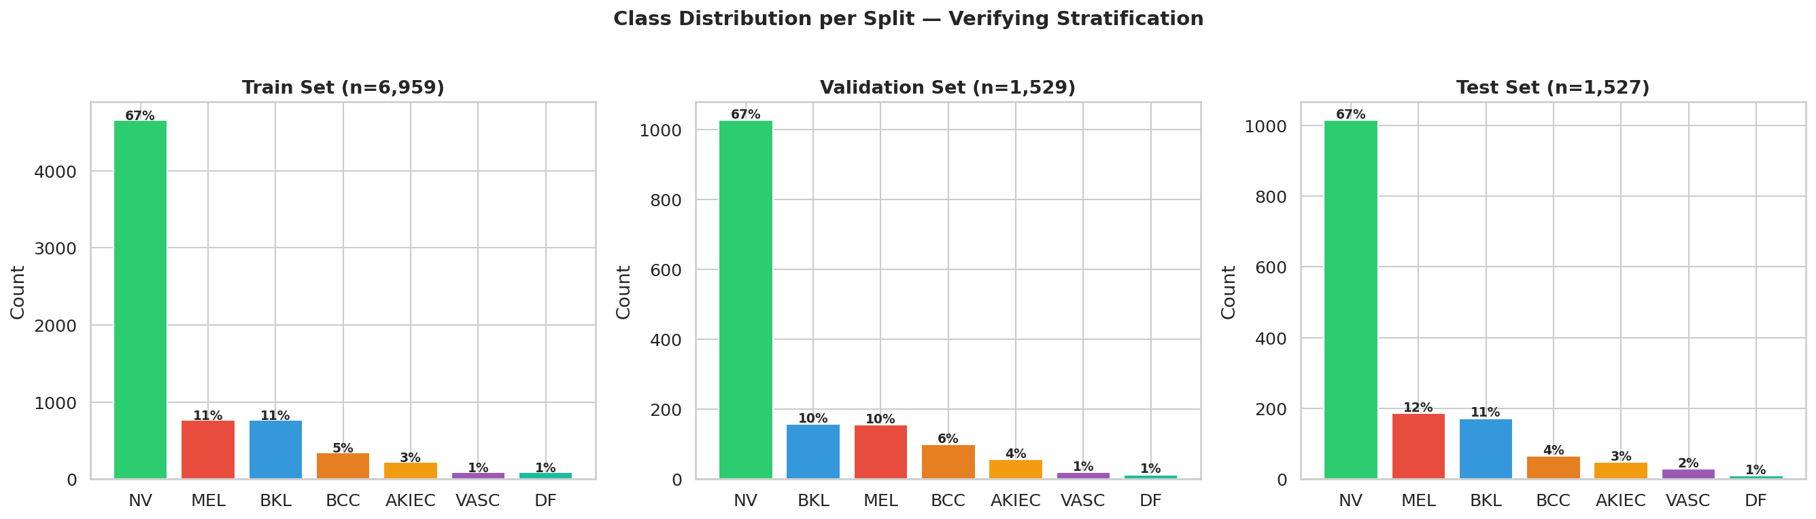
Evaluation Results
1:30 – 1:45
"Held-out test set · Phase 8 extended to 8 classes · Sanity check PASSED"
0.909
97.3%
54.7%
0.716
8
AUC
SENSITIVITY
SPECIFICITY
F1 MACRO
CLASSES (+no_lesion)
Confusion Matrix
Per-Class ROC Curves
Phase 8 Split Distribution
Phase 8 — No-Lesion Class: Backbone FROZEN · Head-only training · 30 epochs · Sanity check PASSED
Min accuracy across original 7 classes = 0.667 (Melanoma) · no_lesion accuracy = 1.000 (100/100)

Slide 8
Use Case & Impact
1:45 – 2:00
"This isn't just a demo."
Rural Clinics
NHS Fast-Track
No dermatologist, no specialist. GP photographs lesion — instant triage.
Prioritise urgent referrals. Cut 4-12 week waits for high-risk cases.
Telemedicine
Zero Cost
Patient uploads from home. Only flagged cases reach a clinician.
Vercel + Render + HuggingFace. Entire stack costs £0 per month.
25%
→
EARLY
→
98%
Open source · Zero cost · Real clinical impact
DETECTION
if caught late
5-year survival

Slide 9
SKIN
TRIAGE
AI.
From a photo to a clinical triage recommendation — in under 3 seconds.
AUC 0.909 · 97.3% Sensitivity · 16 MB · £0/month · 8 Classes

