Slide 1

Welco‏‏‎me‎‎‎‏‏‎.‏‏‎ ‎
Notes:
Hello everyone, we are C3P2 Team. Our project´s name is Hunnigan.

Slide 2
Objectives & Users
C3P2 expects to develop a tool that will help students & professors to take, share and review class notes.
The product objective & proposal is the developing of a conversational bot that will make “class notes taking” efficient and enjoyable.
Technical Functional & Non-Functional requirements can be found at: Hunnigan requirements

Slide 3

HELLO!
I’m here to take care of your notes, in an efficient & organized way!

Slide 4
¿How are we going to achieve it?

Slide 5
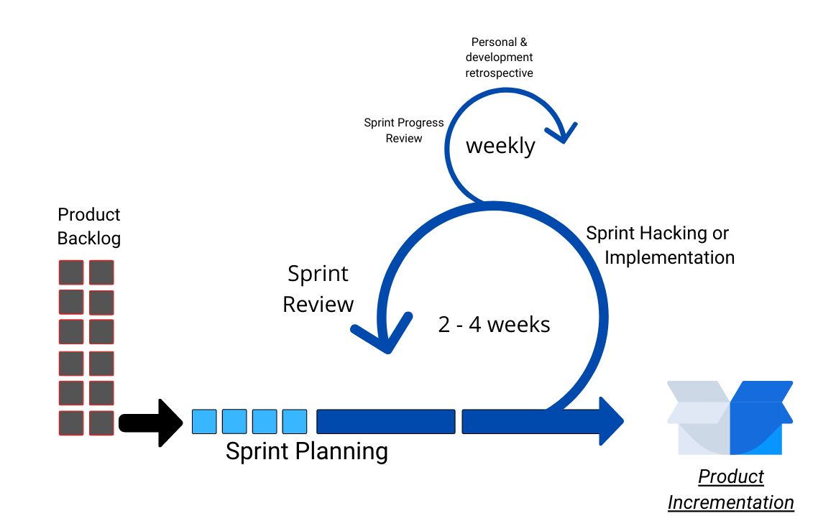
We use an Agile Process
Notes:
We are using an agile process, that´s beacuase it is an adaptation of three different project management methods; SCRUM, KANBAN and Incremental method. It is divided in 6 Steps, the first one is the collection of user requirements priotized with moscow, we call this the Product Backlog, then comes the Sprint Planning, where we take the most prioritized requirements from the Product Backlog list to realize them during the Hacking or implementation step;

Slide 6
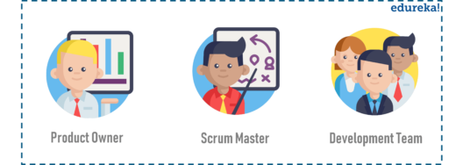
Roles
Product Owner
(Esteban)
- Client proxy
- Activities definer
Scrum Master
(Antonio)
- Team leader & guide
- Feedback lover
- Activities manager
Development Team
(Gabriel, Angel y Erik)
C3P2
- ¡Make the activities happen!👓
- Valuable people
Cross-functional Team

Slide 7
¿What are we going to do to achieve it?

Slide 8
Planning
Sprint 01
Sprint 02
Sprint 03
Sprint 04
User authorization to edit or delete information and online notebook access
Research on bot development and repository creation
Creation of mockups and design of the project architecture
Organization of the information and how it will be presented to the user

Slide 9

Teamwork.
Repo
The tool we use to manage the repository of documents and data is Git and is located at GitHub.
I. C. Metrics
The metric used to measure the individual contribution to the project is a percentage calc that includes:
Accomplishment of agreed activities
Meetings presence
Documental contribution

Slide 10
Expected competences of software engineering.

Slide 11
Subject competences argument
General competences
Implementation of methods and philosophies of project development, specifically Scrum, Kanban and the Incremental Project Development Life Cycle Model.
Specific competences
Specific competences came naturally as the development process was derived from an already established methodology, such as the identification of the areas of Software Development in our process.

Slide 12


THANKS!
You can find more information at:
https://github.com/Antonio-Cituk/Hunnigan
This is a work of C3P2 Team:
@CL-Nayib
@saulpalma26
@estecimo
@erikpsanchez
@Antonio-Cituk

