Slide 1


Dynamic graph models for the Bitcoin P2P network: simulation analysis for expansion and flooding time
Antonio Cruciani¹, Francesco Pasquale²
1. Gran Sasso Science Institute (GSSI), L’Aquila, Italy
antonio.cruciani@gssi.it
2. Università di Roma ‘‘Tor Vergata’’, Rome, Italy
francesco.pasquale@uniroma2.it

Slide 2
In this work
What we do:
Define and analyze two dynamic random graph models inspired by the Bitcoin P2P network generation protocol
Why we do it:
To understand the properties of the network
    Expansion (robustness)
    Reliability (for spreading messages)
How we do that:
We simulate the models

Slide 3
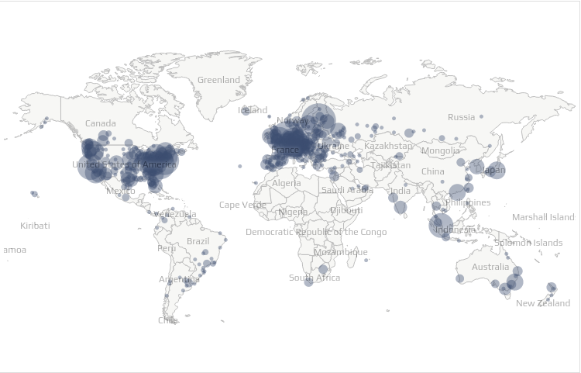
The Bitcoin P2P Network
We can approximately retrieve the set of peers
But we can’t find the links between them
What do we know?
Every node:
Min 8 connections
Max 125 connections
Can we use it to model the network structure?

Slide 4
Some related works
Bitcoin topology inference:
  Miller et al. (2015), Neudecker et al. (2016), Delgado-Segura et al. (2018)
  Difficult to apply on the real Bitcoin P2P Network
Dynamic random graph models:
  Becchetti et al.(2020) [RAES MODEL]
  Dynamic graph that converges to a static random graph
We extend the RAES model

Slide 5
Bitcoin Topology Inference
Miller et al.
Discovering bitcoin’s public topology and influential nodes
2015
Neudecker et al.
Timing analysis for inferring the topology of the bitcoin
peer-to-peer network
2016
Delgado-Segura et al.
TxProbe: Discovering Bitcoin’s Network Topology Using
Orphan Transactions
2018

Slide 6
Dynamic Graph Models (Inspired by the Bitcoin Network)
Becchetti et al.
Finding a bounded-degree expander inside a dense one.
(RAES Model)
2020

Slide 7
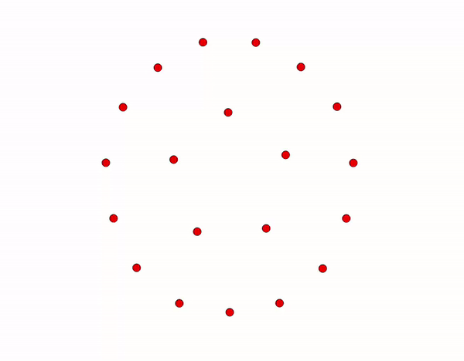
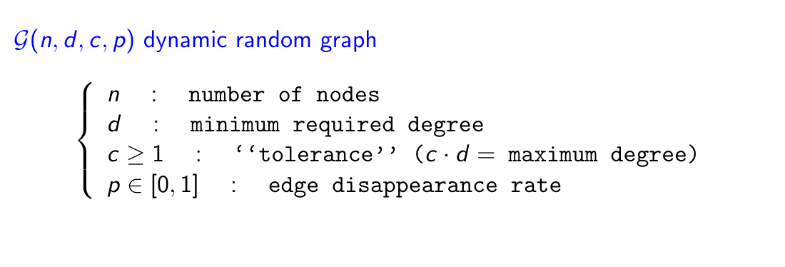
E-RAES (Edge Dynamic-RAES)
RAES
n : 20, d : 4,c : 1.5, p : 0.5

Slide 8
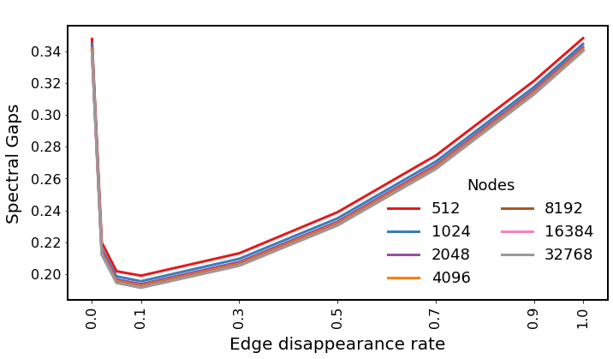
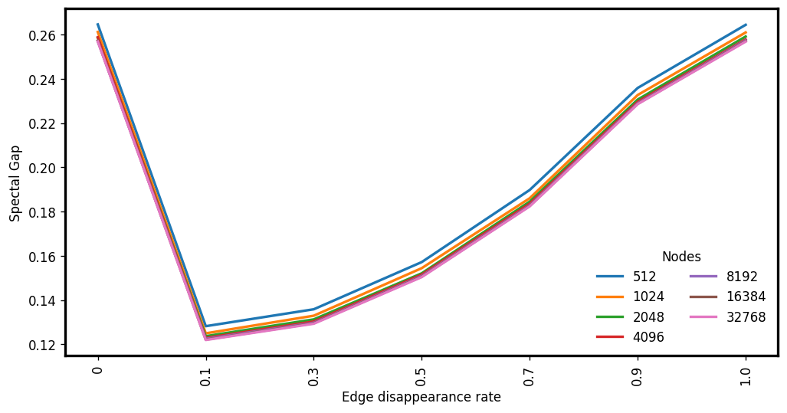
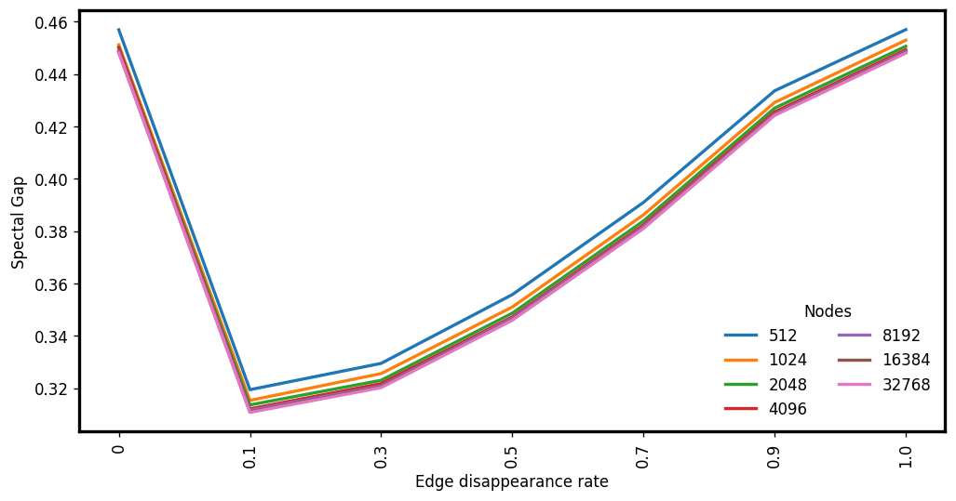
E-RG: (average) Expansion
d:4 c:1.5
d:3 c:3
d:6 c:5

Slide 9
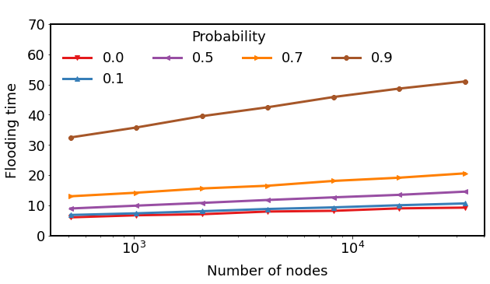
E-RAES: (average) Expansion and Flooding Time
Results for d:4 c:1.5
Spectral Gap (Expansion)
Flooding time
Measured before the edge disappearance phase
Flooding step executed after
the edge disappearance phase

Slide 10
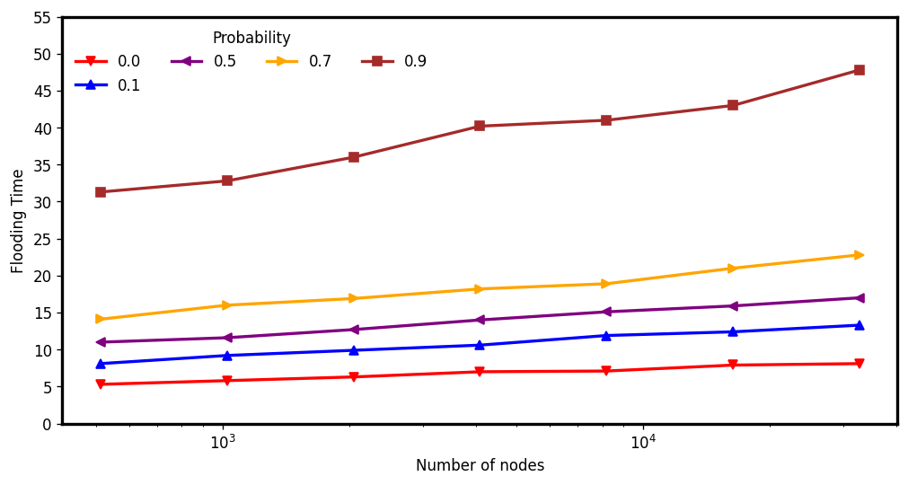
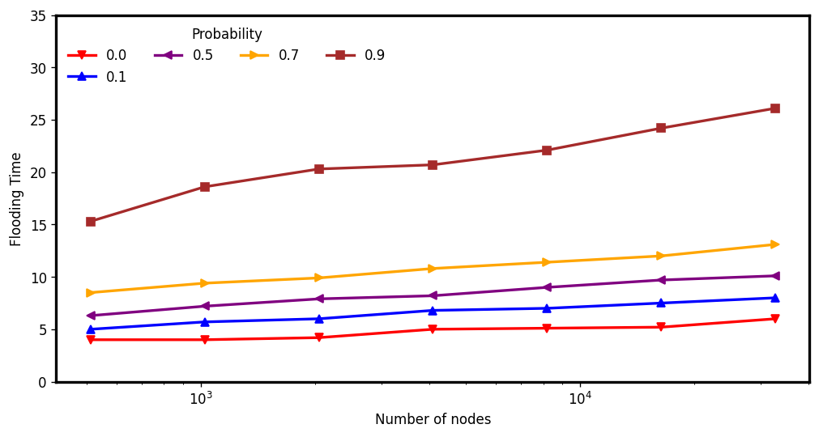
E-RG: (average) Flooding time
d:4 c:1.5
d:3 c:3
d:6 c:5

Slide 11
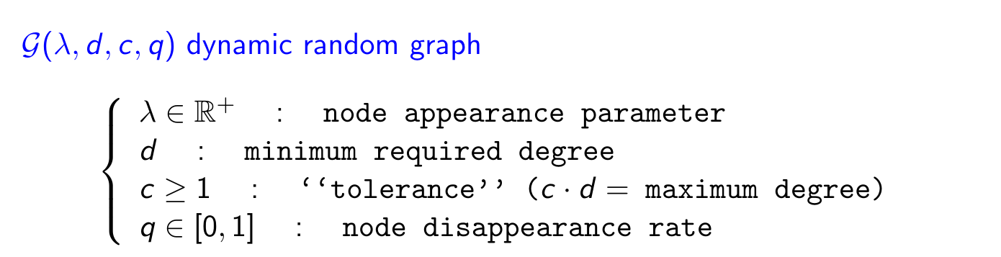
V-RAES (Vertex Dynamic-RAES)

Slide 12
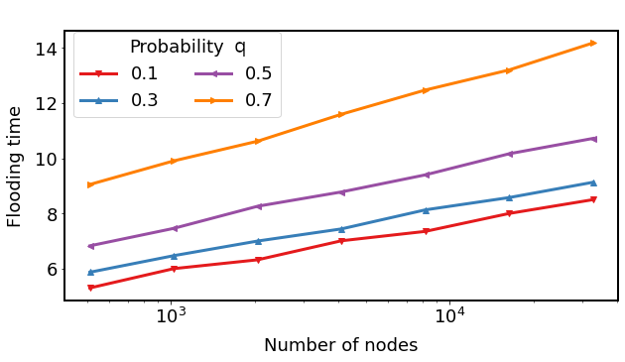
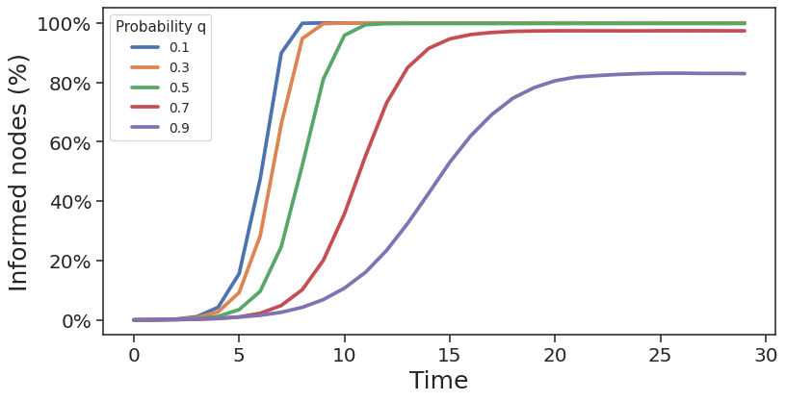
V-RAES: (average) Fraction of informed nodes
Results for d:4 c:1.5
% of informed nodes at each round
Flooding time
Flooding step executed after the node disappearance phase

Slide 13

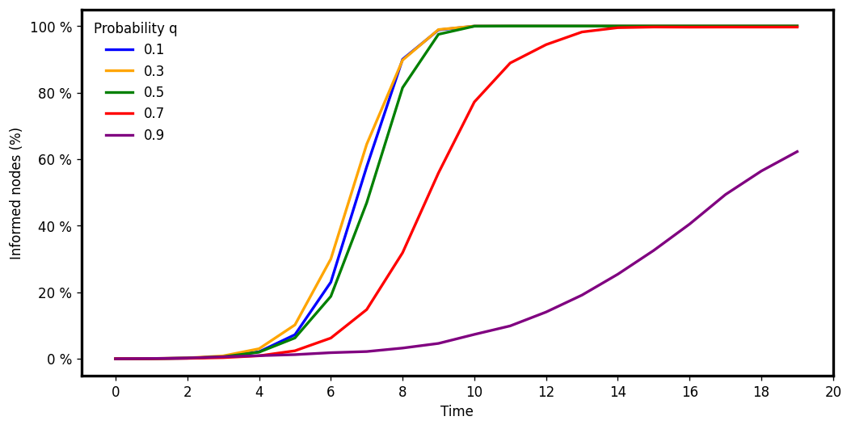
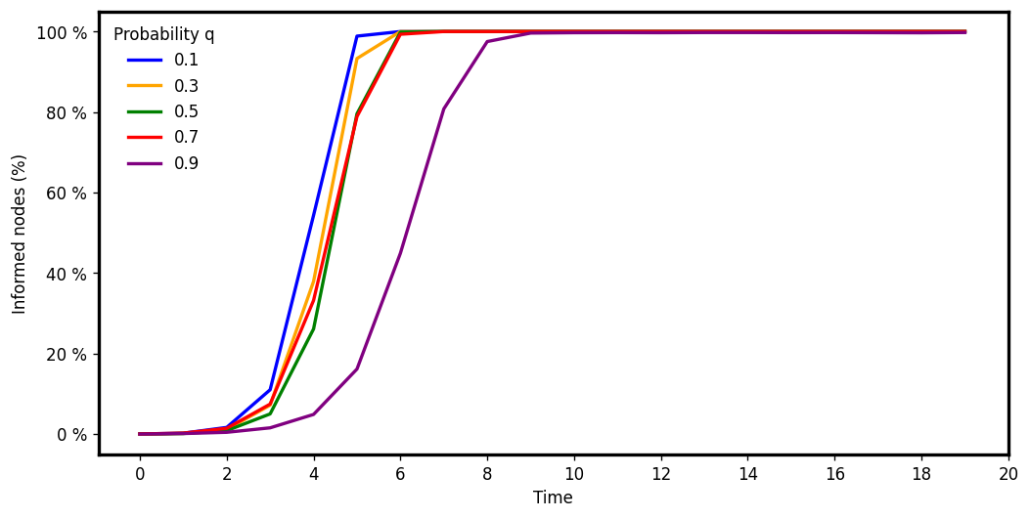
V-RG: (average) Fraction of informed nodes
d:4 c:1.5
d:3 c:3
d:6 c:5

Slide 14
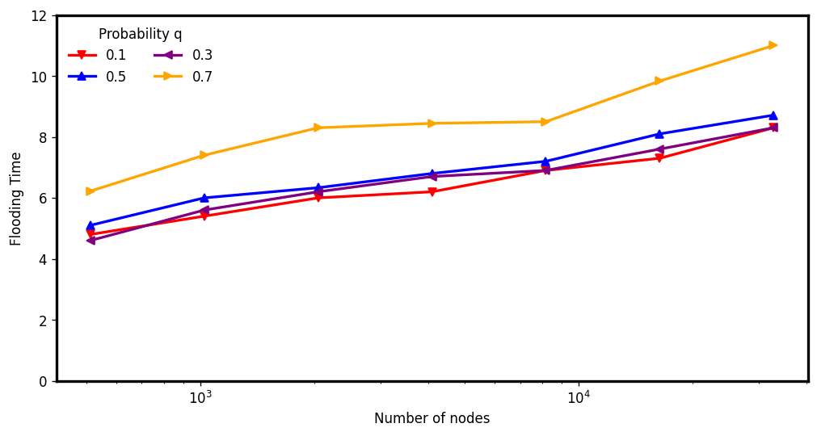
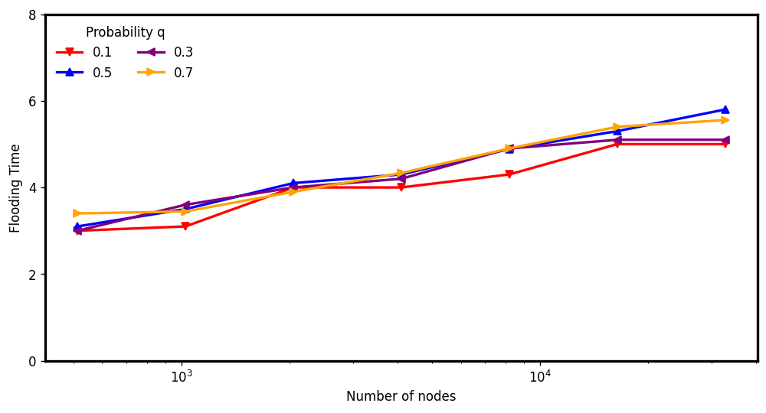
V-RG: (average) Flooding Time
d:4 c:1.5
d:3 c:3
d:6 c:5

Slide 15
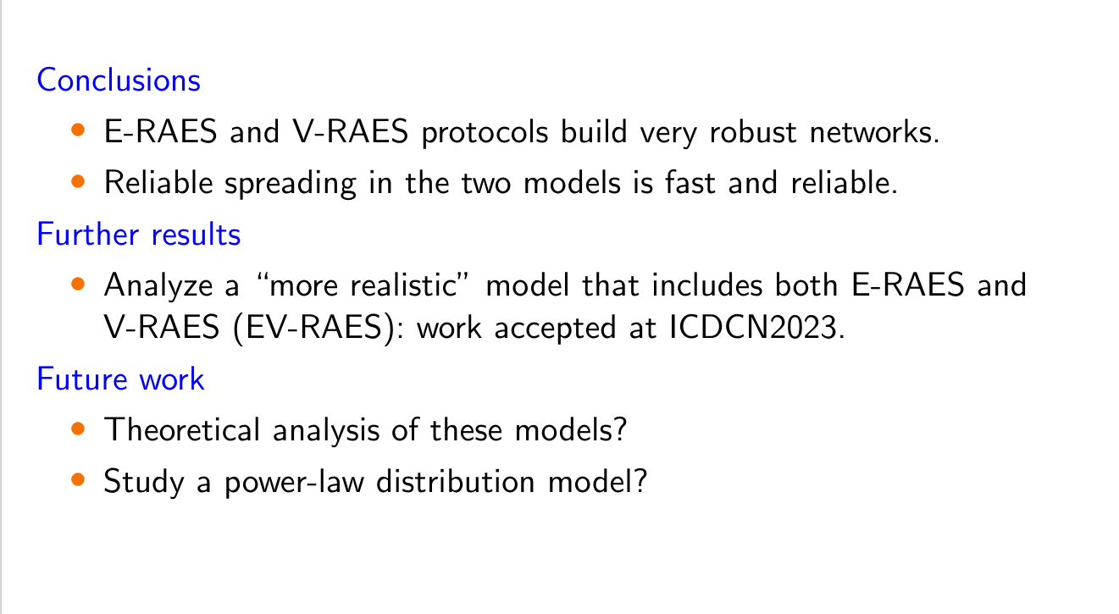
Conclusions and future work

Slide 16
Thank You!

Slide 17
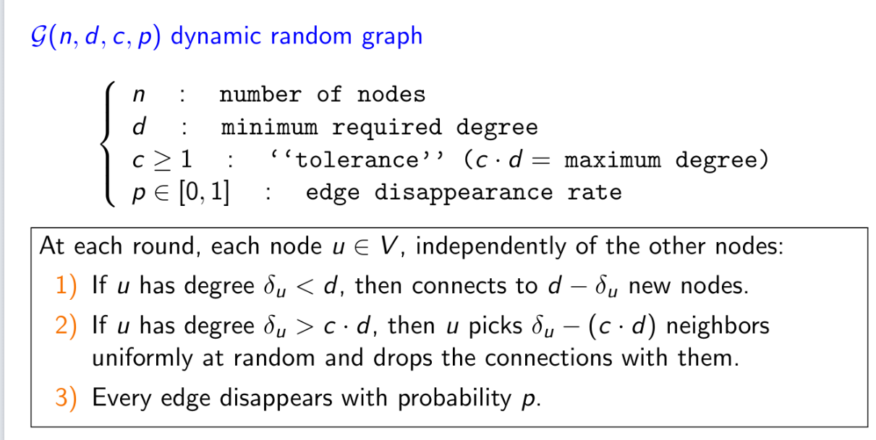
E-RAES (Edge Dynamic-RAES)
0

Slide 18
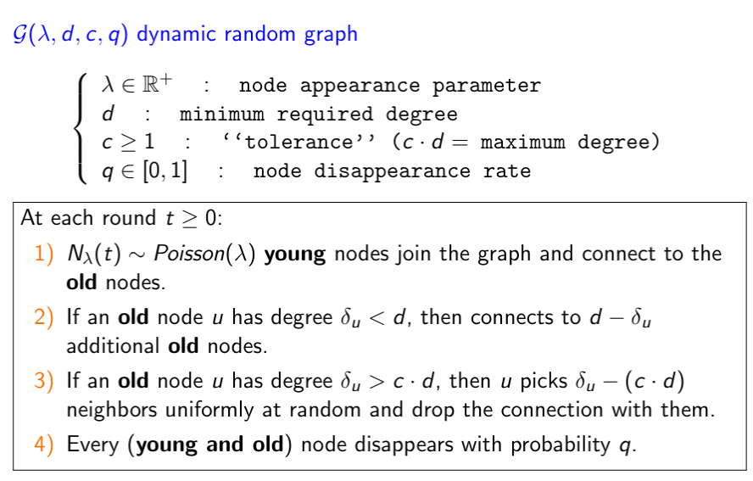
V-RAES (Vertex Dynamic-RAES)

Slide 19
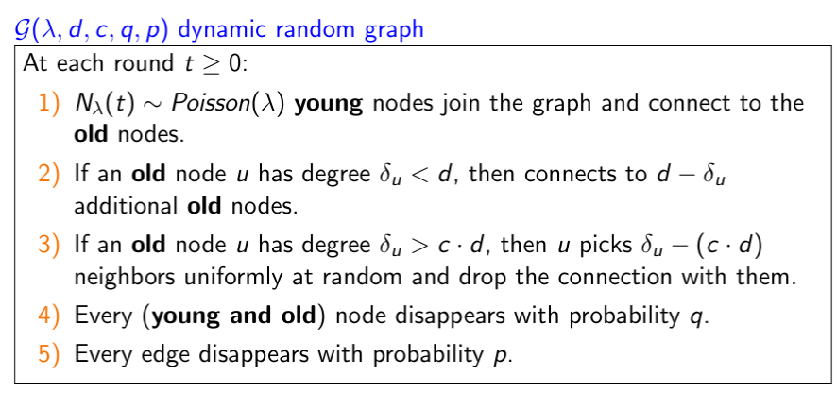
EV-RAES (Edge Vertex Dynamic-RAES)

Slide 20
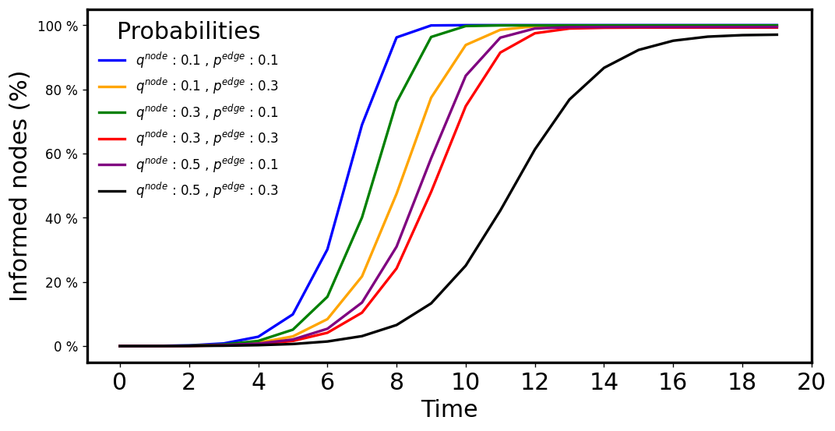
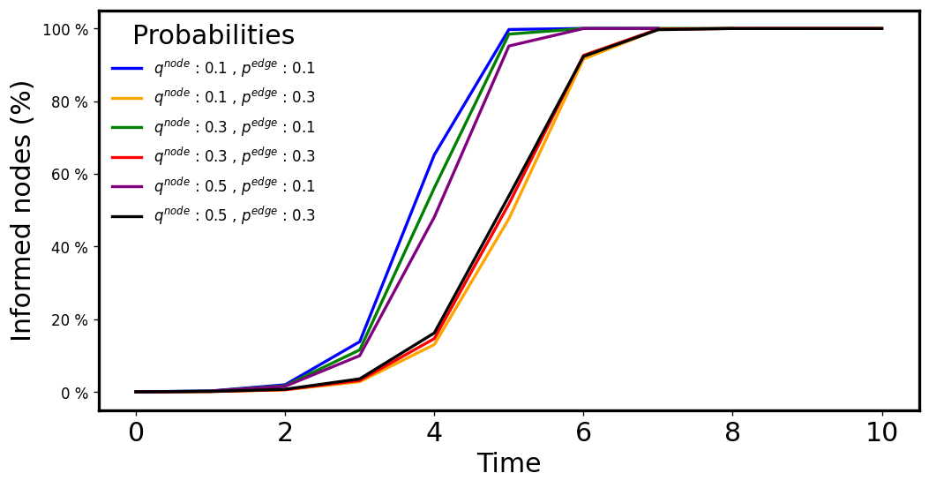
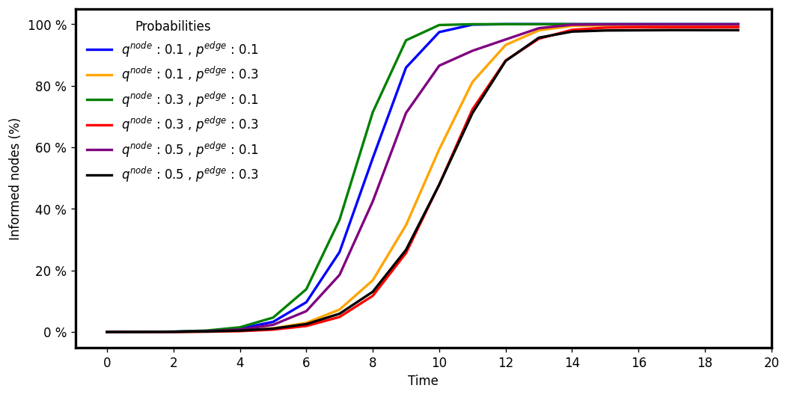
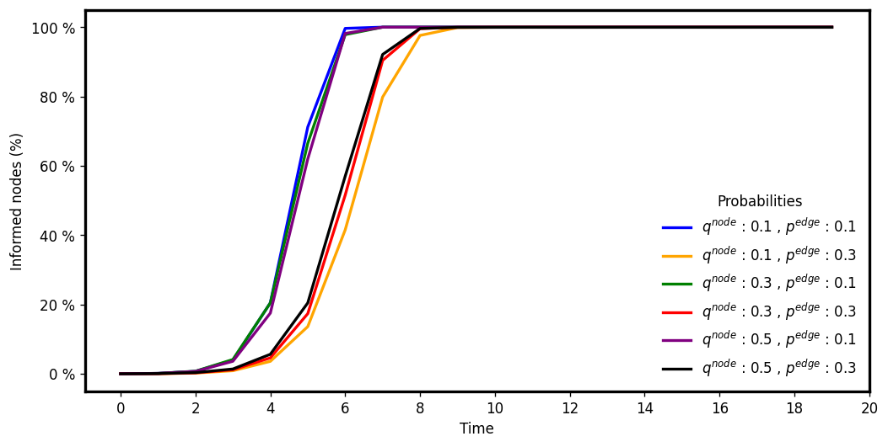
EV-RAES: (average) Fraction of informed nodes
d:4 c:1.5
d:8 c:15.625
d:3 c:3
d:6 c:5

Slide 21
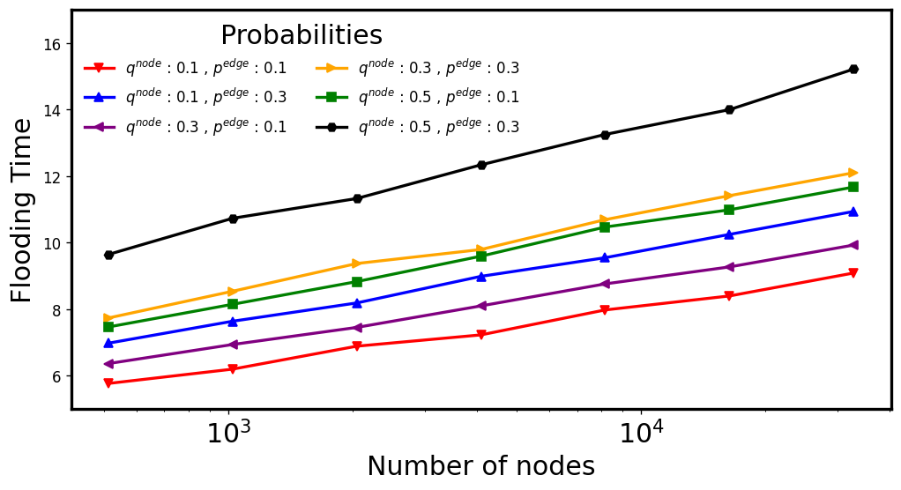
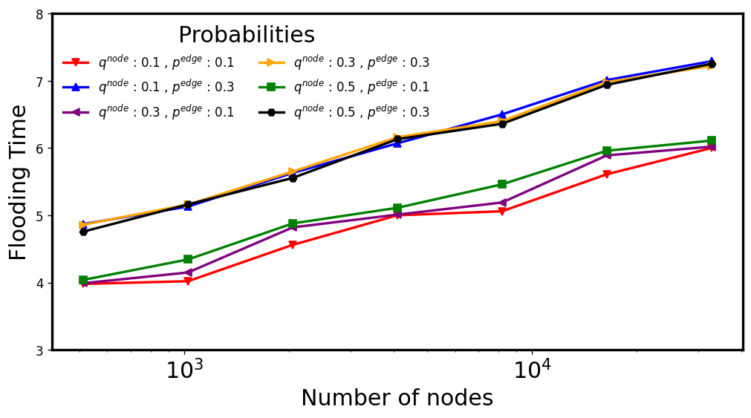
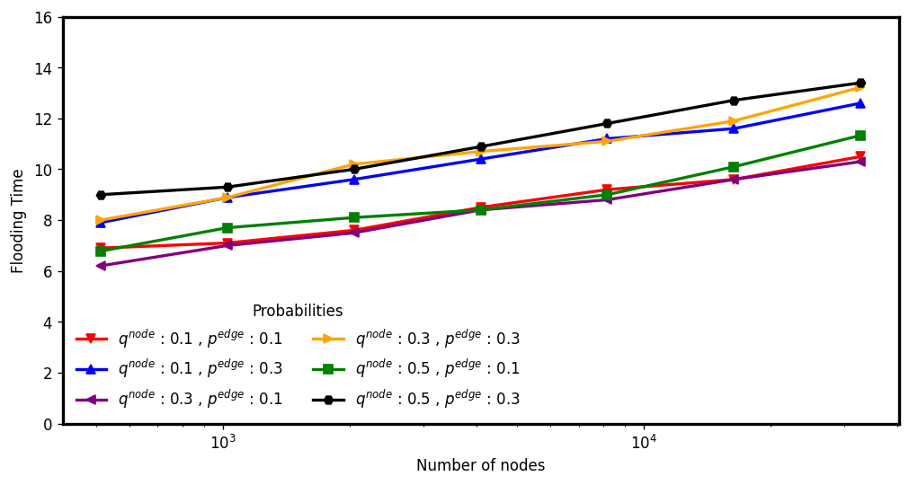
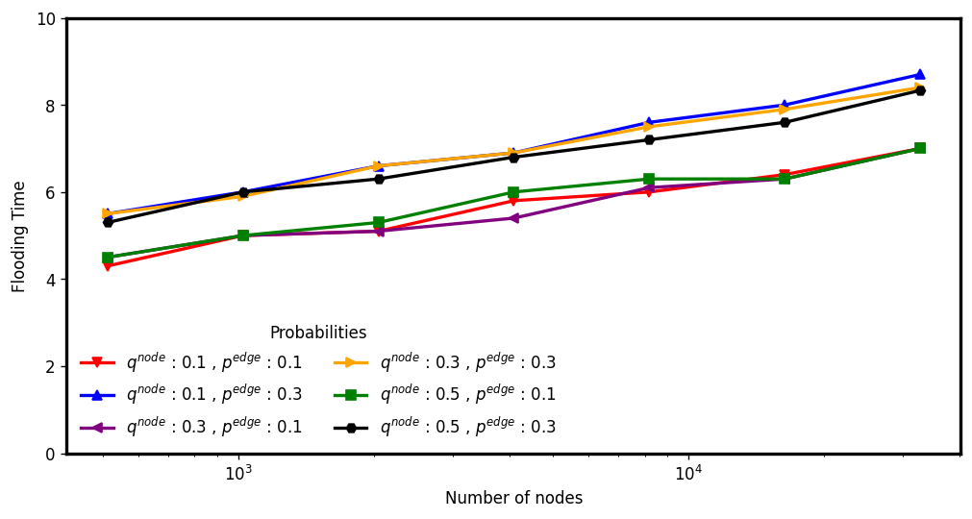
EV-RAES: (average) Flooding Time
d:4 c:1.5
d:8 c:15.625
d:3 c:3
d:6 c:5

